Slide 1


Semester project
Solving Signal Temporal Logic Planning
Problems Online via a Learning-based Framework
Student: QI YI
Supervisor: Prof. Maryam Kamgarpour
Dr. Tony Alan Wood
Notes:
Good afternoon, everyone! It is a great honor to be here give you a presentation about my project.

Slide 2
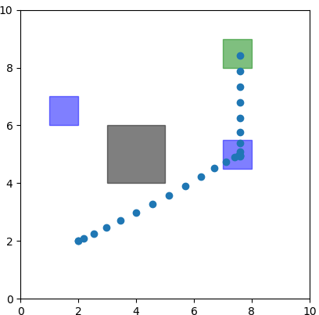
Why we need STL?
Example
Example
B
Imagining a cleaning robot:
needs to go to area A to charge itself first
then go to B to implement the task
always avoid obstacle C
C
A
However, this task can not be formulated with standard optimal control constraints.
Reason: associated with temporal relations and logical behaviors
Need to introduce signal temporal logic (STL) to impose a high-level logical behavior into the robot.
Notes:
To begin with, I would like a give you an example to show you why we need STL. I will explain STL more clearly later. And now, I need you to imagine if you have a cleaning robot in a room. And we want it to go to charge itself first, and then go to B to implement the task. And robot should always avoid the obstacle. It seem easy for a human being to understand, but actually for a robot we need to formulate this task as mixed-integer programming problems.

Slide 3
Motivation
Motivation
WHAT: Complex robot motion planning problems combined with STL.
WHY: 1. Need to encode high-level logical behaviors to capture complex task
2. Slow computation when solving MIPs. (real-time computations)
HOW: 1. Design an efficient STL encoding, using as few as possible binary variables
2. Develop an online optimization framework via learning-based method
to solve MIPs combined with STL

Slide 4
Semester project
1
2
Problem formulation
Technical background
CONTENTS
3
Solution approach
4
Case studies

Slide 5

STL
Technical background
STL: a formal language to describe the timed behaviors of systems may or may not satisfy
The syntax of STL is defined as :
Read as: predicate |not | or | and |always |eventually| until
x ⊨ φ: x satisfy φ
Predicates π: a symbol which represents a property or a relation. (e.g $x≥2$) )

Slide 6
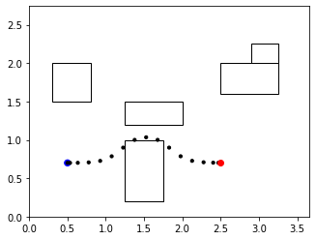


Technical background
Big-M constraints
Example: Obstacle avoiding $φ≔¬O$ for a 2-D position $(p1,p2)$
Need 4 predicates combined with ‘OR’ : $(p1 ≥a) ∨(p1≤c) ∨(p2≥b) ∨(p2≤d)$
Introduce 4 binary variables $δ$using Big-M constraints:
$p1−a≥M\left(1−δ1\right) p1−c≤M\left(1−δ3\right) p2−b≥M\left(1−δ2\right) p2−d≤M(1−δ4)$
$$δ1=1→p1≥a$$
Predicate works!
a
d
b
c
M Sufficient large
$$δ3=0→p1≤c+M$$
Trivial constraint !
Need at least one predicate works: $δ1$+ $δ2+δ3+δ4$ $≥1$

Slide 7
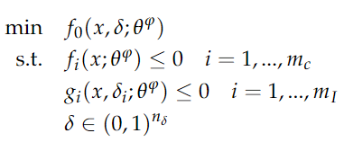

Technical background
Mixed-integer programming
Parameterized Mixed-integer Convex Programs (MICP). Given the STL specification φ:
$δ1=1→x≥a$
δ₄=0
δ₂=0
δ₄=0
δ₃=0
x ∈ R^{nc} : continuous decision variables
δ ∈ (0, 1) ^{nI} : binary variables,
θ^{φ} ∈ R^{np}: parameters depending on STL φ. (e.g. initial conditions, obstacles, goal)
f_{i} : constraints only contain x
g_{i}: mixed-integer constraints contain binary variables δ_{i}

Slide 8
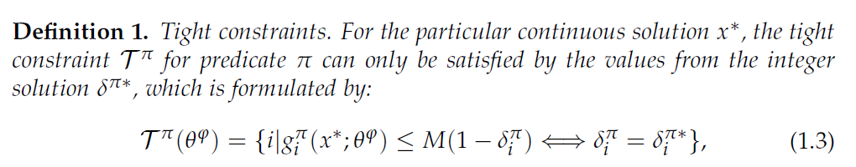
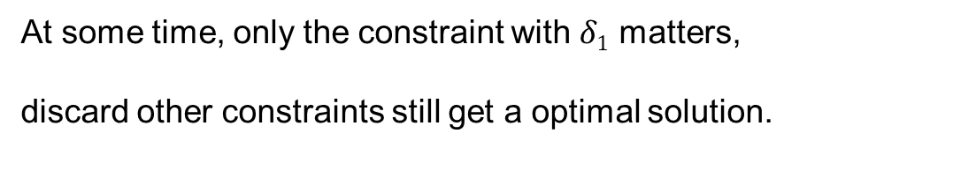




Technical background
Technical background
Tight constraint
Tight constraints:
Insight behind: constraints that really work when solving MIP, corresbonding to $δ1=1$
$δ1=1 ⇒p1≥a$ tight
At some time, only the constraint with $δ1$ matters,
discard other constraints still get a optimal solution.
$$a$$
$$c$$
$δ3=0⇒p1≤c+M$ trivial
Notes:
For the particular continuous solution x∗, the tight constraint T^{π} for predicate π can only be satisfied by the values from the integer solution δ^{π∗}

Slide 9

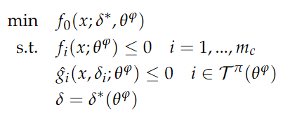
Technical background
STL integer strategy
Technical background
Technical background
STL integer strategy is defined as a tuple:
T^{π}: the index of the tight constraint; δ: the binary variables.
MICP be simplified as a convex optimization problem with fewer constraints:
Easier to solve because it is continuous, convex and has fewer constraints (in milliseconds)

Slide 10
Semester project
2.Problem formulation

Slide 11

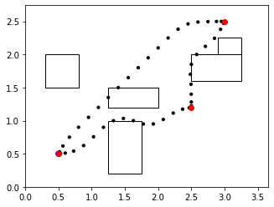
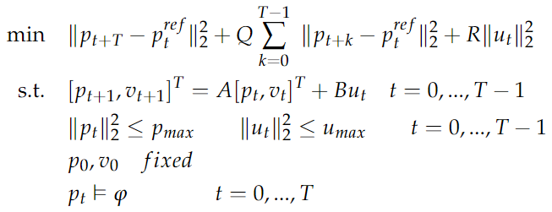





STL motion planning problem
Example 1
MPC with obstacles avoidance
Given φ for obstacles avoidance:
Given: Q ⪰ 0, R ⪰ 0: symmetric cost matrices; T: prediction horizon;
(p₀, v₀), ( p^{ref} , v^{ref} ):initial state and reference state
Solve T$→$ move 1 step $→$new state
MPC solve it online recursively in a receding horizon:
$$x_{3}^{ref}$$
$$x_{2}^{ref}$$
$$x_{1}^{ref}$$
Key challenge: define p_{t} ⊨ φ with MIP, using as few binary variables as possible.
Contributions: formulate the static LQR as real-time MPC with STL constraints, computing online in a receding horizon (time-varying destinations and initial conditions).

Slide 12
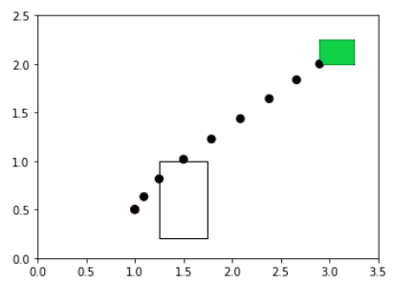
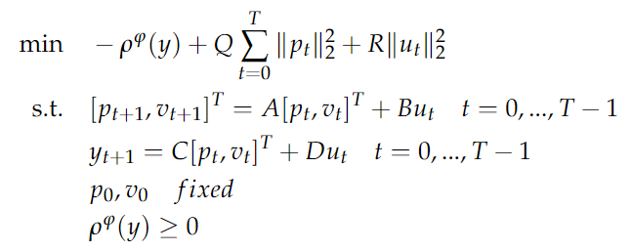

STL motion planning problem
Example 2
STL Motion planner with
robust satisfaction
STL motion planning problem
Q ⪰ 0, R ⪰ 0: cost matrices; (p₀, v₀): initial state; y: output signal [p, v, u]
STL planning problem considering robustness:
“Robustness value” ρ^{φ}(y)：measure how strongly a formula is satisfied by a signal y, which is positive only if y ⊨ φ
Apart from the robustness measure ρ^{φ}(y), this is a convex optimization problem.
Goal: define the ρ^{φ}(y) in a efficient way
Notes:
Our goal is to introduce mixed-integer constraints to define the ρ^{φ}(y) in a efficient way, with our proposed STL encoding and STL tree decomposition.

Slide 13
STL motion planning problem
Example 2
STL Motion planner with
robust satisfaction
STL motion planning problem
For □ always formula: set a constraint for each timestep to satisfy obstacle avioding all the time.
For ♢ eventually formula: cannot use standard optimal control constraints
Reason: associated with the temporal property, which means the constraints can be satisfied at different timesteps
Notes:
The first constraint is the system dynamic function, and the others are robust STL formulars

Slide 14
Semester project
3. Solution approach

Slide 15
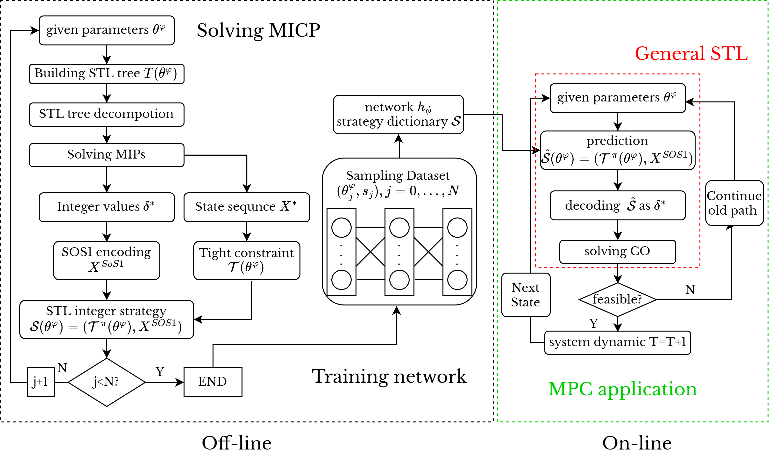
Solution approach
Solution approach
Framework of OMISTL
Online Mixed-Integer Optimization Based on Signal Temporal Logic (OMISTL)

Slide 16
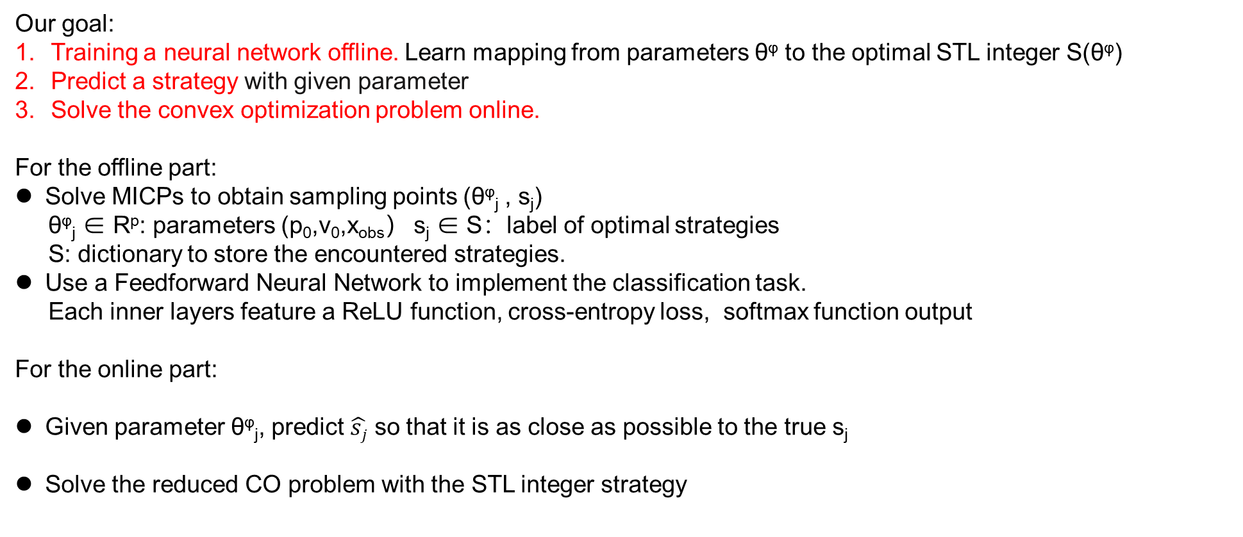
Solution approach
Solution approach
Framework of OMISTL
Our goal:
Training a neural network offline. Learn mapping from parameters θ^{φ} to the optimal STL integer S(θ^{φ})
Predict a strategy with given parameter
Solve the convex optimization problem online.
For the offline part:
Solve MICPs to obtain sampling points (θ^{φ}_{j} , s_{j})
θ^{φ}_{j} ∈ R^{p}: parameters (p₀,v₀,x_{obs}） s_{j} ∈ S：label of optimal strategies
S: dictionary to store the encountered strategies.
Use a Feedforward Neural Network to implement the classification task.
Each inner layers feature a ReLU function, cross-entropy loss, softmax function output
For the online part:
Given parameter θ^{φ}_{j}, predict $\hat{sj}$ so that it is as close as possible to the true s_{j}
Solve the reduced CO problem with the STL integer strategy
For Ex1 θ^{φ} is: (p₀,v₀,p^{ref},v^{ref},obs)
For Ex2 θ^{φ} is: (p₀,v₀,obs,goal)

Slide 17
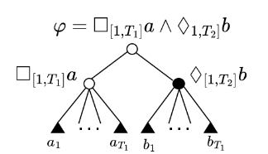
Solution approach
STL tree structure
Solution approach
T: time horizon N^{π} : number of predicates N∨ :number of disjunctive subformulas
Definition of disjunctive (sub)formulas:
Conjuntive formula: ∧and, □ always （parent node=1 implies all subnodes=1）
Disjunctive formula: ∨or, ♢ eventually, U until （parent node=1 implies at least one subnode =1）
Decomposed as: ∧-type nodes (conjunctive formulas) and ∨-type nodes (disjunctive formulas) and leaf nodes (predicates).
Consider the specification φ = □_{[1,T]} a ∧ ♢_{[1,T]}b
Has two∧-type nodes (associated with φ and □a), one ∨-type node (♢b) denoted, and 2T leaf nodes
∧-type
∧-type
∨-type
leaf nodes
Notes:
Here I would like to introduce novel STL tree structure, and show you how to encode the STL efficiently.

Slide 18




Solution approach
Solution approach
STL encoding
For leaf node: we use the big-M constraint, which is associated with a linear predicate π:
For ∧-type nodes: no more binaries needed, δ^{φ} = 1 implies all the subformulas φ₁,..., φ_{N} must also hold:
For ∨-type nodes : need to introduce binary variables, using SOS1 constraints:
A vector λ is in Special Ordered Set of Type 1(SOS1), if contains exactly one 1 element, others are zeros. E.g. SOS1 encoding X^{SOS1}=[1,1,0] (Gray Code 5) implies an SOS1 vector λ = [0, 0, 0, 0, 1, 0, 0, 0].
∧-type
∧-type
∨-type
leaf nodes

Slide 19
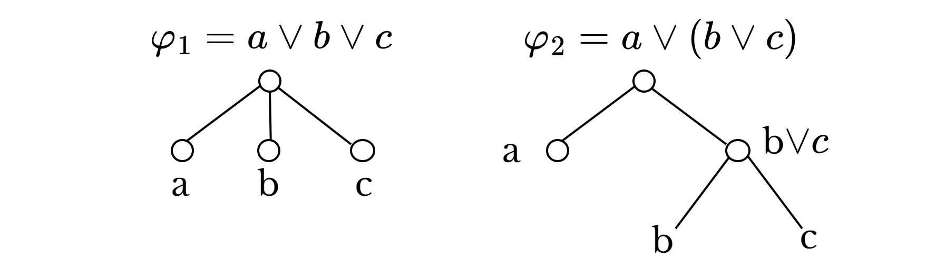
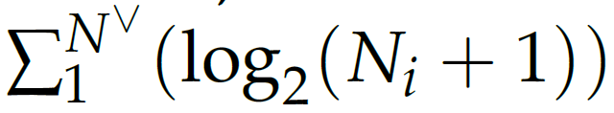
Solution approach
Solution approach
Simplify STL tree
φ₁ requires 2 binary variables
the logically equivalent φ₂ requires 4.
Prefer “flatter” STL Tree
STL Trees for two logically equivalent formulas
Formula flattening: search for nodes which have the same combination type as their parent, then the children node can be moved up a level and that node removed.
STL tree decomposition: further exploit the STL tree structure and decompose the tree into a more succinct form.
Contribution: Compared with standard STL encoding
Adopt STL tree structure, formula flattening method, STL tree decomposition
Reduce binaries. MPC with $¬O$: $TNf$ to $Tlog2Nf$ General STL: $TNπ$ to

Slide 20
Semester project
4. Case studies

Slide 21
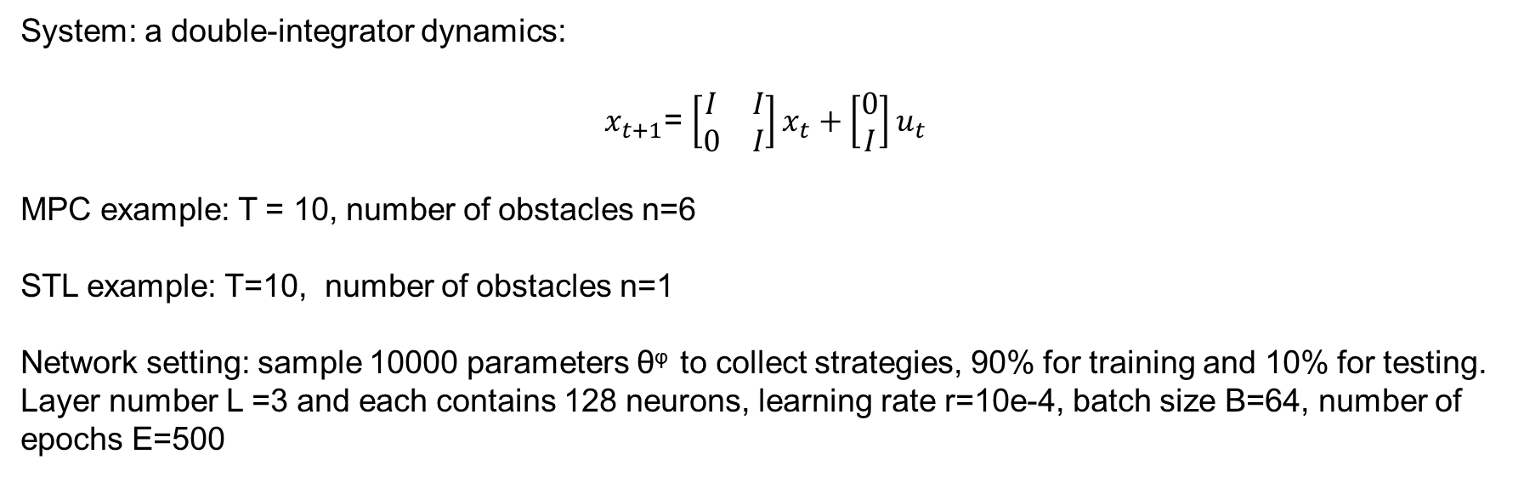
Case studies
Parameter setting
System: a double-integrator dynamics:
$x_{t+1}$= ${\left[\begin{matrix}I & I \\ 0 & I\end{matrix}\right]x}_{t}+{\left[\begin{aligned}0 \\ I\end{aligned}\right]u}_{t}$
MPC example: T = 10, number of obstacles n=6
STL example: T=10, number of obstacles n=1
Network setting: sample 10000 parameters θ^{φ} to collect strategies, 90% for training and 10% for testing.
Layer number L =3 and each contains 128 neurons, learning rate r=10e-4, batch size B=64, number of epochs E=500

Slide 22
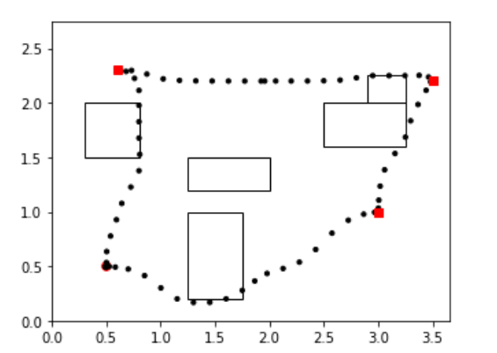
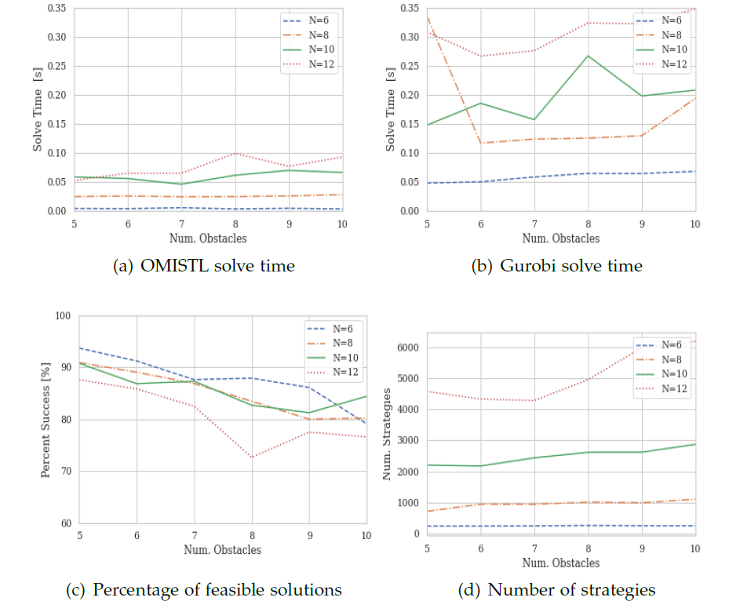
Solution approach
Case studies
Obstacle avoiding example
Num. of obstacles 5-10
horizons N=6,8,10,12
(a) and (b) demonstrate OMISTL consistently outperforms Gurobi in all problem settings, where the solving time is always within 0.1s.
(c) shows number of feasible solutions decreases continuously with the increasing problems size,
while the number of integer strategies is increasing in (d).

Slide 23
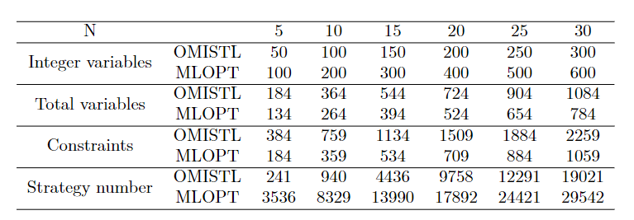
Solution approach
Obstacle avoiding
numerical experiments
Encoding comparison in different horizons
OMISTL has fewer integer variables and integer strategies compared with OMISTL,
but has more continuous variables and constraints.

Slide 24
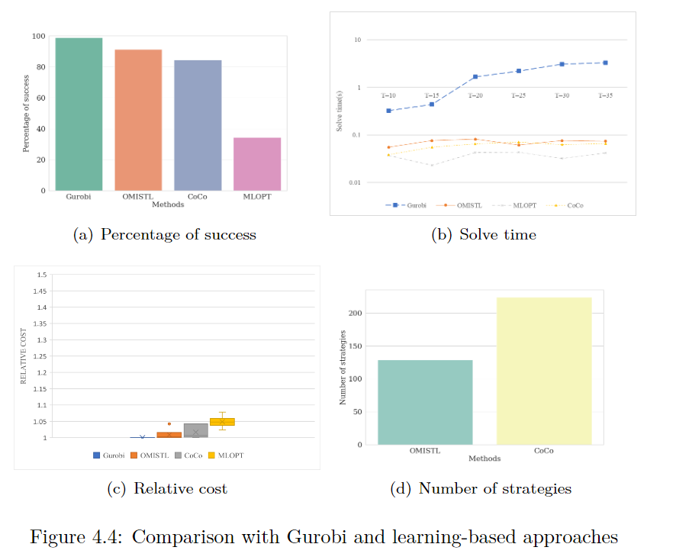
Solution approach
numerical experiments
Compared with other learning-based approaches:
(a):OMISTL provides more feasible solutions
(b):less time solving MICP compared with Gurobi, similar to
other learning-based methods.
(c):better solutions, the cost is closed to the optimal solution.
(d): fewer strategies
Comparison with Gurobi and other learning-based approaches

Slide 25
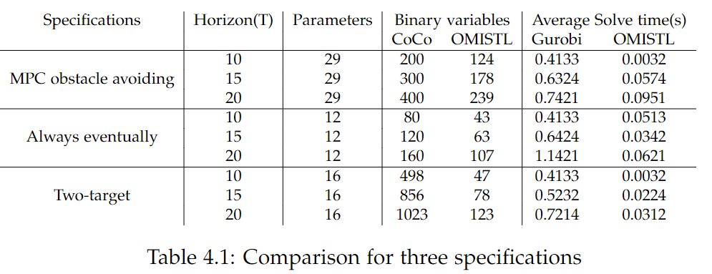
Performance comparison
Benchmarks: three different specifications Implementing: python and CVXPY Solving: Gurobi 9.1.2
Compute STL problem by 1000 times and take the average
Contributions:
Compared with previous learning-based method: fewer binary variables (nearly a half), higher network accuracy(80%-90%).
Compared with state-of-the-art STL encoding: less solving time. (a speed-up of 1-2 orders of magnitude)

Slide 26
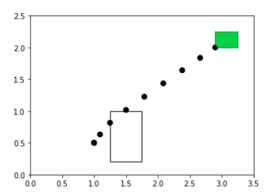
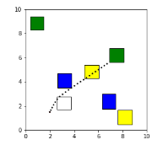

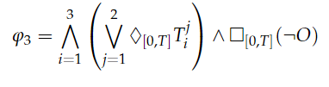
Solution approach
numerical experiments
General STL example results
Alway eventually example
Multi-target example

Slide 27
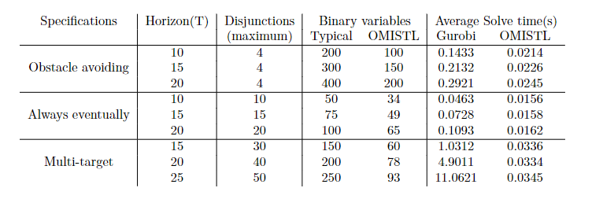
Solution approach
numerical experiments
General STL example
Comparison for three specifications
OMISTL significantly reduce the number of binary variables
OMISTL gains speed-ups of 1-2 orders of magnitude when solving online, which is depending on the number of binary variables and disjunctions

Slide 28
Conclusions
Conclusion
A learning-based framework is proposed to solve MPC and STL motion planning.
The proposed efficient STL encoding approach leads to fewer integer variables (logarithmic).
Our framework gains speed-ups of 1-2 orders of magnitude in online computation time.
The solution is better than existing learning-based method with 92% globally optimal.
Notes:
Let’s move to conclusion, this brings me to the end of my presentation
At last, I want to especially thank Tony and Maryam for their valuable and careful comments on this project. They are really helpful.

