Slide 1
Git
NCU HCI Lab 108 summer, 7/15

Slide 2
Introduce
What is ”Git”
A distributed version-control system for tracking changes in source code [ref.]
Why to use
[ref.1][ref.2]
We are plan to use it to manage the source code of our system
How to use
Graphic user interface
Command line tool

Slide 3
Setup the environment
Get an account
Sign up on Github
private message your account to me
Do not post on FB club
Install Git
You can choose between the following options
GUI (e.g. Sourcetree)
Command line tool (e.g. Git Bash, one of the tool of Git for Windows)
Please finish this step within 20 minute

Slide 4
Git flow
Manage your source code by Git is like planting a tree
Which the tree is construct with many branches and normally with a main branch
Especially when your project is collaborating with a team
And you can imagine that as multi-universe(science fiction movies plot e.g. Avengers: Endgame) as well
There many ways (or principle or roles) to manage your “tree” depend on different group or team or company, and “Git Flow” is one of the most common standard
[ref.]
And this is the main standard that we’ll using

Slide 5
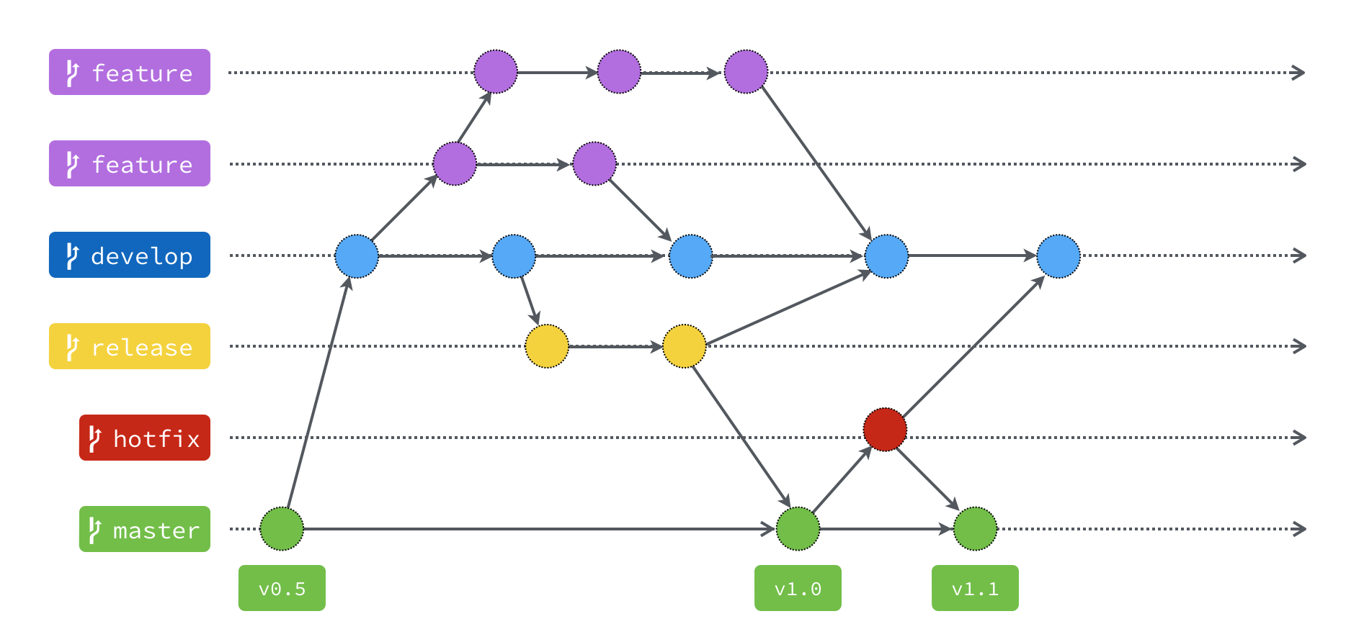
Git flow

Slide 6
Basic steps
On a existing repository, modify a tracked file
Check out to certain branch
Pull the branch
Modify your file
“Stage” all the changes
Commit (at local)
Pull from remote again (in case there’re any changes during step 3~5)
Merge if need
which you may choose to use the merge tool or just do it manually
Push to remote repository

Slide 7
Demonstration
Git GUI (Sourcetree)
Git Bash

Slide 8
Homework
Detail
Please clone the following remote repository
https://github.com/alfredyu0911/NCU_HCI_temp
Modify the html file
Just fill in your information in it
Commit and push to remote repository
Deadline
7/16 14:00

