Slide 1


Data Mining
Heart Disease 分析
組員：00557019 何寬宥 00657049 黃姿涵 00557039 王晧宇(已退選)
老師：蔡宇軒 老師

Slide 2
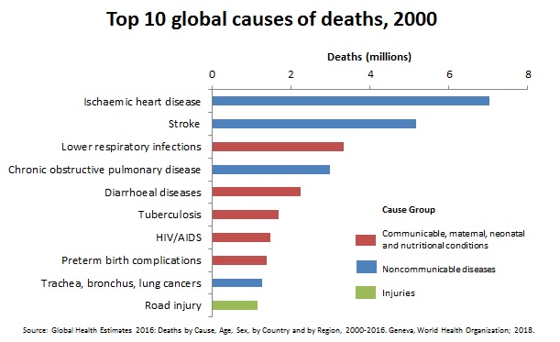
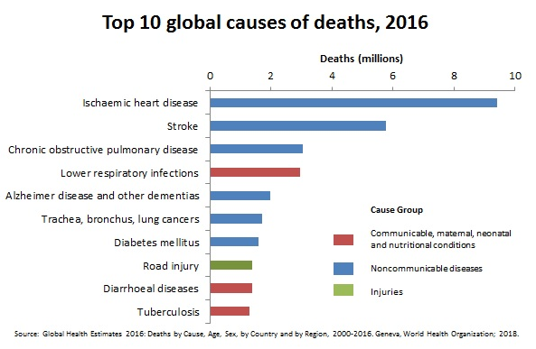
Why Heart Disease ?

Slide 3
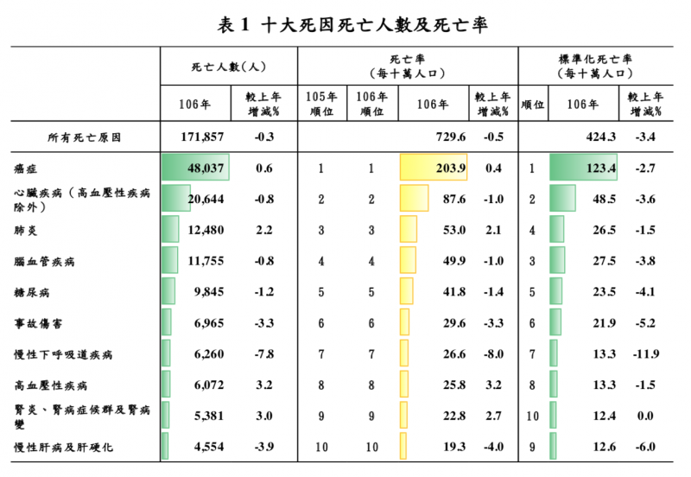
Why Heart Disease ?

Slide 4
CONTENTS
01
Data Source & Preprocessing
02
Supervised Learning
03
Unsupervised Learning
04
References
05
Work Distribution

Slide 5
01
Data Source & Preprocessing

Slide 6
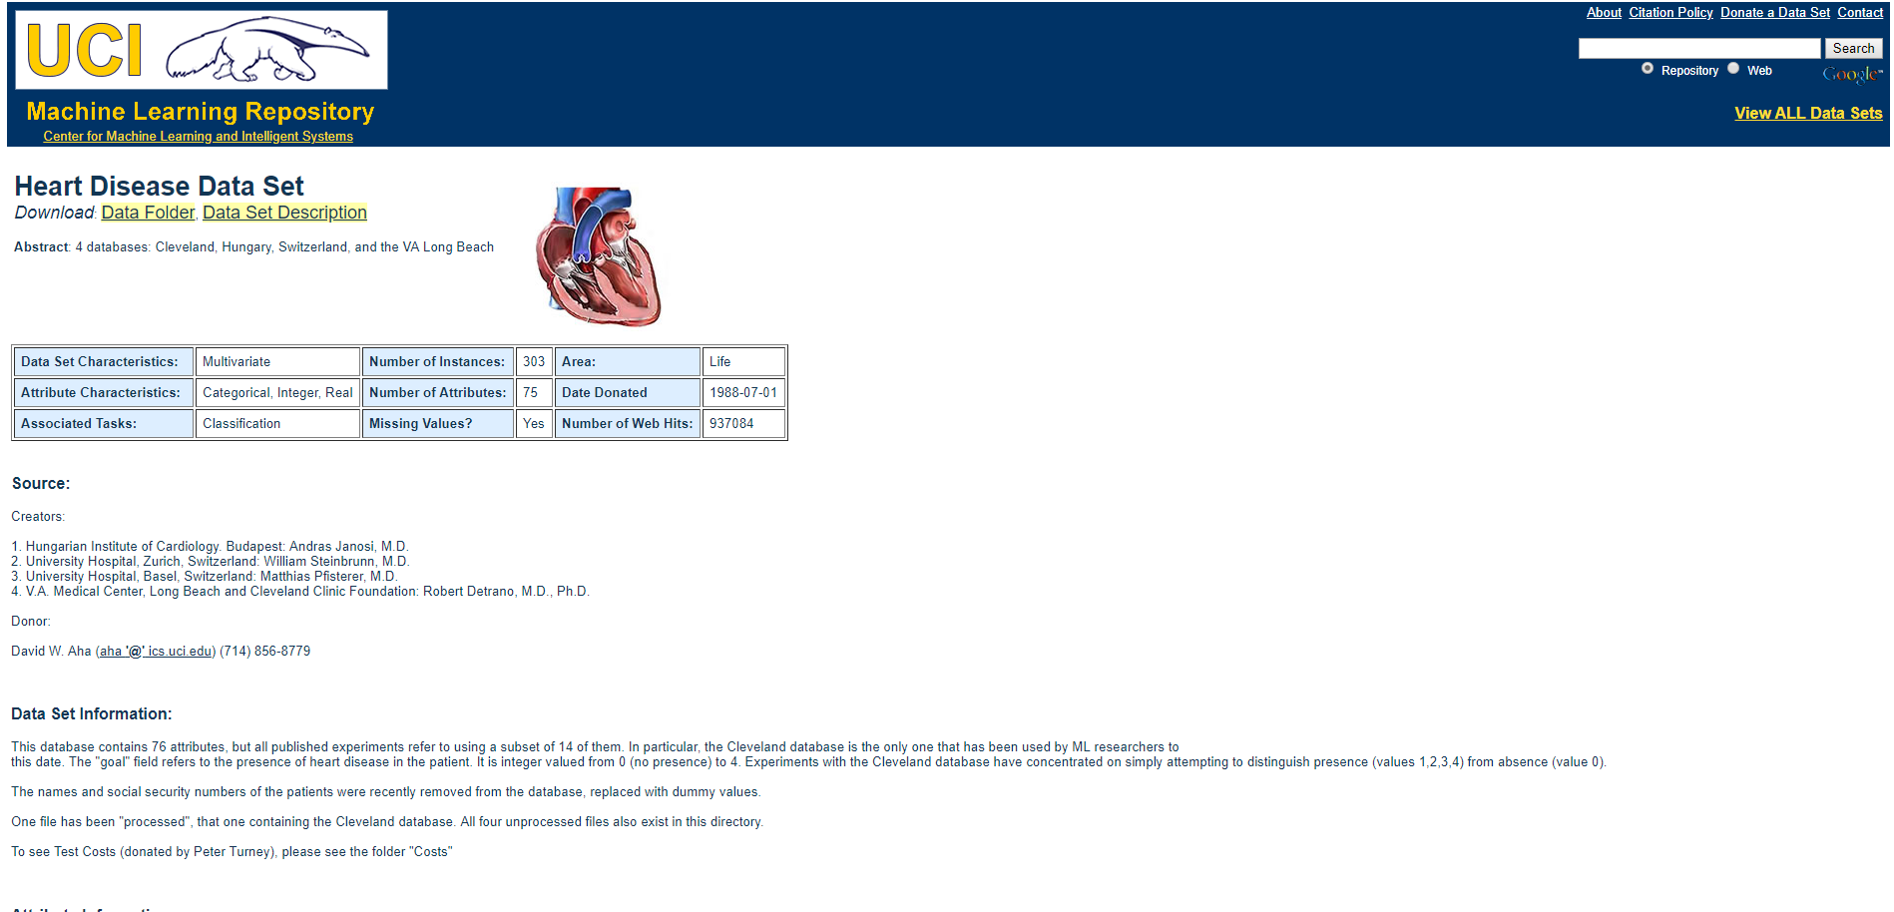
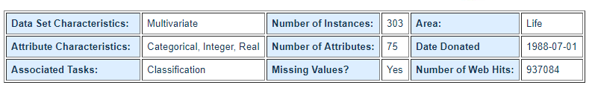
Data Source

Slide 7
Data Attributes
屬性 | 描述
age | 年齡
sex | 性別 (0=女性，1=男性)
cp | 胸痛經歷 (0=典型心絞痛; 1=非典型心絞痛; 2=非心絞痛; 3=無症狀)
trestbps | 靜態血壓 (mm Hg)
chol | 膽固醇 (mg / dl)
fbs | 空腹血糖 ( > 120 mg / dl，1=是; 0=否)
restecg | 靜態心電圖測量 (0=正常; 1=有ST-T波異常; 2=依Estes標準顯示有可能或明確的左心室肥厚)
thalach | 最大心率
exang | 運動誘發心絞痛 (0=否; 1=是)
oldpeak | 運動相對於休息引起的ST段壓低
slope | 運動時ST段峰值的斜率 (0=上升; 1=平坦; 2=下降)
ca | 主要血管數量(0-3)
thal | 地中海貧血 (1=正常; 2=固定缺陷; 3=可逆缺陷)
target | 心臟病 (0=否; 1=是)
cp_typical_angina
cp_atypical_angina
cp_non-anginal_pain
cp_asymptomatic
restecg_normal
restecg_ST-T_wave_abnormality
restecg_left_ventricular_hypertrophy
slope_upsloping
slope_flat
slope_downsloping
thal_normal
thal_fixed_defect
thal_reversable_defect

Slide 8
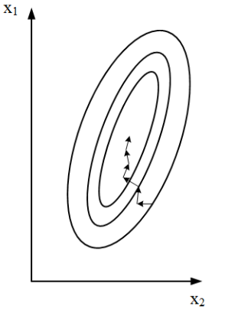
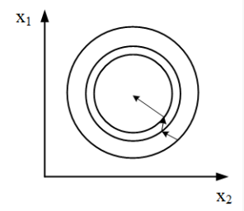
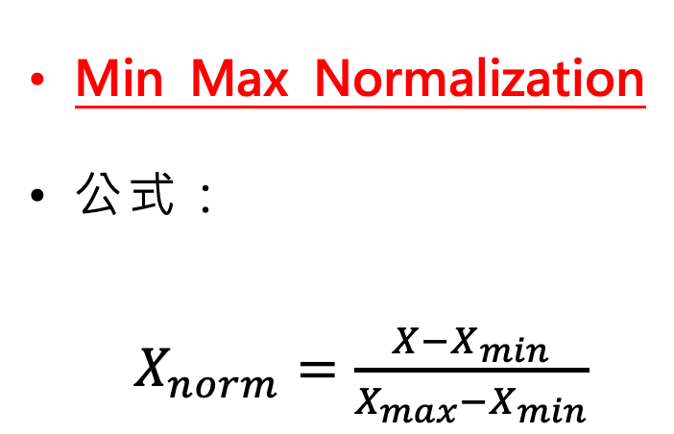
Data Preprocessing
Min Max Normalization
公式：
$X_{norm}=\frac{X−X_{min}}{X_{max}−X_{min}}$
(A)未標準化梯度下降過程
(B)標準化梯度下降過程

Slide 9
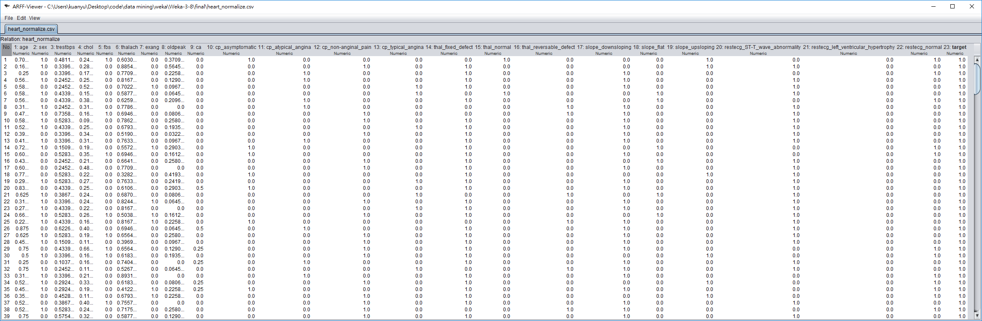
Data

Slide 10
02
Supervised Learning (Kfolds)

Slide 11
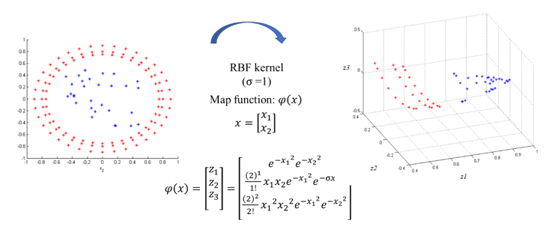
LibSVM

Slide 12
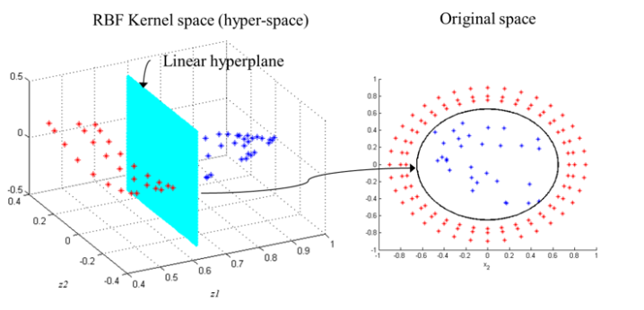
LibSVM

Slide 13
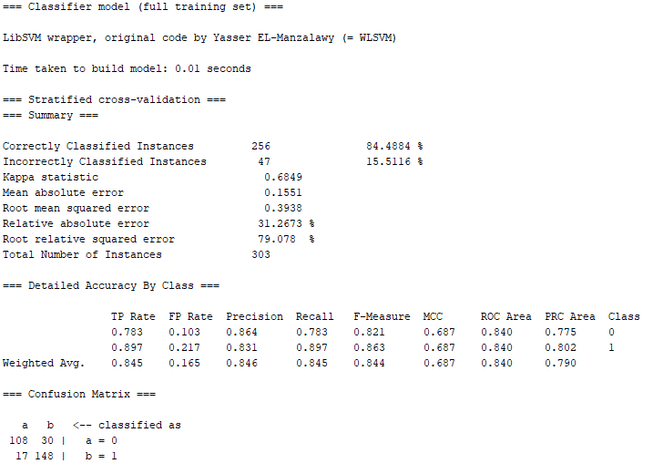
LibSVM - RBF kernel (C=100, gamma=0.01)

Slide 14
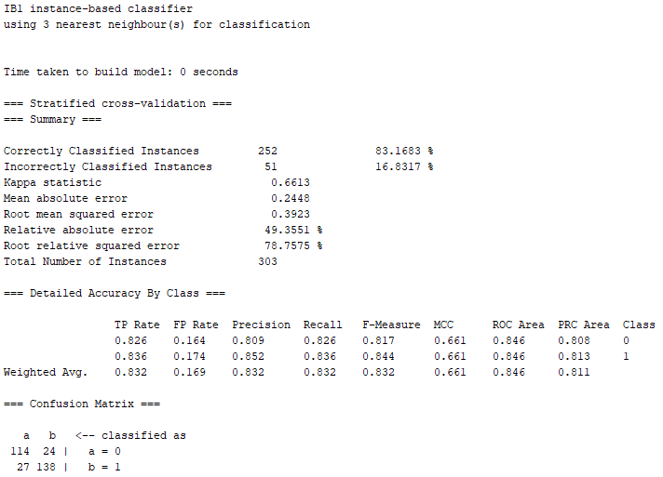
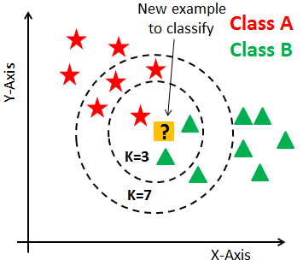
IBk(K-nearest neighbors) - K=3

Slide 15
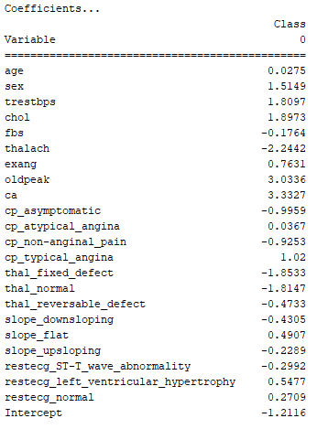
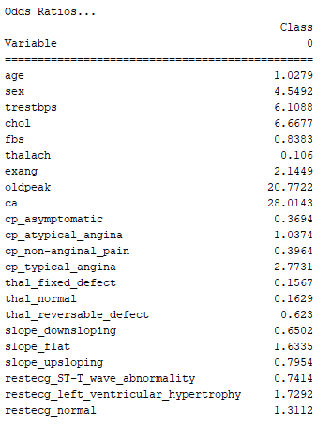
Logistic

Slide 16
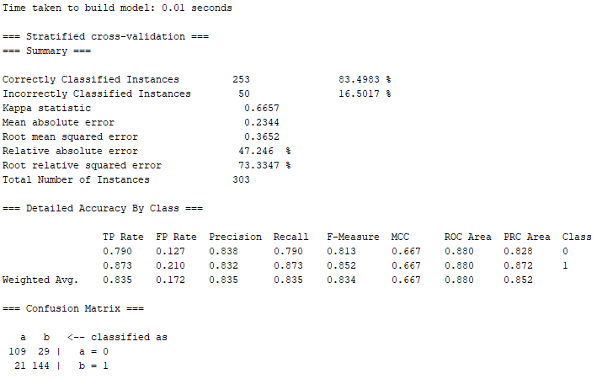
Logistic

Slide 17
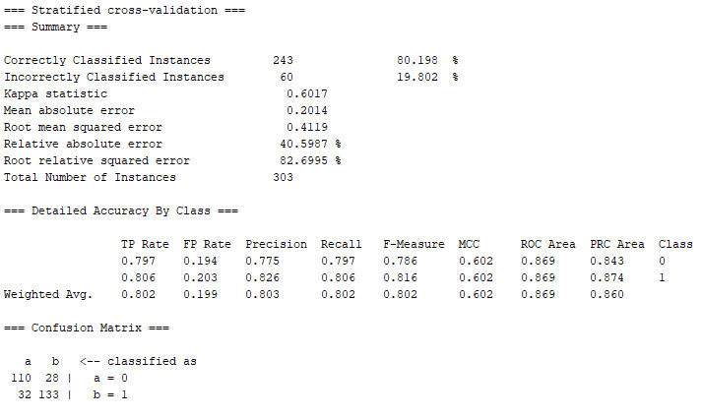
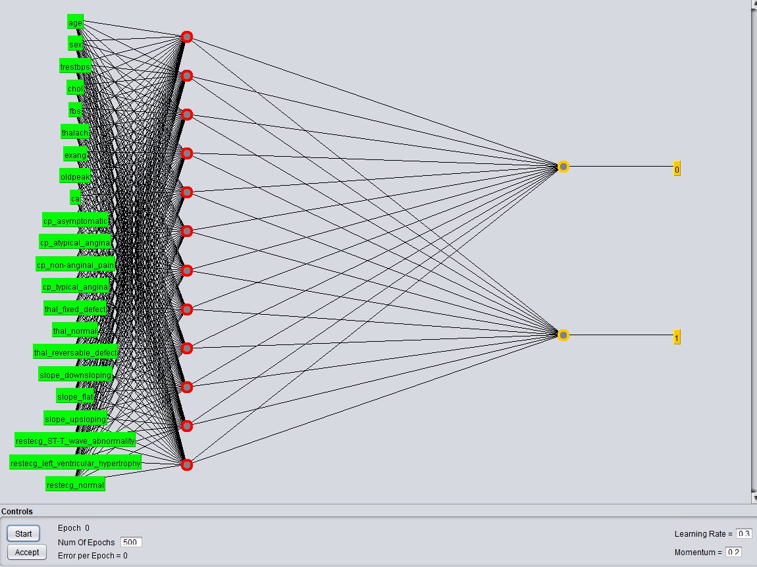
MultilayerPerceptron
Nodes = (attributes + classes) / 2 => (22 + 2) / 2 = 12

Slide 18
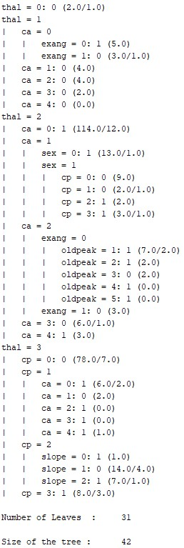
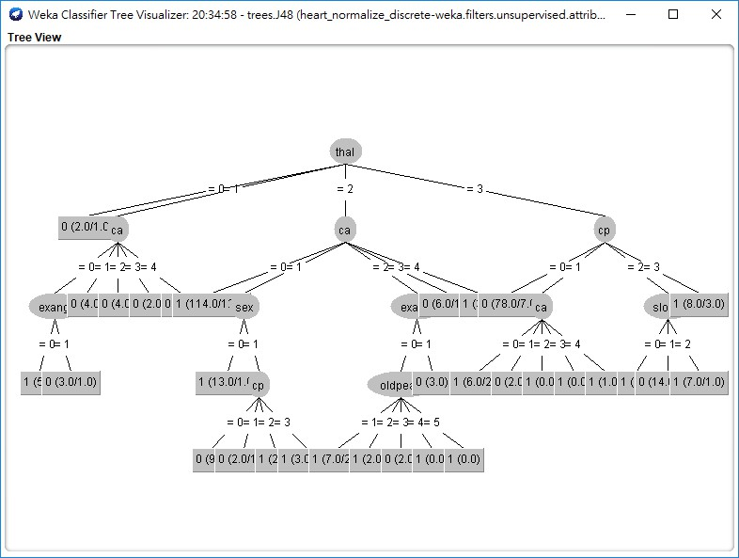
J48

Slide 19
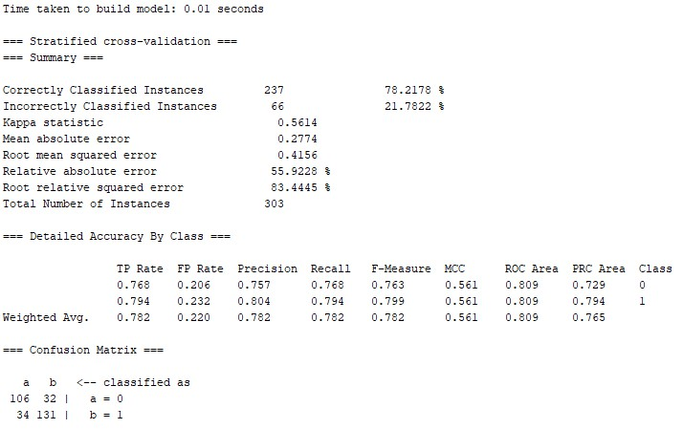
J48

Slide 20
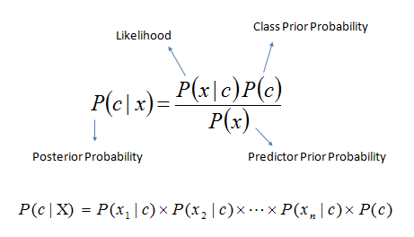
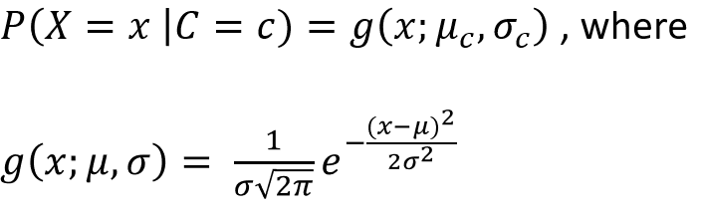
Naïve Bayes
如果數值是連續的

Slide 21
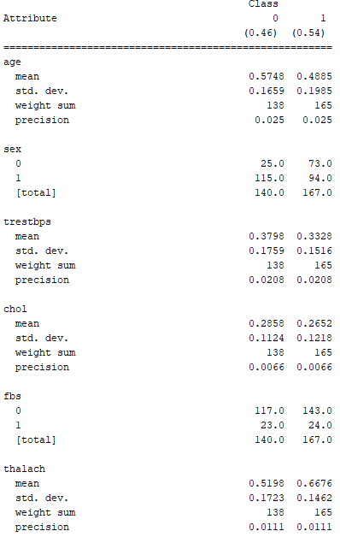
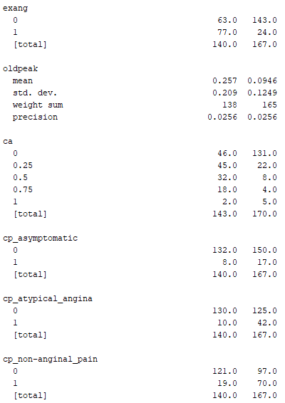
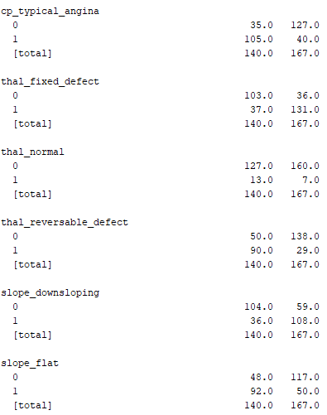
Naïve Bayes

Slide 22
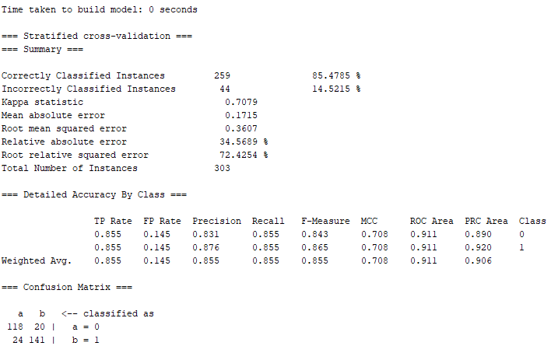
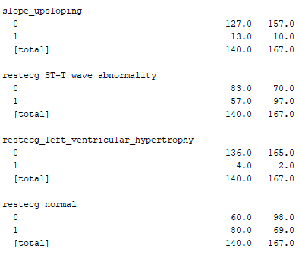
Naïve Bayes

Slide 23
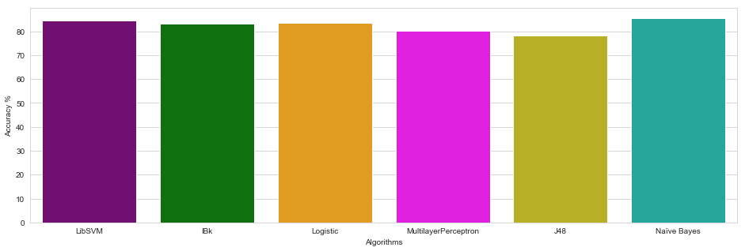
Result

Slide 24
03
Unsupervised Learning

Slide 25
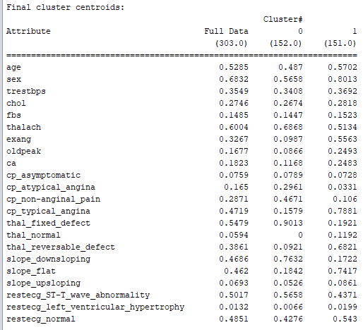
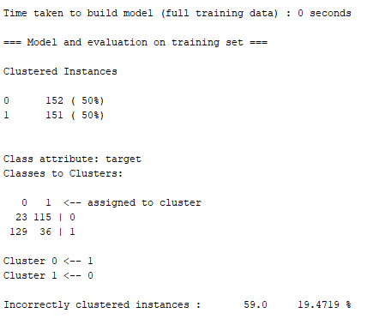
SimpleKMeans
6

Slide 26
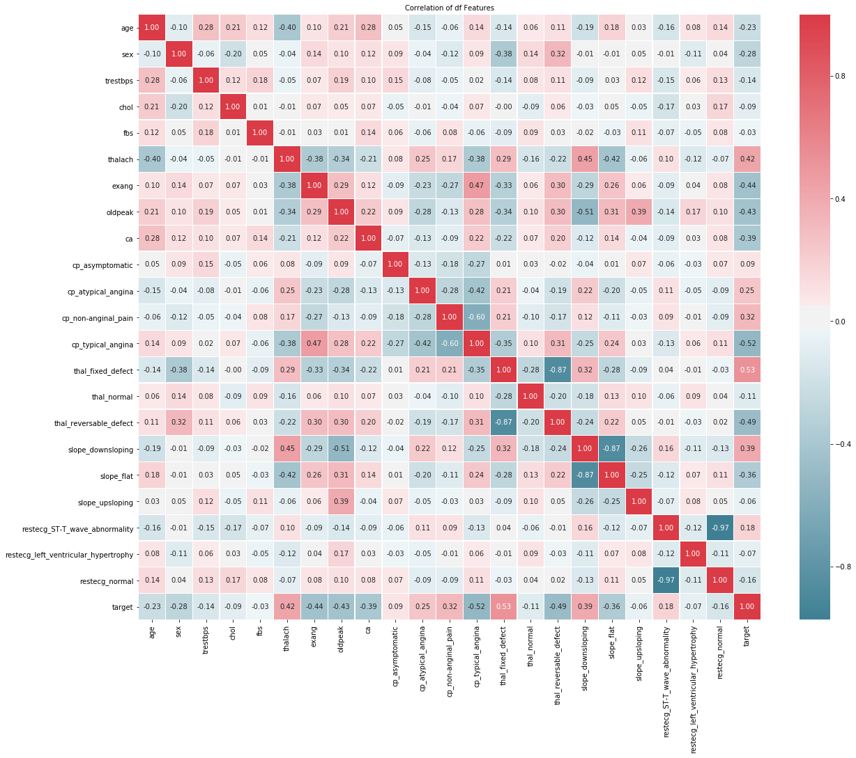
Correlations

Slide 27
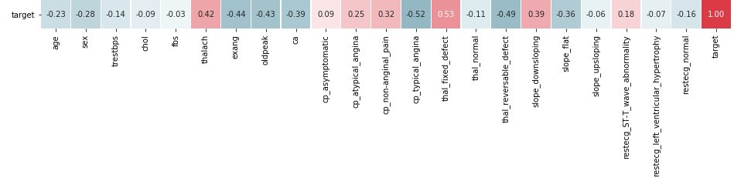
Correlations

Slide 28
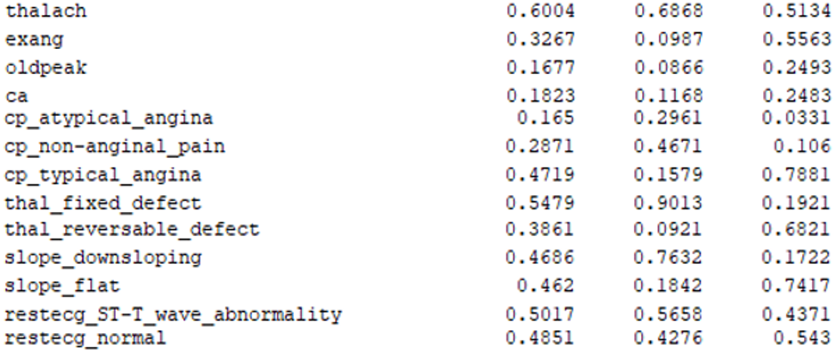
Comparing correlations

Slide 29
04
References

Slide 30
References
C.L. Blake and C.J. Merz. UCI repository of machine learning databases, 1998.
George H. John, Pat Langley: Estimating Continuous Distributions in Bayesian Classifiers. In: Eleventh Conference on Uncertainty in Artificial Intelligence, San Mateo, 338-345, 1995.
風傳媒 2017國人十大死因出爐！癌症高居死因榜首36年https://www.storm.mg/article/449458?srcid=73746f726d2e6d675f31383365306333346137303162363865_1560091470
World Health Organization The top 10 causes of death
https://www.who.int/news-room/fact-sheets/detail/the-top-10-causes-of-death

Slide 31
05
Work Distribution

Slide 32
Work distribution
00557019 何寬宥 | 上台報告、資料分析
00657049 黃姿涵 | 做投影片、蒐集資料、資料前處理
00557039 王晧宇(已退選) | 資料分析(K means)、進度監督

Slide 33
Thanks For
Your Attention

