Slide 1
Project1 - Forest Management System
YiTong Wang

Slide 2
Project progress
The project has been basically completed, and some parts need to be improved.

Slide 3
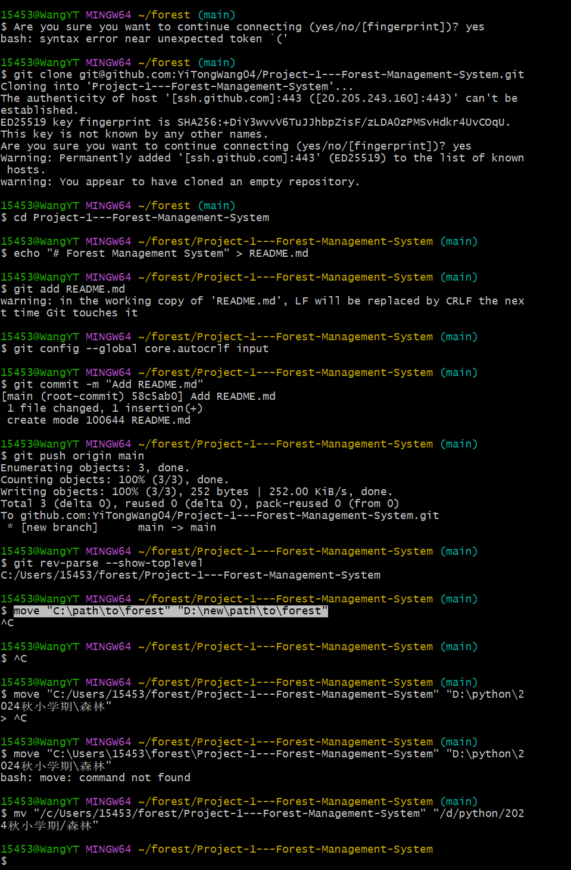
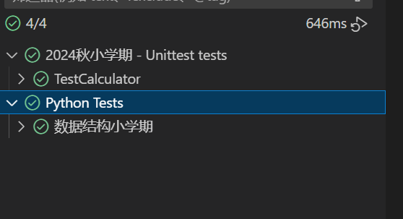
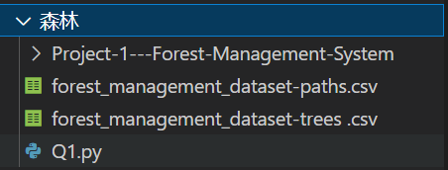
Daily progress
Day1

Slide 4
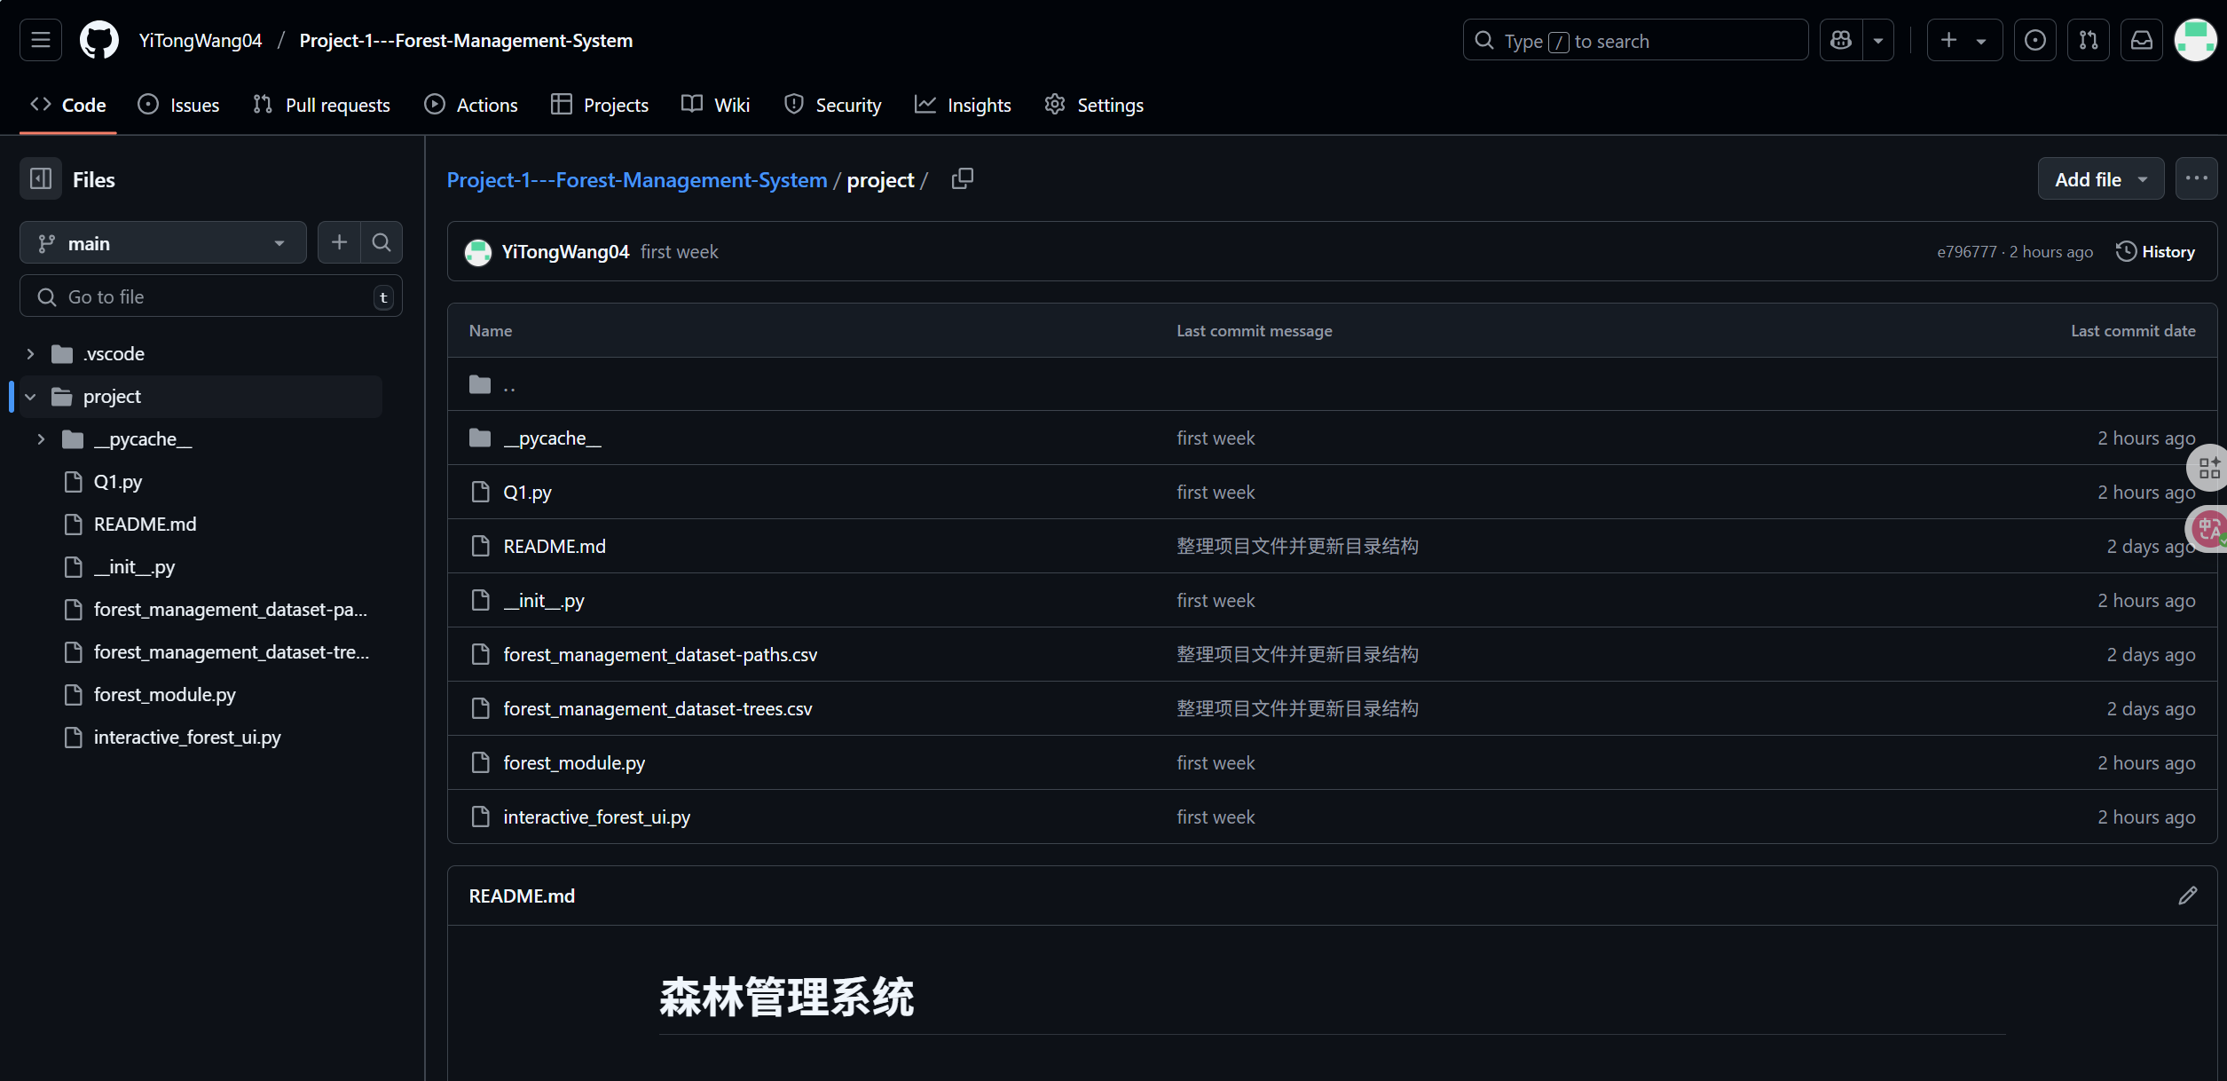
https://github.com/YiTongWang04/Project-1---Forest-Management-System.git

Slide 5
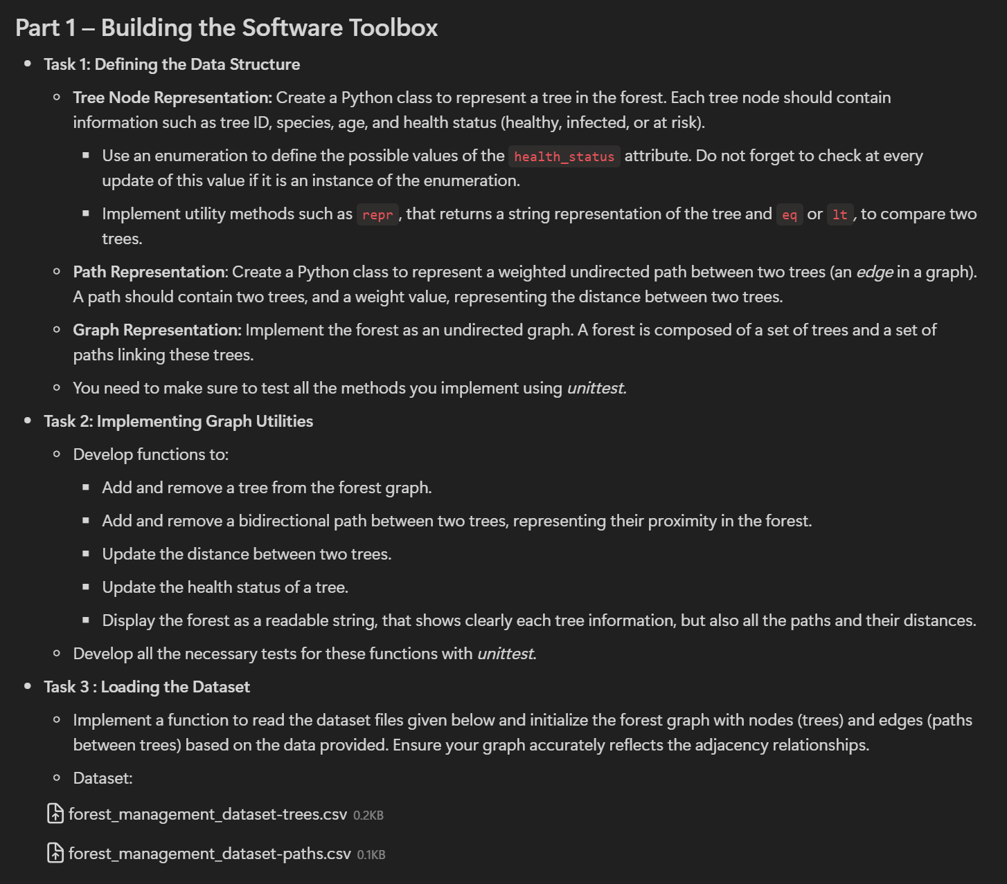
Day2 finish part1

Slide 6
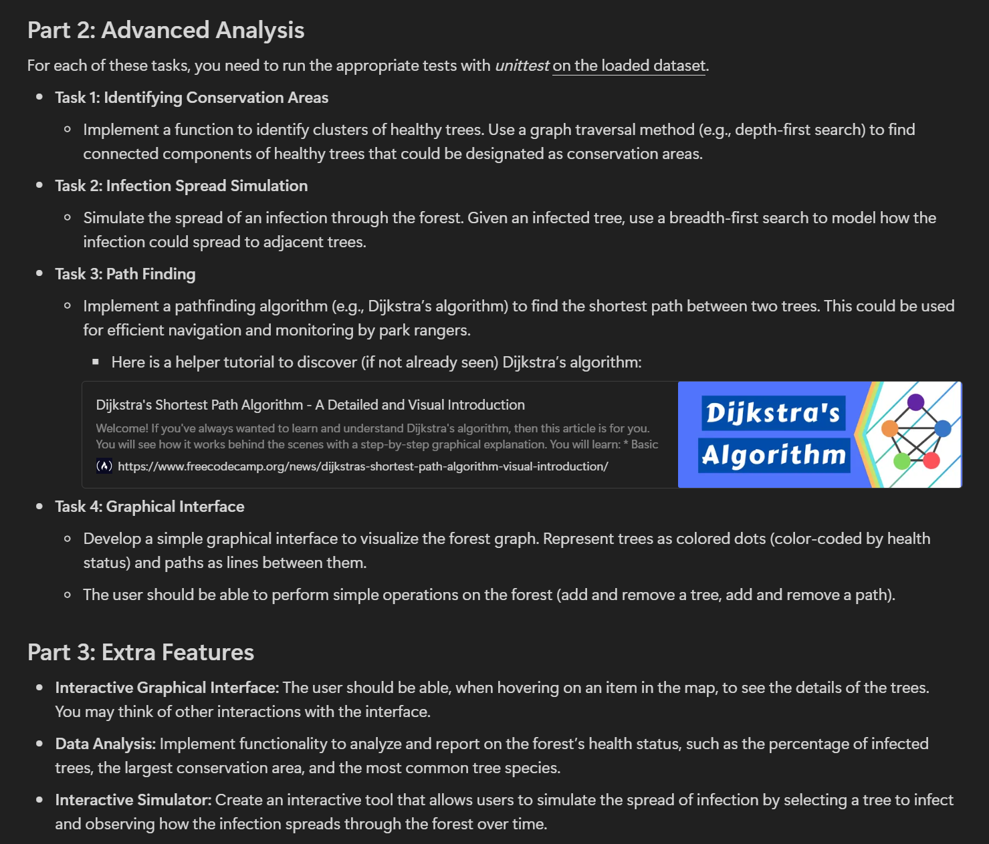
Day3 Complete the visualization of Part 1 and the algorithm part of Part 2.

Slide 7
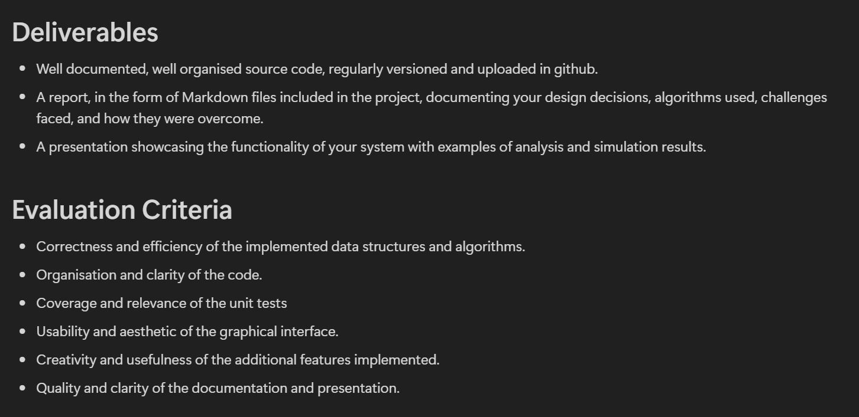
Day4 part2 part3 UI

Slide 8
Demonstration code program

Slide 9
shortcomings
1.The file has not been subpackaged. I feel that this is more convenient to writing. After the improvement is completed, subpackaging will be carried out.
2.There is still a lot of Chinese in the UI interface. It will be changed to English after the debugging is completed.

Slide 10
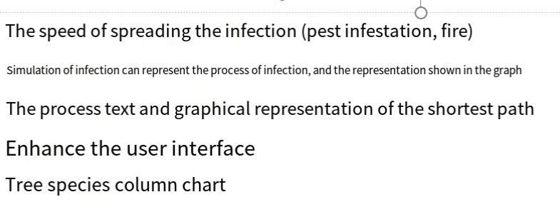
Next step plan
添加传染的速度（病虫害，火灾）
模拟传染 可表示传染的过程，及图上表示
最短路径的过程文本及图上展示
美化ui
树种柱形展示图
用prim算法规划巡林员最短连通图

