Slide 1
Applied Mathematics and Statistics
Talk 01 Xiangqi Yi (yixq@jmu.edu.cn)

Slide 2
Why do you choose this course?

Slide 3
About this course
General assumptions(limitations) of basic statistical methods
Student’s t test
ANOVA
Linear regression
Pearson’s correlation analysis …
Beyond linear regression
Linear mixed-effects model (LMM)
Generalized linear model (GLM)
Generalized additive model(GAM) …

Slide 4
About this course
Tools
R, Rstudio and R markdown
Git and github -…

Slide 5
“Young man, in mathematics you don’t understand things. You just get used to them.”
by JOHN VON NEUMANN, to FELIX SMITH

Slide 6
How to achieve good scores in this course？
Homework(50%) + Final project (50%)
Homework
Deadline: Wednesday
.Rmd files + others
Final project
Deadline: June 21, 2025 (Week 18)
.Rmd files + others

Slide 7
About final project
Topic selection
Select one from the topic collection
Self-selected topic confirmed by me
Scoring criteria
A complete story
Appropriate statistical methods
easy or hard …
No tolerance for plagiarism, but large language models, such as DeepSeek, ChatGPT and Qwen, are acceptable.

Slide 8
Resources
R for Data Science(R4DS): This popular book by Hadley Wickham and Garrett Grolemund covers data manipulation, visualization, and modeling in R and tidyverse.
Mixed Effects Models And Extensions in Ecology with R
Swirl: An R package that turns your R console into an interactive learning environment.

Slide 9
R Markdown
This is an R Markdown presentation. Markdown is a simple formatting syntax for authoring HTML, PDF, and MS Word documents. For more details on using R Markdown see http://rmarkdown.rstudio.com.
When you click the Knit button a document will be generated that includes both content as well as the output of any embedded R code chunks within the document.

Slide 10
Underlying assumptions of linear regression
Linearity: the independent variables is linearly related to dependent variable.
Independence: the observations are independent of each other.
Homoscedasticity: the variance of the residuals (errors) is constant across all levels of the independent variables.
Normality: the residuals follow a normal distribution.
No multicollinearity: independent variables are not highly correlated with each other.

Slide 11
A case of linear regression model

Slide 12
Import packages
# chooseCRANmirror() # install.packages("tidyverse") library(tidyverse)

Slide 13
Read data to dataframe
Clams <- read_table("Data/ZuurDataMixedModelling/Clams.txt")

Slide 14
A glimpse of the dataframe
head(Clams, n = 3) # try glimpse(), summary(), tail(), and slice()
## # A tibble: 3 × 5 ## MONTH LENGTH AFD LNLENGTH LNAFD ## <dbl> <dbl> <dbl> <dbl> <dbl> ## 1 11 28.4 0.248 3.35 -1.39 ## 2 11 16.6 0.052 2.81 -2.96 ## 3 11 13.7 0.028 2.62 -3.57

Slide 15
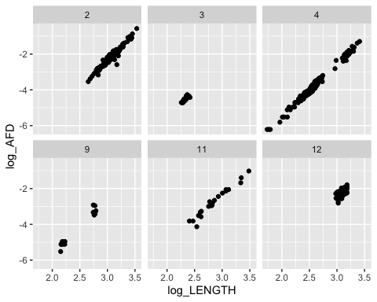
Data transformation and pipe

Slide 16
Homework 01
Installing R and Rstudio

