Slide 1

Internationalization Plugin for Vue.js
Ying 2019/10/02

Slide 2
Installation
with npm
with vue-cli 3.x
npm install vue-i18n
vue add i18n

Slide 3
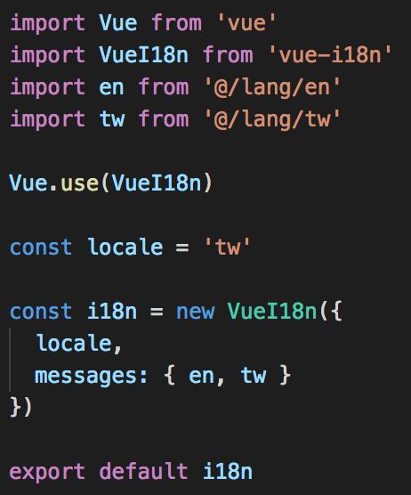
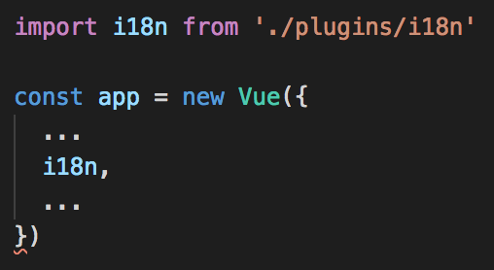
Add to Vue Instance
@/plugins/i18n.js
@/main.js

Slide 4
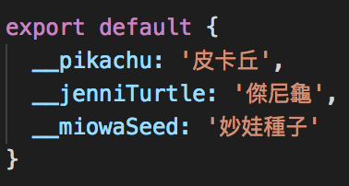
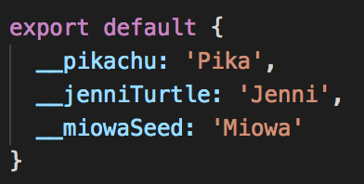
Create Locale String Files
@/lang/tw.js
@/lang/en.js

Slide 5
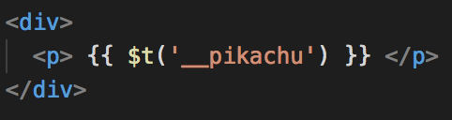


Basic Usage
$t(id)
In <template>
In <script>
In any other .js

Slide 6
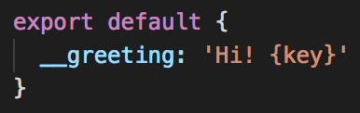
Named Formatting
$t(id, parameters)
@/lang/tw.js
<template>
// user.name === 'pikachu'
output:
Hi! pikachu

Slide 7
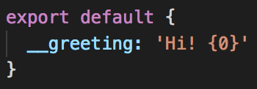
List Formatting
$t(id, parameters)
@/lang/tw.js
<template>
output:
Hi! Pika

Slide 8
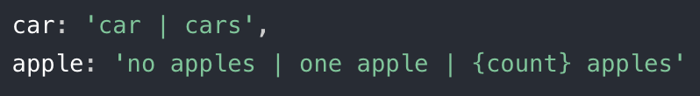
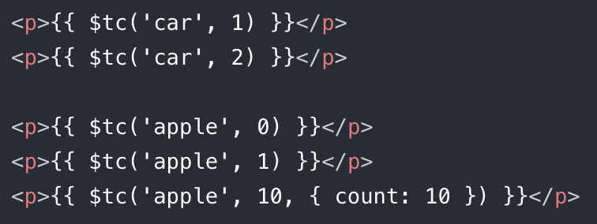
Pluralization
$tc(id, count, parameters)
@/lang/tw.js
<template>
output:
car
cars
no apples
one apple
10 apples

Slide 9

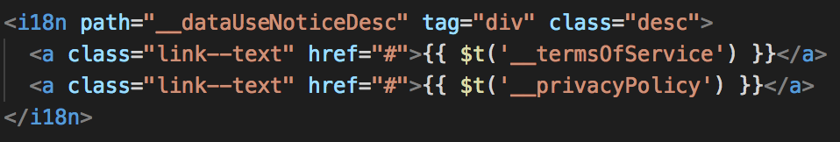

Component Interpolation
<i18n path="">
@/lang/tw.js
<template>
// <div class="desc">…</div>
output:
Notes:
0, 1 用到 list formatting

Slide 10
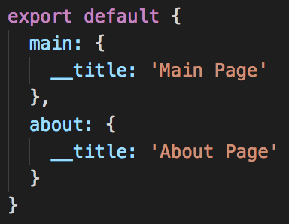
Structuring Strings
@/lang/tw.js
<template>
output:
Main Page
Notes:
簡單來說可以 nested

Slide 11
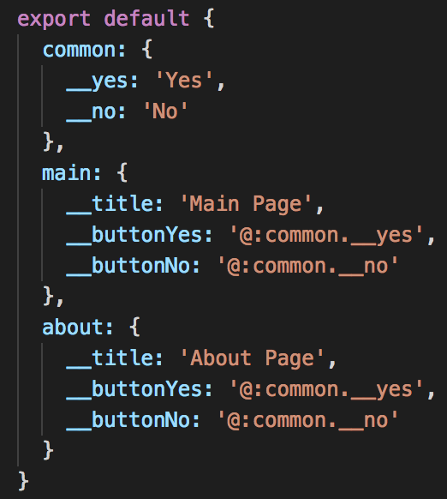
Referencing Other String
@/lang/tw.js
Notes:
簡單來說可以 nested

Slide 12
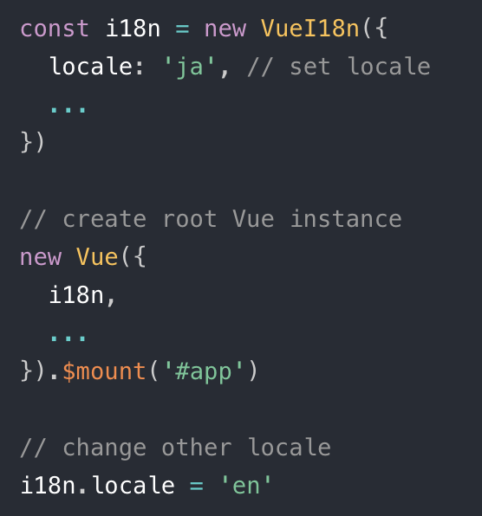
Switching Locales
// No need to set hot reloading for switching
Notes:
不需要設 hot reload 就可以換字串～

Slide 13
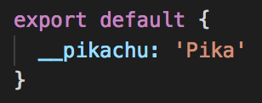
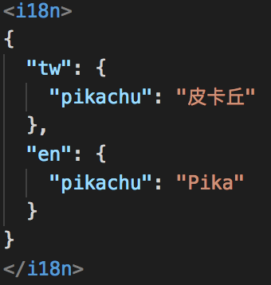
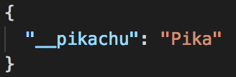
Alternatives to Manage Strings
In .js
In .json
In .vue
Notes:
小型專案可用 .vue
cannot use comment in .json
.json 比較 portable

Slide 14

String Naming
__pikachu?
pikachu?

Slide 15

String Naming
__pricingPlans ?
__pricePageTitle ?

Slide 16
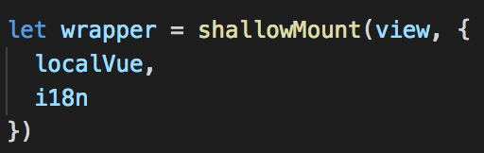
Note
Remember to add i18n instance when mount in testing
Need other settings for hot reloading
https://kazupon.github.io/vue-i18n/guide/hot-reload.html

Slide 17
References
https://kazupon.github.io/vue-i18n/ (official document)
https://www.codeandweb.com/babeledit/tutorials/how-to-translate-your-vue-app-with-vue-i18n
https://dotblogs.com.tw/wasichris/2018/05/12/012517

Slide 18
Thanks.

