Slide 1
Growth Analysis for Hawksbill Sea Turtles in Anegada, British Virgin Islands
Yin Zhou
The central research question my project will address:
Does wild hawksbill sea turtles have high growth rate?

Slide 2
Motivation and Background
Compelling reason(s) to study my question
The hawksbill sea turtle is a Critically Endangered sea turtle. Ecologist try to recover the population size of hawksbill sea turtle. In order to know the situation of wild hawksbill sea turtle, ecologist collect the data from Anegada. In this project, I will visualize the growth data (size, weight etc.) of hawksbill sea turtle in Anegada.

Slide 3
Approach
I use the following data set from Dryad for this project:
Hawkes LA, McGowan A, Broderick AC, Gore S, Wheatley D, White J, Witt MJ, Godley BJ (2014) Data from: High rates of growth recorded for hawksbill sea turtles in Anegada, British Virgin Islands. Dryad Digital Repository. https://doi.org/10.5061/dryad.27n36
This study measure the size and weight of hawksbill turtles over 109 irregularly spaced days.

Slide 4
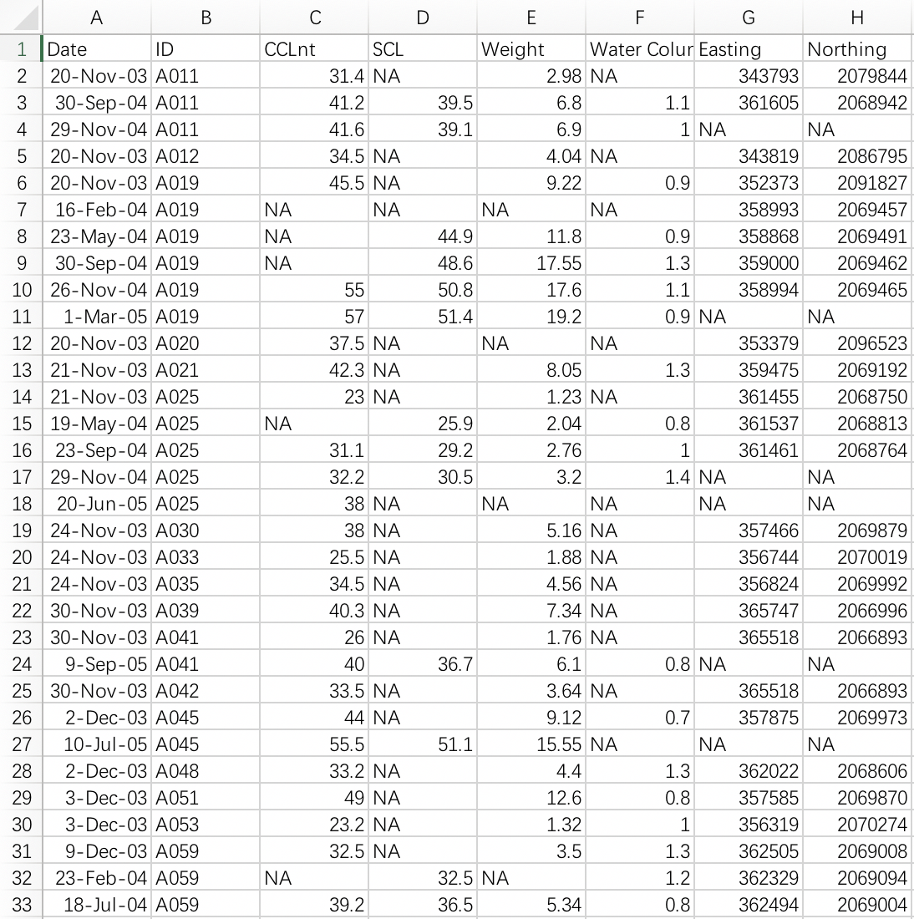
About the Data
Data set include
Date(char), ID(char), CCLnt(numerical), SCL(numerical), Weight(numerical), Water Column Depth(numerical), Easting(numerical), Northing(numerical)

Slide 5
Anticipated Details
The analysis will involve
1. Calculation of the growth rate for each turtle
2. Analysis of the general growth rate and SE
3. Visualize the capture point
4. Visualize the growth data
5. Comparison between wild hawksbill sea turtle and these in captivity
6. Comparison between hawksbill sea turtle and other turtles

Slide 6
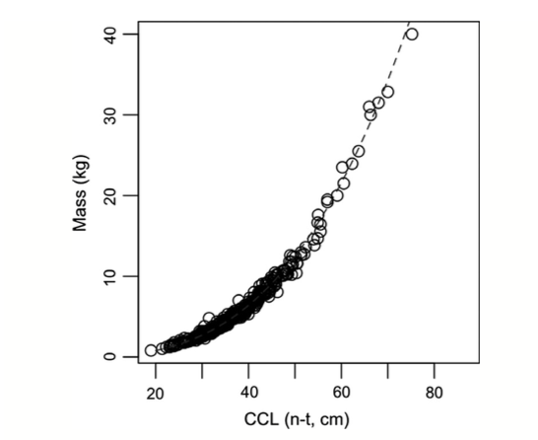
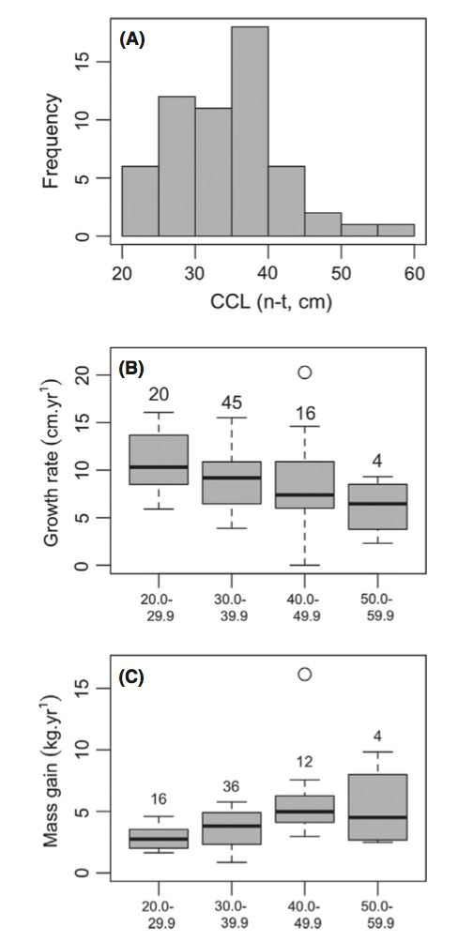
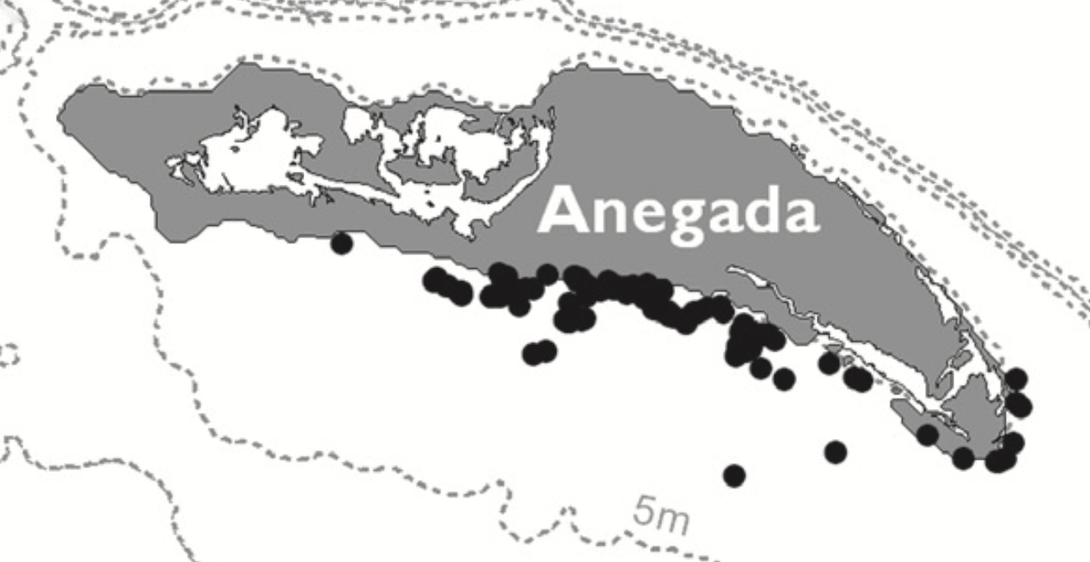
Anticipated Results

