Slide 1

Emotion Detection in Dialogues
Xiangjue DONG, Yanan DA, Yibo WANG
Notes:
Good morning, everyone. My name is Yibo, this is Xiangjue, this is Yanan. Today, we’d like to provide an overview of our project -- emotion detection in dialogues.

Slide 2
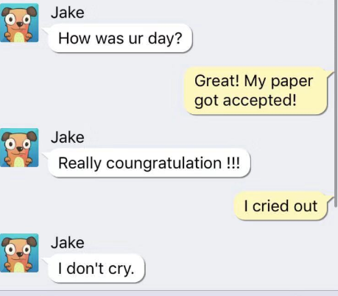
Motivation and Background
App: Vitural Talk
Notes:
Emotion detection is important because emotions play a significant role in human life. Emotions can indicate opinions, influence decision-making and affect social relationships. Besides, emotion detection can be used in chatbots to generate proper response to communicate with humans.
Here's an example. Jake is a robot. When I said "I cried out", I meant I was too happy to cry because my paper got accepted. But the robot thought I was sad. The robot cannot detect emotions from a constant conversation. If the robot can detect emotions from dialogues, it can give better response.
In fact, emotion detection is not a new topic. Many people have already researched on it. However, classifying emotions in textual dialogues is a relatively new research area.
Emotions are physiological states generated in humans in reaction to internal or external events. They are complex and studied across numerous fields including computer science. As humans, on reading “Why don’t you ever text me!” we can either interpret it as a sad or angry emotion and the same ambiguity exists for machines. Lack of facial expressions and voice modulations make detecting emotions from text a challenging problem. However, as humans increasingly communicate using text messaging applications, and digital agents gain popularity in our society, it is essential that these digital agents are emotion aware, and respond accordingly.
To our knowledge, there are not many works that focus on studying how emotions are reflected verbally. However, studying emotions on text messaging platforms such as WhatsApp, Facebook Messenger or Telegram is important as more and more users are using them to share their experiences and emotions. Currently, detecting emotions in instant messaging has multiple applications in different fields (Gupta et al., 2017; Yadollahi et al., 2017; Hakak et al., 2017), such as businesses intelligence to increase customer satisfaction knowing their preferences, social media to alert users if they are going to post an offensive tweet or psychology to detect some disorders like anorexia, anxiety or stress.

Slide 3

Data Set
Training set with around 30,000 dialogues
Testing set: around 2,700 dialogues
https://www.humanizing-ai.com/emocontext.html
Notes:
Our data set is selected from a competition. It has a training set with around 30,000 dialogues and a testing set which has around 2,700 dialogues.
Here's the preview of our dataset. A dialogue in the data set is seperated into three turns. Most of reseachers just use turn3 to detect emotions, and others use turn1 and turn3. Considering there may be a trasition on turn2, we want to take turn2 into account but give it a reasonable weight.
Dialogues are labelled as one of the four classes: happy, sad, angry, or others. And they are labelled by human being, so this data set is relatively reliable.

Slide 4
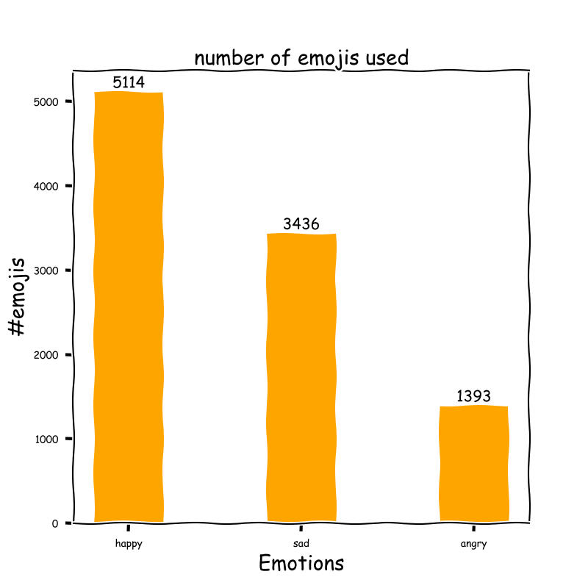
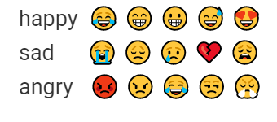
Data Analysis
Top 5 Emojis
Notes:
Besides, our data set also shows that people tend to use emojis when they are happy or sad.
It can be observed that number of emojis used in dialogues labelled as happy is the largest, followed by dialogues labelled as sad.
And the top used emojis are shown on slides.
So dialogues labelled as different emotions have very different characteristics and feartures. Depending on this observation, we want to build different models to detect different emotions. This is quiet different from others' work, because they all use one model to detect all the emotions.

Slide 5
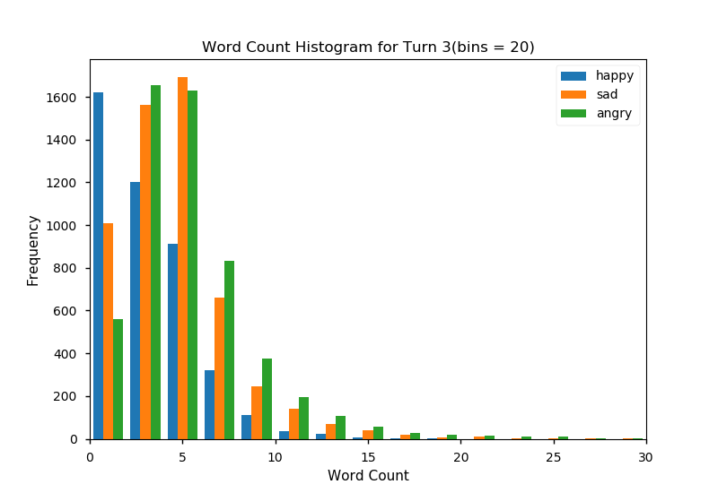
Data Analysis
Word Count
Notes:
We have done some research on our dataset.
As shown above, the most common word count of different emotions are different.
Word count with emojis removed for each class

Slide 6
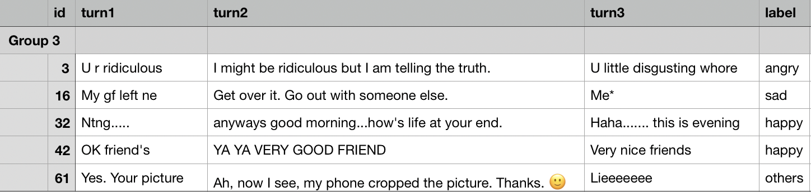
Preprocess Data
Notes:
Before building models, we have to preprocess data.
Here are several samples of data set.
Abbreviations, capitals, repeat and so on. All these things should be preprocessed before analysis.

Slide 7
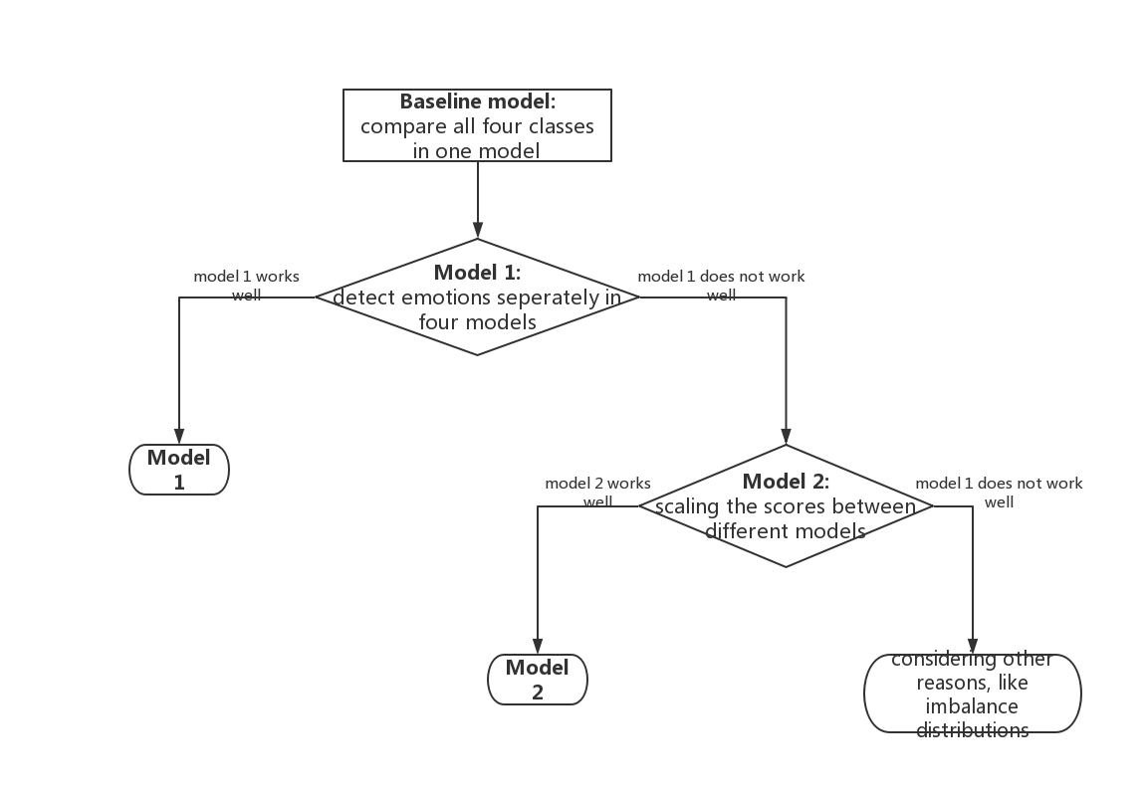
Models
Notes:
The baseline model is to compare all four classes in one model.
And our main idea is to detect emotions seperately in four models depending on different features as I just mentioned.
If it works well, that's nice.
But if it does not perform well as we assumed, we will consider the influence of scales between different models. So we will scaling the scores.
If it still doesn't work, we will think about other reasons, like the imbalance distributions between training set and test set.

Slide 8
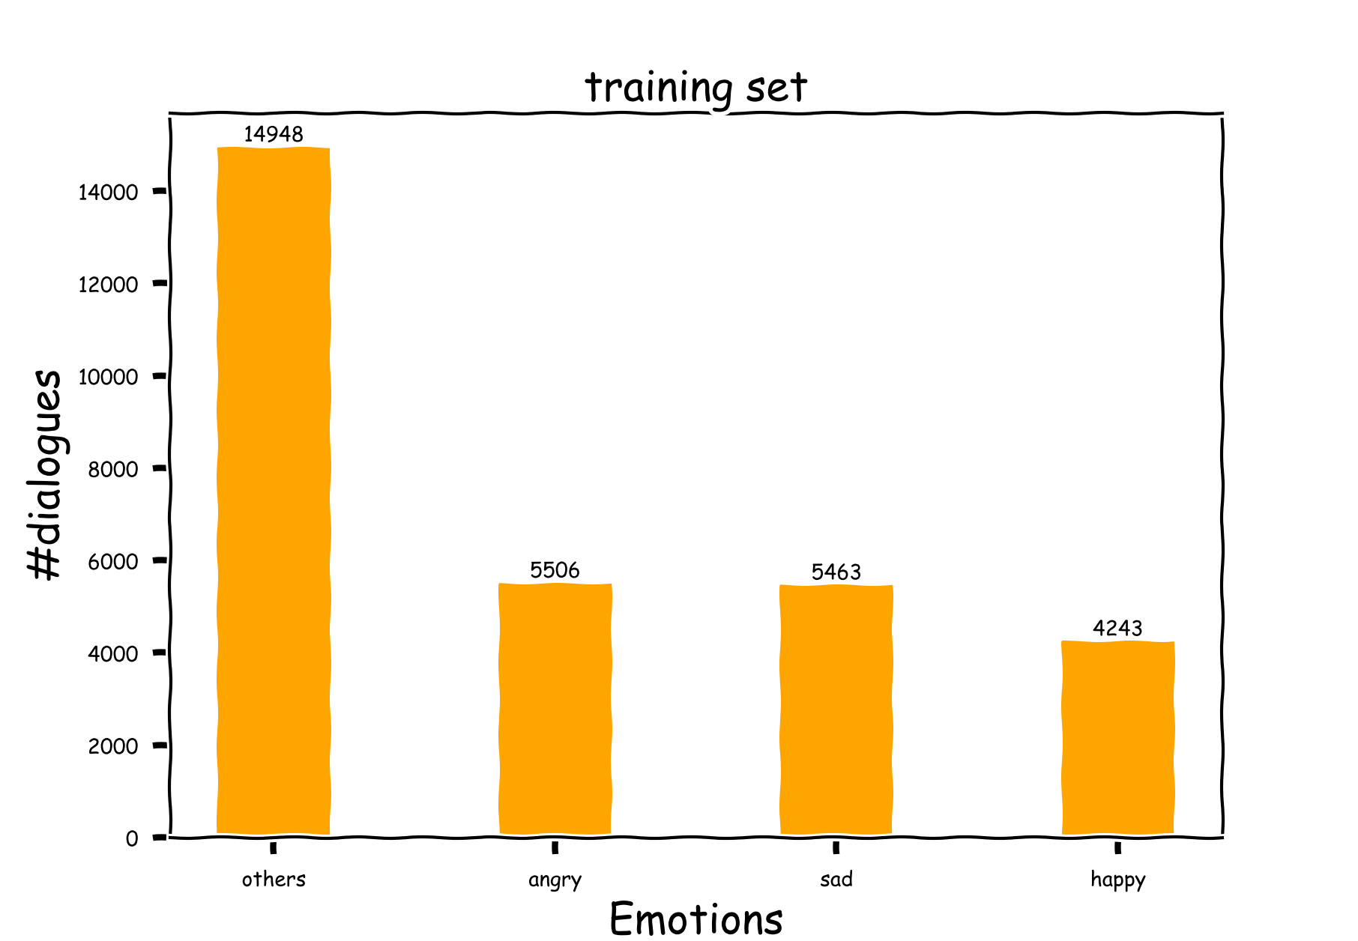
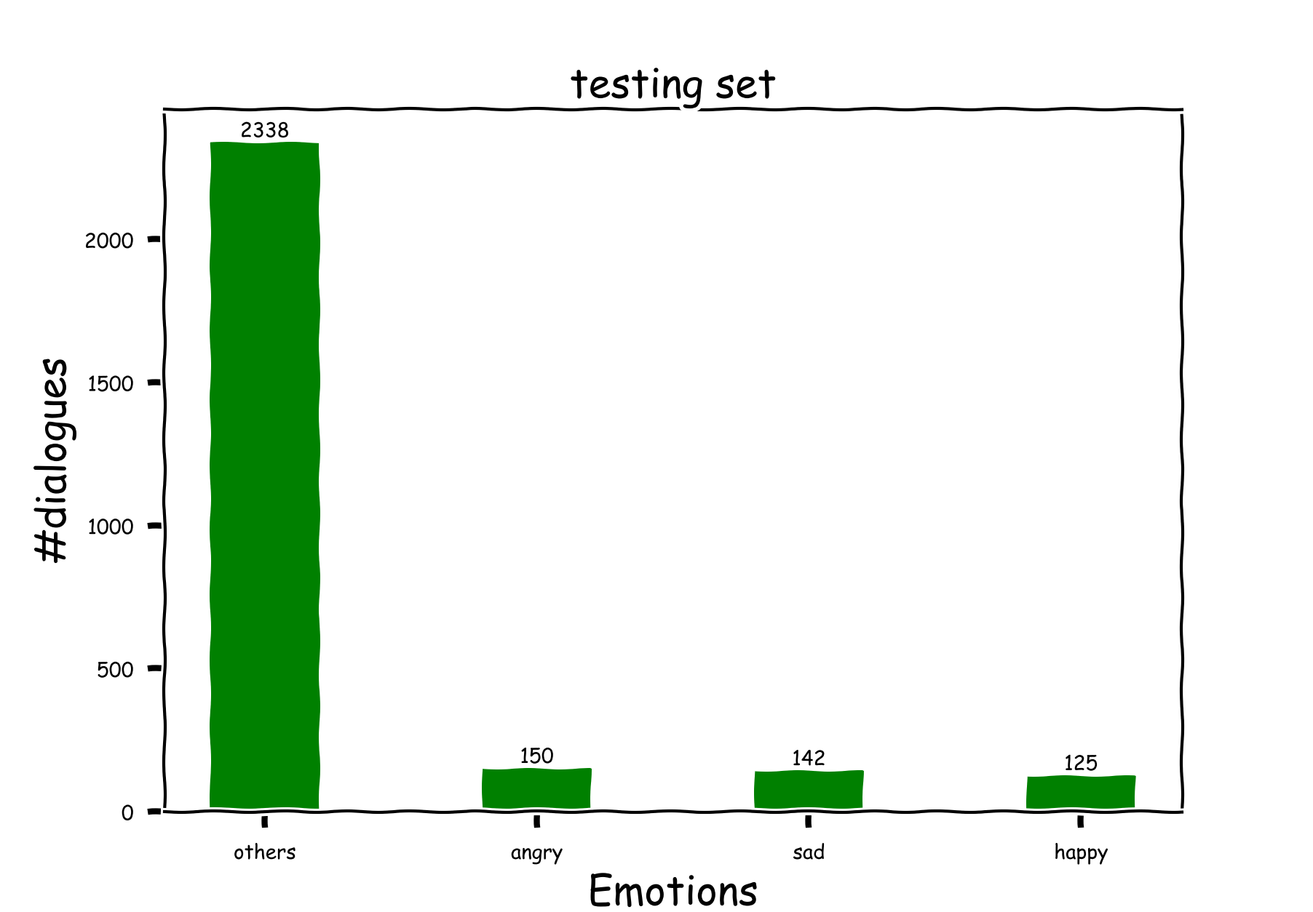
Imbalanced distribution

Slide 9
Methods and Evaluation Strategies
Feature Extraction:
Statistic features: TF(term frequency), n-grams(unigram, bigrams...)
Morphological features: PoS (part of speech)
Lexical features
Models
SVM
GBDT
Evaluation
Precision
Recall
F1 Score
Notes:
We will consider features like term frequencey, n-grams, part of speech and lexical features.
We will use models like SVM and GBDT and evaluation metrics like precision, recall and F1 Score.
So, that's the overview of our project.
Most work have done use deep learning models, we would like to explore supervised methods on this data, because supervised model is more interpretable.
First, we will address the problem of unbalanced data distribution as discussed before.
Second, we will try to give each turn different weights instead of treat them equally or simply ignore one of them. Situation1 : the motivation example, we need the 1st turn to correctly recognize that the 3 turn is in a happy mood. Situation 2: the last turn does not contain much info, eg. Simply say yes!
Third: since different may
Feature engineering:
We will explore better methods to preprocess data set, implement and compare different algorithms (like Naive Bayes (NB) classifier, Support Vector Machine (SVM) classifier, Gradient Boosted Decision Tree (GBDT) classifier, Logistic Regression, Random Forest, and Ensemble methods), figure out proper features such as tf-idf, unigrams, bigrams and trigrams, and use 10-fold cross validation to run our experiments and report precision, recall, and F1 score.

Slide 10
References
https://github.com/DhruvDh/emocontext/tree/master/data
https://www.aclweb.org/anthology/S19-2005.pdf
https://www.aclweb.org/anthology/S19-2020.pdf
https://arxiv.org/pdf/1903.02163v2.pdf
https://github.com/byramag/Emo_Eval
https://www.aclweb.org/anthology/S19-2050.pdf
Notes:
Here're references we've used.

Slide 11
Thank you!
Q & A
Notes:
Thank you! Are there any questions?

