Slide 1
Ovarian Cancer RNA-Seq Analysis
Yichao Li
Xiaoyu Liang

Slide 2
Hypothesis
A subset of genes can be used as classifiers to tell one type from another.

Slide 3
Cufflinks Assembled Genes/Transcripts
 | # of total transcripts | # of unique* transcripts | # of known transcripts | # of unknown transcripts
NML | 93428 | 91788 | 11087 | 80701
LMP_R1 | 45940 | 43978 | 9545 | 34433
LMP_R2 | 32191 | 30143 | 9506 | 20637
LMP_R3 | 89533 | 87561 | 8431 | 79130
LMP_R4 | 48760 | 46793 | 9687 | 37106
PSO2_R1 | 58038 | 56035 | 8023 | 48012
PSO2_R2 | 52202 | 50279 | 9067 | 41212
PSO2_R3 | 73674 | 71764 | 7648 | 64116
PSO3_R1 | 104183 | 102304 | 7240 | 95064
PSO3_R2 | 228718 | 226784 | 5474 | 221310
PSO3_R3 | 140220 | 138289 | 5252 | 133037
PSO3_R4 | 260893 | 259205 | 5375 | 253830
Unique: the gene/transcript only has one locus.

Slide 4
Cufflinks Assembled Genes/Transcripts
NML
11087
LMP_R1
9545
LMP_R2
9506
LMP_R3
8431
LMP_R4
9687
LMP
5896
PSO2_R1
8023
PSO2_R2
9067
PSO2_R3
7648
NML&LMP
5316
PSO2
5238
PSO3_R1
7240
PSO3_R2
5474
PSO3_R3
5252
PSO3_R4
5375
NML&LMP&PSO2
3973
PSO3
2699
NML&LMP&PSO2&PSO3
2129

Slide 5
Genes Filtering
Select genes that were identified by Cufflinks, and shared by all samples.
Delete unknown genes/transcripts.
Delete genes that have more than one locus.
Obtained 2129 genes.

Slide 6
Random Forest Recursive Feature Elimination
Perform random forest using all available genes
Compute importance value for each gene
Remove the smallest importance gene
Iterative do 1-3 until no genes available
Select the set of genes that gives the highest accuracy
Pang H, George SL, Hui K, Tong T. Gene selection using iterative feature elimination random forests for survival outcomes. IEEE/ACM transactions on computational biology and bioinformatics / IEEE, ACM 2012;9(5):1422-1431. doi:10.1109/TCBB.2012.63.

Slide 7
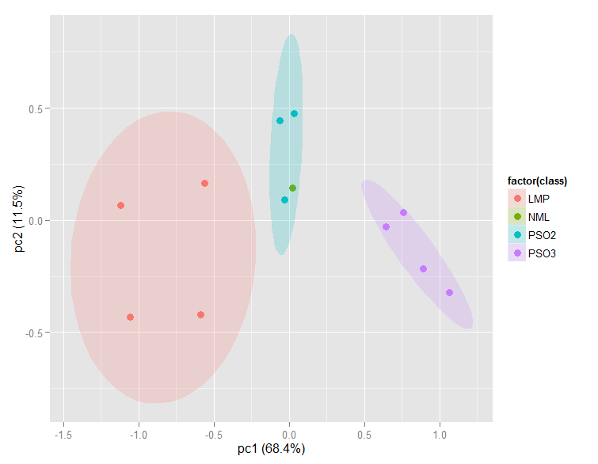
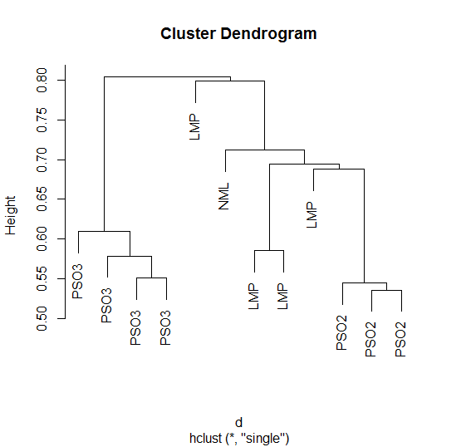
Result
LOC642366
KCTD12
ARL4A
COA3
ATPIF1
BCL2L10
KCNJ1
EIF4EBP2
CSTF2T
Selected 9 Genes, with accuracy 92.86% ±10%

Slide 9
Expression Values
 | LMP R1 | LMP R2 | LMP R3 | LMP R4 | NML | PSO2 R1 | PSO2 R2 | PSO2 R3 | PSO3 R1 | PSO3 R2 | PSO3 R3 | PSO3 R4
LOC642366 | 0.01 | 0.01 | 0.01 | 0 | 0.02 | 0.02 | 0.05 | 0.02 | 0.04 | 0.02 | 0.07 | 0.05
KCTD12 | 52.61 | 91.77 | 42.37 | 59.21 | 11.8 | 38.73 | 37.36 | 27.78 | 3.18 | 9.55 | 17.49 | 12.71
ARL4A | 3.31 | 3.67 | 2.9 | 4.57 | 3.34 | 2.65 | 2.77 | 1.98 | 0.76 | 0.55 | 1.87 | 1.05
COA3 | 129.69 | 113.46 | 101.44 | 156.46 | 125.17 | 61.06 | 97.73 | 48.59 | 22.73 | 26.24 | 32.93 | 19.25
ATPIF1 | 168.53 | 394.6 | 334.04 | 374.5 | 153.25 | 139.69 | 244.91 | 143.78 | 128.92 | 73.76 | 135.25 | 49.63
BCL2L10 | 2.24 | 3.75 | 3.68 | 4.33 | 0.25 | 0.24 | 0.5 | 2.07 | 0 | 0.11 | 0 | 0.4
KCNJ1 | 0 | 0.01 | 0 | 0 | 0.02 | 0.05 | 0.07 | 0.02 | 0.21 | 0.01 | 0.07 | 0.1
EIF4EBP2 | 13.85 | 15.64 | 8.43 | 10.05 | 10.9 | 16.47 | 15.89 | 12.7 | 2.57 | 6.95 | 6.93 | 3.56
CSTF2T | 5.51 | 7.67 | 4.07 | 3.92 | 2.83 | 5.03 | 5.85 | 5.13 | 2.16 | 2.39 | 2.34 | 1.82

Slide 10
Genes Annotation Study
LOC642366
uncharacterized LOC642366[Homo sapiens]
Chromosome: 5; Location: 5q11.1
Annotation: Chromosome 5NC_000005.10 (51372736..51383332, complement)
ID: 642366
KCTD12
Official Symbol: KCTD12 and Name: potassium channel tetramerization domain containing 12[Homo sapiens]
Other Aliases: C13orf2, PFET1, PFETIN
Other Designations: BTB/POZ domain-containing protein KCTD12; potassium channel tetramerisation domain containing 12; predominantly fetal expressed T1 domain
Chromosome: 13; Location: 13q22.3
Annotation: Chromosome 13NC_000013.11 (76880169..76886405, complement)
MIM: 610521
ID: 115207
ARL4A
Official Symbol: ARL4A and Name: ADP-ribosylation factor-like 4A[Homo sapiens]
Other Aliases: ARL4
Other Designations: ADP-ribosylation factor-like 4; ADP-ribosylation factor-like protein 4A
Chromosome: 7; Location: 7p21.3
Annotation: Chromosome 7NC_000007.14 (12686827..12690934)
MIM: 604786
ID: 10124
COA3
Official Symbol: COA3 and Name: cytochrome c oxidase assembly factor 3[Homo sapiens]
Other Aliases: HSPC009, CCDC56, MITRAC12
Other Designations: coiled-coil domain-containing protein 56; cytochrome C oxidase assembly factor 3 homolog, mitochondrial; cytochrome c oxidase assembly factor 3 homolog, mitochondrial; cytochrome c oxidase assembly protein 3 homolog, mitochondrial; mitochondrial translation regulation assembly intermediate of cytochrome c oxidase protein of 12 kDa
Chromosome: 17; Location: 17q21
Annotation: Chromosome 17NC_000017.11 (42797618..42798725, complement)
MIM: 614775
ID: 28958

Slide 11
Genes Annotation Study – cont.
ATPIF1
Official Symbol: ATPIF1 and Name: ATPase inhibitory factor 1[Homo sapiens]
Other Aliases: RP5-1092A3.1, ATPI, ATPIP, IP
Other Designations: ATP synthase inhibitor protein; ATPase inhibitor protein; ATPase inhibitor, mitochondrial; IF(1); IF1; inhibitor of F(1)F(o)-ATPase
Chromosome: 1; Location: 1p35.3
Annotation: Chromosome 1NC_000001.11 (28236091..28238105)
MIM: 614981
ID: 93974
BCL2L10
Official Symbol: BCL2L10 and Name: BCL2-like 10 (apoptosis facilitator)[Homo sapiens]
Other Aliases: BCL-B, Boo, Diva
Other Designations: anti-apoptotic protein NrH; apoptosis regulator Bcl-B; bcl-2-like protein 10; bcl2-L-10
Chromosome: 15; Location: 15q21
Annotation: Chromosome 15NC_000015.10 (52109293..52112775, complement)
MIM: 606910
ID: 10017
KCNJ1
Official Symbol: KCNJ1 and Name: potassium inwardly-rectifying channel, subfamily J, member 1[Homo sapiens]
Other Aliases: KIR1.1, ROMK, ROMK1
Other Designations: ATP-regulated potassium channel ROM-K; ATP-sensitive inward rectifier potassium channel 1; inward rectifier K(+) channel Kir1.1; inwardly rectifying K+ channel; potassium channel, inwardly rectifying subfamily J member 1
Chromosome: 11; Location: 11q24
Annotation: Chromosome 11NC_000011.10 (128838014..128867373, complement)
MIM: 600359
ID: 3758

Slide 12
Genes Annotation Study – cont.
EIF4EBP2
Official Symbol: EIF4EBP2 and Name: eukaryotic translation initiation factor 4E binding protein 2[Homo sapiens]
Other Aliases: 4EBP2, PHASII
Other Designations: 4E-BP2; eIF4E-binding protein 2; eukaryotic translation initiation factor 4E-binding protein 2; phosphorylated, heat and acid stable regulated by insulin protein II
Chromosome: 10; Location: 10q21-q22
Annotation: Chromosome 10NC_000010.11 (70404105..70428618)
MIM: 602224
ID: 1979
CSTF2T
Official Symbol: CSTF2T and Name: cleavage stimulation factor, 3' pre-RNA, subunit 2, 64kDa, tau variant[Homo sapiens]
Other Aliases: CstF-64T
Other Designations: CF-1 64 kDa subunit tau; CSTF 64 kDa subunit tau; cleavage stimulation factor 64 kDa subunit tau; cleavage stimulation factor subunit 2 tau; cleavage stimulation factor subunit 2 tau variant; tauCstF-64
Chromosome: 10; Location: 10q11
Annotation: Chromosome 10NC_000010.11 (51695486..51699595, complement)
MIM: 611968
ID: 23283

Slide 13
Filter Genes
Delete genes that have fpkm of 0 across all samples
Delete genes that only expressed in one sample (unless the sample is NML)
Delete non-protein coding RNAs
Use gene names from http://www.genenames.org/genefamilies/rna
Including:
microRNAs (MIRXX)
small nucleolar RNA (SNORXX)
long intergenic non-protein coding RNA (LINCXX)
vault RNA (VTRNAXX)
Small Cajal body-specific RNA (SCARNAXX)
Small nuclear RNAs (RNUXX)
MiscRNAs (RMRP, RPPH1)
Obtained 674 genes

Slide 14
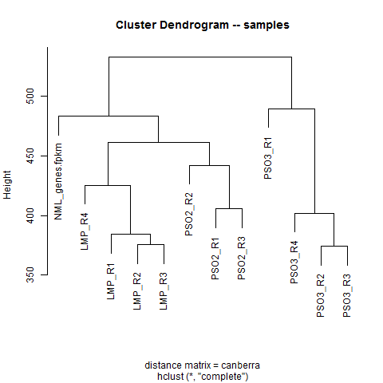
Clustering for samples
This set of genes successfully separate samples, with the distance matrix of “canberra”
Other distance matrix cannot separate samples successfully.

Slide 15
SVM Classification
Binary classification

Slide 16
Nested Cross Validation
Outer Loop
12-fold cross validation
Test
Inner Loop
11-fold cross validation for each parameters setting
For each parameters setting, calculate the average accuracy.
Choose parameters setting that performed the best.
If more than one setting achieve the highest accuracy, choose the most general one (which give the simplest model)
Use the best parameters setting train 11 data samples, and test on 1.
validation
training
.
.
.
Repeat the process 12 times, so that each data sample was used as the testing data.
Obtain the average accuracy.
.
.
.

Slide 17
Sdfds fsd sdf

Slide 18
Discriminative Genes
gene | LMP_R1 | LMP_R2 | LMP_R3 | LMP_R4 | NML | PSO2_R1 | PSO2_R2 | PSO2_R3 | PSO3_R1 | PSO3_R2 | PSO3_R3 | PSO3_R4
HOXC11 | 0 | 0 | 0 | 0 | 0 | 0 | 0 | 0 | 0.024091 | 0.100221 | 0.070688 | 0.183144
HOXD13 | 0 | 0 | 0 | 0 | 0 | 0.033296 | 0.03475 | 0.026931 | 0 | 0 | 0 | 0
BARHL1 | 0 | 0 | 0 | 0 | 0.279823 | 0 | 0 | 0 | 0 | 0 | 0 | 0
FABP1 | 0 | 0 | 0 | 0 | 1.00618 | 0 | 0 | 0 | 0 | 0 | 0 | 0
PRLHR | 0 | 0 | 0 | 0 | 0.179434 | 0 | 0 | 0 | 0 | 0 | 0 | 0

Slide 19
Using 5 discriminative genes

Slide 20
Using 138 genes that don’t have 0 values

Slide 21
Appendix
Literature Search
GO Analysis

Slide 22
Literature Search

Slide 23
KCTD12
Therefore, we hypothesized that KCTD family genes may be useful for assessing the malignant potential of GIST cells.
Kubota D., Yoshida A., Tsuda H., Suehara Y., Okubo T., Saito T., Orita H., Sato K., Taguchi T., Yao T. Gene expression network analysis of ETV1 reveals KCTD10 as a novel prognostic biomarker in gastrointestinal stromal tumor. PLoS One. 2013;8:e73896.
Overall, KCTD12 expression was specific for GISTs from neoplastic and nonneoplastic adult tissues other than brain and served as a predictor of GIST recurrence. These findings suggest that KCTD12 is a useful and reliable biomarker for both the diagnosis and prognosis of GIST.
Tadashi Hasegawa, Hiroko Asanuma, Jiro Ogino, Yoshihiko Hirohashi, Yasuhisa Shinomura, Hiroyuki Iwaki, Hironobu Kikuchi, Tadashi Kondo, Use of potassium channel tetramerization domain-containing 12 as a biomarker for diagnosis and prognosis of gastrointestinal stromal tumor, Human Pathology, Volume 44, Issue 7, July 2013, Pages 1271-1277, ISSN 0046-8177, http://dx.doi.org/10.1016/j.humpath.2012.10.013.

Slide 24
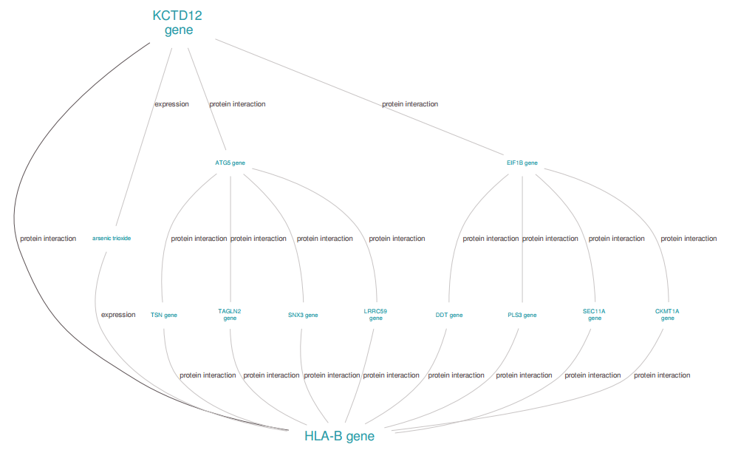
http://www.biograph.be/concept/graph/C1422834/C1415561

Slide 25
Most of low malignancy potential (LMP) tumors were classified as Epi-A subtype.
http://www.google.com/patents/US20140236495
KCTD12 | EpiA_Up

Slide 26
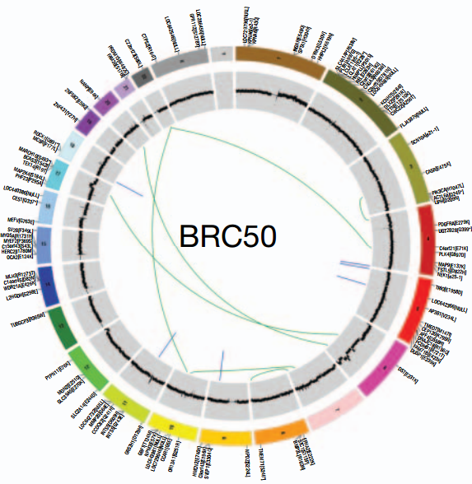
LOC642366
Significantly mutated genes are highlighted in red
Ellis, M. J., Ding, L., Shen, D., Luo, J., Suman, V. J., Wallis, J. W., … Mardis, E. R. (2012). Whole-genome analysis informs breast cancer response to aromatase inhibition. Nature, 486(7403), 353–360. Retrieved from http://dx.doi.org/10.1038/nature11143

Slide 27
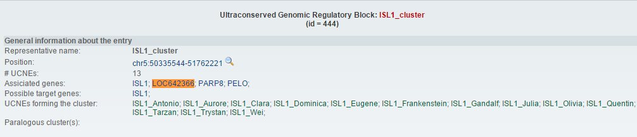
http://ccg.vital-it.ch/UCNEbase/view.php?data=cluster&entry=ISL1

Slide 28
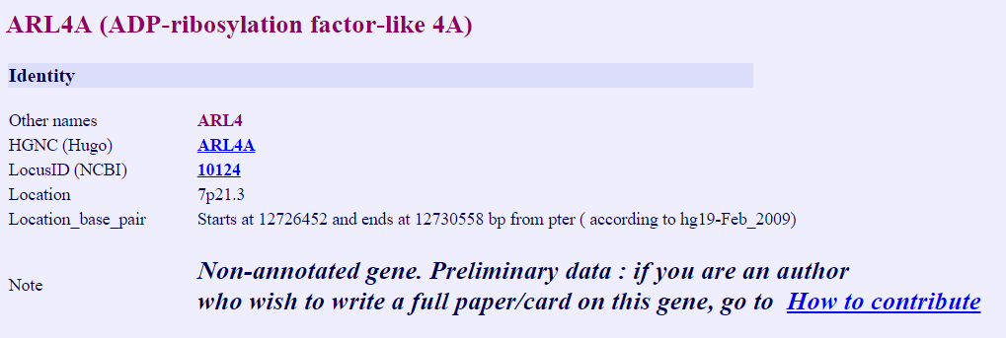
ARL4A
http://atlasgeneticsoncology.org/Genes/GC_ARL4A.html

Slide 29
COA3
In our study, very limited hormone related genes were differentially expressed. One such gene encodes the caspase 8 associated protein 2 (CASP8AP2) which differentially suppresses steroid hormone receptor - induced transcriptional activity by interfering with their association with steroid hormone receptor coactivator 2 (SRC2)/N-CoA2 and SRC3/N-CoA3
Sun X, Mei S, Tao H, Wang G, Su L, Jiang S, Deng C, Xiong Y, Li F: Microarray profiling for differential gene expression in PMSG-hCG stimulated preovulatory ovarian follicles of Chinese Taihu and Large White sows.
BMC Genomics 2011, 12:111.

Slide 30
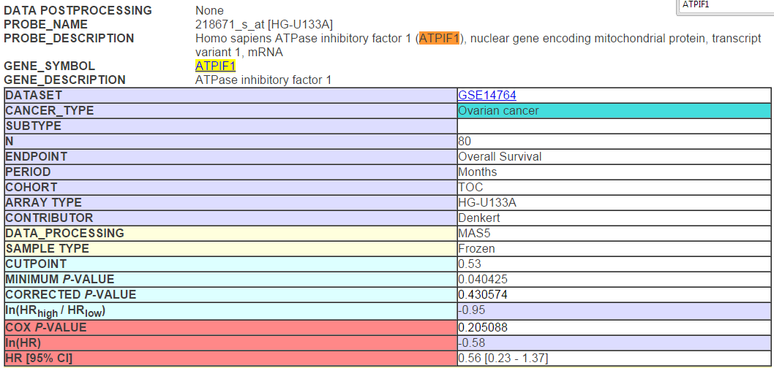
ATPIF1

Slide 31
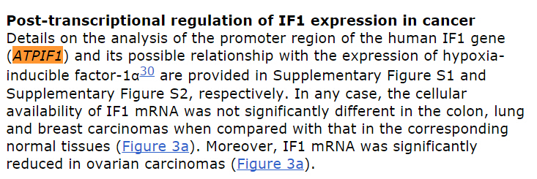
ATPIF1
Sanchez-Arago, M., Formentini, L., Martinez-Reyes, I., Garcia-Bermudez, J., Santacatterina, F., Sanchez-Cenizo, L., … Cuezva, J. M. (2013). Expression, regulation and clinical relevance of the ATPase inhibitory factor 1 in human cancers. Oncogenesis, 2, e46. Retrieved from http://dx.doi.org/10.1038/oncsis.2013.9

Slide 32
BCL2L10
Circulating microRNAs in patients with polycystic ovary syndrome
Can’t access this paper.

Slide 33
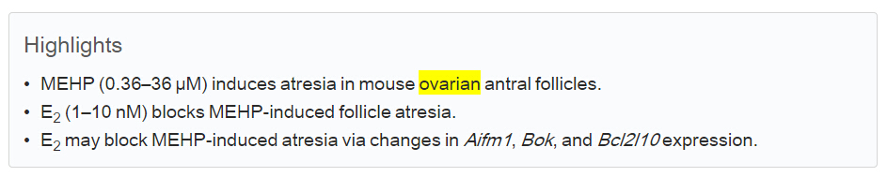
E₂ interfered with MEHP-induced changes in Aifm1 and Bcl2l10. Our findings suggest that decreased E₂ levels are required for MEHP-induced follicle atresia and that Aifm1, Bok, andBcl2l10 are involved in this process.
Zelieann R. Craig, Jeffrey Singh, Rupesh K. Gupta, Jodi A. Flaws, Co-treatment of mouse antral follicles with 17β-estradiol interferes with mono-2-ethylhexyl phthalate (MEHP)-induced atresia and altered apoptosis gene expression, Reproductive Toxicology, Volume 45, June 2014, Pages 45-51, ISSN 0890-6238, http://dx.doi.org/10.1016/j.reprotox.2014.01.002

Slide 34
In contrast, the anti-apoptotic gene Bcl-2 like-10 (Bcl2l10) remains unchanged in the mutant oocyte, suggesting a self-protective mechanism adopted by the degenerating oocytes.
Wang, W., Tang, Y., Ni, L., Kim, E., Jongwutiwes, T., Hourvitz, A., … Rosenwaks, Z. (2012). Overexpression of Uromodulin-like1 accelerates follicle depletion and subsequent ovarian degeneration. Cell Death Dis, 3, e433. Retrieved from http://dx.doi.org/10.1038/cddis.2012.169

Slide 35
We characterized the expression of different genes of the BCL2 family either over expressed in oocytes (BCL2L1, BCL2L10, BCL2L11 (BIM), BCL2L14 (BCLG)) or in GCs (BCL2 BCL2L2, BOK) and that mainly prevent oocyte loss. For example, the BCL2L1 gene was shown to play a crucial role in the survival of germ cells [31]. BCL2L10 may antagonize BAX activities and may also play other roles related to cell cycle control and oocyte maturation (for a review see [32]). In sheep, the high expression of BCL2L10 in oocytes and its up-regulation during preantral stages reinforces its already important role in oocyte development. By decreasing GC atresia, the BCL2 gene family expressed in GCs, such as BCL2, was also believed to increase the number of germ cells and enhance their development. Lastly, BOK mRNA, was found to be restricted to reproductive tissue and was detected in GCs from PM to antral follicles in rat species
An overview of gene expression dynamics during early ovarian folliculogenesis: specificity of follicular compartments and bi-directional dialog
Agnes Bonnet, Cedric Cabau, Olivier Bouchez, Julien Sarry, Nathalie Marsaud, Sylvain Foissac, Florent Woloszyn, Philippe Mulsant, Beatrice Mandon-Pepin
BMC Genomics. 2013; 14: 904. Published online 2013 December 19. doi: 10.1186/1471-2164-14-904

Slide 36
Role of Bcl2-like 10 (Bcl2l10) in Regulating Mouse Oocyte Maturation¹
Se-Jin Yoon3,4,
Eun-Young Kim4,
Yun Sun Kim,
Hyun-Seo Lee,
Kyeoung-Hwa Kim,
Jeehyeon Bae and
Kyung-Ah Lee2

Slide 37
KCNJ1
The expression levels of these three up-regulated (PTP4A3, CAV2 and LAMA4) and three down-regulated genes (KCNJ1, SFRP1 and TCF21)
Our analyses indicated that gene-level regulation is somehow affected by the carcinogenesis process for a great number of genes, among which we identified four genes (PTP4A3, CAV2, LAMA4 and KCNJ1) whose expression was previously not known to be altered in ccRCC.
Genome-Wide Analysis of Differentially Expressed Genes and Splicing Isoforms in Clear Cell Renal Cell Carcinoma
Alessio VallettiMargherita GiganteOrazio PalumboMassimo CarellaChiara DivellaElisabetta SbisàApollonia TulloErnesto PicardiAnna Maria D’Erc

Slide 38
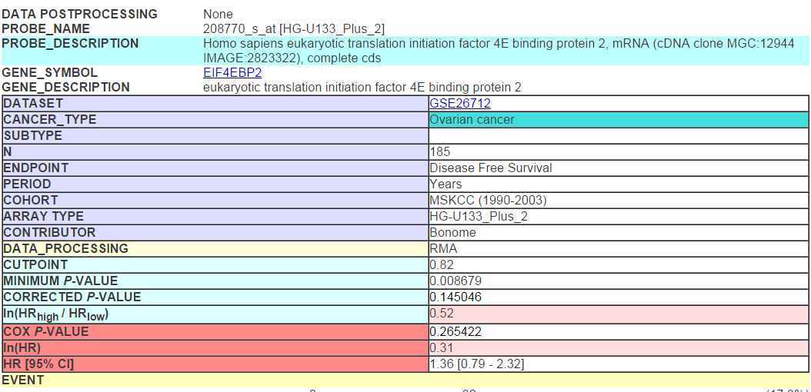
EIF4EBP2
http://www.abren.net/PrognoScan-cgi/PrognoScan.cgi?TITLE=Prognostic+value%20of%20EIF4EBP2%20mRNA%20expression%20in%20Ovarian%20cancer&DATA_POSTPROCESSING=None&TEST_NUM=106&PROBE_ID=4018186&MODE=SHOW_GRAPH

Slide 39
Many of them such as HMOX1, TGFBI, LY6D, S100P, EIF4EBP2, DHRS2, and PCSK9 have been involved in apoptosis, cell cycling/proliferation, cell adhesion/migration, transcription regulation, and signal transduction.
Suppression of annexin A11 in ovarian cancer: implications in chemoresistance.
Song J1, Shih IeM, Chan DW, Zhang Z.
http://www.empiregenomics.com/search/gene/EIF4EBP2/articles

Slide 40
GO analysis
Biological process
Molecular function
cellular_component

Slide 41
Term | Sample frequency | Expected | P-value
positive regulation of mitochondrion organization (GO:0010822) | 2 | 2.128e-02 | 3.921e-04
regulation of G-protein activated inward rectifier potassium channel activity (GO:1900128) | 1 | 3.669e-04 | 7.337e-04
regulation of mitochondrion organization (GO:0010821) | 2 | 3.265e-02 | 9.179e-04
regulation of inward rectifier potassium channel activity (GO:1901979) | 1 | 7.338e-04 | 1.467e-03
positive regulation of mitochondrial translation (GO:0070131) | 1 | 7.338e-04 | 1.467e-03
renal sodium ion absorption (GO:0070294) | 1 | 1.468e-03 | 2.933e-03
renal sodium ion transport (GO:0003096) | 1 | 1.835e-03 | 3.666e-03
mitochondrial respiratory chain complex IV assembly (GO:0033617) | 1 | 1.835e-03 | 3.666e-03
regulation of mitochondrial translation (GO:0070129) | 1 | 1.835e-03 | 3.666e-03
mitochondrial respiratory chain complex IV biogenesis (GO:0097034) | 1 | 1.835e-03 | 3.666e-03
positive regulation of mitochondrial outer membrane permeabilization involved in apoptotic signaling pathway (GO:1901030) | 1 | 2.935e-03 | 5.863e-03
protein homooligomerization (GO:0051260) | 2 | 8.439e-02 | 5.973e-03
protein complex assembly (GO:0006461) | 3 | 3.181e-01 | 6.056e-03
protein complex biogenesis (GO:0070271) | 3 | 3.196e-01 | 6.136e-03
regulation of translation (GO:0006417) | 2 | 9.356e-02 | 7.309e-03
renal absorption (GO:0070293) | 1 | 4.770e-03 | 9.520e-03
positive regulation of organelle organization (GO:0010638) | 2 | 1.075e-01 | 9.582e-03

Slide 42
Term | Sample frequency | Expected | P-value
angiostatin binding (GO:0043532) | 1 | 7.338e-04 | 3.668e-03
ATPase inhibitor activity (GO:0042030) | 1 | 7.338e-04 | 3.668e-03
eukaryotic initiation factor 4E binding (GO:0008190) | 1 | 2.568e-03 | 1.283e-02
ATPase regulator activity (GO:0060590) | 1 | 6.237e-03 | 3.110e-02
translation initiation factor binding (GO:0031369) | 1 | 7.338e-03 | 3.657e-02
inward rectifier potassium channel activity (GO:0005242) | 1 | 7.705e-03 | 3.840e-02
binding (GO:0005488) | 8 | 4.540e+00 | 5.383e-02
phosphatidylinositol-4,5-bisphosphate binding (GO:0005546) | 1 | 1.394e-02 | 6.929e-02
ATPase binding (GO:0051117) | 1 | 1.431e-02 | 7.110e-02
phosphatidylinositol bisphosphate binding (GO:1902936) | 1 | 1.908e-02 | 9.460e-02
protein homodimerization activity (GO:0042803) | 2 | 2.308e-01 | 1.038e-01
phosphatidylinositol phosphate binding (GO:1901981) | 1 | 3.045e-02 | 1.503e-01
voltage-gated potassium channel activity (GO:0005249) | 1 | 3.119e-02 | 1.538e-01
potassium channel activity (GO:0005267) | 1 | 4.293e-02 | 2.107e-01
nucleotide binding (GO:0000166) | 3 | 8.329e-01 | 2.114e-01

Slide 43
Term | Sample frequency | Expected | P-value
mitochondrial membrane (GO:0031966) | 3 | 1.941e-01 | 5.108e-03
mitochondrial envelope (GO:0005740) | 3 | 2.073e-01 | 6.185e-03
mitochondrial membrane part (GO:0044455) | 2 | 5.760e-02 | 9.873e-03
mitochondrial part (GO:0044429) | 3 | 2.954e-01 | 1.715e-02
organelle envelope (GO:0031967) | 3 | 3.276e-01 | 2.306e-02
envelope (GO:0031975) | 3 | 3.291e-01 | 2.335e-02
integral component of mitochondrial inner membrane (GO:0031305) | 1 | 5.504e-03 | 3.843e-02
intrinsic component of mitochondrial inner membrane (GO:0031304) | 1 | 5.504e-03 | 3.843e-02
mitochondrial inner membrane (GO:0005743) | 2 | 1.365e-01 | 5.328e-02
mitochondrial proton-transporting ATP synthase complex (GO:0005753) | 1 | 8.072e-03 | 5.630e-02
proton-transporting ATP synthase complex (GO:0045259) | 1 | 8.439e-03 | 5.885e-02
organelle inner membrane (GO:0019866) | 2 | 1.512e-01 | 6.488e-02
integral component of mitochondrial membrane (GO:0032592) | 1 | 1.358e-02 | 9.447e-02
intrinsic component of mitochondrial membrane (GO:0098573) | 1 | 1.394e-02 | 9.700e-02
mitochondrion (GO:0005739) | 3 | 5.650e-01 | 1.054e-01
proton-transporting two-sector ATPase complex (GO:0016469) | 1 | 1.761e-02 | 1.223e-01
presynaptic membrane (GO:0042734) | 1 | 2.055e-02 | 1.425e-01

