Slide 1
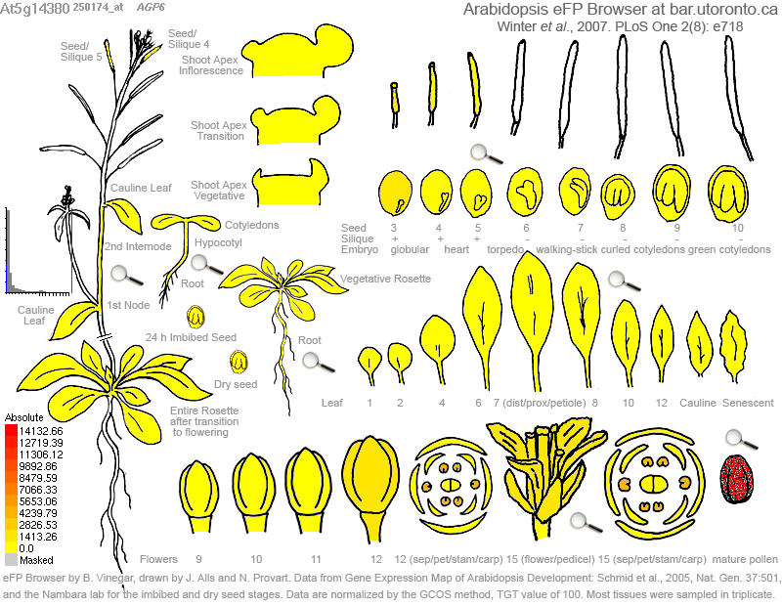

At5G14380 (AGP6)

Slide 2
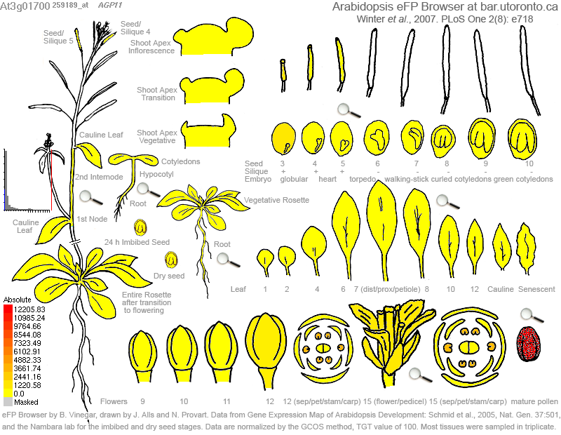

At3G01700 (AGP11)

Slide 3
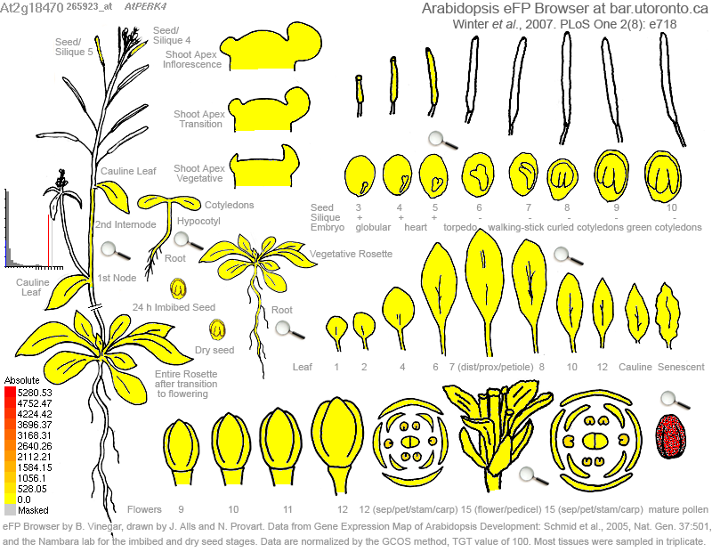

At2G18470 (PERK4)

Slide 4
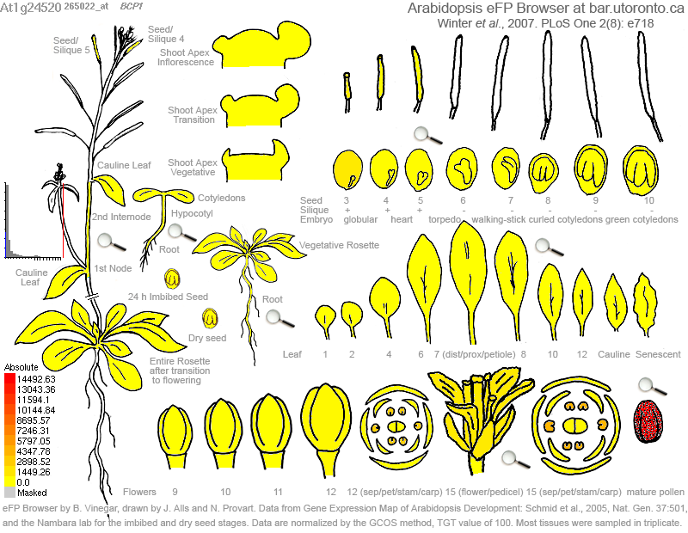

AT1G24520 (AGP50C)

Slide 5


At1G49490 (PEX2)

Slide 6


At4G33970 (PEX4)

Slide 7


At2G24450 (FLA3)

Slide 8


At4G34440 (PERK5)

Slide 9
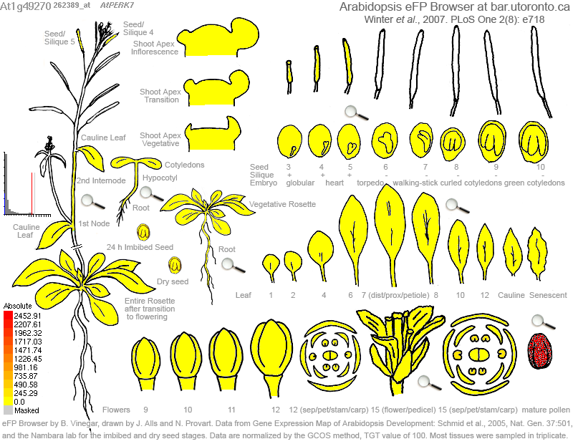

At1G49270 (PERK7)

Slide 10


At1G51915 (AGP42)

Slide 11


At2G28440 (AGP54)

Slide 12


At3G19020 (PEX1)

Slide 13


AT3G57690 (AGP23)

Slide 14


At1G23540 (PERK12)

Slide 15


At2G15880 (PEX3)

Slide 16


At3G18810 (PERK6)

Slide 17


At1G10620 (PERK11)

Slide 18


At5G40730 (AGP24)

Slide 19


At3G20865 (AGP40)

Slide 20
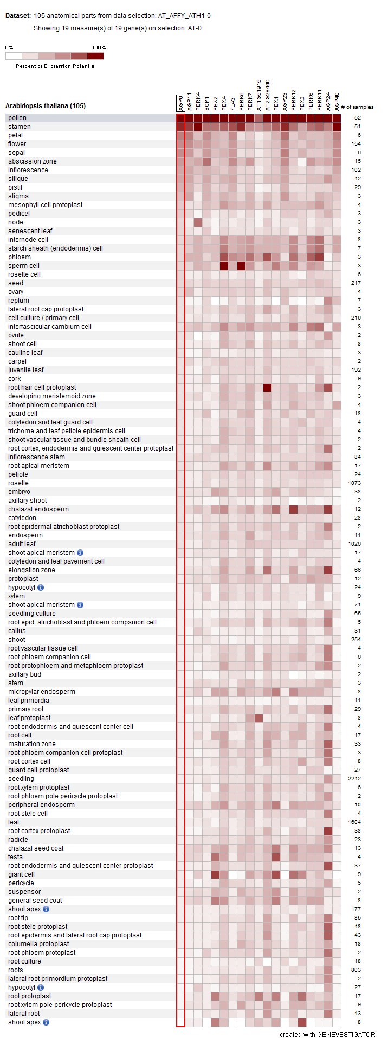
Gene investigator result

