Slide 1
TensorFlow Object Detection API Tutorial
Yichao Li

Slide 2
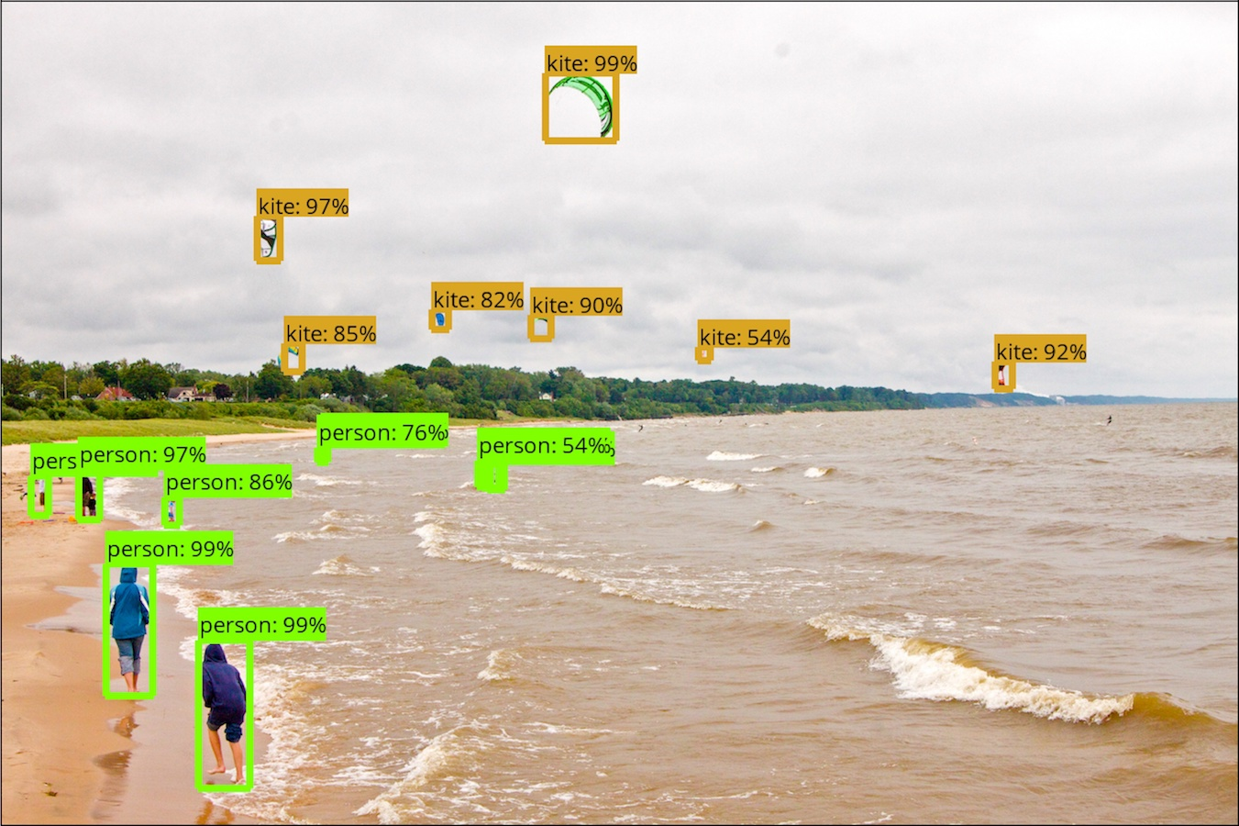
Outline
12/4
How to use TensorFlow Object Detection API

Slide 3
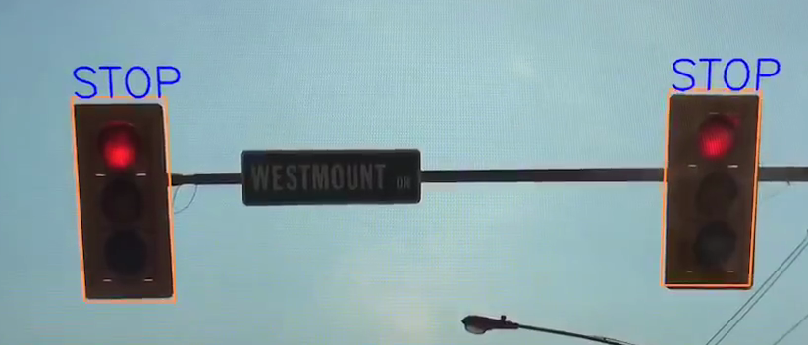
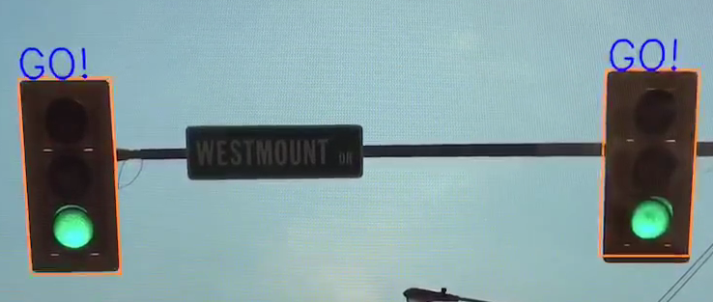
Outline
12/4
How to use TensorFlow Object Detection API

Slide 4
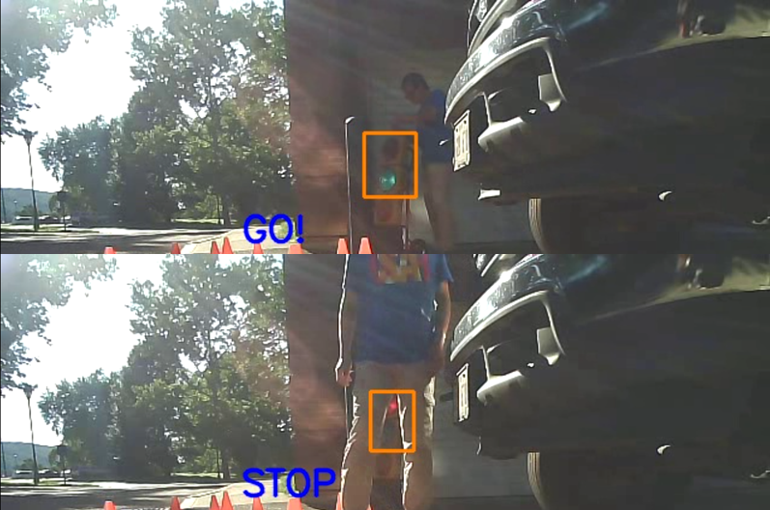
Outline
12/4
How to use TensorFlow Object Detection API
12/6
How to train your own object detection model

Slide 5
TensorFlow
Initial release‎: ‎November 9, 2015

Slide 6
Installation (Windows)
Download and install Python 3 (anaconda)
https://www.anaconda.com/download/
~30 min
Open anaconda prompt
Install TensorFlow
GPU version:
CUDA Toolkit & cuDNN ()
CPU version

Slide 7
Test TensorFlow
import tensorflow as tf
hello = tf.constant('Hello, TensorFlow!')
sess = tf.Session()
print(sess.run(hello))

Slide 8
Installation (cont.)
Install TensorFlow Object Detection API
Download (~5min) https://github.com/tensorflow/models.git
Install https://github.com/protocolbuffers/protobuf
Windows users have to use v3.4
# From tensorflow/models/research/
protoc object_detection/protos/*.proto --python_out=.
Add to environment variable
# From tensorflow/models/research/
export PYTHONPATH=$PYTHONPATH:`pwd`:`pwd`/slim

Slide 9
Test demo
Jupyter notebook

Slide 10
Test a traffic light image
Jupyter notebook

Slide 11
Create your own training samples
https://github.com/tzutalin/labelImg

Slide 12
Next lecture
Train your own model
OpenCV video
OpenCV camera

