Slide 1
TensorFlow Object Detection API Tutorial
Yichao Li

Slide 2
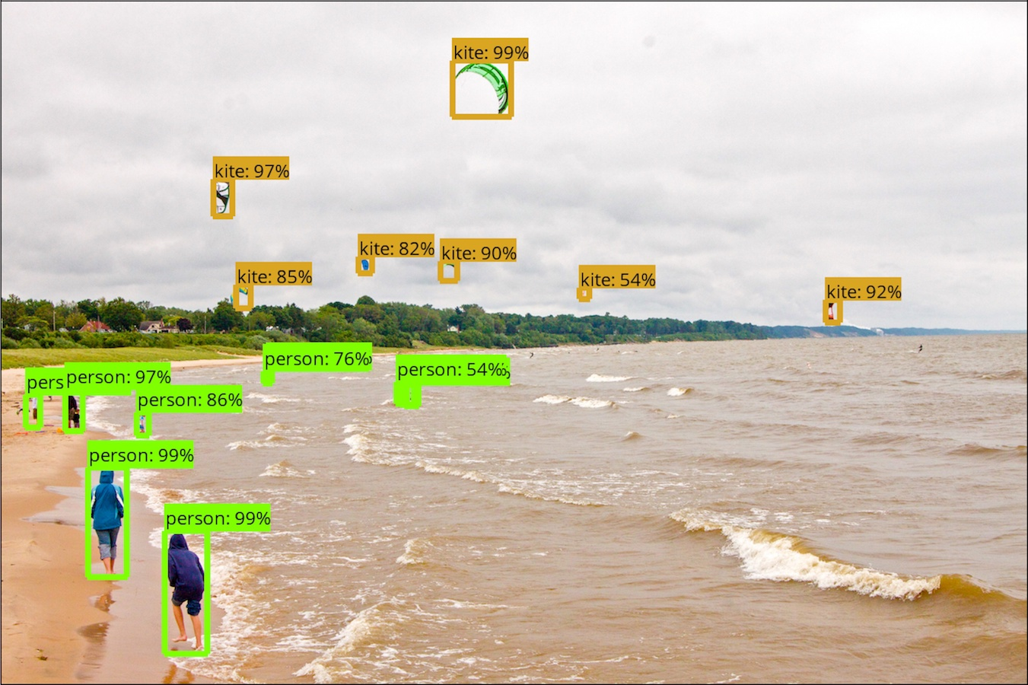
Outline
12/4
How to use TensorFlow Object Detection API

Slide 3
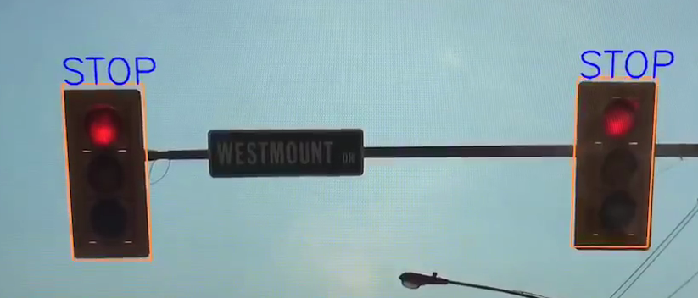
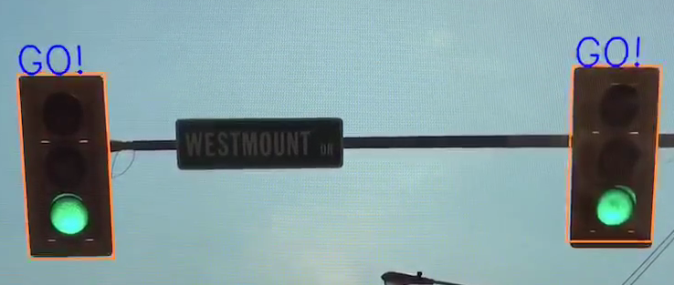
Outline
12/4
How to use TensorFlow Object Detection API

Slide 4
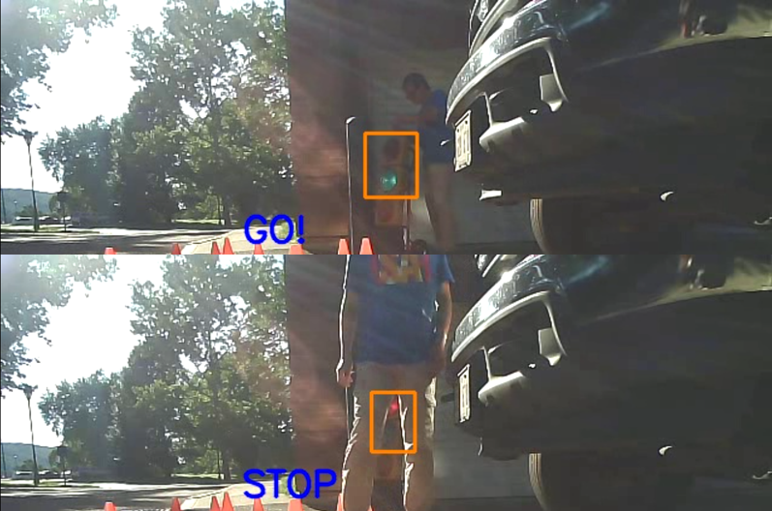
Outline
12/4
How to use TensorFlow Object Detection API
12/6
How to train your own object detection model

Slide 5
Installation TensorFlow
Download and install Python 3 (anaconda)
https://www.anaconda.com/download/
~30 min
Open anaconda prompt
Install TensorFlow
GPU version
Ref: https://www.pugetsystems.com/labs/hpc/The-Best-Way-to-Install-TensorFlow-with-GPU-Support-on-Windows-10-Without-Installing-CUDA-1187/
CPU version
conda install -c conda-forge tensorflow

Slide 6
Test TensorFlow
import tensorflow as tf
hello = tf.constant('Hello, TensorFlow!')
sess = tf.Session()
print(sess.run(hello))

Slide 7
Install TensorFlow Object Detection API
Download (~5min) https://github.com/tensorflow/models.git
Install https://github.com/protocolbuffers/protobuf
use v3.4
# From tensorflow/models/research/
protoc object_detection/protos/*.proto --python_out=.
Add to environment variable
# From tensorflow/models/research/
models\research
models\research\slim
Possibly need to reboot

Slide 8
Test demo
Run Jupyter notebook:
object_detection_tutorial.ipynb
Exercise:
Put some of your favorite images into test_images folder
Name them as image{}.jpg
Run the notebook again
Notes:
30 min

Slide 9
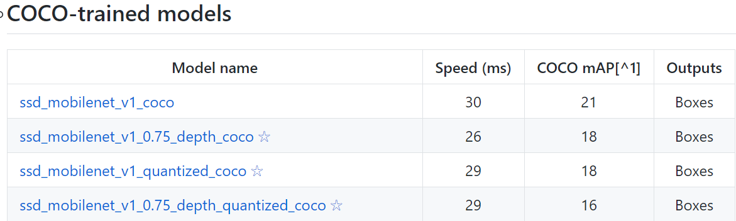
TensorFlow pretrained models
https://github.com/tensorflow/models/blob/master/research/object_detection/g3doc/detection_model_zoo.md

Slide 10
Test demo
Run Jupyter notebook:
object_detection_tutorial.ipynb
Exercise:
Put some of your favorite images into test_images folder
Name them as image{}.jpg
Run the notebook again
Exercise:
Use a different pretrained model
Run the notebook again

Slide 11
Detect a traffic light
Jupyter notebook
Output “Stop” when the traffic light is red
Exercise
Output “GO” when the traffic light is green
Notes:
20

Slide 12
Create your own training samples
https://github.com/tzutalin/labelImg
Hotkeys:
W: draw a region
A: previous
D: next
Save : Ctrl + S
Notes:
10

Slide 13
Homework
Generate some training samples for the next lecture

Slide 14
Next lecture
Train your own model
OpenCV video
OpenCV camera

Slide 15
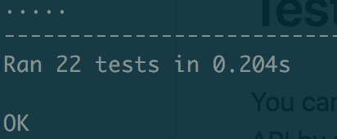
Recap of last lecture
Anaconda (Python)
TensorFlow
Use LabelImg to create training samples
TensorFlow Obj API
Protobuf
Add env var
python object_detection/builders/model_builder_test.py
Test installation

Slide 16
Generate TFRecords Format training samples
Use LabelImg to create training samples
All images have to be in the same folder
Dependencies
Move output csv to the image folder
Pandas
Pillow
xml_to_csv.py
python xml_to_csv.py
generate_tfrecord.py
python generate_tfrecord.py --csv_input traffic_light_labels.csv --output_path=train.record
Train.record
conda install -c anaconda pandas
conda install -c anaconda pillow

Slide 17
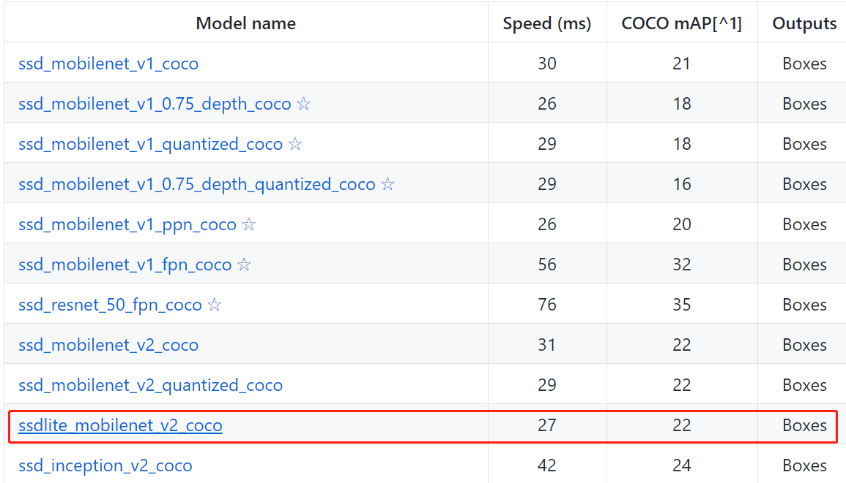
Download a model from https://github.com/tensorflow/models/blob/master/research/object_detection/g3doc/detection_model_zoo.md
Uncompress the file

Slide 18
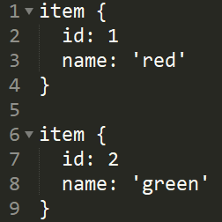
Create a data folder, call it data2/
In the folder:
Copy train.record to this folder
Copy pipeline.config (from the downloaded model)
Create a label.txt file shown below

Slide 19
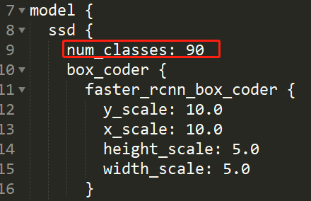
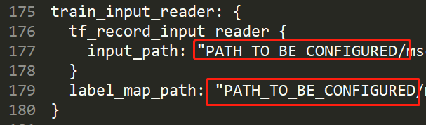
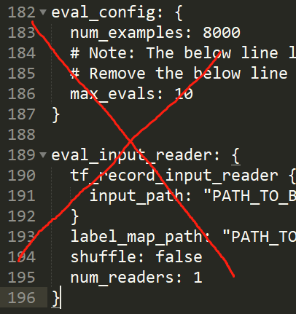
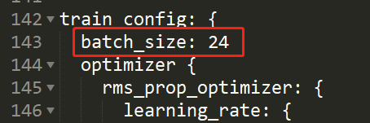
Edit ssdlite_mobilenet_v2_coco.config
This file is inside object_detection/samples/configs
Copy it to data2/ then edit it
Delete them

Slide 20
Train a model (transfer learning)
OLD API training command:
python train.py --logtostderr --train_dir=model_from_data2/ --pipeline_config_path=data2/ssdlite_mobilenet_v2_coco.config
NEW command
python object_detection/model_main.py --pipeline_config_path=data2/ssdlite_mobilenet_v2_coco.config --model_dir=model_from_data2/ --num_train_steps=500

Slide 21
Export graph
python export_inference_graph.py --input_type image_tensor --pipeline_config_path data2/ssdlite_mobilenet_v2_coco.config --trained_checkpoint_prefix model_from_data2/model.ckpt-237 --output_directory traffic_inference_graph
Space is denoted by _

Slide 22
Test the trained model
Lecture-2-test-traffic-light-image.ipynb
vision-own-model.py

