Slide 1
TensorFlow Object Detection API Tutorial
Yichao Li

Slide 2
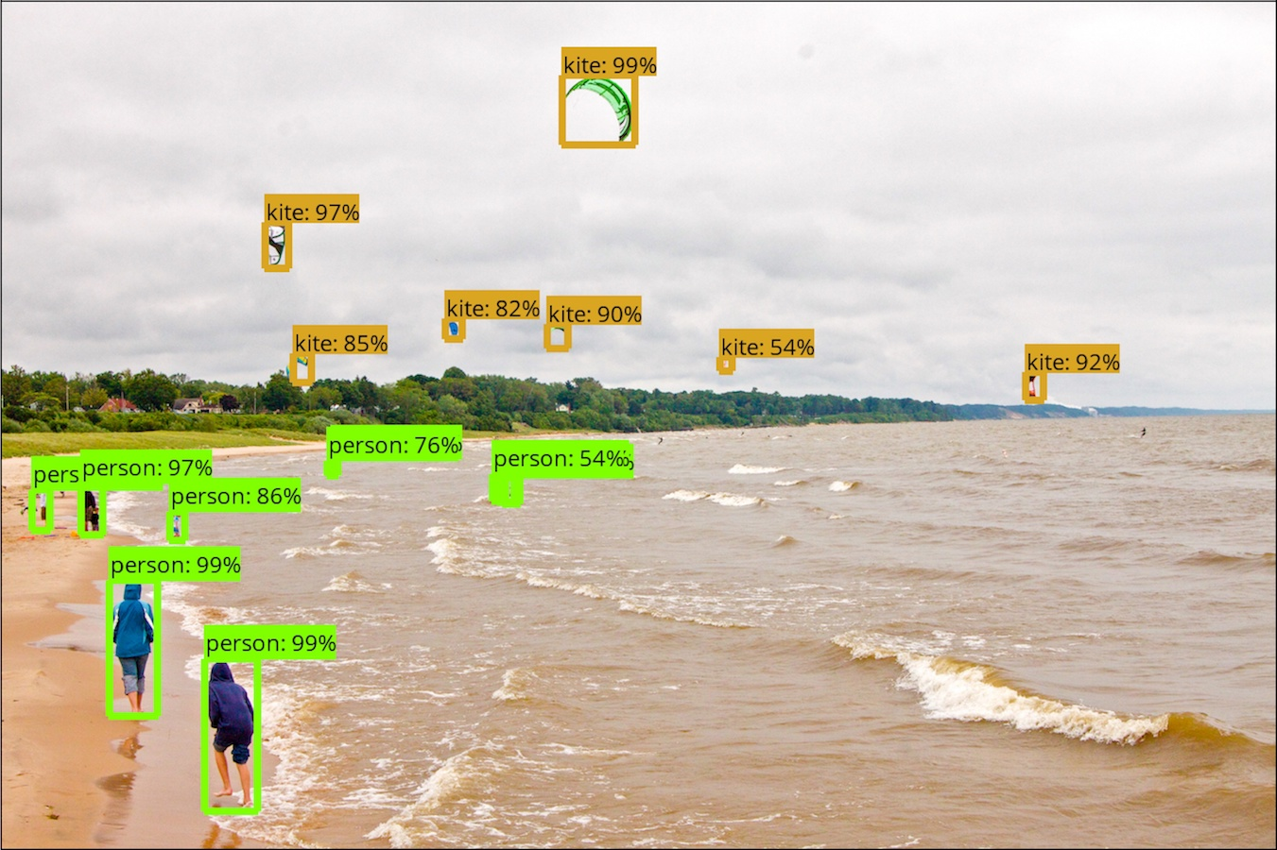
Outline
12/4
How to use TensorFlow Object Detection API

Slide 3
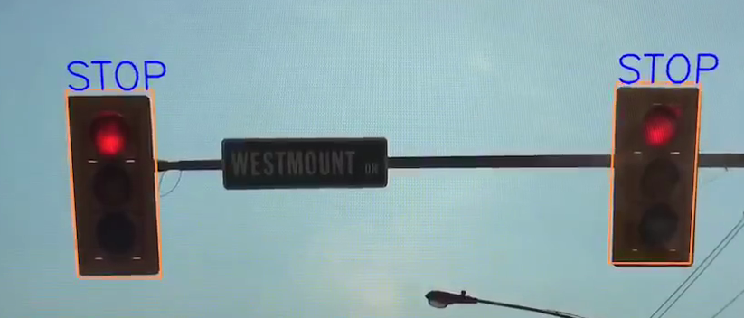
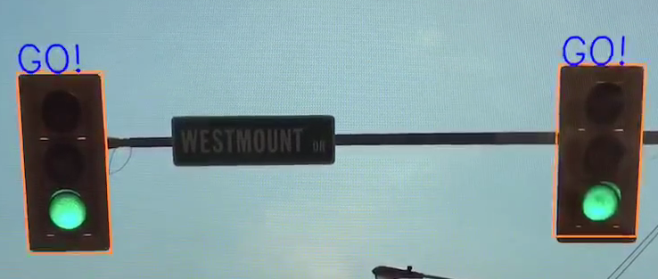
Outline
12/4
How to use TensorFlow Object Detection API

Slide 4
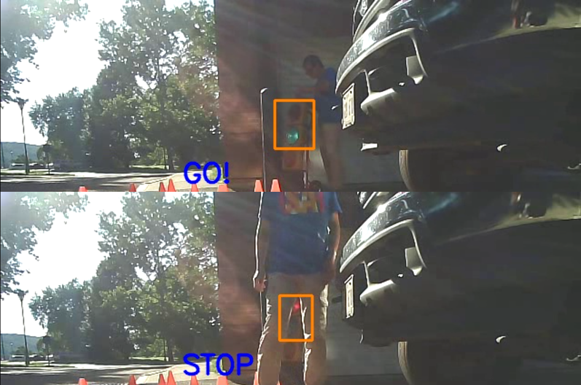
Outline
12/4
How to use TensorFlow Object Detection API
12/6
How to train your own object detection model

Slide 5
Installation TensorFlow
Download and install Python 3 (anaconda)
https://www.anaconda.com/download/
~30 min
Open anaconda prompt
Install TensorFlow
GPU version
Ref: https://www.pugetsystems.com/labs/hpc/The-Best-Way-to-Install-TensorFlow-with-GPU-Support-on-Windows-10-Without-Installing-CUDA-1187/
CPU version
conda install -c conda-forge tensorflow

Slide 6
Test TensorFlow
import tensorflow as tf
hello = tf.constant('Hello, TensorFlow!')
sess = tf.Session()
print(sess.run(hello))

Slide 7
Install TensorFlow Object Detection API
Download (~5min) https://github.com/tensorflow/models.git
Install https://github.com/protocolbuffers/protobuf
use v3.4
# From tensorflow/models/research/
protoc object_detection/protos/*.proto --python_out=.
Add to environment variable
# From tensorflow/models/research/
models\research
models\research\slim
Possibly need to reboot

Slide 8
Test demo
Run Jupyter notebook:
object_detection_tutorial.ipynb
Exercise:
Put some of your favorite images into test_images folder
Name them as image{}.jpg
Run the notebook again

Slide 9
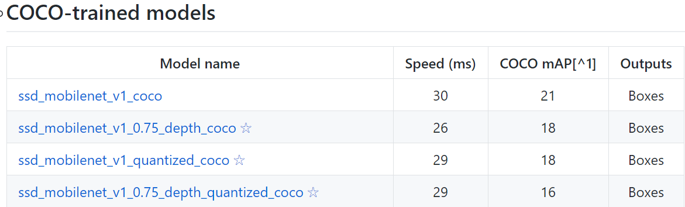
TensorFlow pretrained models
https://github.com/tensorflow/models/blob/master/research/object_detection/g3doc/detection_model_zoo.md

Slide 10
Test demo
Run Jupyter notebook:
object_detection_tutorial.ipynb
Exercise:
Put some of your favorite images into test_images folder
Name them as image{}.jpg
Run the notebook again
Exercise:
Use a different pretrained model
Run the notebook again

Slide 11
Detect a traffic light
Jupyter notebook
Output “Stop” when the traffic light is red
Exercise
Output “GO” when the traffic light is green

Slide 12
Create your own training samples
https://github.com/tzutalin/labelImg
Hotkeys:
W: draw a region
A: previous
D: next
Save : Ctrl + S

Slide 13
Homework
Generate some training samples for the next lecture

Slide 14
Next lecture
Train your own model
OpenCV video
OpenCV camera

