Slide 1

DATS6312– Natural Language Processing
Final Project Presentation:
NLP Applications in Business Healthcare
From Social Media Shortage Detection to Medical AI Agent
Yichen Wang Ph.d. Student Department of Information Systems & Technology Management School of Business, The George Washington University

Slide 2
Healthcare Application: Challenges
Challenge 1: Early Signal Detection
Challenge 2: Medical Knowledge Access
Physicians repeatedly answer the same refractive surgery questions
General-purpose LLMs hallucinate clinical specifics and cite stale data
Need: Accurate, traceable, evidence-based answers for patients
Approach: RAG — retrieve AAO guidelines → ground LLM generation
GLP-1 drug shortages affect patient access & treatment continuity
Patient experiences embedded in noisy Reddit posts before official reports
Need: Transform ~800K unstructured posts into shortage signals
Approach: Fine-tuned RoBERTa encoder — binary classification
PART 1: Encoder NLP
PART 2: Medical RAG
Drug Shortage Detection from Reddit
(RoBERTa · 800K posts · F1=0.87)
Ophthalmology Follow-up Assistant
(DeepSeek · 800 docs · +43.4% quality)

Slide 3
Whole Picture
Aspect | PART 1: Shortage Detection | PART 2: Medical RAG
Input Data | 800K Reddit posts (14–16 subreddits) | 25 patient questions
Knowledge Base | 1,200 labeled posts (κ=0.85) | 800 medical docs (2.27M chars)
Method | Supervised encoder classification | Retrieval + generation (RAG)
Core Model | RoBERTa-base (fine-tuned) | BGE embeddings + DeepSeek-R1:1.5b
Output | Binary shortage signals | Natural language answers
Evaluation | F1 = 0.87 (shortage class) | Physician 5-pt rating: 4.36/5
Downstream Use | VAR model + GNN forecasting | Patient education & physician support Application

Slide 4
PART 1 — Drug Shortage Detection: Problem & Motivation
Context: GLP-1 Receptor Agonist Shortages (2010–2025)
Medications: Ozempic · Wegovy · Rybelsus · Victoza · Mounjaro · Zepbound | Affects patient access, treatment continuity & medication switching decisions
Traditional Data Gap
NLP Task Defined
Key Challenges
Business Question
FDA reports & manufacturer announcements are lagging indicators (don't capture real-time information)
Binary classification: given Reddit post → shortage-related (1) vs. non-shortage (0)
· Noisy informal text
· Class imbalance
· No-label Data
Can social media discussions predict prescription behavior changes and serve as leading indicators?

Slide 5
PART 1— Dataset & Processing Pipeline
Dataset Facts
Pipeline Architecture
~800K
Reddit posts & comments
Reddit Collection (800K posts)
14–16
Manual Labeling (1,200 posts · κ=0.95)
GLP-1 related subreddits
RoBERTa Fine-tuning (60/20/20 split)
Jan 2010
– Jan 2025 timespan
Full Corpus Prediction (batch inference)
1,200
Manually labeled posts
LLM Filtering — o3-mini multi-layer prompting
421
Shortage-related (label=1)
52,866 Shortage Posts Identified ✓
κ = 0.95
Cohen's Kappa (2 RAs + GPT)
LDA Topic Modeling (10 topics)
95.6%
Overall annotation agreement
Weekly Time-Series → VAR + GNN Downstream

Slide 6
PART 1 — Model Architecture & Hyperparameters
Model Architecture
Hyperparameter Settings
Two-Stage Filtering
Input: Reddit Post xᵢ
Hyperparameter | Baseline | Improved
Model | RoBERTa-base | RoBERTa-base
Batch size | 16 | 16
Learning rate | 2e-5 | 3e-5
Max seq length | 128 tokens | 512 tokens
Weight decay | 0.01 | 0.02
Warmup steps | — | 500
Early stopping | — | Patience = 3
Loss function | Cross-entropy | Weighted CE
Layer freezing | None | Embed + layers 1–8
800,000
Full Reddit corpus
RoBERTa Tokenizer → [CLS] t₁…tₙ [SEP]
→ 88,554
RoBERTa predictions (shortage=1)
RoBERTa Encoder — 12 Transformer Layers
→ 52,866
After o3-mini LLM filtering
hᵢ = Encoder(xᵢ) [768-dim representation]
Classification Head: zᵢ = Whᵢ + b
0.87
0.94
P(yᵢ=1|xᵢ) = softmax(zᵢ)₁
F1 Score
(Shortage Class)
F1 Score
(Non-Shortage Class)

Slide 7
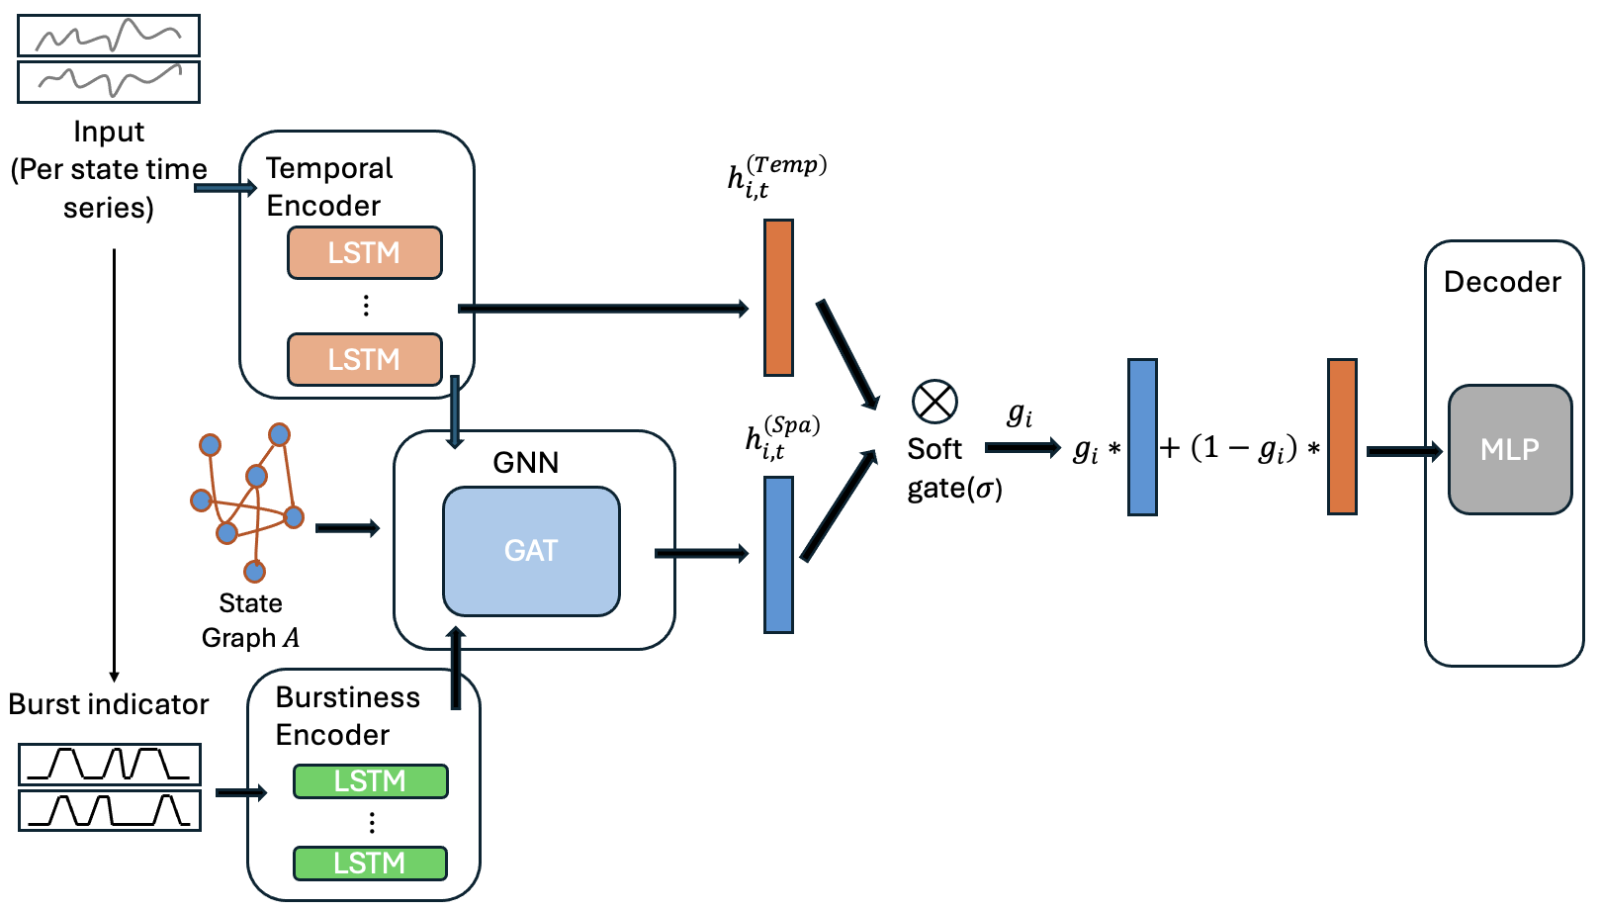
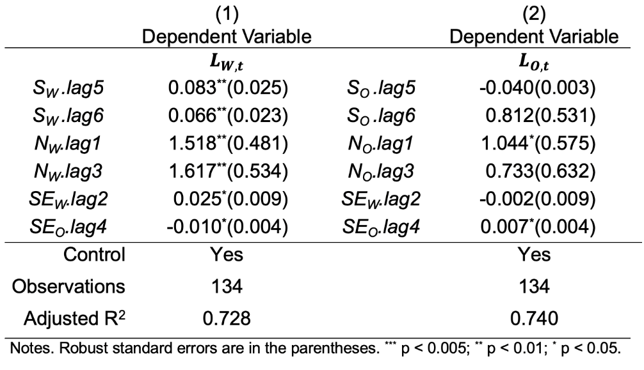
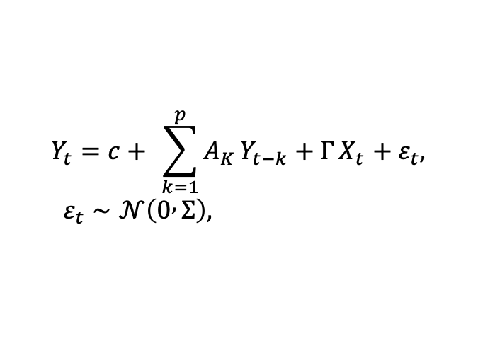
Next: Enhanced Causality and Prediction Power (Downstream Business Value)
Model Architecture
Causality with Social Media (VAR MODEL)
$$Y_{t}=c+ \sum_{k=1}^{p}{A_{K}}Y_{t−k}+Γ X_{t} +ε_{t}, ε_{t}∼𝒩\left(0 , Σ\right),$$
Temporal Encoder (LSTM) → h_i^Temp
GNN → h_i^Spa
Burstiness Encoder (LSTM) — Burst indicator

Slide 8
Next: GNN Forecasting Results: Impact of Social Media Features
Improvement Over Best Baseline (NBEATS)
Model | MAE | RMSE | MAPE | sMAPE
LSTM | 226.97 | 419.74 | 15.3% | 15.5%
NHiTS | 225.66 | 409.38 | 16.0% | 15.2%
NBEATS | 221.72 | 409.13 | 14.8% | 14.8%
LSTM + Burst + GATED GNN (with Social Media) | 182.19 | 336.90 | 12.7% | 13.0%
MAE
221.72 → 182.19
▼ 17.8% improvement
RMSE
409.13 → 336.9
▼ 17.7% improvement
MAPE
14.8 → 12.7
▼ 14.2% improvement
sMAPE
14.8 → 13
NEW DESIGN is the best model across all 4 metrics
▼ 12.2% improvement
Social media NLP signals (52,866 Reddit shortage posts) provide leading indicator advantage，
consistently outperforming all Rx-data-only baselines across every metric

Slide 9
PART 2 — Medical RAG: Problem & Motivation
Context: Refractive Surgery Post-Operative Care (LASIK · PRK · SMILE)
Physicians frequently answer the same recovery, complication & procedure questions. General LLMs hallucinate specifics or cite discontinued techniques based on the limitation of model
Field-Specific
Accuracy
Empathy
Traceability
Grounded in AAO Preferred
Practice Patterns (PPP 2024) and related notebook
No hallucinated
Zero dangerous responses (score=1)
Patient-appropriate language
Compassionate medical persona
Source attribution to specific
guideline & book
Solution: RAG + LLM → traceable, safe patient answers

Slide 10
PART 2 — Medical Document Dataset & Preprocessing
Dataset Statistics
Chunking Pipeline
800
Total medical documents (CHINESE)
PDF Splitting
Files >30 pages → 10-page chunks, 1-page overlap. Original 37 large files → 800 processable documents (<7MB each)
784
PDF files (ophthalmology textbooks + PPP)
Table Extraction
16
Word docs (clinical protocols)
PyMuPDF table detection → Markdown format + metadata. Captures surgical outcome tables & clinical comparison data
2.27M
Total characters
Image/OCR Extraction
37 → 800
Large PDFs expanded (10-pg chunks)
Bounding box coordinates + OCR for embedded text. Anatomical diagrams stored as searchable image-caption metadata
4,119
Final text chunks (avg 45/doc)
Recursive Chunking
800 chars
Chunk size · 100-char overlap
800-char chunks, 100-char overlap into 4,119 chunks. Metadata: source doc, page, content type, section hierarchy

Slide 11
PART 2 — Two-Stage RAG Architecture
Stage 1: Retrieval (Semantic Search)
Stage 2: Generation (Conditioned LLM)
Patient Query q
Prompt = [System Role: Compassionate Ophthalmologist]
+ [Retrieved Medical References D]
+ [Patient Question q]
BGE Embeddings: BAAI/bge-base-zh-v1.5
12 layers · 768-dim · 512 max tokens
DeepSeek-R1:1.5b via Ollama (local)
1.5B params · 934MB · Temperature T=0.7
Mean pooling: e = mean([h₁,…,hₙ])
ChromaDB HNSW indexing
Cosine similarity(q, d) = q·d / (||q||·||d||)
Response r: 150–200 words
Evidence-based · Source-attributed
Retrieve top-k=2 docs where sim > τ=0.5
(0.011s on A10G GPU — 100× CPU speedup)
Hyperparameters optimized on 10 held-out dev questions: top-k=2 · τ=0.5 · 300 chars/chunk · T=0.7
validated before final 25-question evaluation

Slide 12
PART 2 — Physician Evaluation Framework
Test Set: 25 Patient Questions (Ophthalmologist-Curated)
Controlled Evaluation Design
1
General procedure information
Condition A: Without RAG (Baseline)
LASIK/PRK/SMILE basics, how it works
LLM uses only parametric (training) knowledge — represents current common practice (patients using general-purpose LLMs)
2
Eligibility criteria
Candidacy requirements, contraindications
Condition B: With RAG
LLM conditioned on top-k=2 retrieved AAO medical documents — identical system prompt, only difference is knowledge grounding
3
Safety & complications
Risks, side-effects, risk quantification
Controlled Variables
4
Recovery & outcomes
Same system prompt (compassionate ophthalmologist persona) · Same 25 questions · Physician blinded to condition during scoring
Timelines, activity restrictions, healing
5-Point Physician Scoring Rubric
5
Procedure comparisons
1=Incorrect/dangerous · 2=Poor · 3=Adequate · 4=Good · 5=Accurate & complete; based on factual correctness, completeness, safety & appropriateness
LASIK vs PRK vs SMILE trade-offs

Slide 13
PART 2 — EXAMPLES
Question | Answer_NoRAG | Score_NoRAG | Answer_WithRAG | Score_WithRAG
1. What is refractive surgery? | Refractive surgery is a specialized eye care procedure aimed at correcting vision by altering the shape of the eye's lens. It targets areas where light needs to be properly focused, often requiring significant restructuring or removal of tissue around prescriptions. This allows clear lenses to focus on all parts of the eye, enhancing vision without heavy use in sensitive areas. Typically done by optometrists, it can improve conditions like myopia, hyperopia, or presbyopia. It's recommended for those with complex prescriptions or limited near vision, providing a way to maintain clear vision while minimizing discomfort. | 3 | **Refraction Surgery Explained** **What is Refraction Surgery?** Refraction surgery involves altering the shape of an eye to correct vision issues like myopia (nearsightedness), hyperopia (farsightedness), or astigmatism. It uses advanced technologies like corneal photocoherence to create artificial lenses. **Risks and Considerations:** - **Side Effects:** Some patients may experience discomfort, nausea, or difficulty concentrating during surgery. - **Post-Surgical Concerns:** If vision remains unclear after the procedure, further testing might be recommended. They’ll need clear glasses or contact lenses tailored to their needs. **Types of Refraction Surgery:** - **Keratoconstrictive Surgery:** Typically used for mild myopia or hyperopia. - **Keratopraxia (Topical/Regional Anesthesia):** May provide a more comfortable experience by reducing discomfort but may require local anesthesia. **What to Expect:** After surgery, patients may have difficulty concentrating. It’s essential to guide them through the recovery process and remind them to consult their eye care physician for personalized advice. Letting your patient know that refractive surgery is a treatment option for vision correction can empower them. | 4
2. Can I have both eyes treated at the same time? | Yes, certain ophthalmological treatments can indeed be performed on both eyes simultaneously. For example, laser therapy for glaucoma and photorenearctomy for cataracts often involve treating both eyes together to reduce the impact of these conditions. However, most treatments require patient cooperation due to complexity or extensive procedures, necessitating a coordinated approach with a healthcare provider. | 4 | Yes, you can have both eyes treated simultaneously, but the treatment may need to focus on specific areas of each eye that don't interfere with others. For instance, if an issue in the cornea or lens is resolved together with those affecting only one eye, they can be treated at the same time. However, defects in the retina and optic nerve require separate attention for both eyes due to their interconnected nature. It's generally better to treat each eye separately unless combined strategies are safe and effective. Always consult a professional eye doctor for personalized advice. | 5
3. What are the most common complications? | The most common complications of the eye include **cataracts**, which are a significant issue due to their frequent occurrence; **glaucoma**, another prevalent condition characterized by fluid retention inside the lens; **astigmatism** (also known as hyperopia), the most common form; **second degree of maculae damage**, responsible for vision loss later in life; **inherited or inherited eye conditions** such as age-related macular degeneration and cataracts due to genetic mutations; and **age-related changes in vision**, where the eyesight decreases with each year passing. | 2 | The most common complications of corneal refractive issues include: 1. **Dry Eyes**: Inadequate fluids entering the eye due to dryness or excessive sweating. 2. **Scarring (Edema)**: From sunburns, allergies, or infections, leading to redness and sensitivity in the area. 3. **Dehydration**: Inadequate fluids moving within the eye, often caused by sunlight or excessive sweating. 4. **Lubrication Issues**: From skin Scratches or infections that affect fluid movement. 5. **Cataract Formation/Changes**: Development of cataracts due to pressure on the corneum surfaces. 6. **Acute Corneal Damage (Keratopathy)**: Pressure on the back surfaces causing vision issues and discoloration. 7. **Prolonged Use or Injury**: Causing severe changes in corneal structure, often leading to cataracts or other complications. 8. **Atrus/Atoria**: Slowed eye movement, impacting reading and life functions. 9. **Anomalous Corneal Surface**: Affects cataract formation and may lead to sensitivity in the back surfaces. 10. **Pseudorhabesphenoid**: Commonly associated with genetic mutations affecting the epidermis or cornea. 11. **Dry Eyes in Others**: In rare cases, even in patients without eye problems, dryness can manifest elsewhere. 12. **Lacrimofacial Nucleus Mutation**: A genetic condition that may contribute to corneal changes. Additional rare complications include: - **Atrus/Atoria**: Slowed eye movement, impacting life functions. - **Cataract Formation/Changes** (rare). - **Chromophore Dysfunction**: Leading to cataracts and vision changes. - **Acute Chorioretia Syndrome**: Severe back surface pressure causing severe eye damage. These conditions often stem from genetic mutations or structural abnormalities in the cornea. Always consult a ophthalmologist for personalized advice. | 5

Slide 14
Part 2 — Physician Scoring Results
3.04 → 4.36 Mean Physician Score (+1.32 pts · +43.4%) | Median: 3.0 → 4.0 | Range: [2,4] → [3,5] | Zero dangerous responses (1/5) in either condition
Performance by Question Category
Score Level | Without RAG | With RAG
Excellent (5) | 0 questions | 12 questions ▲
Good (4) | 6 questions | 10 questions
Adequate (3) | 14 questions | 3 questions
Poor (2) | 5 questions | 0 questions ▲
Dangerous (1) | 0 questions | 0 questions
Safety / Complications
2.75→4.55
+1.80
Recovery Timelines
3.00→4.55
+1.55
Eligibility Criteria
2.67→4.17
+1.50
Procedure Comparison
3.00→3.88
+0.88
Procedure Basics
3.33→4.13
+0.80
RAG had greatest benefit for questions requiring specific clinical criteria & risk quantification

Slide 15
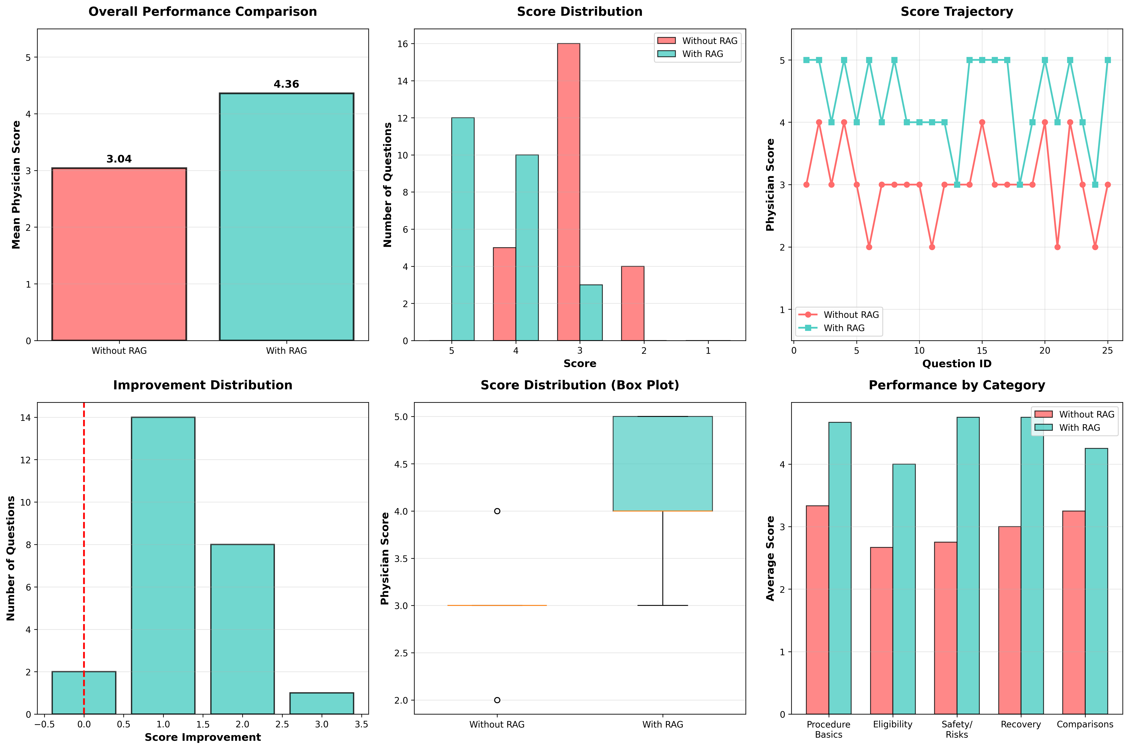
PART 2 — Visual Analysis: 6-Chart Performance Dashboard
① Overall Performance
② Score Distribution
③ Score Trajectory
④ Improvement Distribution
⑤ Box Plot Comparison
⑥ Performance by Category

Slide 16
DATS6312– Natural Language Processing
Thank you for attention!

