Slide 1
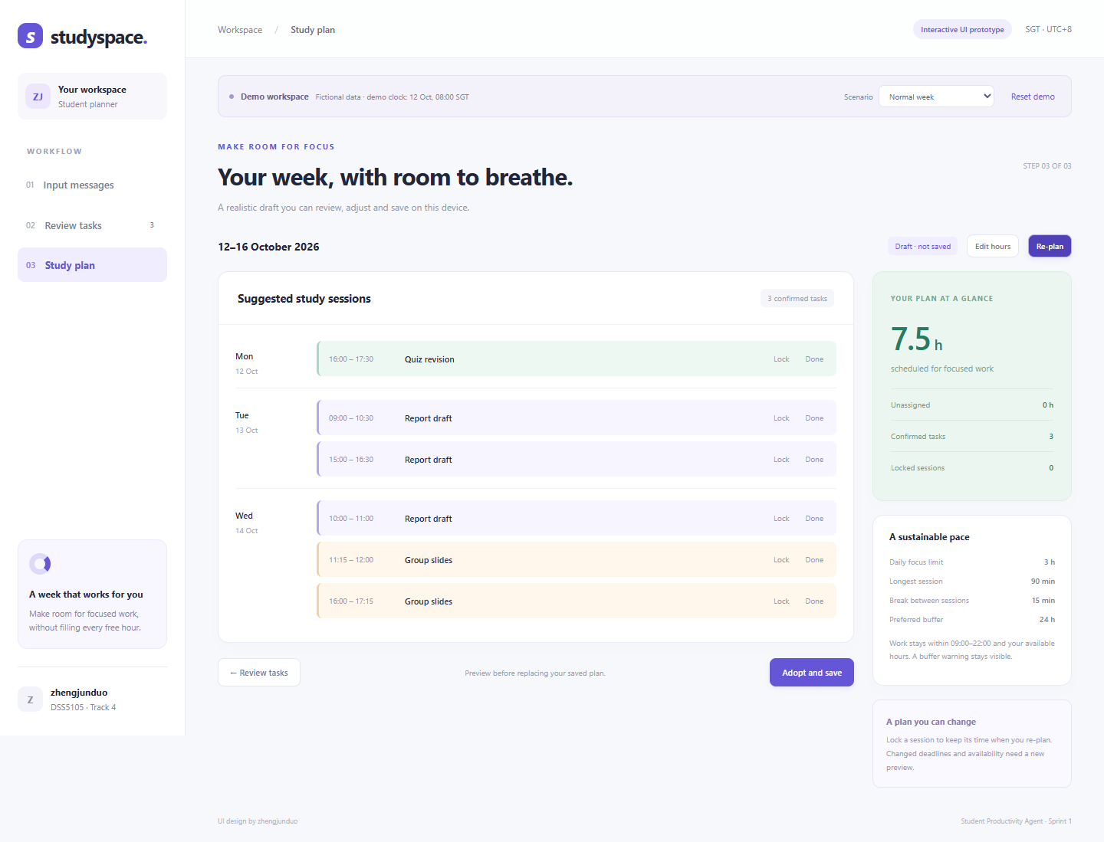
STUDYSPACE / STUDENT PRODUCTIVITY AGENT
An interface students can use
Three connected pages with student confirmation before scheduling
01
Input messages
Paste text or import a CSV.
02
Review tasks
Correct dates against the source.
03
Study plan
Set hours, preview, then save.
Working frontend prototype with fictional demo data
DSS5105 Track 4 / zhengjunduo / Sprint 1
01
Notes:
Slide 1, approximately 30 seconds:
My component is the student interface. It has three connected pages: input messages, review tasks, and study planning. Students can edit deadlines against the original text, add remaining effort, and confirm the tasks they want to schedule. They then set their available hours and preview a plan before saving it.
Team references: https://github.com/YichenLi-02/dss5105-track4/blob/huangpengyu/no5_backendintegration/README.md
https://github.com/YichenLi-02/dss5105-track4/blob/zhaozichen/github_upload/planner/README.md
Screenshots show the locally tested frontend prototype with fictional development data. No live AI or mailbox/calendar integration. Scheduling is a browser simulation, not the final member 4/5 backend. Local browser tests do not establish final model accuracy, time savings or independent evaluation results.

Slide 2
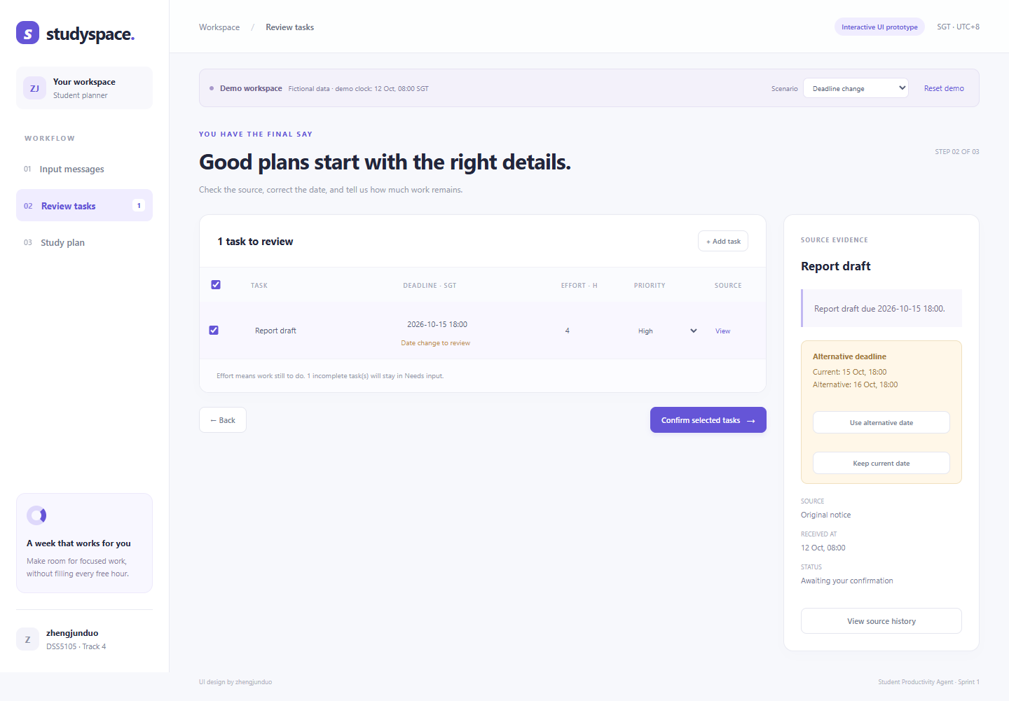
STUDYSPACE / STUDENT PRODUCTIVITY AGENT
Clear decisions when plans change
The UI exposes uncertainty and keeps the previous saved plan safe
Unclear or changed dates
Ask for a date or an explicit choice.
Too little time
Show missing hours for each task.
Progress and re-planning
Record completed work and retain locks.
Next: connect AI extraction and shared backend services
DSS5105 Track 4 / zhengjunduo / Sprint 1
02
Notes:
Slide 2, approximately 30 seconds:
The UI also handles missing dates, conflicting deadline suggestions, and insufficient time. Students can lock a session, record completed work, and re-plan the remaining effort. Saving requires a separate confirmation and restores the workspace after a reload. This is a working frontend prototype with demo extraction and scheduling. Next, I will connect the team’s AI and backend services and test usability with students.
Team references: https://github.com/YichenLi-02/dss5105-track4/blob/huangpengyu/no5_backendintegration/README.md
https://github.com/YichenLi-02/dss5105-track4/blob/zhaozichen/github_upload/planner/README.md
Screenshots show the locally tested frontend prototype with fictional development data. No live AI or mailbox/calendar integration. Scheduling is a browser simulation, not the final member 4/5 backend. Local browser tests do not establish final model accuracy, time savings or independent evaluation results.

Slide 3
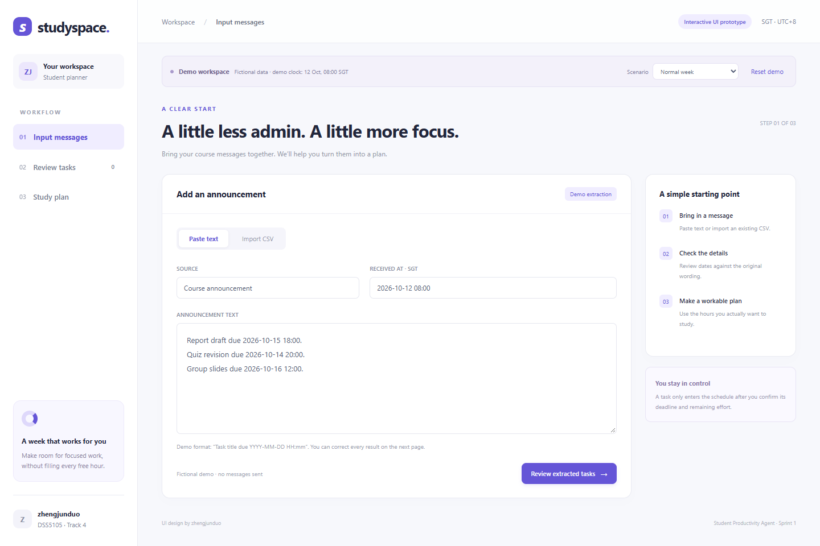
STUDYSPACE / STUDENT PRODUCTIVITY AGENT
Input messages
Paste text or import sources without leaving the workflow
DSS5105 Track 4 / zhengjunduo / Sprint 1
A1
Notes:
Team references: https://github.com/YichenLi-02/dss5105-track4/blob/huangpengyu/no5_backendintegration/README.md
https://github.com/YichenLi-02/dss5105-track4/blob/zhaozichen/github_upload/planner/README.md
Screenshots show the locally tested frontend prototype with fictional development data. No live AI or mailbox/calendar integration. Scheduling is a browser simulation, not the final member 4/5 backend. Local browser tests do not establish final model accuracy, time savings or independent evaluation results.
Appendix screenshot. The full-resolution image is included separately. UI source is in ui/index.html, ui/styles.css, ui/app.js and ui/planner.js.

Slide 4
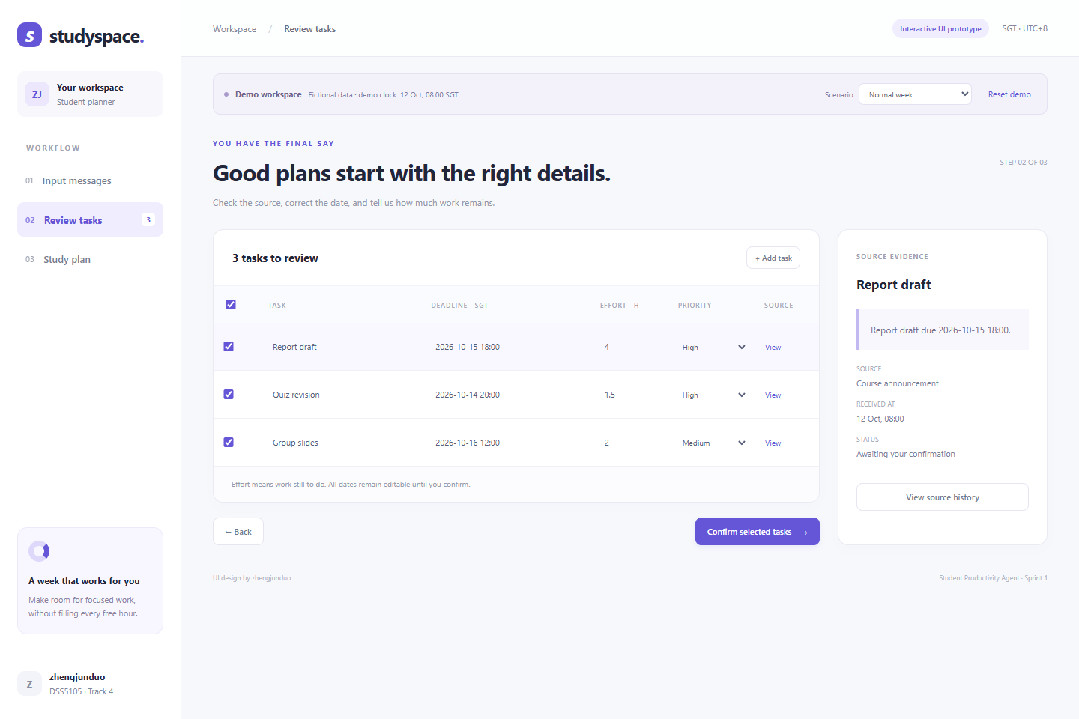
STUDYSPACE / STUDENT PRODUCTIVITY AGENT
Review and confirm
Editable tasks with source evidence and explicit confirmation
DSS5105 Track 4 / zhengjunduo / Sprint 1
A2
Notes:
Team references: https://github.com/YichenLi-02/dss5105-track4/blob/huangpengyu/no5_backendintegration/README.md
https://github.com/YichenLi-02/dss5105-track4/blob/zhaozichen/github_upload/planner/README.md
Screenshots show the locally tested frontend prototype with fictional development data. No live AI or mailbox/calendar integration. Scheduling is a browser simulation, not the final member 4/5 backend. Local browser tests do not establish final model accuracy, time savings or independent evaluation results.
Appendix screenshot. The full-resolution image is included separately. UI source is in ui/index.html, ui/styles.css, ui/app.js and ui/planner.js.

Slide 5
STUDYSPACE / STUDENT PRODUCTIVITY AGENT
Study plan
Available hours, visible shortages, locks, progress and local saving
DSS5105 Track 4 / zhengjunduo / Sprint 1
A3
Notes:
Team references: https://github.com/YichenLi-02/dss5105-track4/blob/huangpengyu/no5_backendintegration/README.md
https://github.com/YichenLi-02/dss5105-track4/blob/zhaozichen/github_upload/planner/README.md
Screenshots show the locally tested frontend prototype with fictional development data. No live AI or mailbox/calendar integration. Scheduling is a browser simulation, not the final member 4/5 backend. Local browser tests do not establish final model accuracy, time savings or independent evaluation results.
Appendix screenshot. The full-resolution image is included separately. UI source is in ui/index.html, ui/styles.css, ui/app.js and ui/planner.js.

