Slide 1

Predicting Heart Disease Risk from Behavioral and Health Indicators
Yichen Li
Brown University, Data Science Institute
10/23/2025
github:https://github.com/YichenLi95/DATA1030_HeartDiseaseProject
Notes:
Good morning everyone.
My name is Yichen Li, and today I’ll be presenting my project “Predicting Heart Disease Risk from Behavioral and Health Indicators.”
This project explores how we can use machine learning to identify people at higher risk of heart disease based on health and lifestyle survey data collected across the US.

Slide 2


Introduction
Goal: Predict whether an individual has heart disease using health and lifestyle indicators.
Why it matters:
Heart disease is one crucial cause of death in the U.S.
Early intervention can reduce hospitalizations and save lives.
Task Type: Binary Classification
Data Source:
Via Kaggle Platform
Collected through nationwide telephone survey
Main Challenge: Large dataset, contain over 250k data points
Notes:
Let’s start with the motivation.
Heart disease is the leading cause of death in the United States, according to the CDC, One person dies every 34 seconds from cardiovascular disease, and In 2023, in every 3 deaths, one of them is died from cardiovascular disease
So the question driving this project is simple but critical:
Can we use data on behavior and health to predict who is at risk—before a major event like a heart attack occurs?
Early detection could guide preventive actions, reduce hospitalizations, and ultimately save lives.
This is a binary classification problem — the target variable is whether the respondent has experienced heart disease or not.
The dataset comes from the Kaggle platform.
It’s collected from a nationwide telephone survey covering over 250k individuals and 22 features describing health status, habits, and demographics.
The large sample size introduces computational and imbalance challenges that I’ll discuss later.

Slide 3
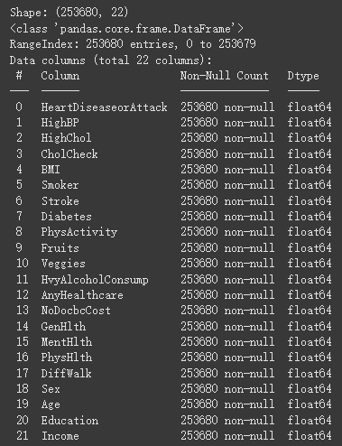
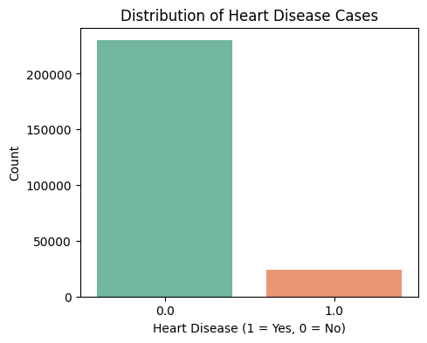
EDA
Imbalance affects model training → need stratified split
Notes:
During exploratory data analysis, the first major observation was a strong class imbalance. Only about 9 percent of respondents reported heart disease.
This tells us that heart disease cases are relatively rare in the dataset, which is realistic for population-level data but poses a challenge for training.
Due to this noticeable imbalance, I later used stratified splitting to ensure that all subsets of data kept the same proportion of positive and negative cases.

Slide 4
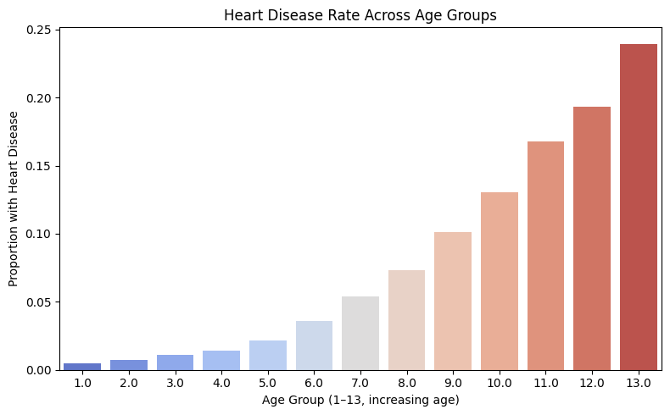
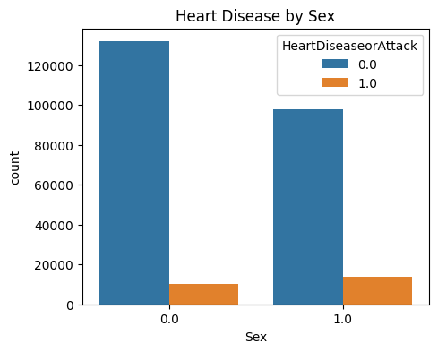
EDA
Highlight features likely to have high model importance.
Notes:
Next, I looked at demographic trends.
The data show that males have a somewhat higher rate of heart disease than females.
In addition, age stood out the most: as we move from younger to older age groups, the rate of heart disease rises steadily. The increase is not just linear but noticeably sharp after middle age, suggesting that age is a dominant predictive factor in this dataset.

Slide 5
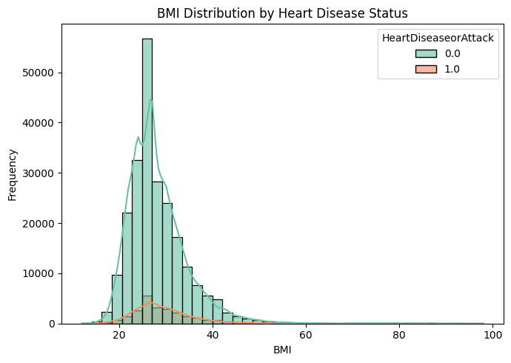
EDA
Boundary considerations
Consider use MinmaxScaler
Notes:
I also examined continuous health indicators such as BMI
The green bars represent individuals without heart disease, while the orange bars represent those with heart disease. Both groups show a similar overall shape.
This graph provides me with some hints to apply what kind of Scaling method to standardize this feature before modeling.

Slide 6
Data Splitting Strategy
Stratified Split
70% Train, 15% Validation, 15% Test
Ensures same heart disease ratio across all splits
Imbalance
Notes:
Next step is data splitting, I split the dataset into 70 percent training, 15 percent validation, and 15 percent testing sets.
Because of the imbalance mentioned earlier, I used stratified sampling, which ensures each subset has the same ratio of target cases.
This helps avoid biased validation scores and gives a more reliable measure of generalization.

Slide 7
Preprocessing
Feature Type | Example Columns | Transformer
Binary | Other 13 Columns | None
Ordinal | GENHLTH, DIABETE, Age, Education, Income | Already ordinal encoded in original dataset
Continuous numeric | BMI, MentHlth, PhysHlth | MinMaxScaler
Notes:
Next comes the preprocessing.
The dataset had no missing values, which simplified the workflow.
13 out of the 21 independent variables are binary features, already encoded as 0 or 1, so these features do not require transformation.
Several ordinal features, such as general health, diabetes status, age group, education, and income were already ordinal encoded in the original dataset.
Finally, the continuous numeric features — BMI, MentHlth, and PhysHlth — were standardized using MinMax Scaler.
Why use MinMaxScaler rather than StandardScaler?

Slide 8
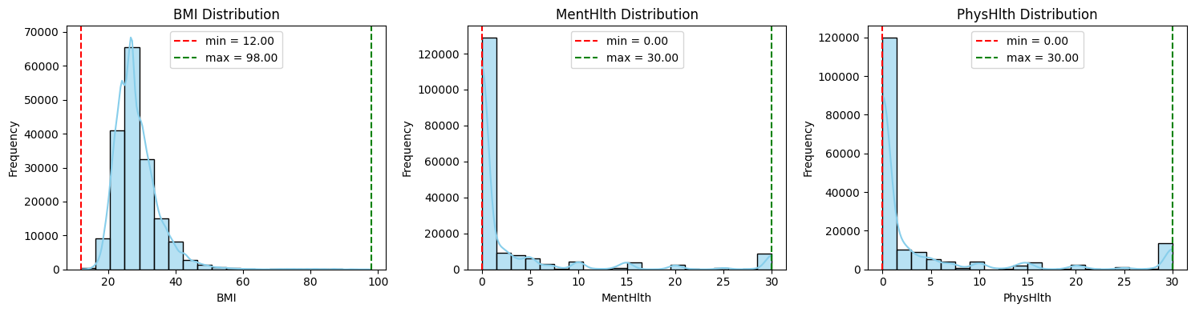
Preprocessing
Reasonable Boundary: [12,98]
MinMaxScaler
MentHlth & PhysHlth lies between [0,30]
Notes:
The histograms here show the distributions of the three features — BMI, MentHlth, and PhysHlth — before scaling.
The dashed red and green lines indicate the boundaries for each variable.
For example, BMI falls between 12 and 98, and both MentHlth and PhysHlth are, defined by the dataset, ranging from 0 to 30 days.
Since these variables have reasonably known upper and lower limits, I used a MinMaxScaler instead of a StandardScaler.

Slide 9
Thank you!

Slide 10
References
Heart Disease Facts. (2024, October 24). Heart Disease. https://www.cdc.gov/heart-disease/data-research/facts-stats/index.html?utm_source=chatgpt.com
Heart Disease Health Indicators Dataset. (2022, March 10). Kaggle. https://www.kaggle.com/datasets/alexteboul/heart-disease-health-indicators-dataset

