Slide 1
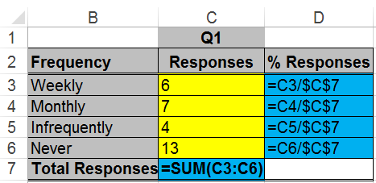
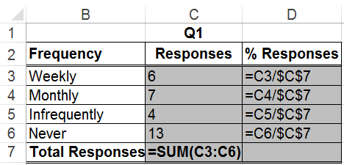
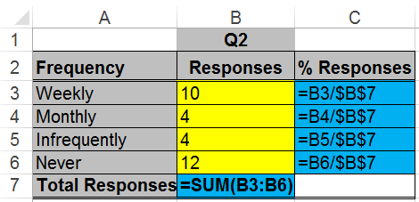
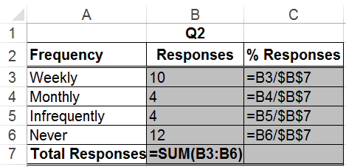
Q1!C3→Weekly:Responses
Q1!D3→Weekly:%Responses
Q1!C4 →Monthly:Responses
Weekly:Responses | Q1!C3, Q2!B3
Weekly:%Responses | Q1!D3, Q2!C3
Monthly:Responses | Q1!C4, Q2!B4
… | …
….
(a) Q1
(a) Q1
Cell
compare
Q2!B3→Weekly:Responses
Q2!C3→Weekly:%Responses
Q2!B4 →Monthly:Responses
….
(b) Q2
(b) Q2

