Slide 1
LLM DFT: Current Results and Next Step
Yicheng Li

Slide 2
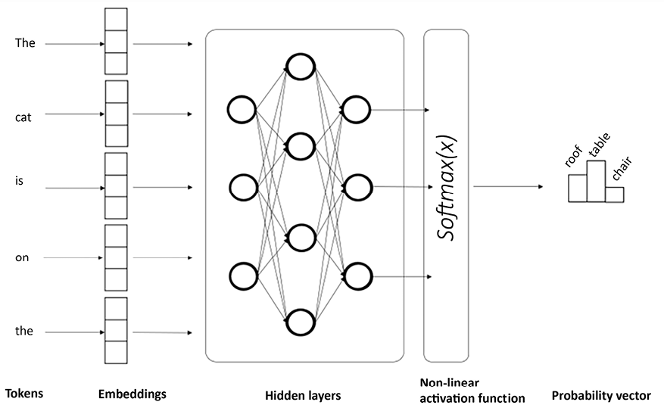
Background: Hidden Layers in LLMs
words
vectors
vectors mutliplied by matrices

Slide 3
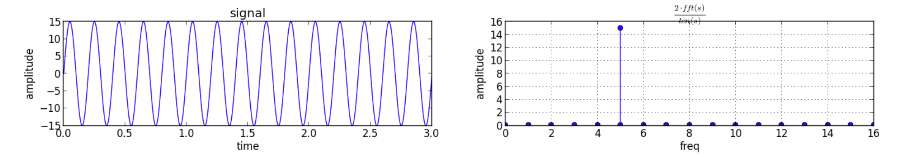
Background: Fourier Transform and Discrete Fourier Transform (DFT)
Fourier transform: convert a wave into its spectrum
What will happen when performing a FT on a pure sin wave?

Slide 4
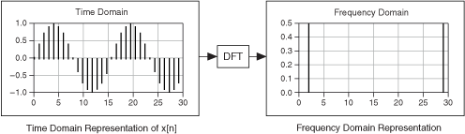
Background: Fourier Transform and Discrete Fourier Transform (DFT)
Also, FT can be applied on a descrete sequence
A little bit more complex example

Slide 5

What am I Doing: DFT on Activations
So for a passage: [Word1, Word2, Word3, ...]
We can get an activation vector [y1, y2, y3, ...]
Perform DFT on this vector!
Text: [Word1]
Embedded Vector: [x1, x2, x3, ...]
Activation Vector in ONE Dimension: [y1]
Embedding Model
Hidden Layer: $\left(\begin{matrix}a_{11} & ⋯ & a_{1n} \\ ⋮ & ⋱ & ⋮ \\ a_{n1} & ⋯ & a_{nn}\end{matrix}\right)$

Slide 6
What am I Doing: DFT on Activations
What is the Meaning of Spetrums of Activations?
Low frequency -> global information;
high frequency -> local details
Spectrums vary in different formats and topics
Edit the specrums, revert them into text and then observe what happens

Slide 7
What am I Doing: DFT on Activations
What kind of text can be a good example? It should be:
Highly fomatted
Significantly periodic
With different topics and semantic features
So I chose 五言诗 and 七言诗 as the toy model

Slide 8
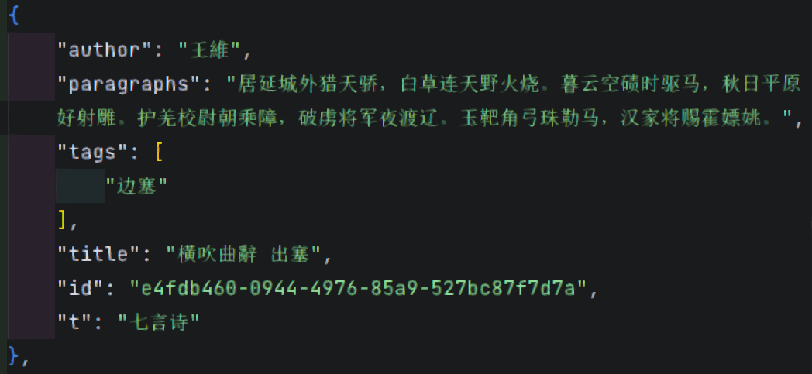
What am I Doing: DFT on Activations
One item in dataset:
Conbine 200 items

Slide 9
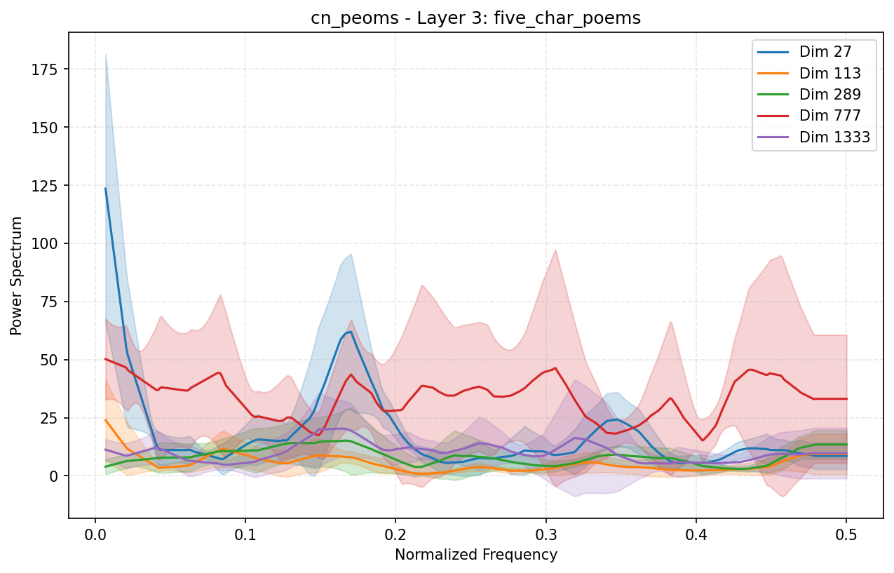
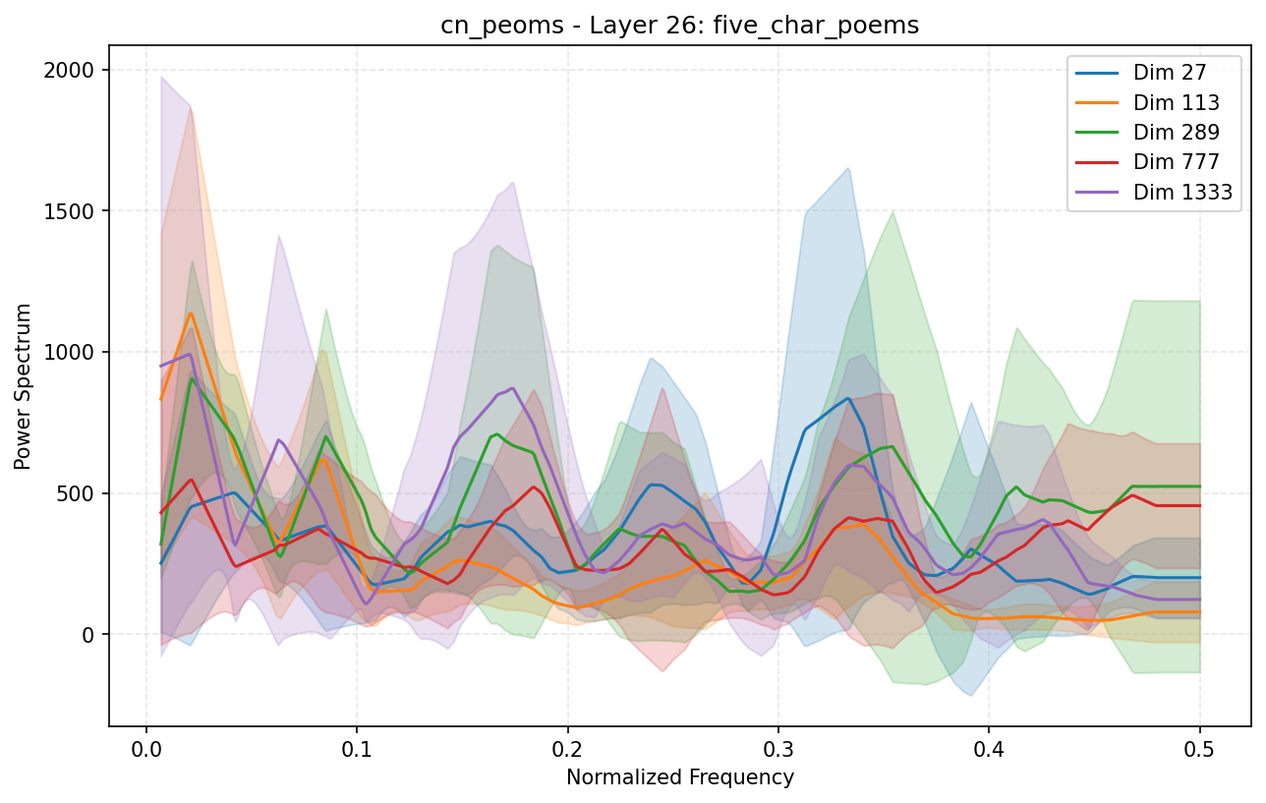
What am I Doing: DFT on Activations

Slide 10
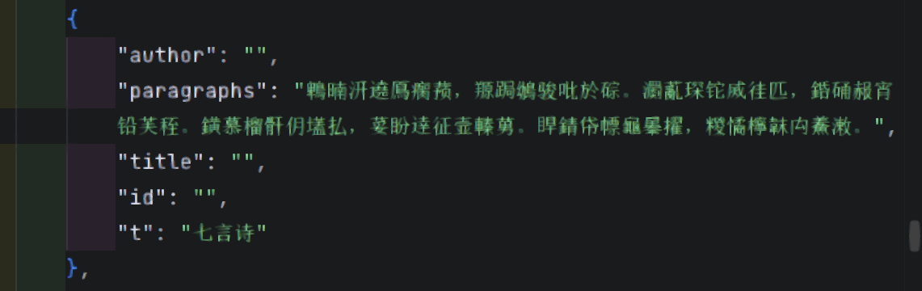
What am I Doing: Baseline Test
- Does DFT really interpret semantic features? The periodic format of 七言诗 can also generate regular spectrum!
So we replace all characters with random ones:

Slide 11
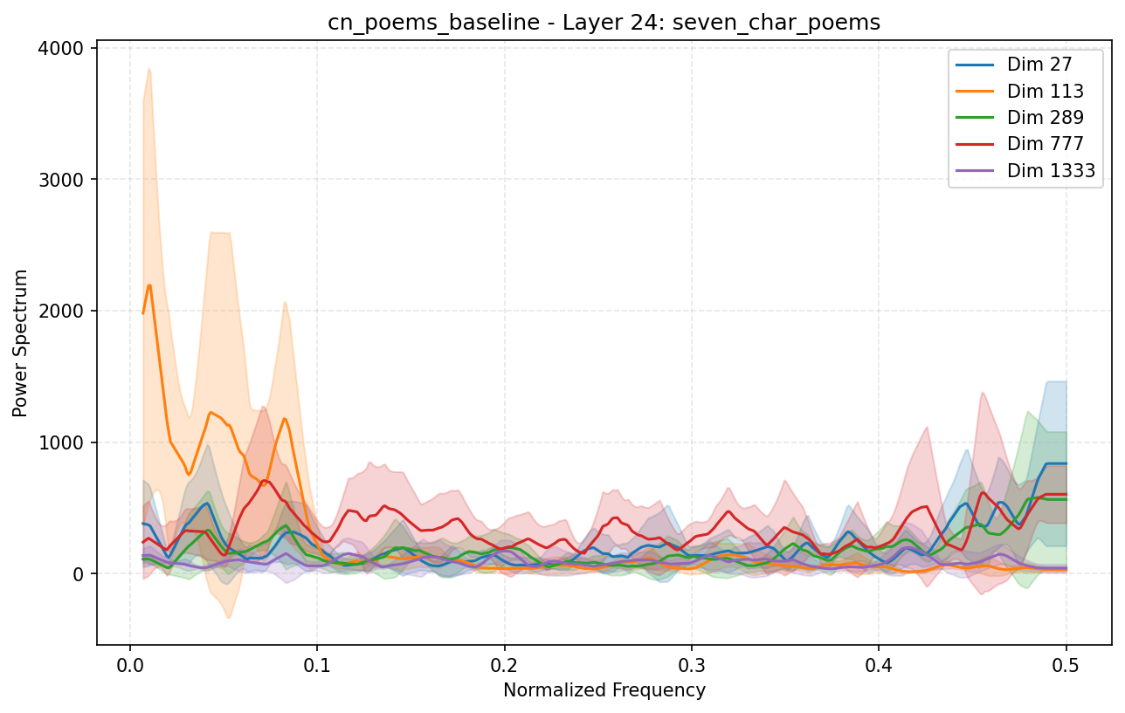
What am I Doing: Baseline Test
Replace all characters with random ones:

Slide 12
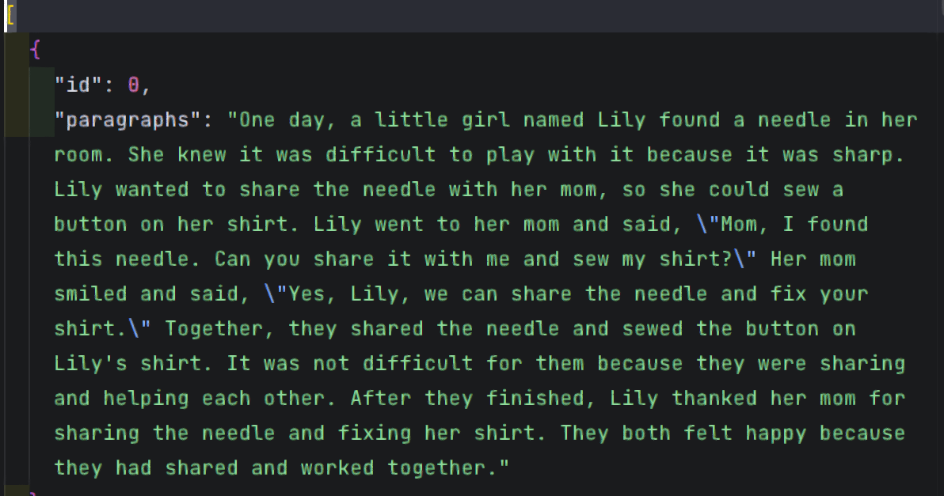
What am I Doing: Test on other Corpus
Tiny stories:

Slide 13
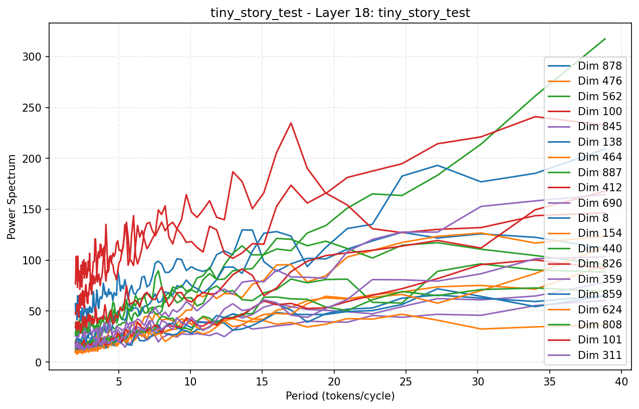
What am I Doing: Test on other Corpus
Tiny stories:

Slide 14
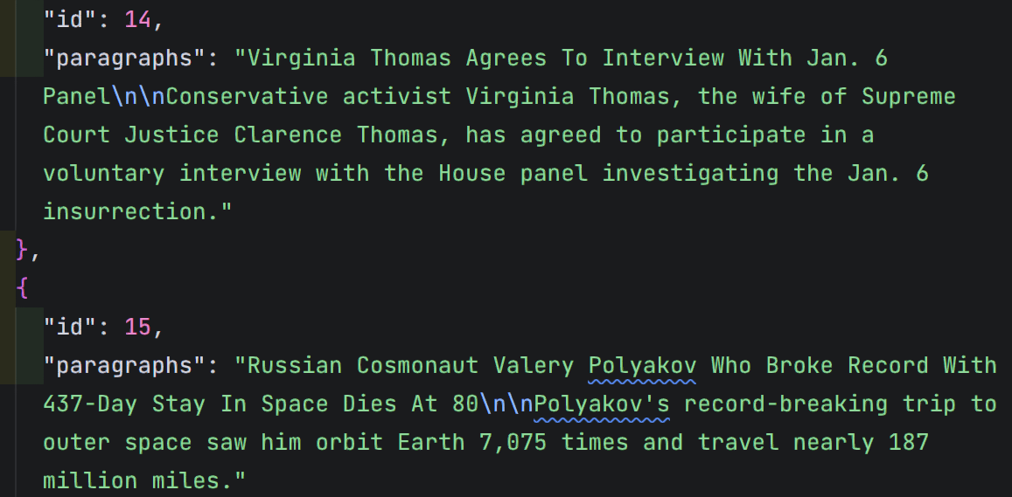
What am I Doing: Test on other Corpus
News:

Slide 15
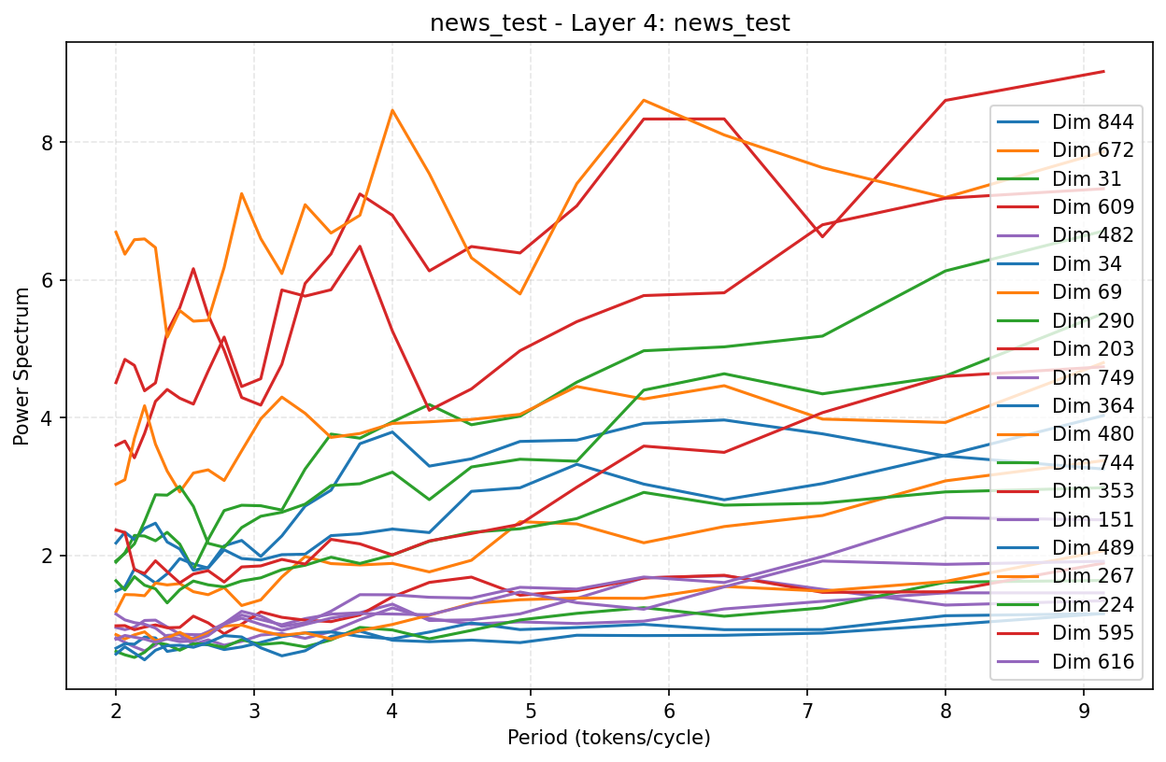
What am I Doing: Test on other Corpus
News:

Slide 16
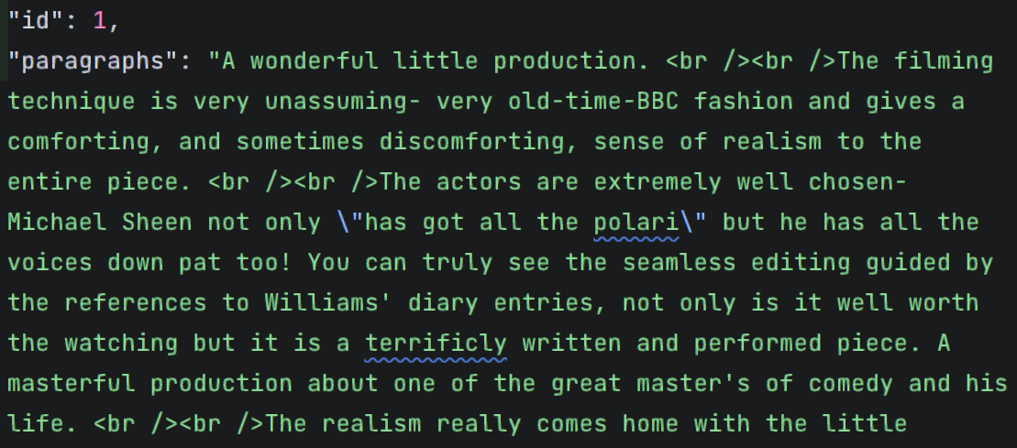
What am I Doing: Test on other Corpus
IMDB movie comments:

Slide 17
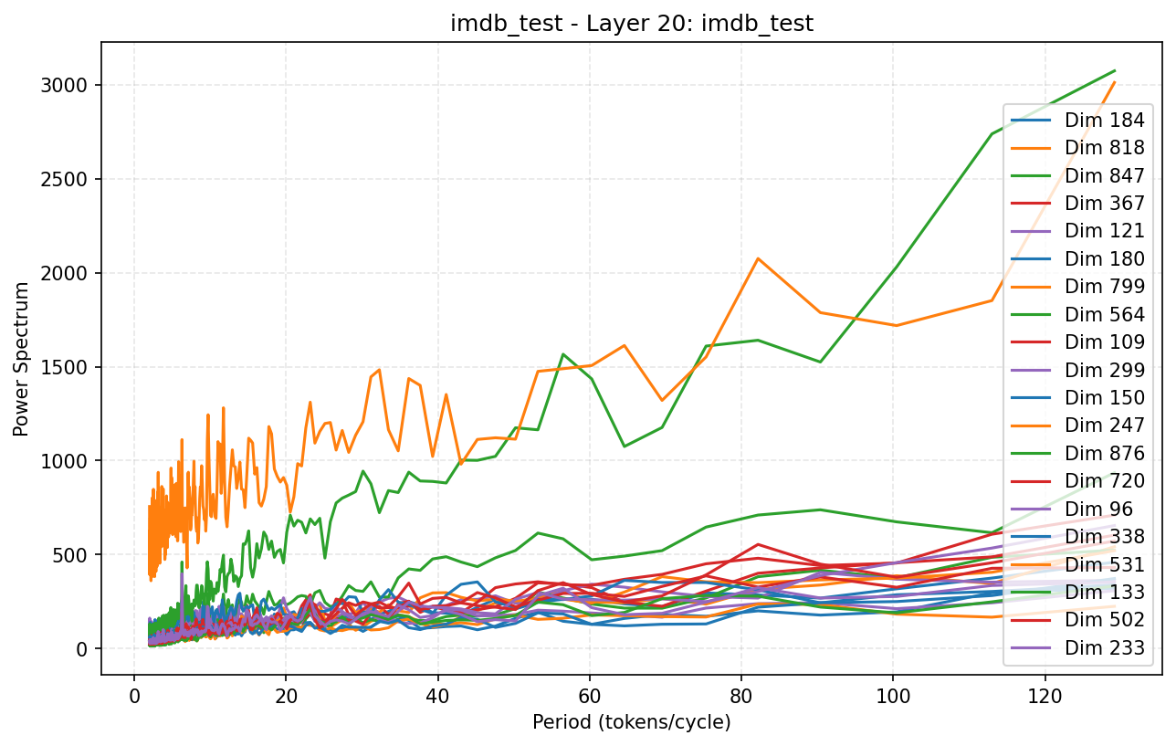
What am I Doing: Test on other Corpus
IMDB movie comments:

Slide 18
Next Step: Revert Spectrums into Text
Editted Text
Spectrum
Editted Spectrum

