Slide 1
Credit Default
MLOps Pipeline
Course Requirements Covered
EDA, train/test split, metric selection, pipeline training, deployed inference, monitoring, original test validation, changed-test validation, and GitHub project delivery.
AutoML, MLflow tracking, FastAPI serving, Docker, Kubernetes, and GitHub CI/CD
Extra MLOps Stack
FastAPI service, Docker image + docker-compose, Kubernetes manifests, and GitHub Actions CI/CD.
• Dataset: UCI default of credit card clients
• Primary metric: ROC-AUC
• Best model: LightGBM from FLAML AutoML
Repository
github.com/Yichun-Zhang-ZYC/MLOps-final
Team presentation deck
MLOps Final Project | Slide 01

Slide 2
Dataset And Prediction Target
Why we chose this dataset and what the model predicts
Chosen Dataset
Outcome Variable
Why It Fits MLOps
UCI Default of Credit Card Clients. This is a structured tabular dataset with billing, repayment status, payment amount, demographics, and a clear binary outcome variable.
Target = whether a client will default on the next payment. The prediction task is binary classification, which fits directly with monitoring and deployment for real-time inference.
It has enough features to make model selection meaningful, supports AutoML comparison, and makes drift testing easy because we can perturb financially meaningful features.
Example feature groups
• Credit limit: LIMIT_BAL
• Repayment status history: PAY_0 to PAY_6
• Billing amount history: BILL_AMT1 to BILL_AMT6
• Repayment amount history: PAY_AMT1 to PAY_AMT6
• Basic profile features: SEX, EDUCATION, MARRIAGE, AGE
MLOps Final Project | Slide 02

Slide 3
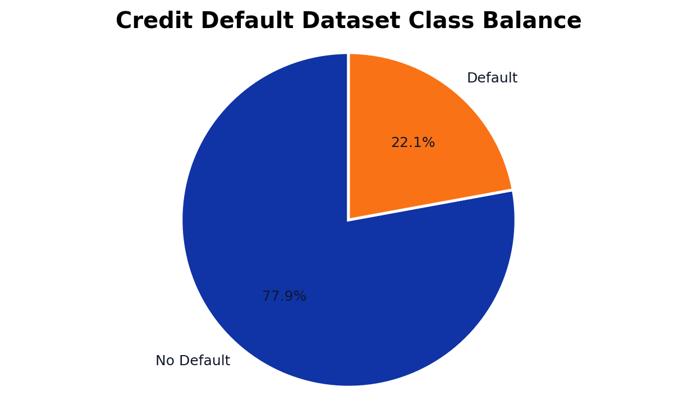
EDA Highlights
Quick exploratory analysis before training
Observation 1
The dataset is imbalanced: non-default cases are the majority. This is why we did not rely only on accuracy when evaluating the model.
Observation 2
Repayment status variables such as PAY_0 and PAY_2 show strong signal. Credit limit and recent bill amounts also help separate riskier clients.
Data Prep
We renamed the raw UCI columns X1 to X23 into business-readable names to make analysis, API payloads, and deployment documentation easier to follow.
Notebook source: notebooks/credit_default_mlops_workflow.ipynb
MLOps Final Project | Slide 03

Slide 4
Train/Test Split And Evaluation Metric
How we set up the supervised learning experiment
Data Split
Why ROC-AUC
We split the dataset into training and test partitions before any modeling. The training split was used for AutoML search and final pipeline fitting, while the held-out test split was reserved for deployment-side validation.
ROC-AUC measures ranking quality across thresholds, which is valuable for imbalanced binary classification. It tells us whether high-risk cases receive higher scores than low-risk cases, even before setting one hard decision threshold.
• Train set for AutoML search and retraining
• Test set for final unbiased validation
• Same test labels reused for changed-data comparison
• Primary metric: ROC-AUC
• Secondary metrics: F1 and Accuracy
• Accuracy alone can look good on imbalanced data
Primary
Secondary
Secondary
Evaluation logic lives in the notebook and is reused when validating original and changed test data.
ROC-AUC
F1
Accuracy
MLOps Final Project | Slide 04

Slide 5
Training Pipeline With MLflow And AutoML
Notebook-first pipeline used for training and experiment tracking
1. Load + Prepare
2. Split + EDA
3. FLAML AutoML
4. MLflow Logging
5. Export + Reports
Fetch UCI dataset, rename columns, clean numeric features, and define target.
Create train/test partitions and run exploratory plots before model search.
Search across candidate learners including LightGBM, Random Forest, XGBoost, and SGD.
Track the chosen estimator, metrics, parameters, and artifacts inside mlruns/.
Save model pipeline and monitoring artifacts for downstream serving and validation.
Key files: notebooks/credit_default_mlops_workflow.ipynb, models/credit_default_pipeline.joblib, mlruns/, artifacts/flaml.log
This pipeline is notebook-driven for the class deliverable, but it still produces reusable artifacts for service deployment.
MLOps Final Project | Slide 05

Slide 6
AutoML Result And Selected Algorithm
FLAML searched multiple learners and selected the strongest model
Selected Model
FLAML Name
Search Time
Task Type
LightGBM
lgbm
~120s
Binary CLS
Learners In Search Space
Why This Winner Makes Sense
Evidence In Repo
FLAML evaluated lgbm, rf, xgboost, extra_tree, xgb_limitdepth, sgd, and lrl1. LightGBM reached the best validation error among the candidates and was retrained as the final pipeline.
Gradient-boosted trees often perform strongly on structured tabular credit-risk features. They capture nonlinear interactions without requiring deep manual feature engineering.
Notebook output includes the FLAML training log. MLflow stores experiment tracking in mlruns/, and the final exported model is committed for reproducible serving and grading.
Notebook output line: Best estimator from FLAML: lgbm
MLOps Final Project | Slide 06

Slide 7
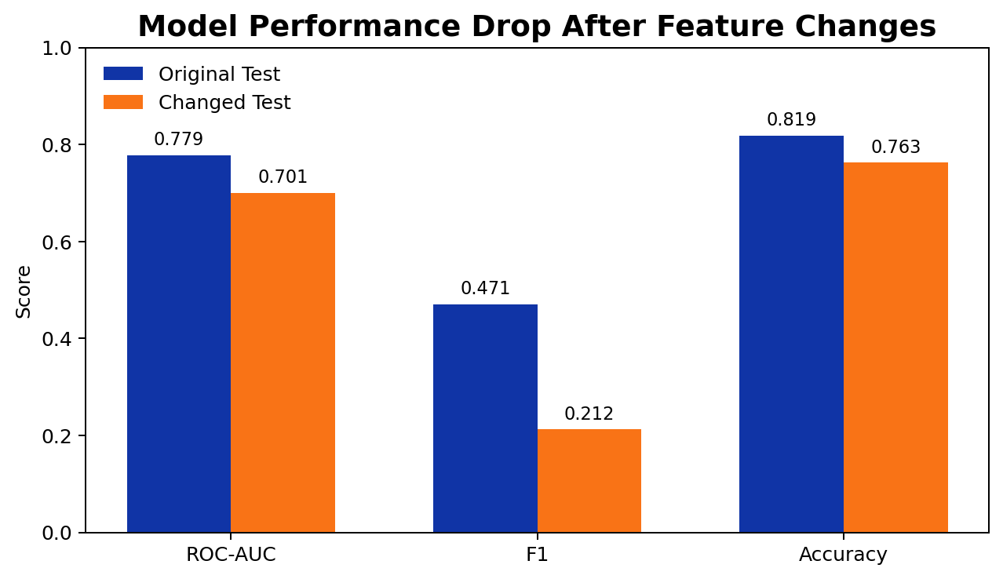
Original Test Validation
Metrics from the held-out test split using the deployed pipeline
ROC-AUC
F1
Accuracy
0.7786
0.4707
0.8193
Interpretation
The model ranks default risk reasonably well and achieves strong overall accuracy, but F1 reminds us that minority-class identification remains harder than the aggregate accuracy suggests.
Deployment Check
The same trained pipeline was exported and later loaded by the FastAPI service, so these evaluation numbers are aligned with the artifact used for inference.
MLOps Final Project | Slide 07

Slide 8
Changed Test Data And Monitoring
We deliberately changed two features and checked both metrics and monitoring
Injected Feature Changes
Changed ROC-AUC
Changed F1
Changed Acc.
We modified at least two feature values in the held-out test set to simulate distribution shift before re-running inference.
0.7011
0.2125
0.7628
• LIMIT_BAL multiplied by 1.8
• PAY_0 shuffled across rows
• Labels kept unchanged for fair comparison
Metric Effect
Monitoring Effect
All three metrics degraded versus the original test set. The sharpest drop was in F1, which shows the model became less reliable at identifying default cases after feature drift.
Evidently reports flagged drift between the reference test distribution and the changed data. This matched the metric drop and validated our monitoring setup.
Artifacts
reports/test_monitoring_report.html and reports/changed_test_monitoring_report.html provide side-by-side evidence for stable versus shifted input behavior.
MLOps Final Project | Slide 08

Slide 9
FastAPI Model Serving
Deployed inference layer for local container and Kubernetes use
Why FastAPI
Sample request
curl -X POST http://localhost:8000/predict \
-H 'Content-Type: application/json' \
-d '{
"features": [20000,2,2,1,24,2,2,-1,-1,-2,-2,3913,3102,689,0,0,0,0,689,0,0,0,0]
}'
FastAPI turns the trained model artifact into a reproducible inference service. This gives the project a clean deployment boundary instead of keeping prediction logic only inside the notebook.
• GET /health
• GET /metadata
• GET /sample-payload
• POST /predict
• POST /predict-batch
Verified response
{"prediction": 1,
"default_probability": 0.7182714474800603}
MLOps Final Project | Slide 09

Slide 10
Docker And Compose
Containerizing the API and local experiment services
Dockerfile
Docker commands
docker-compose.yml
docker build -t mlops-final:local .
docker run -p 8000:8000 mlops-final:local
docker compose up --build
The service image packages the FastAPI app and the trained model artifact. We also fixed a real deployment issue by installing libgomp1 so the LightGBM runtime loads correctly inside the container.
Compose launches both the API service and MLflow UI locally, making it easy to demonstrate model serving and experiment tracking together.
• Image builds from repo root
• Model artifact copied into container
• Health and prediction endpoints exposed on port 8000
What we verified
GET /health -> {"status":"ok"}
GET /metadata -> feature list + model path
POST /predict -> real probability output
docker compose config -> validated
MLOps Final Project | Slide 10

Slide 11
Kubernetes And GitHub CI/CD
Operationalizing the service after local validation
Kubernetes
GitHub Actions
We created namespace, configmap, deployment, service, HPA, and kustomization manifests. After enabling Docker Desktop Kubernetes, we applied the manifests and confirmed the deployment rolled out successfully.
The CI workflow installs dependencies, runs pytest, checks committed artifacts, and smoke-tests Docker build logic. The CD workflow builds and pushes the image to GHCR when main is updated.
• kubectl apply -k k8s
• kubectl rollout status deployment/credit-default-api -n mlops-final
• Service exposed and pod reached Ready state
• ci.yml -> tests + artifact checks + Docker build smoke
• cd.yml -> login to GHCR + build/push image
• Latest CI and CD runs finished successfully
Push
CI
Build Image
CD / GHCR
Deploy
MLOps Final Project | Slide 11

Slide 12
Project Files, Demo Script, And Team Split
Closing slide for repo navigation and speaking order
Core Files To Show
Suggested Speaking Order
Member Contribution Placeholder
Use these files during the live demo or Q&A.
1. Dataset + EDA
2. Metric + AutoML
3. Original vs changed test validation
4. FastAPI + Docker + Kubernetes
5. GitHub CI/CD + repo walkthrough
Member 1: dataset/EDA
Member 2: notebook pipeline + AutoML
Member 3: FastAPI + Docker + Kubernetes
Member 4: CI/CD + monitoring + presentation
Replace these lines with your actual names before presenting.
• notebooks/credit_default_mlops_workflow.ipynb
• src/app/main.py
• Dockerfile and docker-compose.yml
• k8s/*.yaml
• .github/workflows/ci.yml and cd.yml
• reports/*.html
GitHub: github.com/Yichun-Zhang-ZYC/MLOps-final
Speaker notes are provided separately so each slide already has a short script.
MLOps Final Project | Slide 12

