Slide 1
Introduction to Computer Science
and Programming
Lab Class 1
Notes:
Self-introduction, Basic intro to lab class, some rules, today’s outline.

Slide 2
Outline
Short guidance of installation of WinPython & Spyder
Introduction to Python
Execution of Python programs
Output and input
Variable assignment
Commenting source code

Slide 3
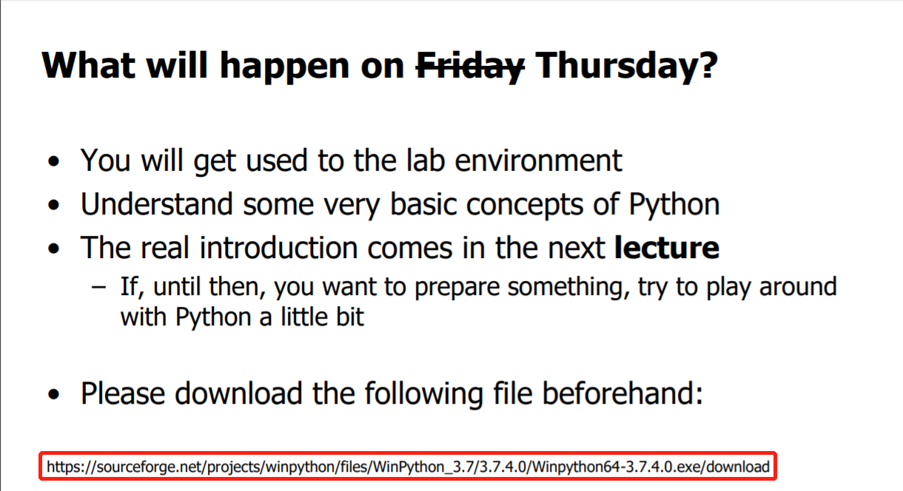
WinPython download
from Page 62 of the Lecture slide.
http://m3nets.de/teaching/SGE2019/

Slide 4
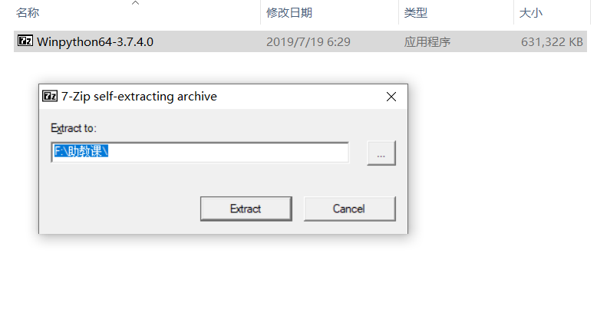
WinPython Installation
Run the downloaded .exe file, you will extract it.

Slide 5
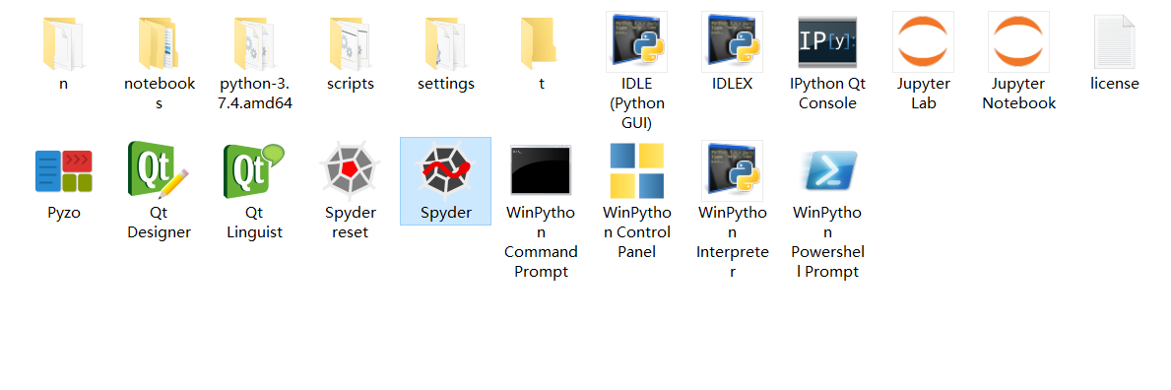
WinPython Installation
Double click on the program and you launch it

Slide 6
Introduction to Python

Slide 7
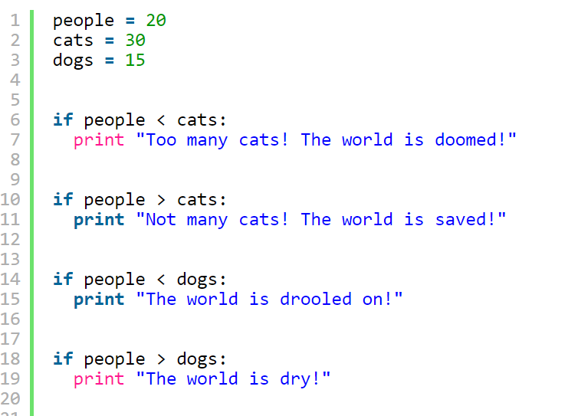
Execution of Python programs
Two methods to execute a Python program:
Terminal (i.e., cmd in windows).
python3 abc.py, here abc.py is the name of Python file.
Simplest way for running a program one time.
Integrated Development Environment (IDE).
You have a graphical user interface.
Many assistants for writing code.
We will use the IDE Spyder.

Slide 8
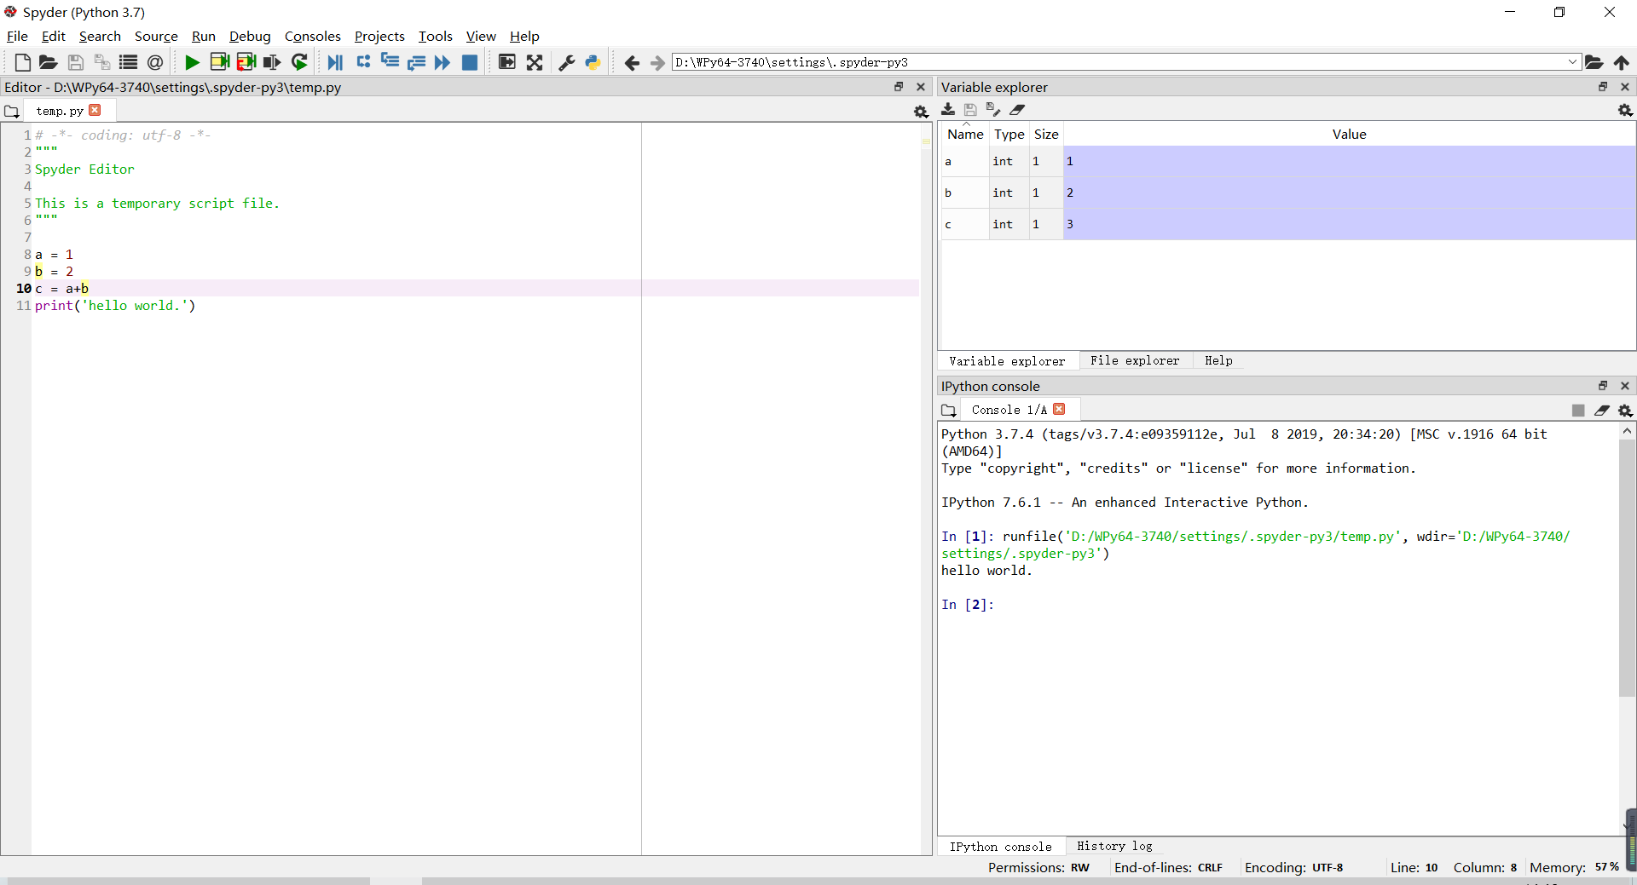
The interface of spyder
Run Button
Current Path
Variable Explorer
Code Editor
Command Window

Slide 9
Create a file and open the file

Slide 10
Output and input

Slide 11

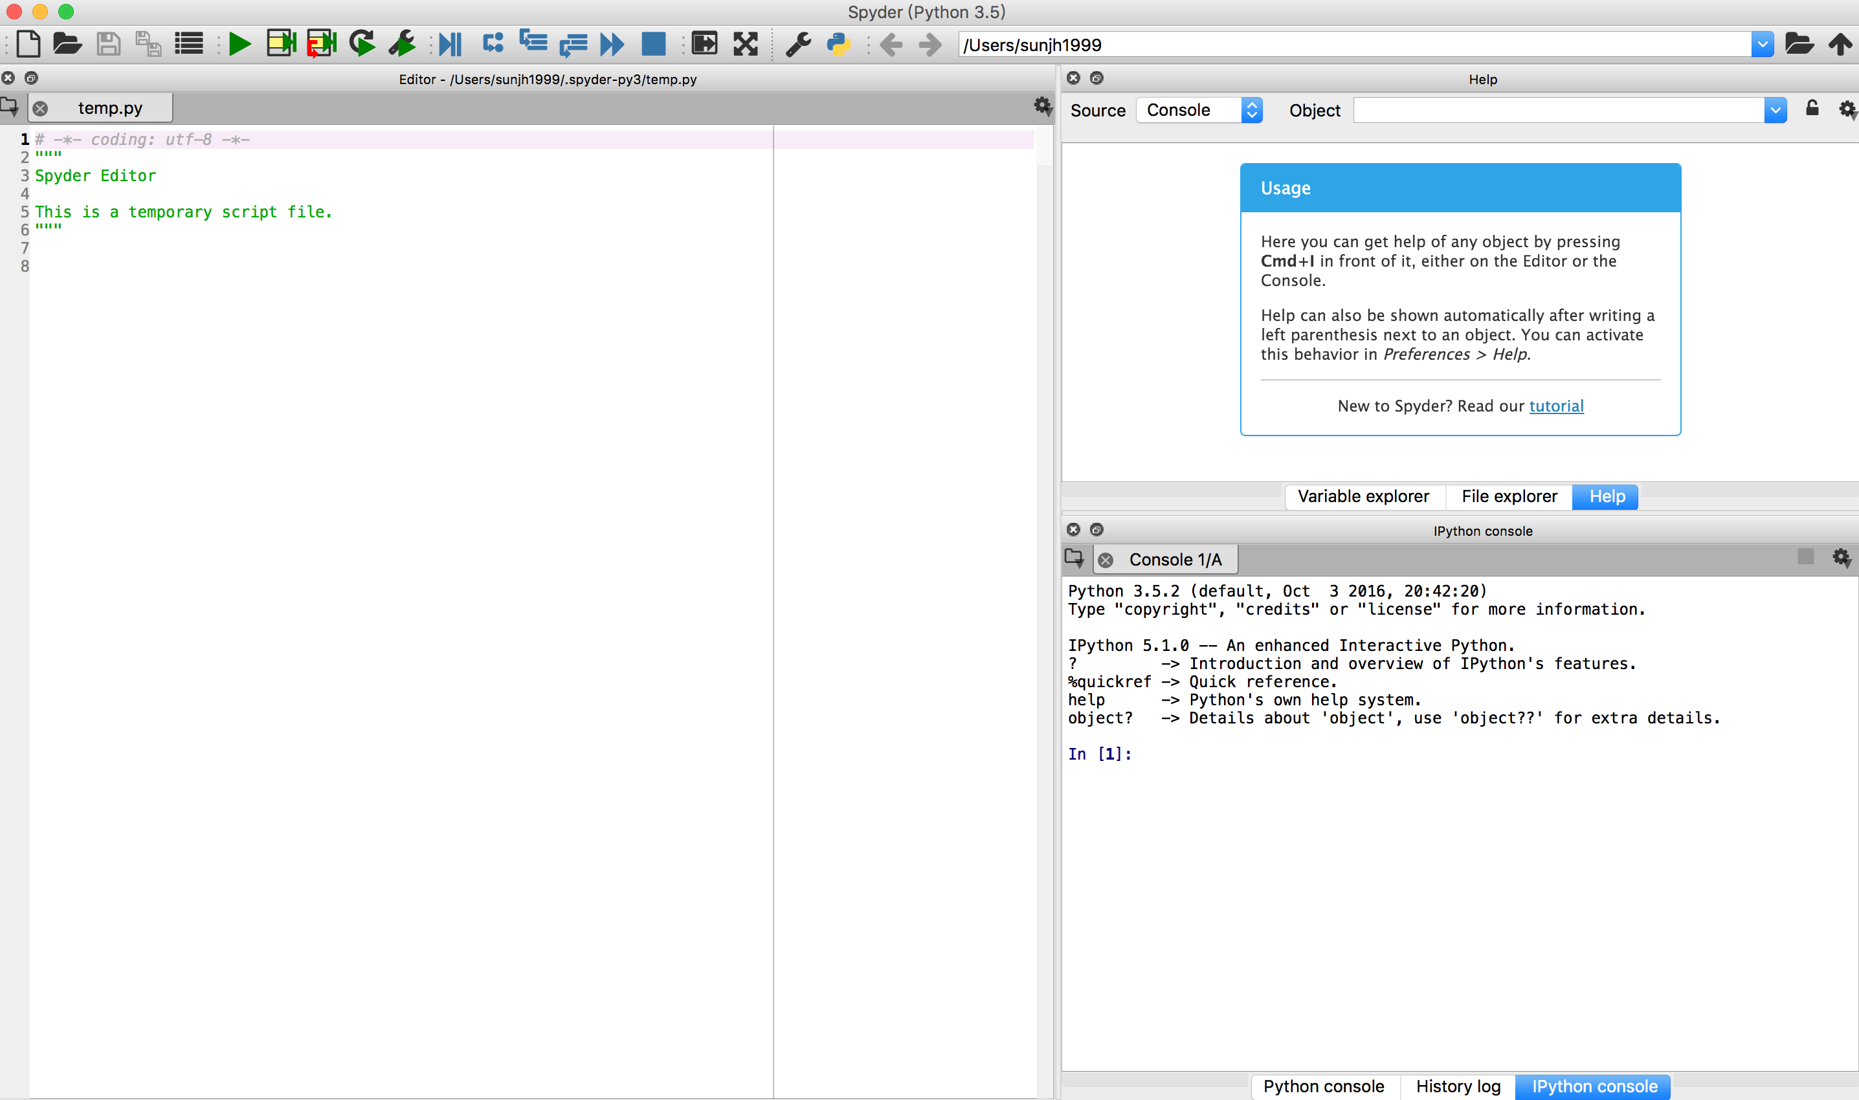
Output: printing
(1) Type print (‘Hello World’) in the Code Editor.
(2) Press the Run Button, then save the file.
(3) See the results in the Console.
(2) Press here and save the file
(1) Type print (‘Hello World’)
(3) See the results here

Slide 12

Input: read from keyboard
The program will use the data which is input by you.
Type the following statements line by line:
a= input(‘input a number:’)
print (a)
Run the program and type whatever you want in the command window.
See the results.

Slide 13
Variable assignments

Slide 14

Variable assignments
Type the following statements line by line and see the difference.
abc=‘def’
print ('first output:',abc)
print ('second output:','abc')

Slide 15

Variable assignments
Type the following statements line by line and see the results.
a=3
b=7
print (‘a=’,a,’,b=’,b)
a-=1
b+=1
print (‘a=’,a,’,b=’,b)

Slide 16
Commenting source code

Slide 17

Commenting source code
It’s a good habit to add some comment to explain your codes using ‘#’
Cooperation between programmers are very important.
It is difficult for other people to maintain your code if they cannot understand the code.
Of course, you do not need to write comments for those very simple code. Like this:

Slide 18
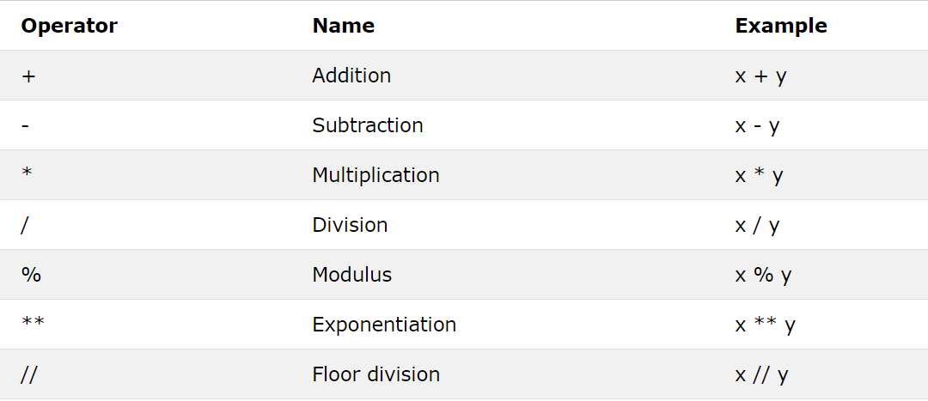
Operators

Slide 19
Tasks Now is your turn

Slide 20
Task1:
Create a python file named as “Lab1.py” and write a Python program which prints “Hello World”.
Task2:
Write a Python program which receives an integer and computes its square.
Task3:
Write a Python program which receives an integer and prints its units digit.
Task4:
As a programmer, you need to solve many problems by yourself in the future. So, looking up the tutorials and documentations online is an important skill. https://docs.python.org/3/ maybe a good start for you.

Slide 21
Open questions? Suggestions from your side?

Slide 22
Thank you very much!

