Slide 1
NoSQL Databases
Slides take from
J. Pokorný
KSI MFF UK

Slide 2
Cloud computing, cloud databases
Cloud computing
data intensive applications on hundreds of thousands of commodity servers and storage devices
basic features:
elasticity,
fault-tolerance
automatic provisioning
Cloud databases: traditional scaling up (adding new expensive big servers) is not possible
requires higher level of skills
is not reliable in some cases
Architectural principle: scaling out (or horizontal scaling) based on data partitioning, i.e. dividing the database across many (inexpensive) machines

Slide 3
Cloud computing, cloud databases
Technique: data sharding, i.e. horizontal partitioning of data (e.g. hash or range partitioning)
Consequences:
manage parallel access in the application
scales well for both reads and writes
not transparent, application needs to be partition-aware

Slide 4
Relaxing ACID properties
Cloud computing: ACID is hard to achieve, moreover, it is not always required, e.g. for blogs, status updates, product listings, etc.
Availability
Traditionally, thought of as the server/process available 99.999 % of time
For a large-scale node system, there is a high probability that a node is either down or that there is a network partitioning
Partition tolerance
ensures that write and read operations are redirected to available replicas when segments of the network become disconnected

Slide 5
Eventual Consistency
Eventual Consistency
When no updates occur for a long period of time, eventually all updates will propagate through the system and all the nodes will be consistent
For a given accepted update and a given node, eventually either the update reaches the node or the node is removed from service
BASE (Basically Available, Soft state, Eventual consistency) properties, as opposed to ACID
Soft state: copies of a data item may be inconsistent
Eventually Consistent – copies becomes consistent at some later time if there are no more updates to that data item
Basically Available – possibilities of faults but not a fault of the whole system

Slide 6
CAP Theorem
Suppose three properties of a system
Consistency (all copies have same value)
Availability (system can run even if parts have failed)
Partitions (network can break into two or more parts, each with active systems that can not influence other parts)
Brewer’s CAP “Theorem”: for any system sharing data it is impossible to guarantee simultaneously all of these three properties
Very large systems will partition at some point
it is necessary to decide between C and A
traditional DBMS prefer C over A and P
most Web applications choose A (except in specific applications such as order processing)

Slide 7
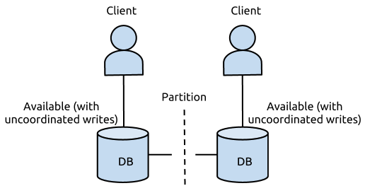
https://foundationdb.com/white-papers/the-cap-theorem
Brewer originally described this impossibility result as forcing a choice of "two out of the three" CAP properties, leaving three viable design options: CP, AP, and CA.
However, further consideration shows that CA is not really a coherent option because a system that is not Partition-tolerant will, by definition, be forced to give up Consistency or Availability during a partition.
A more modern interpretation of the theorem is: during a network partition, a distributed system must choose either Consistency or Availability.

Slide 8
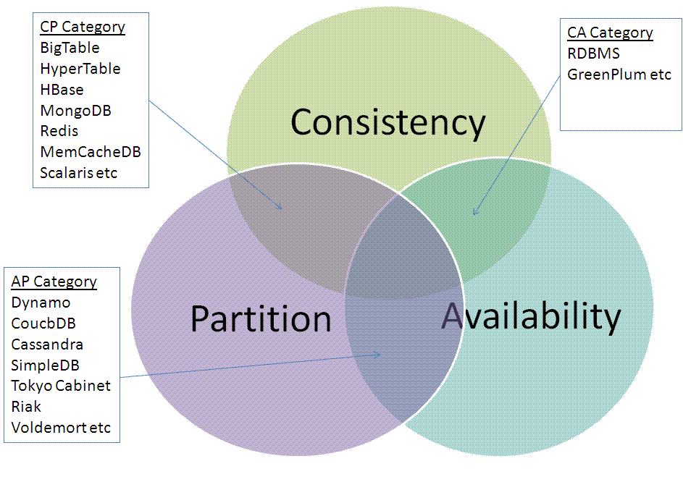
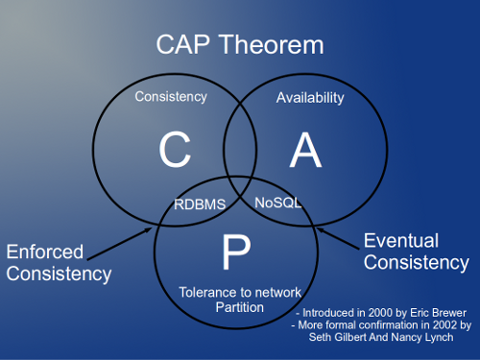
CAP Theorem

Slide 9
CAP Theorem
Drop A or C of ACID
relaxing C makes replication easy, facilitates fault tolerance,
relaxing A reduces (or eliminates) need for distributed concurrency control.

Slide 10
NoSQL databases
The name stands for Not Only SQL
Common features:
non-relational
usually do not require a fixed table schema
horizontal scalable
mostly open source
More characteristics
relax one or more of the ACID properties (see CAP theorem)
replication support
easy API (if SQL, then only its very restricted variant)
Do not fully support relational features
no join operations (except within partitions),
no referential integrity constraints across partitions.

Slide 11
Categories of NoSQL databases
key-value stores
column NoSQL databases
document-based
XML databases (myXMLDB, Tamino, Sedna)
graph database (neo4j, InfoGrid)

Slide 12
Categories of NoSQL databases
key-value stores
column NoSQL databases
document-based
XML databases (myXMLDB, Tamino, Sedna)
graph database (neo4j, InfoGrid)

Slide 13
Key-Value Data Stores
Example: SimpleDB
Based on Amazon’s Single Storage Service (S3)
items (represent objects) having one or more pairs (name, value), where name denotes an attribute.
An attribute can have multiple values.
items are combined into domains.

Slide 14
Column-oriented*
store data in column order
allow key-value pairs to be stored (and retrieved on key) in a massively parallel system
data model: families of attributes defined in a schema, new attributes can be added
storing principle: big hashed distributed tables
properties: partitioning (horizontally and/or vertically), high availability etc. completely transparent to application
* Better: extendible records

Slide 15
Column-oriented
column family
“Contents:”
“anchor:cnnsi.com”
“anchor:my.look.ca”
<html>
t3
“mff.ksi.www”
<html>
t5
“MFF”
t9
“MFF.cz”
t8
<html>
t6
Example: BigTable
indexed by row key, column key and timestamp. i.e. (row: string , column: string , time: int64 ) → String.
rows are ordered in lexicographic order by row key.
row range for a table is dynamically partitioned, each row range is called a tablet.
columns: syntax is family:qualifier

Slide 16
A table representation of a row in BigTable
Row key | Time stamp | Column name | Column family Grandchildren
http://ksi.... | t1 | "Jack" | "Claire" 7
 | t2 | "Jack" | "Claire" 7 | "Barbara" 6
 | t3 | "Jack" | "Claire" 7 | "Barbara" 6 | "Magda" 3

Slide 17
Column-oriented
Example: Cassandra
keyspace: Usually the name of the application; e.g., 'Twitter', 'Wordpress‘.
column family: structure containing an unlimited number of rows
column: a tuple with name, value and time stamp
key: name of record
super column: contains more columns

Slide 18
Document-based
based on JSON format: a data model which supports lists, maps, dates, Boolean with nesting
Really: indexed semistructured documents
Example: Mongo
{Name:"Jaroslav",
Address:"Malostranske nám. 25, 118 00 Praha 1“
Grandchildren: [Claire: "7", Barbara: "6", "Magda: "3", "Kirsten: "1", "Otis: "3", Richard: "1"]
}

Slide 19
Typical NoSQL API
Basic API access:
get(key) -- Extract the value given a key
put(key, value) -- Create or update the value given its key
delete(key) -- Remove the key and its associated value
execute(key, operation, parameters) -- Invoke an operation to the value (given its key) which is a special data structure (e.g. List, Set, Map .... etc).
Notes:
-> http://horicky.blogspot.com/2009/11/nosql-patterns.html

Slide 20
Representatives of NoSQL databases key-valued
Name | Producer | Data model | Querying
SimpleDB | Amazon | set of couples (key, {attribute}), where attribute is a couple (name, value) | restricted SQL; select, delete, GetAttributes, and PutAttributes operations
Redis | Salvatore Sanfilippo | set of couples (key, value), where value is simple typed value, list, ordered (according to ranking) or unordered set, hash value | primitive operations for each value type
Dynamo | Amazon | like SimpleDB | simple get operation and put in a context
Voldemort | LinkeId | like SimpleDB | similar to Dynamo

Slide 21
Representatives of NoSQL databases column-oriented
Name | Producer |  | Data model | Querying
BigTable |  | Google | set of couples (key, {value}) | selection (by combination of row, column, and time stamp ranges)
HBase |  | Apache | groups of columns (a BigTable clone) | JRUBY IRB-based shell (similar to SQL)
Hypertable |  | Hypertable | like BigTable | HQL (Hypertext Query Language)
CASSANDRA |  | Apache (originally Facebook) | columns, groups of columns corresponding to a key (supercolumns) | simple selections on key, range queries, column or columns ranges
PNUTS |  | Yahoo | (hashed or ordered) tables, typed arrays, flexible schema | selection and projection from a single table (retrieve an arbitrary single record by primary key, range queries, complex predicates, ordering, top-k)

Slide 22
Representatives of NoSQL databases document-based
Name | Producer |  | Data model |  | Querying
MongoDB |  | 10gen |  | object-structured documents stored in collections; each object has a primary key called ObjectId |  | manipulations with objects in collections (find object or objects via simple selections and logical expressions, delete, update,)
Couchbase |  | Couchbase¹ |  | document as a list of named (structured) items (JSON document) |  | by key and key range, views via Javascript and MapReduce
¹after merging Membase and CouchOne

Slide 23
