Slide 1
Parallel Programming with Hadoop/MapReduce

Slide 2
Pseudo-code
map(String input_key, String input_value):
// input_key: document name
// input_value: document contents
  for each word w in input_value:
  EmitIntermediate(w, "1");
reduce(String output_key, Iterator intermediate_values):
// output_key: a word
// output_values: a list of counts
  int result = 0;
  for each v in intermediate_values:
  result = result + ParseInt(v);
  Emit(AsString(result));

Slide 3
MapReduce WordCount.java
Hadoop distribution: src/examples/org/apache/hadoop/examples/WordCount.java
public static class TokenizerMapper
extends Mapper<Object, Text, Text, IntWritable>{
private final static IntWritable one = new IntWritable(1);
private Text word = new Text();
public void map(Object key, Text value, Context context
) throws IOException, InterruptedException {
StringTokenizer itr = new StringTokenizer(value.toString());
while (itr.hasMoreTokens()) {
word.set(itr.nextToken());
context.write(word, one);
}
}
}
© Spinnaker Labs, Inc.

Slide 4
MapReduce WordCount.java
map() gets a key, value, and context
key - "bytes from the beginning of the line?“
value - the current line;
in the while loop, each token is a "word" from the current line
Line value
tokens
Input file
US history book
US history book
US history book
School admission records
iPADs sold in 2012
School admission records
iPADs sold in 2012
© Spinnaker Labs, Inc.

Slide 5
Reduce code in WordCount.java
public static class IntSumReducer
extends Reducer<Text,IntWritable,Text,IntWritable> {
private IntWritable result = new IntWritable();
public void reduce(Text key, Iterable<IntWritable> values,
Context context
) throws IOException, InterruptedException {
int sum = 0;
for (IntWritable val : values) {
sum += val.get();
}
result.set(sum);
context.write(key, result);
}
}
© Spinnaker Labs, Inc.

Slide 6
The driver to set things up and start
// Usage: wordcount <in> <out>
public static void main(String[] args) throws Exception {
Configuration conf = new Configuration();
String[] otherArgs = new GenericOptionsParser(conf, args).getRemainingArgs();
Job job = new Job(conf, "word count");
job.setJarByClass(WordCount.class);
job.setMapperClass(TokenizerMapper.class);
job.setCombinerClass(IntSumReducer.class);
job.setReducerClass(IntSumReducer.class);
job.setOutputKeyClass(Text.class);
job.setOutputValueClass(IntWritable.class);
FileInputFormat.addInputPath(job, new Path(otherArgs[0]));
FileOutputFormat.setOutputPath(job, new Path(otherArgs[1]));
System.exit(job.waitForCompletion(true) ? 0 : 1);
}
}
© Spinnaker Labs, Inc.

Slide 7
MapReduce: Execution Details
Input reader
  Divide input into splits, assign each split to a Map task
Map task
  Apply the Map function to each record in the split
  Each Map function returns a list of (key, value) pairs
Shuffle/Partition and Sort
  Shuffle distributes sorting & aggregation to many reducers
  All records for key k are directed to the same reduce processor
  Sort groups the same keys together, and prepares for aggregation
Reduce task
  Apply the Reduce function to each key
  The result of the Reduce function is a list of (key, value) pairs
© 2010, Jamie Callan

Slide 8
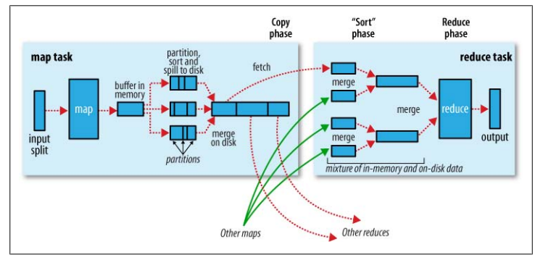

MapReduce with data shuffling& sorting
Tom White, Hadoop: The Definitive Guide
© 2010, Le Zhao

Slide 9
MapReduce:
Skipping Bad Records
Map/Reduce functions sometimes fail for particular inputs.
Fixing the Bug might not be possible : Third Party Libraries.
On Error
  Worker sends signal to Master
  If multiple error on same record, skip record

Slide 10
MapReduce:
Miscellaneous Refinements
Combiner function at a map task
Sorting Guarantees within each reduce partition.
Local execution for debugging/testing
User-defined counters

Slide 11
Combining Phase
Run on map machines after map phase
“Mini-reduce,” only on local map output
Used to save bandwidth before sending data to full reduce tasks
Reduce tasks can be combiner if commutative & associative
© Spinnaker Labs, Inc.

Slide 12
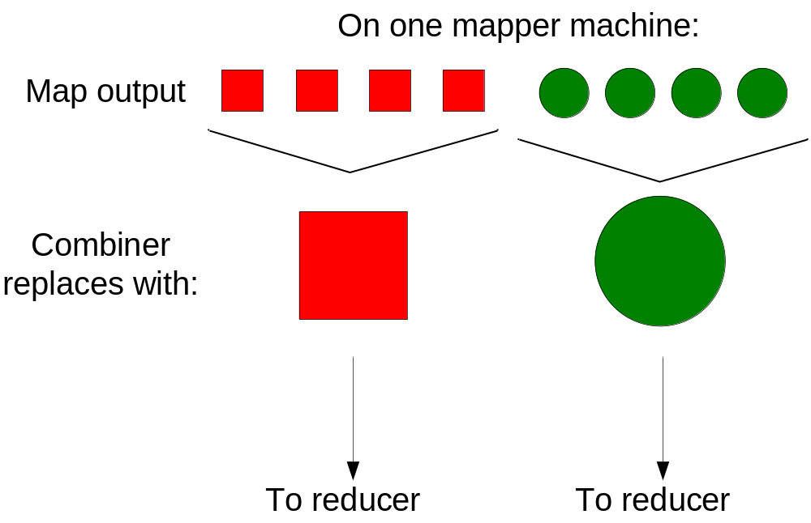
Combiner, graphically
© Spinnaker Labs, Inc.

Slide 13
More MapReduce Applications
Map Only processing
Filtering and accumulation
Database join
Reversing graph edges
Producing inverted index for web search
PageRank graph processing

Slide 14
MapReduce Use Case 1: Map Only
Data distributive tasks – Map Only
E.g. classify individual documents
Map does everything
  Input: (docno, doc_content), …
  Output: (docno, [class, class, …]), …
No reduce tasks

Slide 15
MapReduce Use Case 2: Filtering and Accumulation
Filtering & Accumulation – Map and Reduce
E.g. Counting total enrollments of two given student classes
Map selects records and outputs initial counts
  In: (Jamie, 11741), (Tom, 11493), …
  Out: (11741, 1), (11493, 1), …
Shuffle/Partition by class_id
Sort
  In: (11741, 1), (11493, 1), (11741, 1), …
  Out: (11493, 1), …, (11741, 1), (11741, 1), …
Reduce accumulates counts
  In: (11493, [1, 1, …]), (11741, [1, 1, …])
  Sum and Output: (11493, 16), (11741, 35)

Slide 16
MapReduce Use Case 3: Database Join
A JOIN is a means for combining fields from two tables by using values common to each.
Example :For each employee, find the department he works in
Employee Table
LastName | DepartmentID
Rafferty | 31
Jones | 33
Steinberg | 33
Robinson | 34
Smith | 34
Department Table
DepartmentID | DepartmentName
31 | Sales
33 | Engineering
34 | Clerical
35 | Marketing
JOIN
Pred:
EMPLOYEE.DepID= DEPARTMENT.DepID
JOIN RESULT
LastName | DepartmentName
Rafferty | Sales
Jones | Engineering
Steinberg | Engineering
… | …

Slide 17
MapReduce Use Case 3 – Database Join
Problem: Massive lookups
  Given two large lists: (URL, ID) and (URL, doc_content) pairs
  Produce (URL, ID, doc_content) or (ID, doc_content)
Solution:
Input stream: both (URL, ID) and (URL, doc_content) lists
  (http://del.icio.us/post, 0), (http://digg.com/submit, 1), …
  (http://del.icio.us/post, <html0>), (http://digg.com/submit, <html1>), …
Map simply passes input along,
Shuffle and Sort on URL (group ID & doc_content for the same URL together)
  Out: (http://del.icio.us/post, 0), (http://del.icio.us/post, <html0>), (http://digg.com/submit, <html1>), (http://digg.com/submit, 1), …
Reduce outputs result stream of (ID, doc_content) pairs
  In: (http://del.icio.us/post, [0, html0]), (http://digg.com/submit, [html1, 1]), …
  Out: (0, <html0>), (1, <html1>), …
Notes:
How to distinguish Url and doc_content?

Slide 18
MapReduce Use Case 4: Reverse graph edge directions & output in node order
Input example: adjacency list of graph (3 nodes and 4 edges)
    (3, [1, 2]) (1, [3])
    (1, [2, 3]) ➔ (2, [1, 3])
    (3, [1])
node_ids in the output values are also sorted.
But Hadoop only sorts on keys!
MapReduce format
  Input: (3, [1, 2]), (1, [2, 3]).
  Intermediate: (1, [3]), (2, [3]), (2, [1]), (3, [1]). (reverse edge direction)
  Out: (1,[3]) (2, [1, 3]) (3, [[1]).
1
2
1
2
➔
3
3
Notes:
What a hack! Would be better if sort can access value as well as keys.

Slide 19
MapReduce Use Case 5: Inverted Indexing
Preliminaries
Construction of inverted lists for document search
Input: documents: (docid, [term, term..]), (docid, [term, ..]), ..
Output: (term, [docid, docid, …])
  E.g., (apple, [1, 23, 49, 127, …])
A document id is an internal document id, e.g., a unique integer
Not an external document id such as a url
© 2010, Jamie Callan

Slide 20
Using MapReduce to Construct Indexes:
A Simple Approach
A simple approach to creating inverted lists
Each Map task is a document parser
  Input: A stream of documents
  Output: A stream of (term, docid) tuples
    (long, 1) (ago, 1) (and, 1) … (once, 2) (upon, 2) …
    We may create internal IDs for words.
Shuffle sorts tuples by key and routes tuples to Reducers
Reducers convert streams of keys into streams of inverted lists
  Input: (long, 1) (long, 127) (long, 49) (long, 23) …
  The reducer sorts the values for a key and builds an inverted list
  Output: (long, [df:492, docids:1, 23, 49, 127, …])
© 2010, Jamie Callan

Slide 21
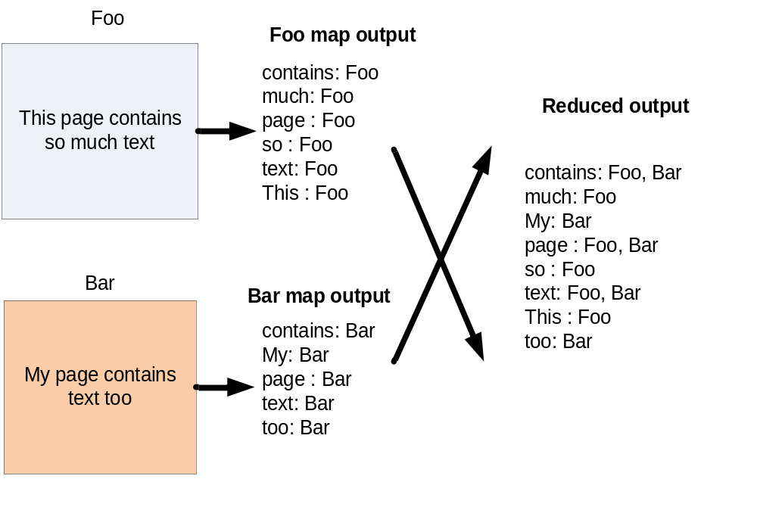
Inverted Index: Data flow

Slide 22
Processing Flow Optimization
A more detailed analysis of processing flow
Map: (docid₁, content₁) → (t₁, docid₁) (t₂, docid₁) …
Shuffle by t, prepared for map-reducer communication
Sort by t, conducted in a reducer machine
  (t₅, docid₁) (t₄, docid₃) … → (t₄, docid₃) (t₄, docid₁) (t₅, docid₁) …
Reduce: (t₄, [docid₃ docid₁ …]) → (t, ilist)
docid: a unique integer
t: a term, e.g., “apple”
ilist: a complete inverted list
but a) inefficient, b) docids are sorted in reducers, and c) assumes ilist of a word fits in memory
© 2010, Jamie Callan

Slide 23
Using Combine () to Reduce Communication
Map: (docid₁, content₁) → (t₁, ilist_{1,1}) (t₂, ilist_{2,1}) (t₃, ilist_{3,1}) …
  Each output inverted list covers just one document
Combine locally
  Sort by t
  Combine: (t₁ [ilist_{1,2} ilist_{1,3} ilist_{1,1} …]) → (t₁, ilist_{1,27})
  Each output inverted list covers a sequence of documents
Shuffle by t
Sort by t
  (t₄, ilist_{4,1}) (t₅, ilist_{5,3}) … → (t₄, ilist_{4,2}) (t₄, ilist_{4,4}) (t₄, ilist_{4,1}) …
Reduce: (t₇, [ilist_{7,2}, ilist_{3,1}, ilist_{7,4}, …]) → (t₇, ilist_{final})
ilist_{i,j}: the j’th inverted list fragment for term i
© 2010, Jamie Callan

Slide 24
Using MapReduce to Construct Indexes
Inverted List
Fragments
Inverted
Lists
Documents
Parser /
Indexer
A-F
:
Merger
Parser /
Indexer
:
G-P
:
Merger
:
:
Parser /
Indexer
:
:
:
Q-Z
Merger
Map/Combine
Shuffle/Sort
Reduce
© 2010, Jamie Callan

Slide 25
Construct Partitioned Indexes
Useful when the document list of a term does not fit memory
Map: (docid₁, content₁) → ([p, t₁], ilist_{1,1})
Combine to sort and group values
([p, t₁] [ilist_{1,2} ilist_{1,3} ilist_{1,1} …]) → ([p, t₁], ilist_{1,27})
Shuffle by p
Sort values by [p, t]
Reduce: ([p, t₇], [ilist_{7,2}, ilist_{7,1}, ilist_{7,4}, …]) → ([p, t₇], ilist_{final})
p: partition (shard) id
© 2010, Jamie Callan

Slide 26
Generate Partitioned Index
Inverted List
Fragments
Inverted
Lists
Documents
Parser /
Indexer
Partition
:
Merger
Parser /
Indexer
:
Partition
:
Merger
:
:
Parser /
Indexer
:
:
:
Partition
Merger
Map/Combine
Shuffle/Sort
Reduce
© 2010, Jamie Callan

Slide 27
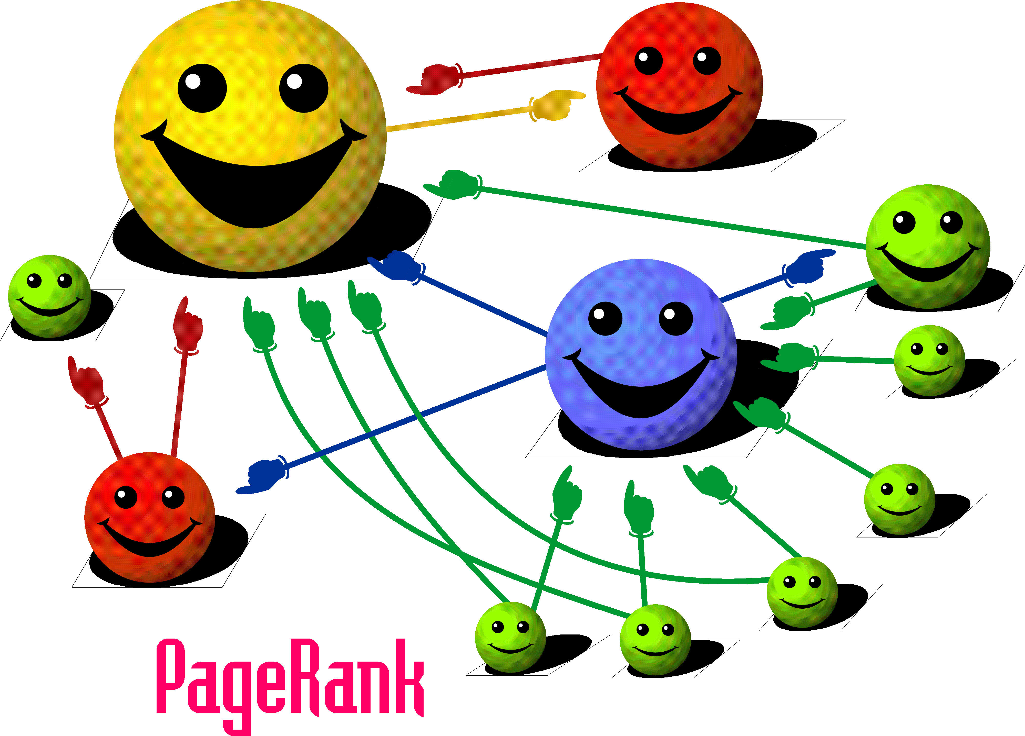
MapReduce Use Case 6: PageRank

Slide 28
Example: PageRank
Good example of a more complex algorithm
  Multiple stages of map & reduce
Benefits from Spark’s in-memory caching
  Multiple iterations over the same data

Slide 29
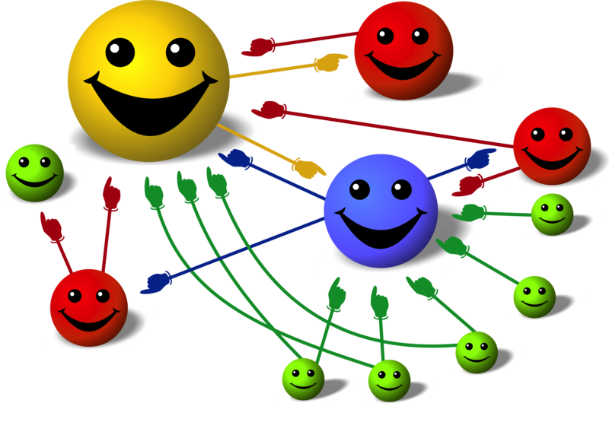
Basic Idea
Give pages ranks (scores) based on links to them
Links from many pages ➔ high rank
Link from a high-rank page ➔ high rank
Image: en.wikipedia.org/wiki/File:PageRank-hi-res-2.png

Slide 30
Algorithm
Start each page at a rank of 1
On each iteration, have page p contribute
rank_{p} / |neighbors_{p}| to its neighbors
Set each page’s rank to 0.15 + 0.85 × contribs
1.0
1.0
1.0
1.0

Slide 31
Algorithm
Start each page at a rank of 1
On each iteration, have page p contribute
rank_{p} / |neighbors_{p}| to its neighbors
Set each page’s rank to 0.15 + 0.85 × contribs
1.0
1
0.5
1
1.0
0.5
1.0
0.5
0.5
1.0

Slide 32
Algorithm
Start each page at a rank of 1
On each iteration, have page p contribute
rank_{p} / |neighbors_{p}| to its neighbors
Set each page’s rank to 0.15 + 0.85 × contribs
1.85
0.58
1.0
0.58

Slide 33
Algorithm
Start each page at a rank of 1
On each iteration, have page p contribute
rank_{p} / |neighbors_{p}| to its neighbors
Set each page’s rank to 0.15 + 0.85 × contribs
1.85
0.58
0.5
1.85
0.58
0.29
1.0
0.5
0.29
0.58

Slide 34
Algorithm
Start each page at a rank of 1
On each iteration, have page p contribute
rank_{p} / |neighbors_{p}| to its neighbors
Set each page’s rank to 0.15 + 0.85 × contribs
1.31
0.39
. . .
1.72
0.58

Slide 35
Algorithm
Start each page at a rank of 1
On each iteration, have page p contribute
rank_{p} / |neighbors_{p}| to its neighbors
Set each page’s rank to 0.15 + 0.85 × contribs
Final state:
1.44
1
0.46
4
2
1.37
3
0.73

Slide 36
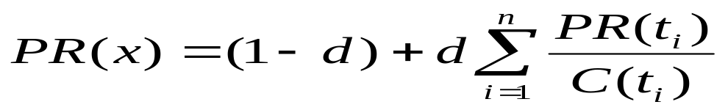
PageRank
Model page reputation on the web
i=1,n lists all parents of page x.
PR(x) is the page rank of each page.
C(t) is the out-degree of t.
d is a damping factor .
0.4
0.2
0.2
0.2
0.2
0.4
0.4

Slide 37
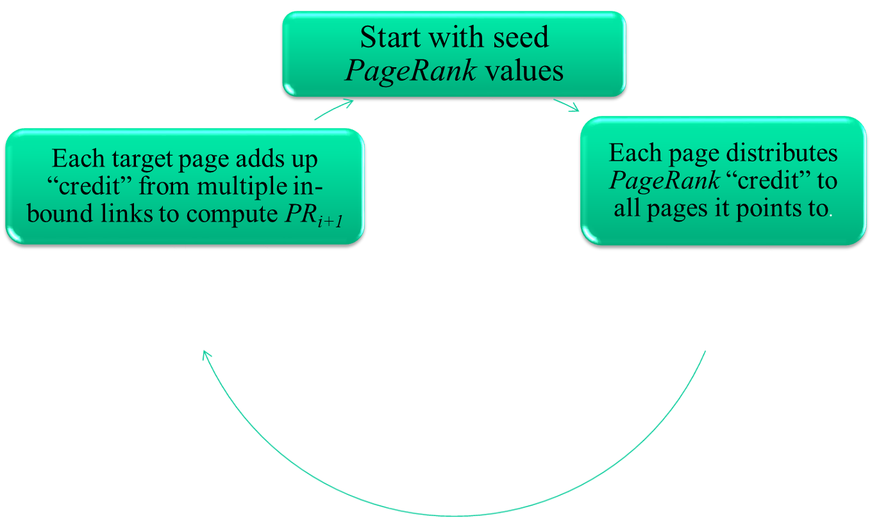
Computing PageRank Iteratively
  Effects at each iteration is local. i+1th iteration depends only on i^{th} iteration
  At iteration i, PageRank for individual nodes can be computed independently

Slide 38
Page Rank
PageRank is an iterative algorithm that performs many joins, so it is a good use case for RDD partitioning.
The algorithm maintains two datasets: one of (pageID, linkList) elements containing the list of neighbors of each page, and one of (pageID, rank) elements containing the current rank for each page. It proceeds as follows:
Initialize each page’s rank to 1.0.
On each iteration, have page p send a contribution of rank(p)/numNeighbors(p) to its neighbors (the pages it has links to).
Set each page’s rank to 0.15 + 0.85 * contributionsReceived.
The last two steps repeat for several iterations, during which the algorithm will converge to the correct PageRank value for each page. In practice, it’s typical to run about 10 iterations.

Slide 39
Conclusions
MapReduce advantages
Application cases
  Map only: for totally distributive computation
  Map+Reduce: for filtering & aggregation
  Database join: for massive dictionary lookups
  Secondary sort: for sorting on values
  Inverted indexing: combiner, complex keys
  PageRank: side effect files
© 2010, Jamie Callan

Slide 40
For More Information
J. Dean and S. Ghemawat. “MapReduce: Simplified Data Processing on Large Clusters.” Proceedings of the 6th Symposium on Operating System Design and Implementation (OSDI 2004), pages 137-150. 2004.
S. Ghemawat, H. Gobioff, and S.-T. Leung. “The Google File System.” OSDI 200?
http://hadoop.apache.org/common/docs/current/mapred_tutorial.html. “Map/Reduce Tutorial”. Fetched January 21, 2010.
Tom White. Hadoop: The Definitive Guide. O'Reilly Media. June 5, 2009
http://developer.yahoo.com/hadoop/tutorial/module4.html
J. Lin and C. Dyer. Data-Intensive Text Processing with MapReduce, Book Draft. February 7, 2010.
© 2010, Jamie Callan

