Slide 1
Datebase Design for Used Furniture Store
Team Members: Tianrou Chang, Xiaoyu Zhang, Yidan Sheng

Slide 2
Content
ER Diagram
Final Relational Schema
Triggers
Stored Procedure

Slide 3
ER Diagram
The used furniture company includes three branch stores and four warehouses.

Slide 4
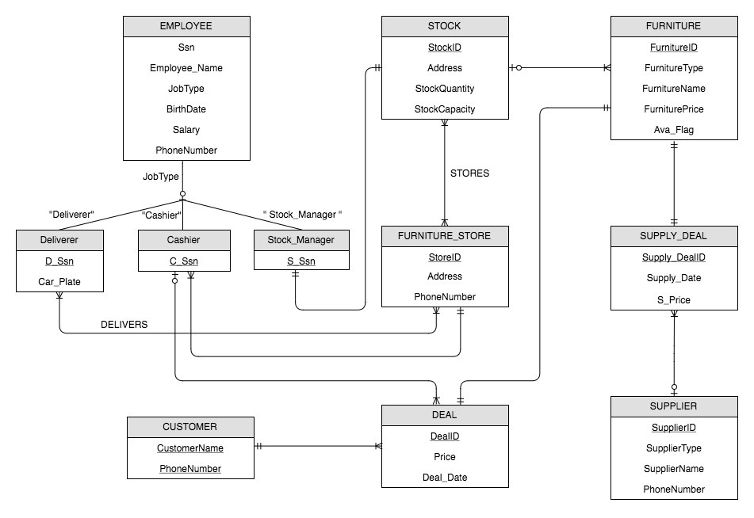

Slide 5
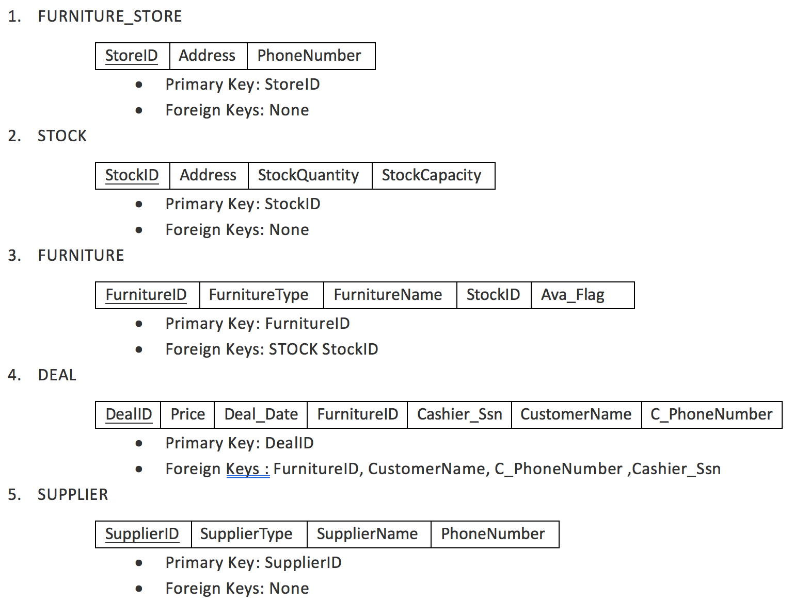
Relational Schema

Slide 6
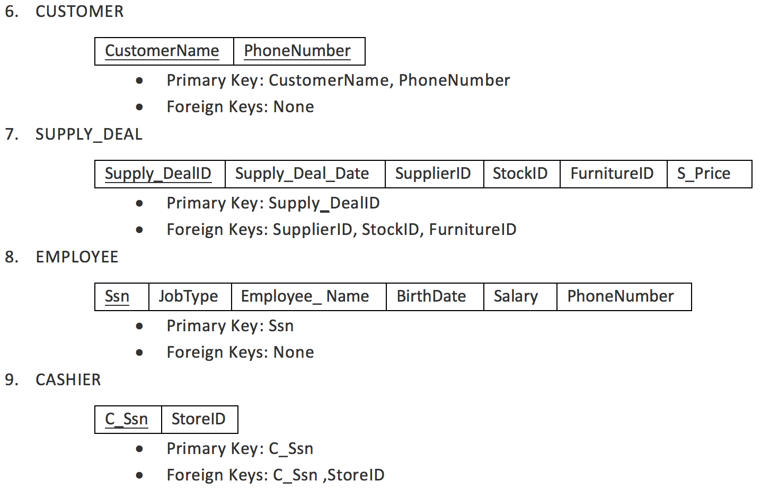
Relational Schema

Slide 7
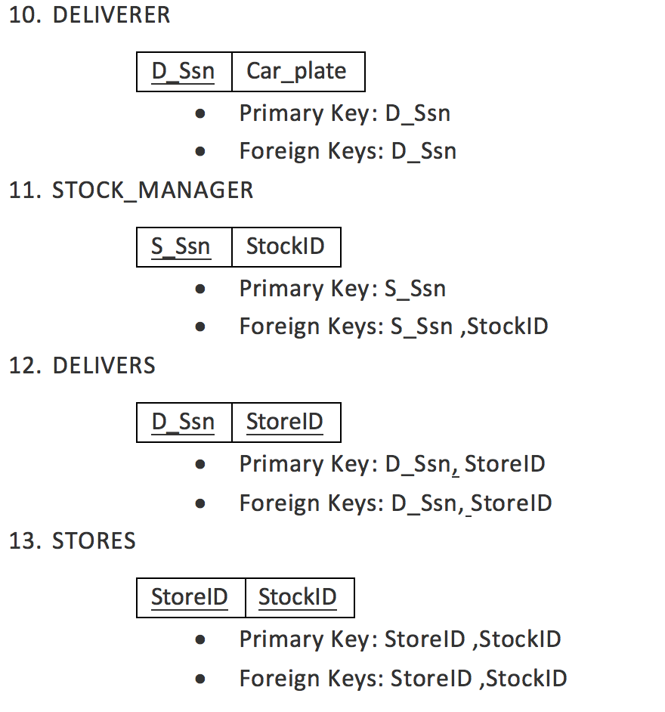
Relational Schema

Slide 8
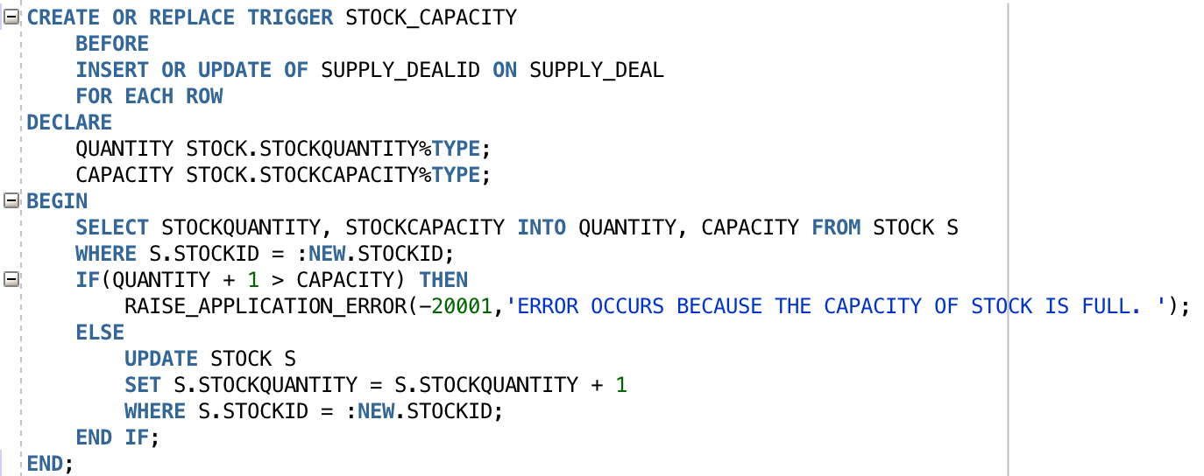
Trigger-I Stock Capacity
When the store process is successful, the number of the furniture quantity in the warehouse in which it store should be increased by one.

Slide 9
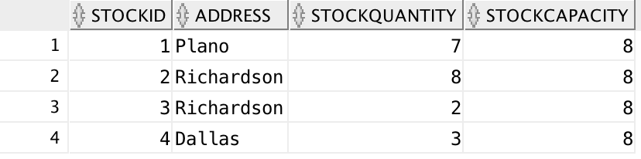
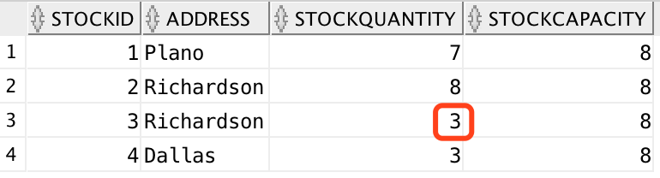
Test Output
INSERT INTO SUPPLY_DEAL (Supply_DealID,SUPPLY_DEAL_DATE,SUPPLIERID,STOCKID,FURNITUREID,S_Price) VALUES (23,to_date ( '03/20/1995' , 'MM/DD/YYYY' ),2,3,23,60);

Slide 10
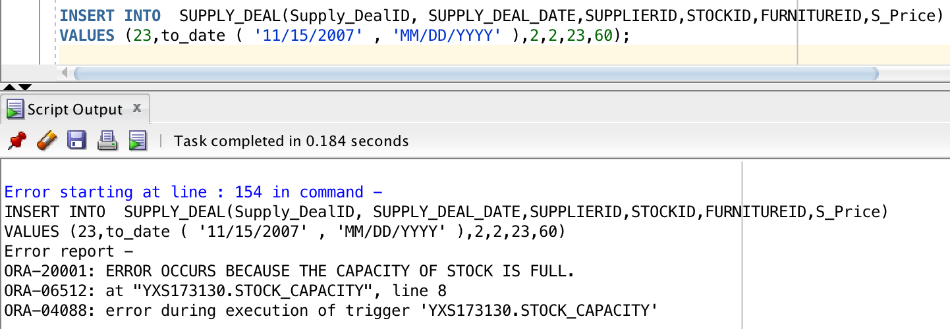
Test Output

Slide 11
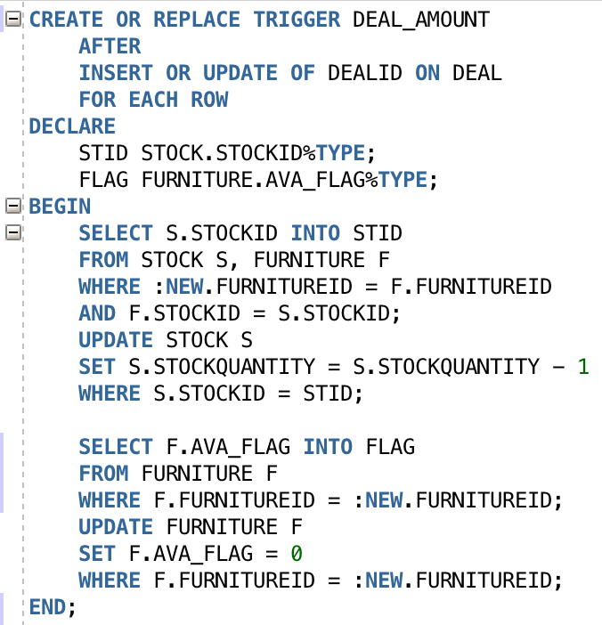
Trigger-II Deal Amount
When one deal completes successfully, the number of the furniture quantity in the warehouse in which the furniture store should be decreased by one, the system should update the information of the furniture so that its status is marked as sold.

Slide 12
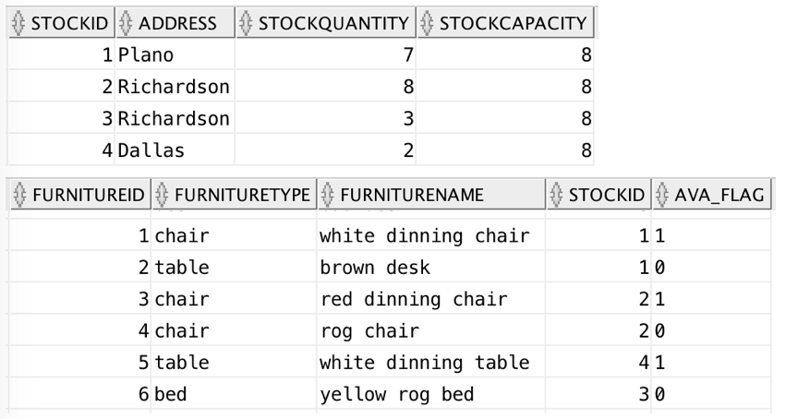
Test Output
INSERT INTO DEAL(DEALID, PRICE, DEAL_DATE, FURNITUREID, CASHIER_SSN, CUSTOMERNAME, C_PHONENUMBER)
VALUES(10,110,to_date ( '03/27/2017' ,'MM/DD/YYYY'),5,333333333,'Tom',4693343687);

Slide 13
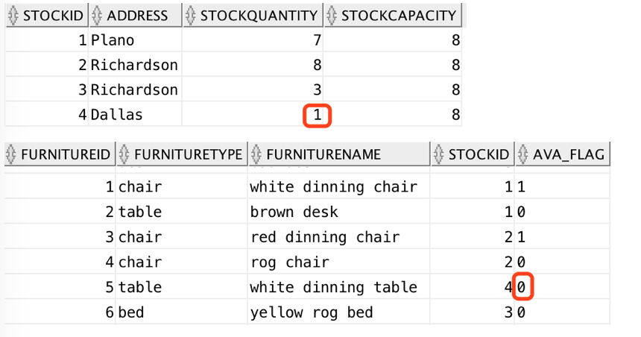
Test Output

Slide 14
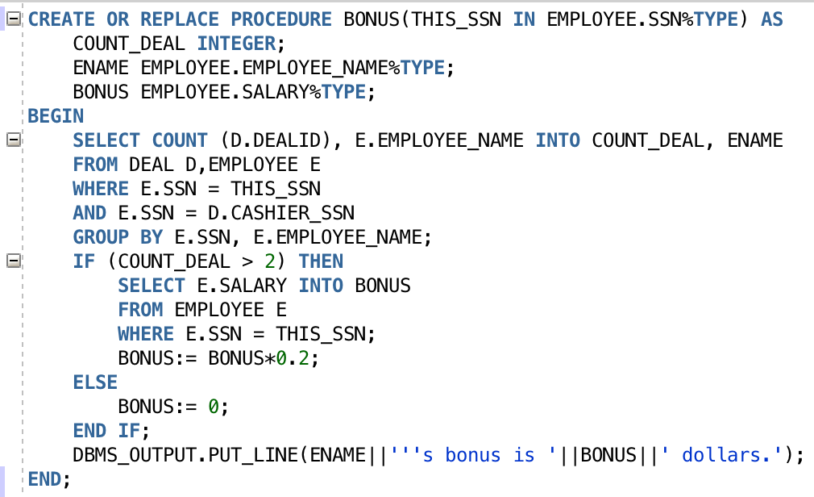
Procedure-I Calculating Bonus
When a cashier sells two or more pieces of furniture in one season, the company gives the cashier a bonus. The amount of the bonus was 20 percent of the cashier's original salary.

Slide 15
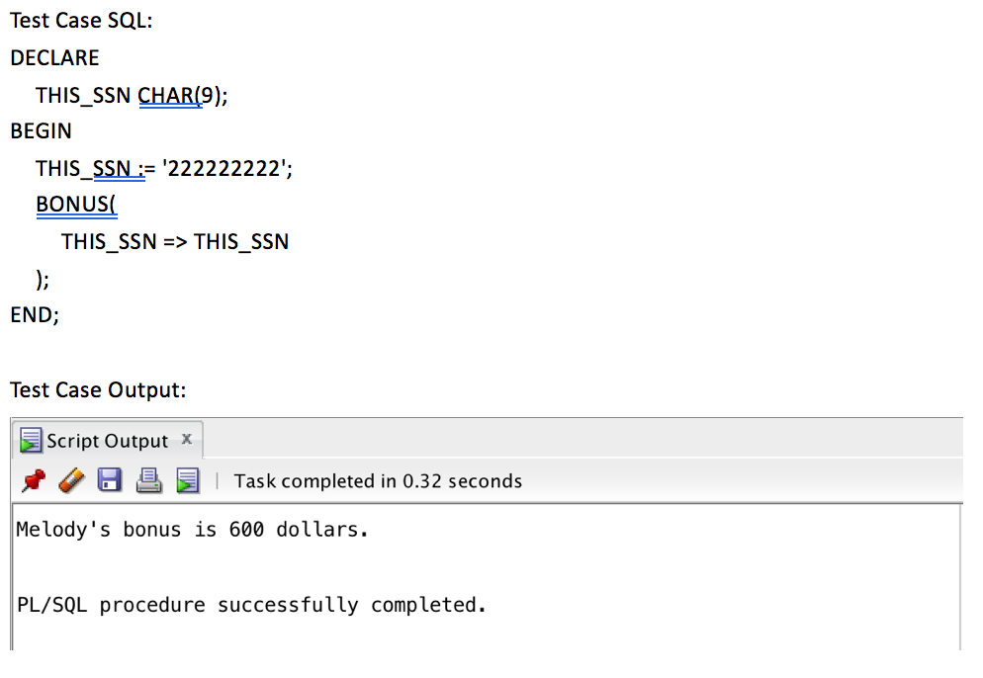
Test Output

Slide 16
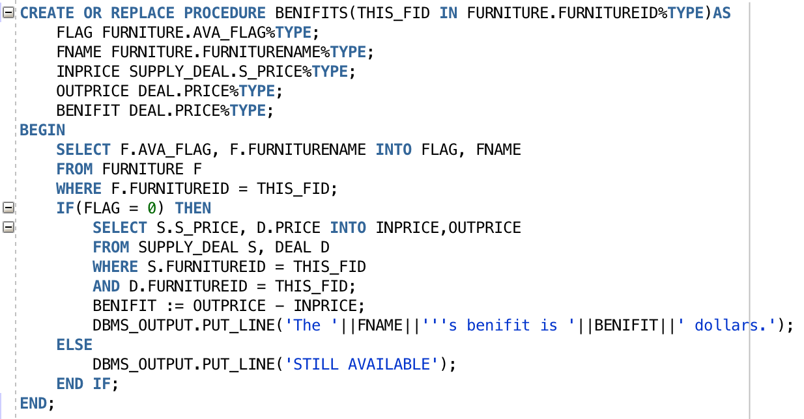
Procedure-II Calculating Benefit for Each Deal
According to the supply deal record and the deal record, the company can calculate the profit of each piece of furniture.

Slide 17
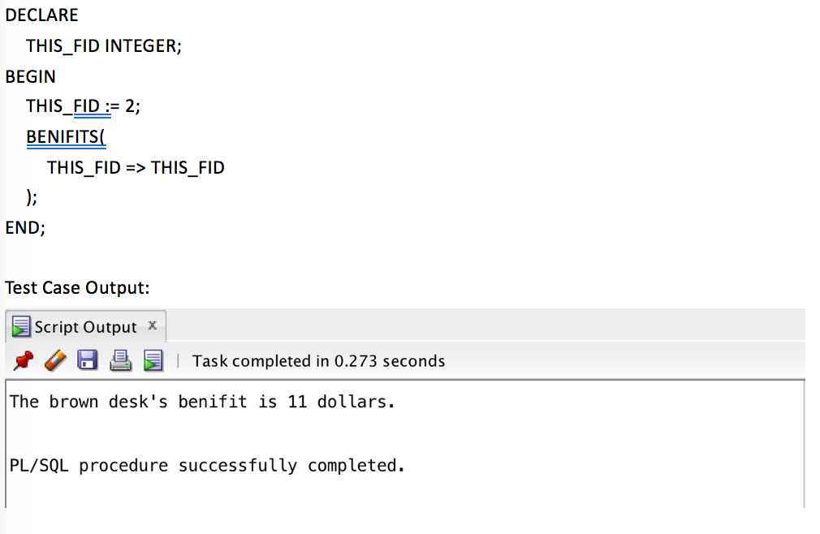
Test Output

