Slide 1
President Speech Analysis Presentation:
A reusable framework for text analysis and comparison

Slide 2
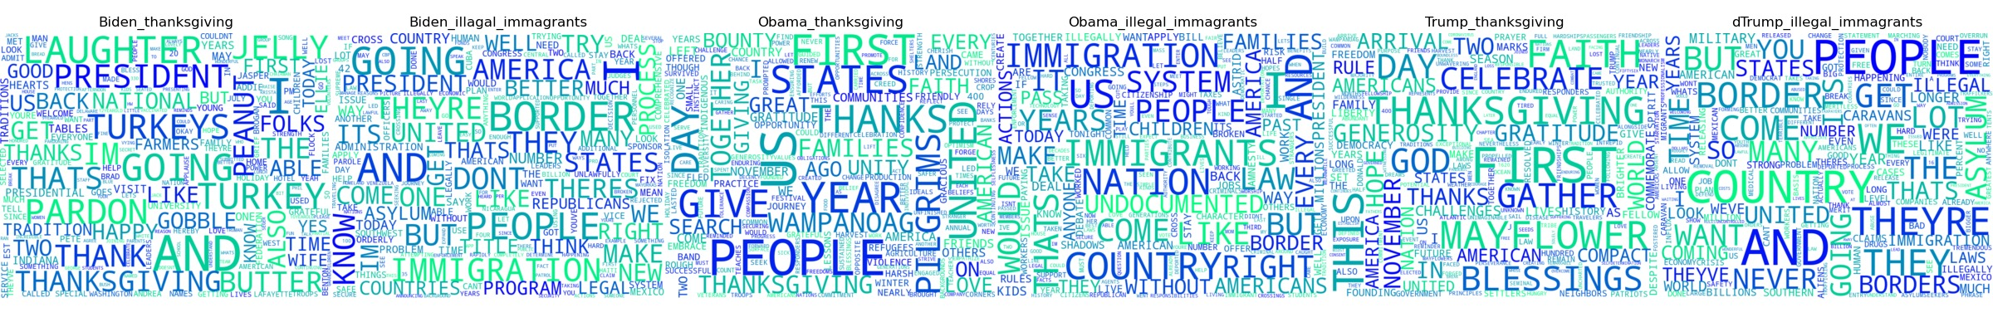
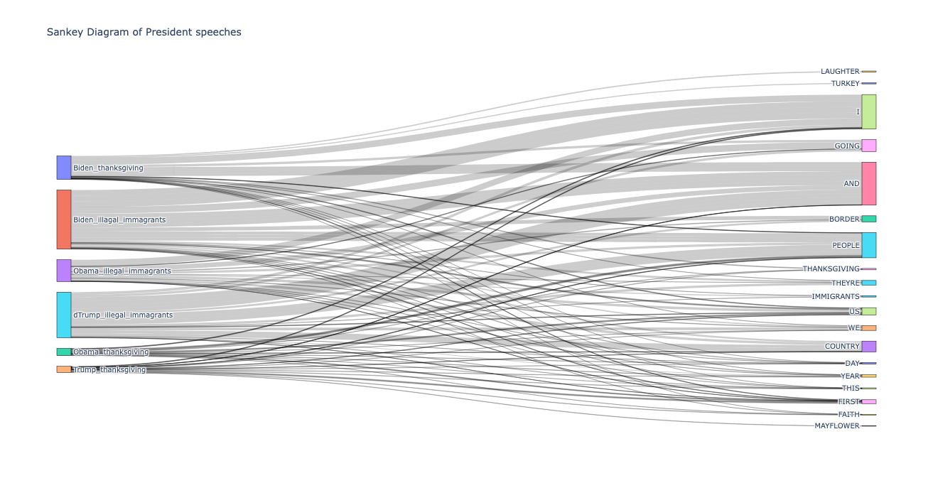
President Speech Analysis Jingkai Wang, Yidi Wang, Qixiang Jiang
The United States Government. (n.d.). Speeches and remarks archives. The White House. Retrieved February 27, 2023, from https://www.whitehouse.gov/briefing-room/speeches-remarks/

