Slide 1

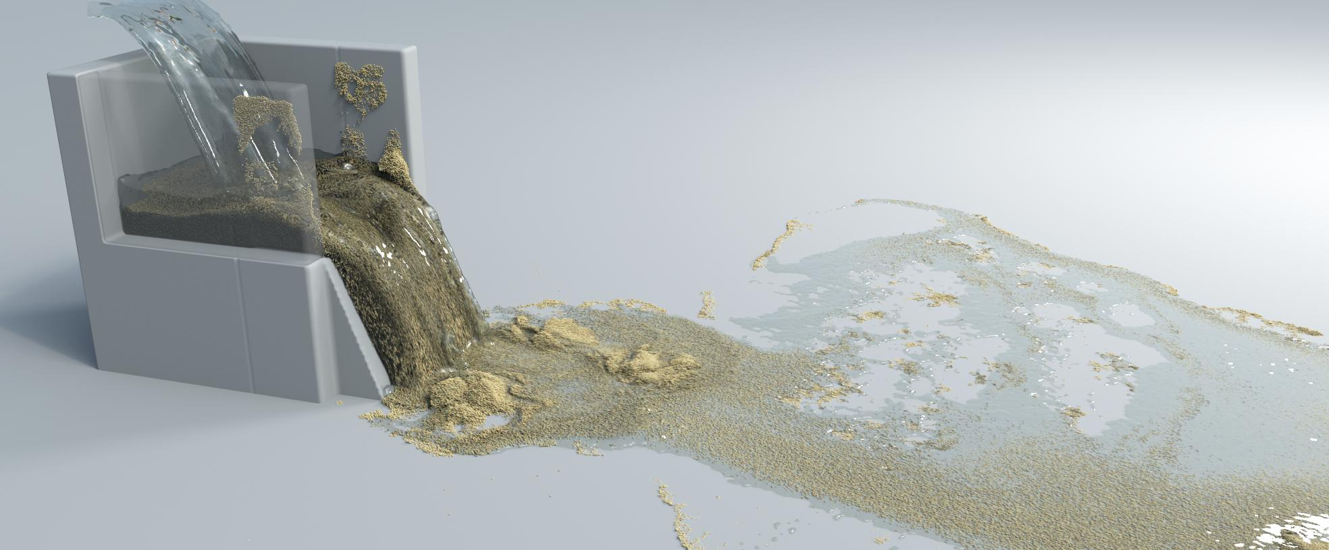
CS570 Team 19
Project progress 1: data generation
Changjun Lee Yidong Zhao Seongbin An Sihyun Kim
Computer Science
Civil and Environmental Engineering
Mechanical Engineering
Computer Science
Apr. 30, 2022

Slide 2
Outline:
Problem description
Data generation
Next step

Slide 3
Problem description

Slide 4
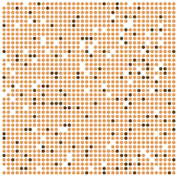
Problem description
Sand box collapse:
Under gravity loading, these 1600 sand particles will collapse.
0.4 m
0.4 m

Slide 5
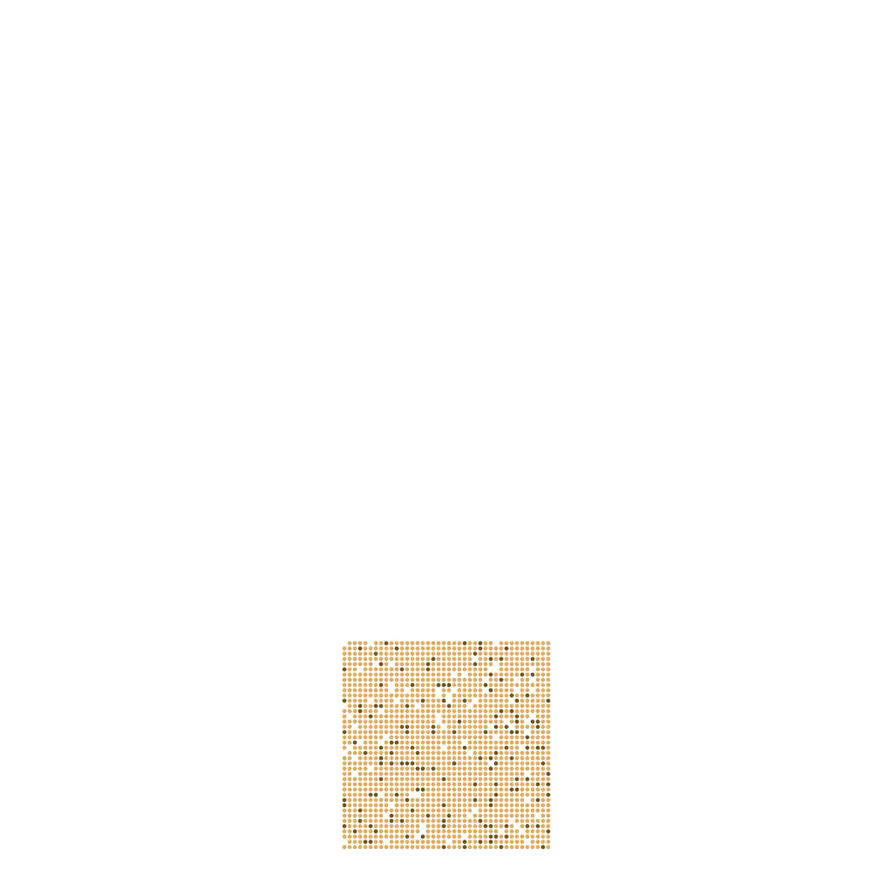
Problem description
Sand box collapse video:

Slide 6
Data generation

Slide 7
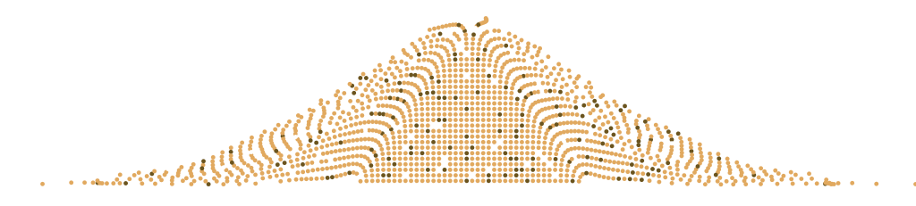
Data range:
Y
Max y = 0.342 m
Min y = 0.0385 m
X
Min x = 0.169 m
Max x = 1.832 m

Slide 8
Negative samples generation:
We may generate 1600 negative particles in this box region?
Y
Max y = 0.342 m
Min y = 0.0385 m
X
Min x = 0.169 m
Max x = 1.832 m

Slide 9
Next step

Slide 10
Next step:
Generate negative samples
Feed into the MLP to see results

