Slide 1
Live Classroom
Welcome to CS555: Data Analysis & Visualization
Heather Shappell, PhD

Slide 2
CS555: Data Analysis & Visualization
Intensive 6-week course
Provides overview of the statistical methods most used to process, analyze, and visualize data.
Demonstrates how to perform the statistical methods in R.

Slide 3
Deliverables
Weekly quizzes (30%)
Weekly homeworks (30%)
Final Project (10%)
Cumulative final exam (30%)

Slide 4
Tools
Live Classrooms:
  Wednesdays 7 PM EST to review some of the bigger concepts, as well as how to apply concepts in R.
  Q & A sessions:
    Katherine: Fridays 12:00 – 1:00 PM EST
    Michael: Sundays 10:30 – 11:30 AM EST
    Teresa: Sundays 11:30 AM – 12:30 PM EST
    Sarah: Mondays 8:00 – 9:00 PM EST
  Tuesdays: Quiz and homework due at 6AM EST!
  Fridays: Solutions to homework and quizzes released

Slide 5
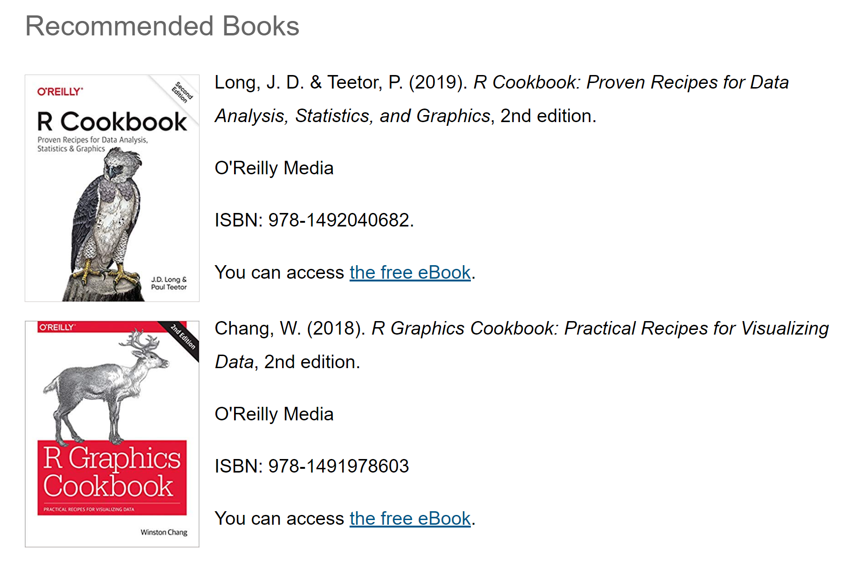
Tools
Textbooks:

Slide 6
Tools
Github Account:
https://github.com/kiat/R-Examples
Video Tutorials
  Check out the videos at the end of each module’s reading sections!
  These will help solidify the statistical concepts.
  They will also demonstrate how to apply the concepts in R.
  R scripts associated with these tutorials are located on the github account.

Slide 7



A little about me…
Instructor: Heather Shappell
  Professor of Biostatistics and Data Science at Wake Forest University
  Previously, a post-doctoral fellow in the Biostatistics Department at JHU
  BS in Math and Computer Science from Arcadia University
  MA, PhD in Biostatistics from
  Boston University
  Have been teaching with CS
  Department since 2013

Slide 8
Live Classroom
Applications in R
Module 1 – Describing and Interpreting Data

Slide 9
Why R?
Powerful tool for statistics and graphics
New technologies and ideas often appear first in R
It’s free!
Accessible to you after course
Highly marketable skill

Slide 10
Resources for getting help
Textbook (use Table of Contents and Index)
R project website (https://www.r-project.org/help.html)
R-specific search engine (http://rseek.org)
GOOGLE!
The facilitators and I (by group discussion board, email, or during live classrooms)

Slide 11
Reminders
More than one way of doing things.
Programming isn’t easy!
Try to figure things out on your own, but don’t kill yourself either.
Incentive: extra credit for writing up an issue or challenge you had and how you solved it (to be applied toward your homework grade) and posting for other student’s benefit on your group discussion board.
  Should be something not directly taught in class or in the module notes!

Slide 12
Working Efficiently
Using R Editor
  From “File” menu, select “New Script”
  Write, revise, and run code from R editor window
  Save script for future reference and “starting place” for new programs
  Use “#” to make comments throughout your program
Set the working directory

Slide 13
The Working Directory
Default location for all file input and output (important for reading in data, opening and saving R scripts)
Set the working directory to a folder of your choosing
  Use “setwd(directory)” command to set the working directory
    Remember to either double up on backslashes “\\” or use forward slash “/”
    Example “setwd("C:\\Users\\hshap\\Documents\\CS 555 Assignments\\Teaching\\Week1") “
To check, the getwd() function will tell you what it is currently set to

Slide 14
Installing and Accessing Functions
Installing
  Only need to do this once
  Use “install.packages(“packagename”)” function
    Will recognize dependencies between packages and also install required “sub” packages
  Select “Install packages…” from Package menu after downloading file from web
Accessing
  Will need to do this every time you need to use a package’s functions in a particular session
  Use “library(packagename)” function

Slide 15
Reading in Data
Loading data from a text data file
  Use “read.table(“filename”)” or “read.csv(“filename”)” functions
Loading data from an excel file (.xlsx)
  Will need to install and load packages!
  https://www.datacamp.com/community/tutorials/r-data-import-tutorial#txt
Make it easier on yourself
  Save file you are going to read into your working directory (so you don’t have to specify path)
  Ensure there are column headers which are labelled in a simple way
  Check your data after you read it in to make sure it is right

Slide 16
Qualitative Data Summaries
Numerical Summaries
  Class Frequencies
    Use table(data$variable) function.
  Class Relative Frequencies
    Divide table function output by the number of rows in the dataset (ie, number of observational units) by using nrow(data)
Graphical Summaries
  Bar Graphs
    Use barplot(table(data$variable)) function inputting the class frequencies or class relative frequencies
  Pie Charts
    Use pie(table(data$variable)) function inputting the class frequencies or class relative frequencies

Slide 17
Example – Education Level of CEOs
Read in data
  data<-read.csv("ceo.csv")
Numerical summaries
  Frequencies: table(data$edlevel)
  Relative Frequencies: table(data$edlevel)/nrow(data)*100
Bar graph
  barplot(table(data$edlevel))
  barplot(table(data$edlevel)/nrow(data)*100)
Pie Chart
  pie(table(data$edlevel))

Slide 18
Example – Education Level of CEOs
Using ggplot2 package
  install.packages(“ggplot2”)
  library(ggplot2)
More flexibility in controlling output
  ggplot(data, aes(x=edlevel))+
    geom_bar(width = .9, fill = c("lightsalmon","navy","lightseagreen","mediumorchid1"), color = "black")+
    xlab("Education Level")+ylab("Count")

Slide 19
Quantitative Data Summaries
Numerical Summaries
  Mean
  Median
  Variance
  Standard Deviation
  Quartiles
Graphical Summaries
  Histograms
  Box Plots

Slide 20
Numerical Summaries
Mean: mean(data$variable)
Median: median(data$variable)
Variance: var(data$variable)
Standard Deviation: sd(data$variable)
Quartiles: quantile(data$variable)
Minimum: min(data$variable)
Maximum: max(data$variable)
Or you could use summary(data$variable) function to get all but the standard deviation and variance

Slide 21
Graphical Summaries
Histograms
  Use hist(data$variable) function
  Can specify number of bins or cutpoints
    hist(data$variable, bins)
    hist(data$variable, breaks = c(#,#,#,#,#,#))
    hist(data$variable, breaks = seq(a, b, by=c))
Boxplots
  Use boxplot(data$variable) function

Slide 22
Example – Ages of Employees
Read in data
Numerical Summaries
  Min, Max, Mean, Median, Quartiles
    summary(data$age)
  Variance and Standard Deviation
    var(data$age) and sd(data$age)
Graphical Summaries
  Histograms
    hist(data$age)
    Or, ggplot(data, aes(x=age))+geom_histogram(binwidth=5, fill = "white", color = "black", origin = 20)
  Box Plots
    boxplot(data$age)

Slide 23
“Beautifying” Graphics
Labelling
  titles: main = “title”
  x-axis label: xlab = “label”
  y-axis label: ylab = “label”
Colors
  http://www.stat.columbia.edu/~tzheng/files/Rcolor.pdf
Controlling the window
  x-axis: xlim=c(min,max)
  y-axis: ylim=c(min,max)
Putting more than one graph in a single output window
  use function par(mfrow=c(a, b)) to divide graphics window into a rows and b columns

Slide 24

Normal Distribution
The normal distribution is the most common continuous distribution in practice. The classic bell-shaped curve represents the normal distribution.
The probability is calculated for values that occur within a certain range or interval as the area under the curve.
A normal distribution is completely determined by the mean (μ) and the standard deviation (σ).
Two normally distributed random variables having the same mean and standard deviation must have identical distributions.

Slide 25
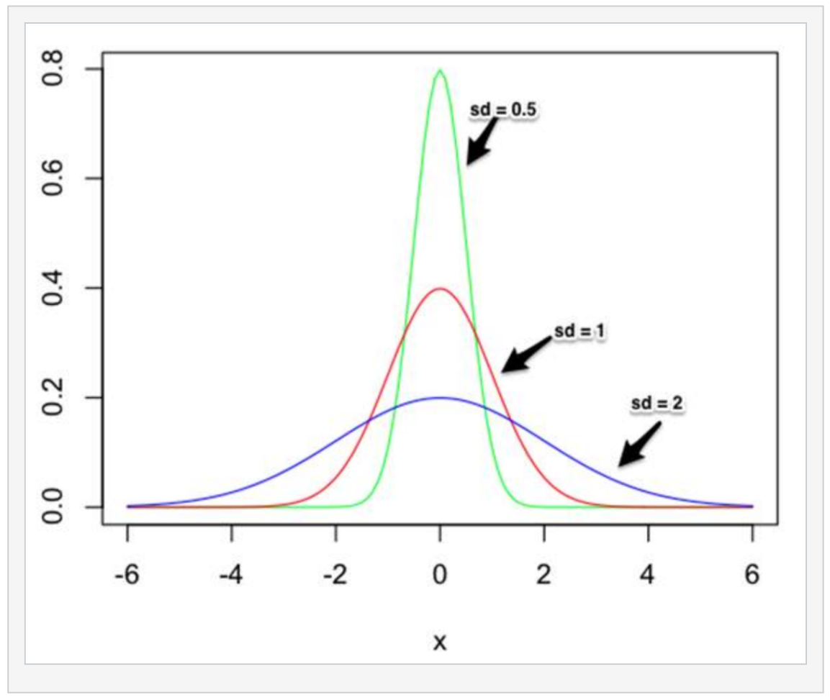
Normal Distribution
Same means but different standard deviations.

Slide 26
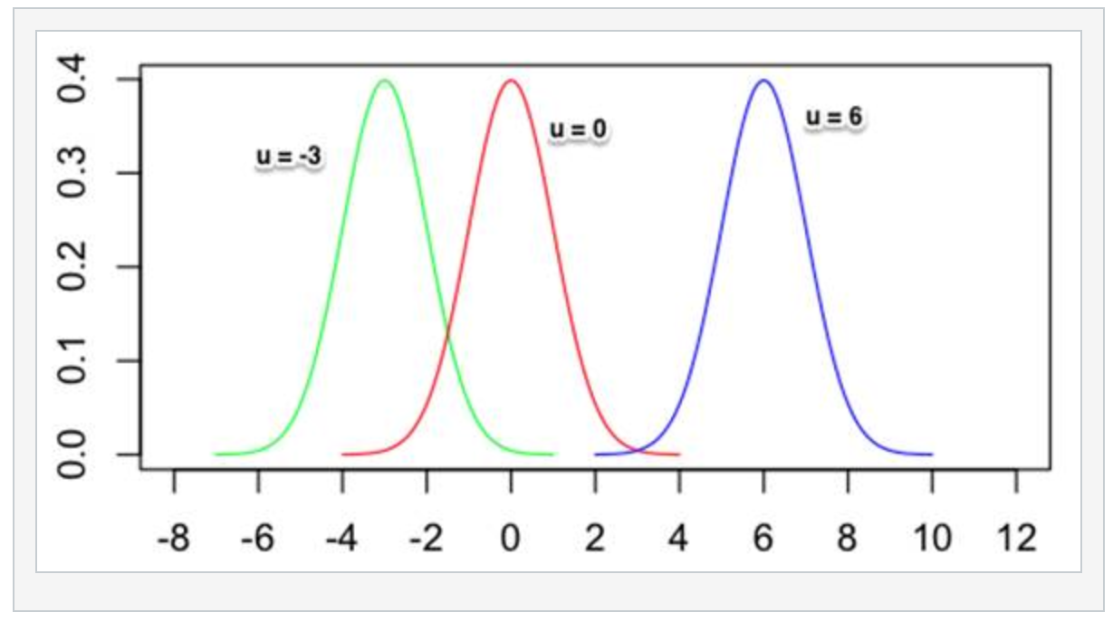
Normal Distribution
Same standard deviation but different means.

Slide 27
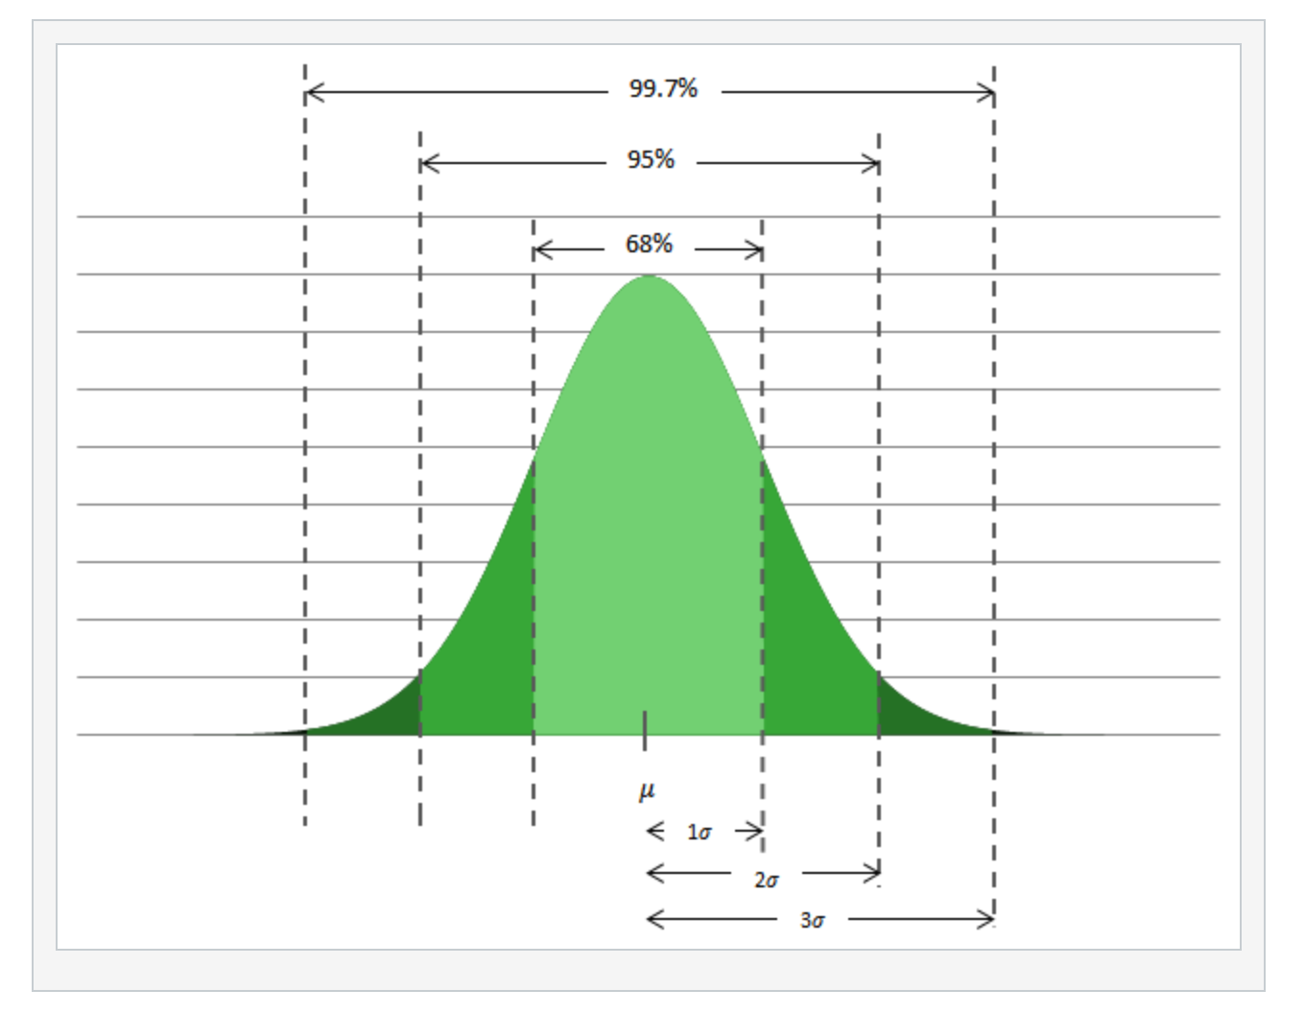
Normal Distribution
68.27% of the observations lie within one standard deviation of the mean
95.45% of the observations lie within two standard deviations of the mean
99.73% of the observations lie within three standard deviations of the mean

Slide 28
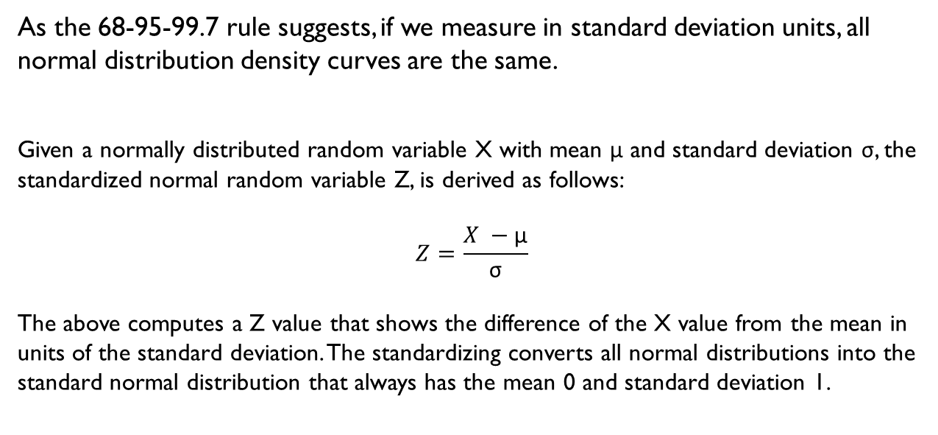
Standard Normal Distribution
As the 68-95-99.7 rule suggests, if we measure in standard deviation units, all normal distribution density curves are the same.
Given a normally distributed random variable X with mean μ and standard deviation σ, the standardized normal random variable Z, is derived as follows:
$$Z=\frac{X −\text{μ}}{\text{σ}}$$
The above computes a Z value that shows the difference of the X value from the mean in units of the standard deviation. The standardizing converts all normal distributions into the standard normal distribution that always has the mean 0 and standard deviation 1.

Slide 29
Normal Distribution
Areas
  Under the standard normal curve
    Use the pnorm(z) function to calculate the area to the left of z
  Under then normal curve
    Use the pnorm(x, mean = mean, sd = sd) function to calculate the areas to the left of x
    Doesn’t require you to standardize first
Z-value associated with an area
  Standardized
    Use the qnorm(a) function to find the standardized z value with a as the area to the left
  Original Scale
    Use the qnorm(a, mean = mean, sd = sd) to find the unstandardized value associated with an area of a to the left

Slide 30
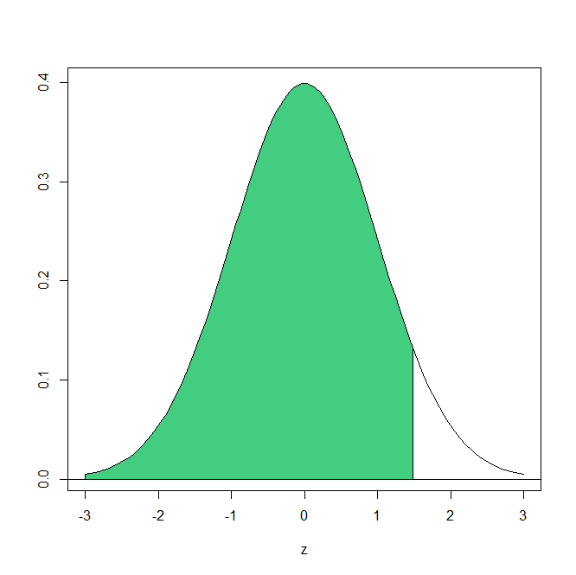
Example – Areas under Std Normal Curve
Find the area under the standard curve to the left of z = 1.53
  By hand, use the table.
  In R, use the pnorm(z) function
    pnorm(1.53)

Slide 31
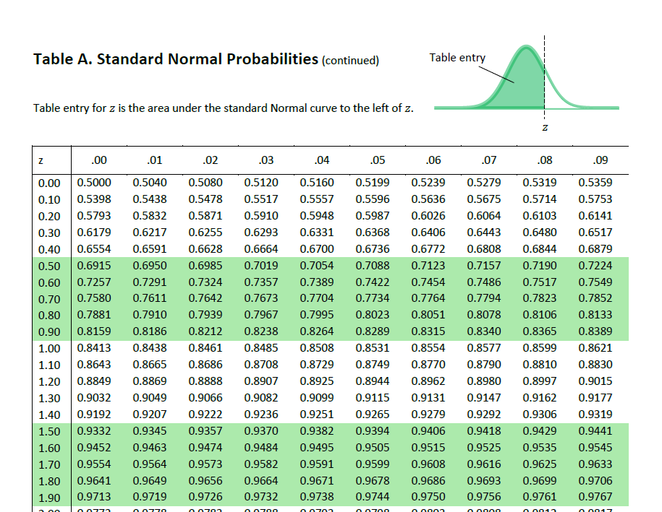

Slide 32
Example – Birth Weights
Let’s assume that the distribution of birth weights is normally distributed with a mean of 3500 grams with a standard deviation of 500 grams. What proportion of infants weigh less than 4100 grams?
  By hand, we have to standardize 4100, then use the tables to find the area to the left.
  Using R, we can just use the pnorm() function directly
    pnorm(4100, mean=3500, sd = 500)

Slide 33
Example – Birth Weights
Let’s assume that the distribution of birth weights is normally distributed with a mean of 3500 grams with a standard deviation of 500 grams. What proportion of infants weigh greater than or equal to 3200 grams?
  By hand, we have to standardize 3200, use the tables to find the area to the left, then calculate the area to the right by subtracting the area to the left from 1.
  Using R, we can just use the pnorm() function and subtract from 1 in a single step
    1-pnorm(3200, mean=3500, sd = 500)

Slide 34
Example – Birth Weights
Let’s assume that the distribution of birth weights is normally distributed with a mean of 3500 grams with a standard deviation of 500 grams. What proportion of infants are between 3250 and 3750 grams?
  By hand, we have to standardize 3250 and 3750, use the tables to find the area to the left of each of these and subtract.
  Using R, we can just use the pnorm() function twice and subtract in a single step
    pnorm(3750, mean=3500, sd = 500) - pnorm(3250, mean=3500, sd = 500)

Slide 35
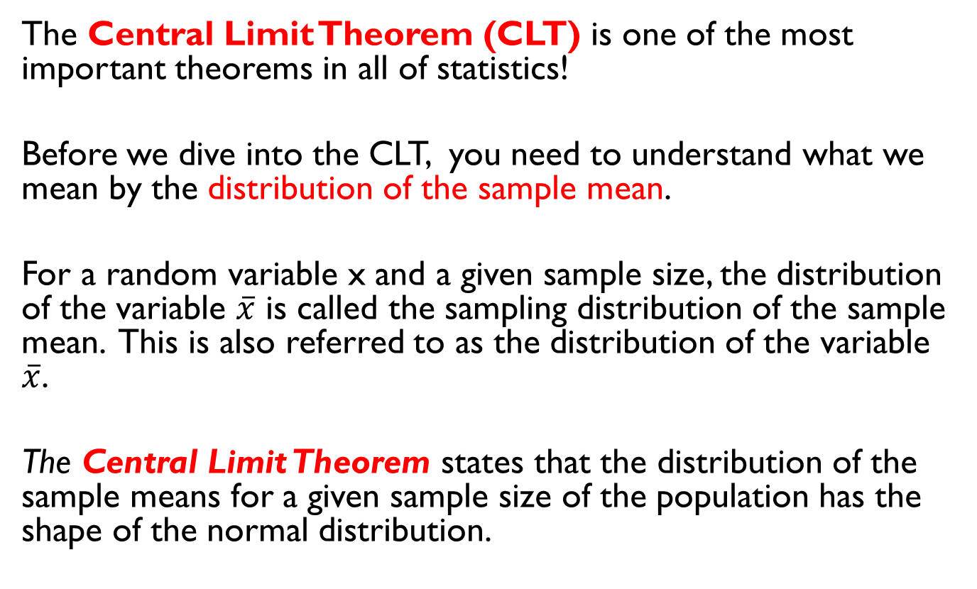
Central Limit Theorem
The Central Limit Theorem (CLT) is one of the most important theorems in all of statistics!
Before we dive into the CLT, you need to understand what we mean by the distribution of the sample mean.
For a random variable x and a given sample size, the distribution of the variable $\overline{x}$ is called the sampling distribution of the sample mean. This is also referred to as the distribution of the variable $\overline{x}$.
The Central Limit Theorem states that the distribution of the sample means for a given sample size of the population has the shape of the normal distribution.

Slide 36
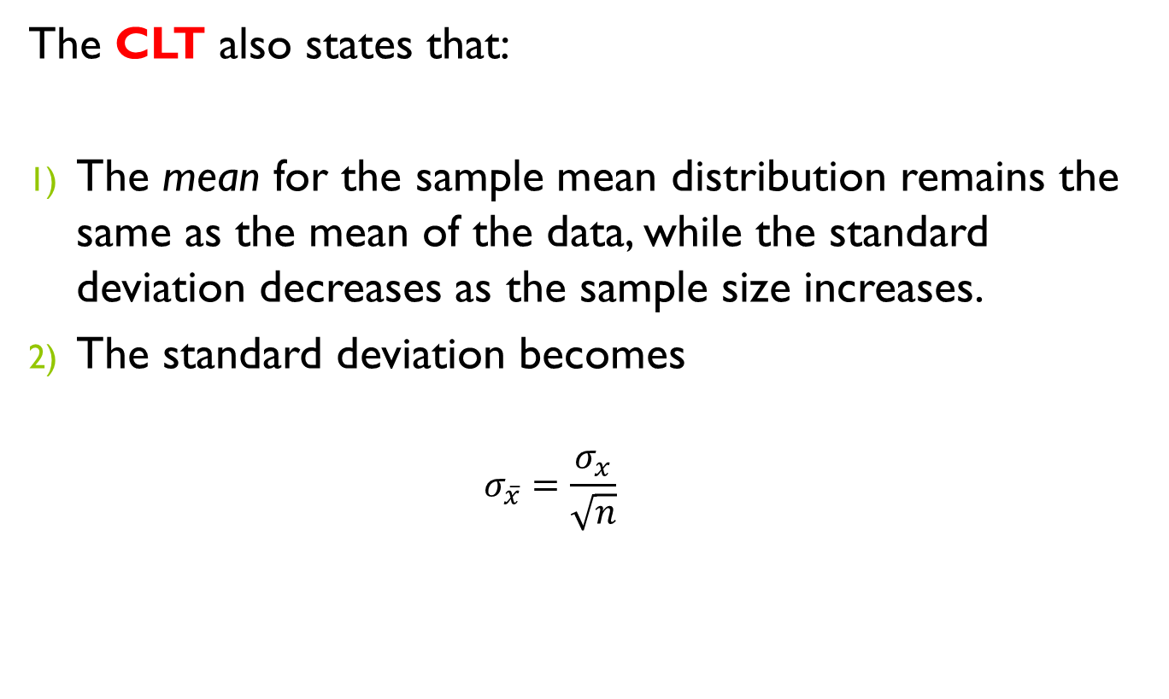
Central Limit Theorem
The CLT also states that:
The mean for the sample mean distribution remains the same as the mean of the data, while the standard deviation decreases as the sample size increases.
The standard deviation becomes
    $$σ_{\overline{x}}=\frac{σ_{x}}{\sqrt{n}}$$

Slide 37
Central Limit Theorem
The coolest thing about the CLT is…
It holds even if the original data is not from a normal distribution!!

Slide 38
Example – IQ Scores
Suppose we have selected a random sample of n=40 students’ IQ scores from a population with a mean of 100 and a standard deviation of 10. Find the probability that the sample mean will be between 90 and 95.
pnorm(95, mean=??, sd = ??) - pnorm(90, mean=??, sd = 5??)

