Slide 1
Sports Data Analytics
Yiduo Feng. 12/06/2022
CS688 Final Project – Prof. Zlatko Vasilkoski

Slide 2

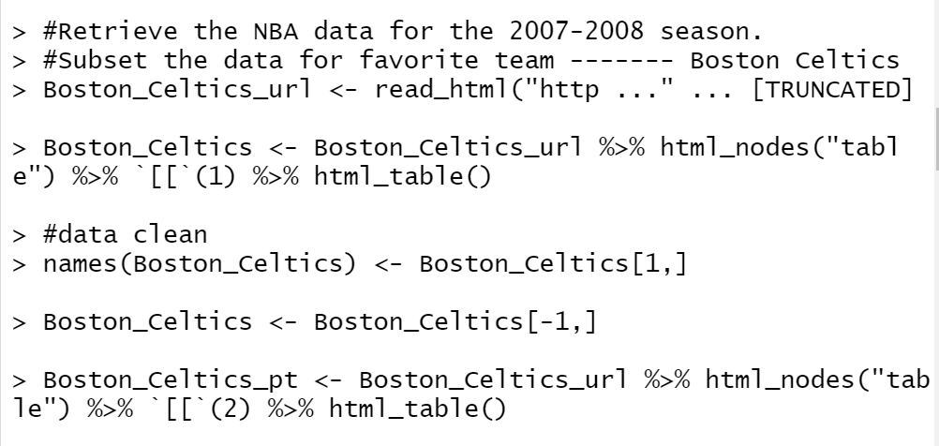
Retrieve the NBA data
Use rvest package to scrape the data from NBA website.
Through visiting the website, find that the first and second tables are what I need, so use “%>% html_nodes("table") %>% `[[`(1) %>% html_table()” to save the tables in R.

Slide 3
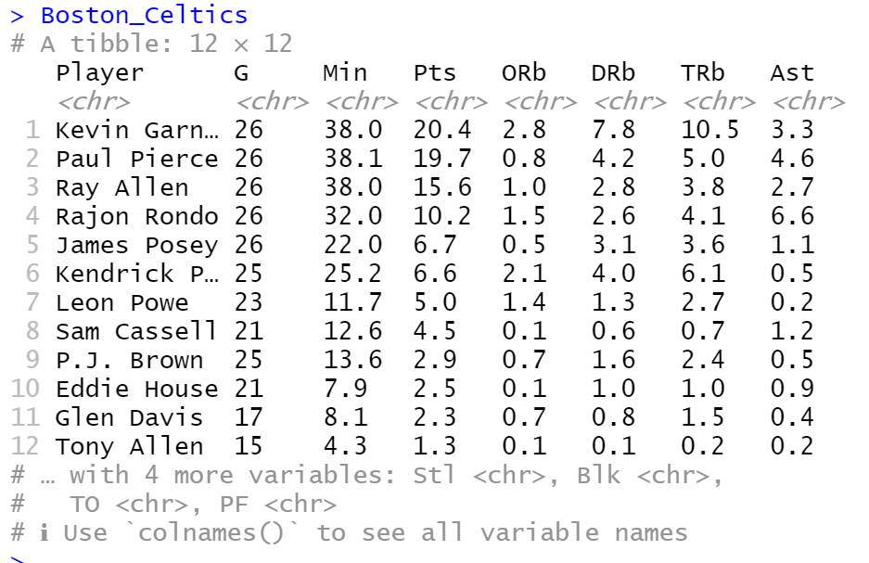
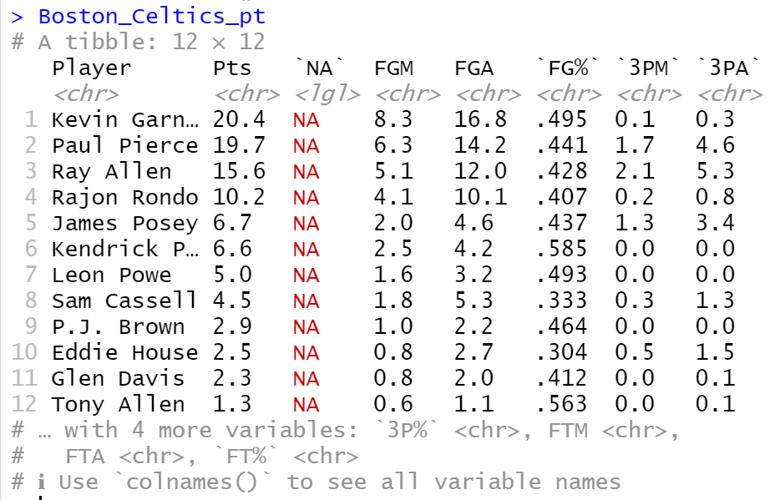
Retrieve the NBA data
The two tables are shown below:

Slide 4
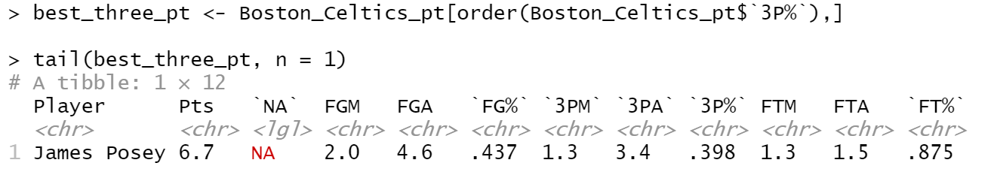
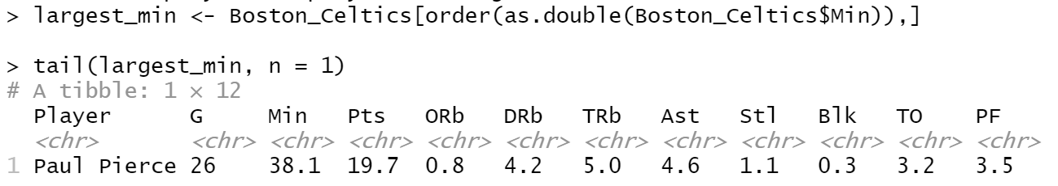
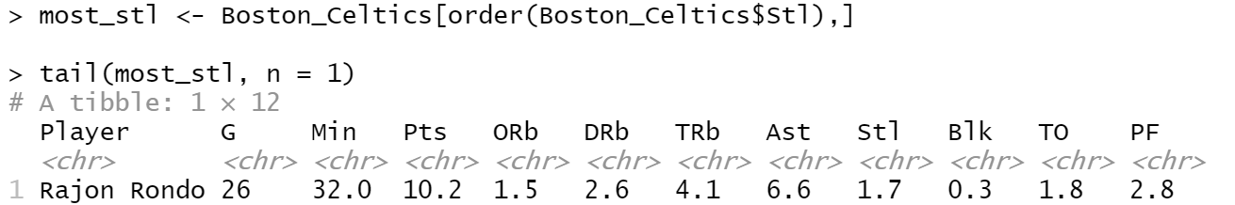
Boston Celtics
Which player has the best three point percentage?
Which player has played the largest number of minutes?
Which player has the most "Steals"?
Use order() function to sort the data frame.
Then , the players with the largest 3 points percentage, most time, most “Streals” should be at the bottom of the data frame, so I used tail() function to get them.

Slide 5

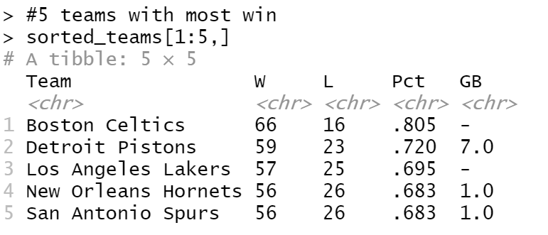
5 teams for the 2007-2008 season that have the most wins in descending order.
The team with most wins should have least lost, so I sort the teams by the number of lost, then the first 5 teams will be the teams that have the most win.

Slide 6
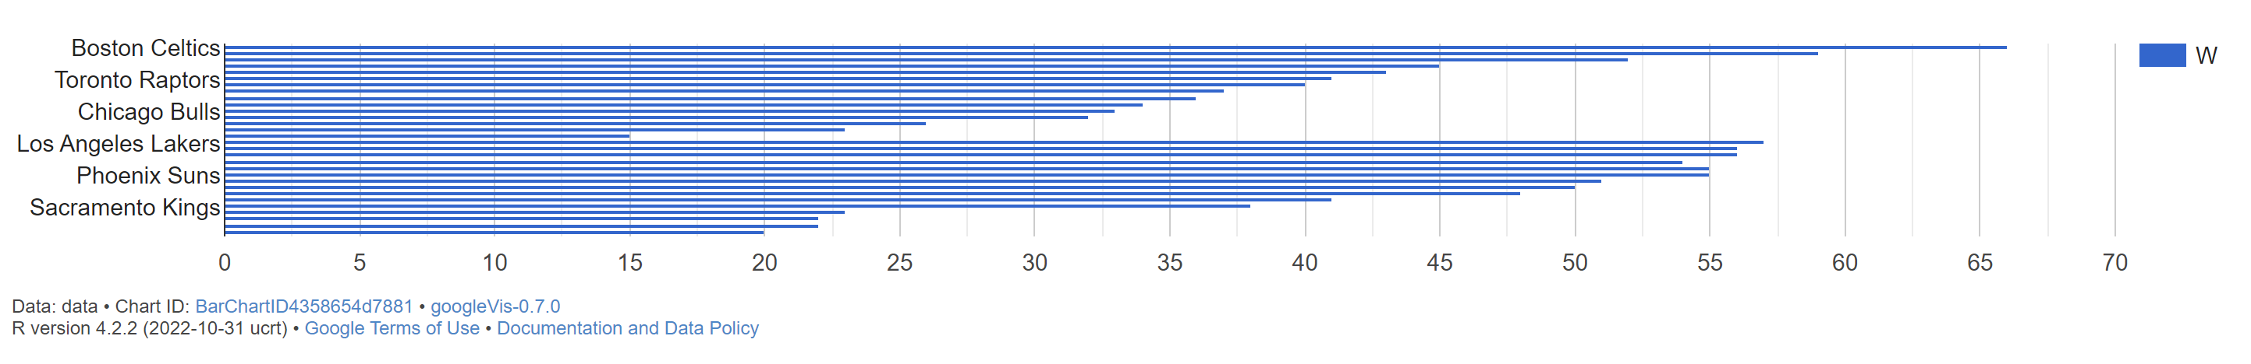
The number of wins for each team
According to the bar chart we can check the number of wins for each team directly.
Boston Celtics has the most wins.

Slide 7
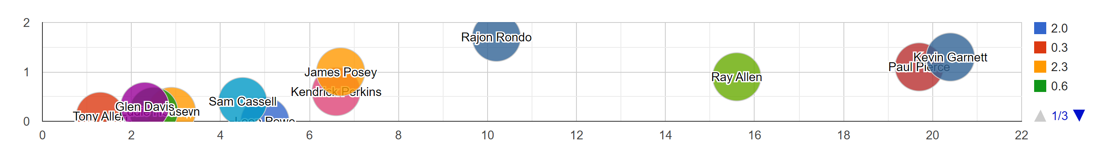
The correlation among points, steal and pf
According to the bubble chart we can check the correlation among points, steal and pf. We can find that the color of the circles distribute randomly, so steals and points will impact personal fouls.

Slide 8
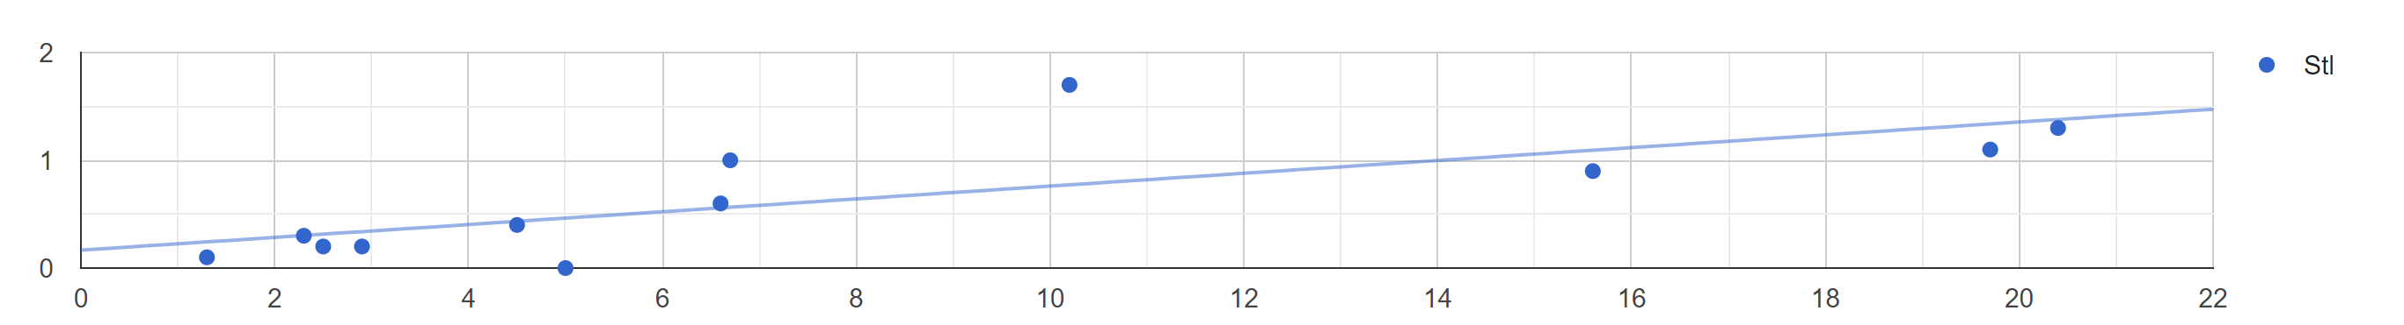
The score changes according to Steal
According to the scatter chart we can find the more steals cause more points.

Slide 9
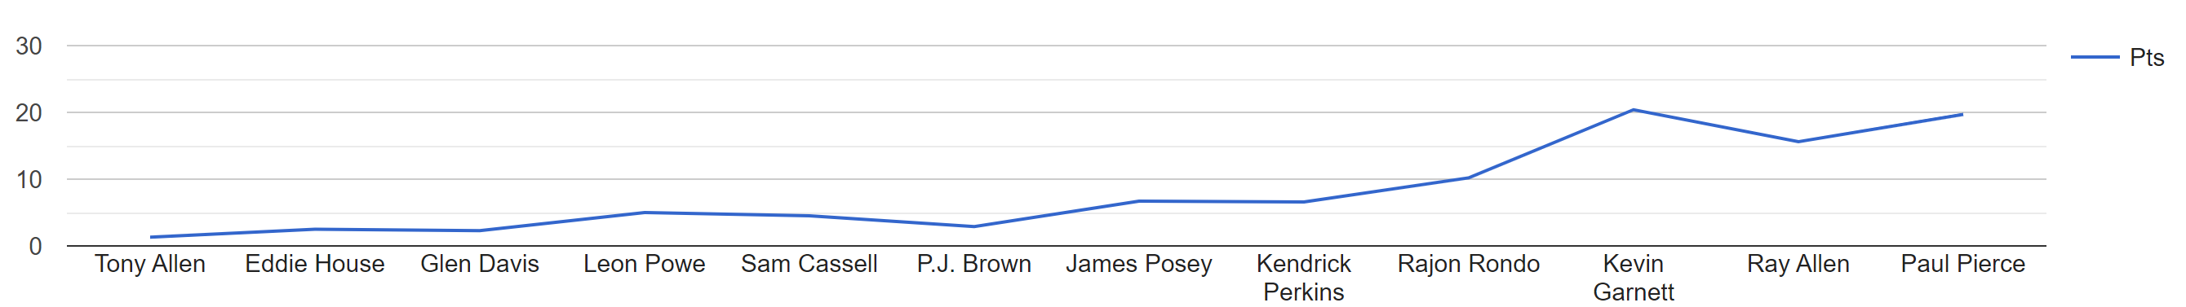
The score changes according to time
According to the line chart we can find the more playing time cause more points.

Slide 10
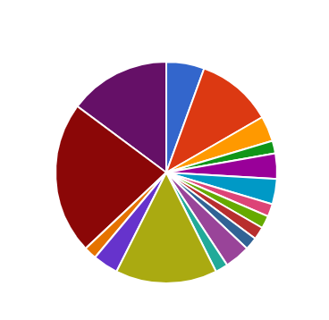
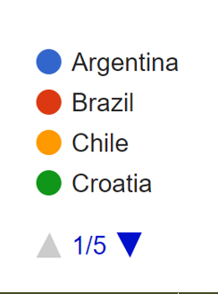
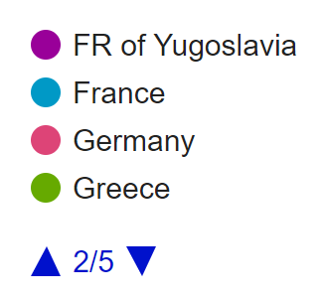
Percentage of champions by countries
According to the pie chart we can check percentage of champions by
counties.

Slide 11
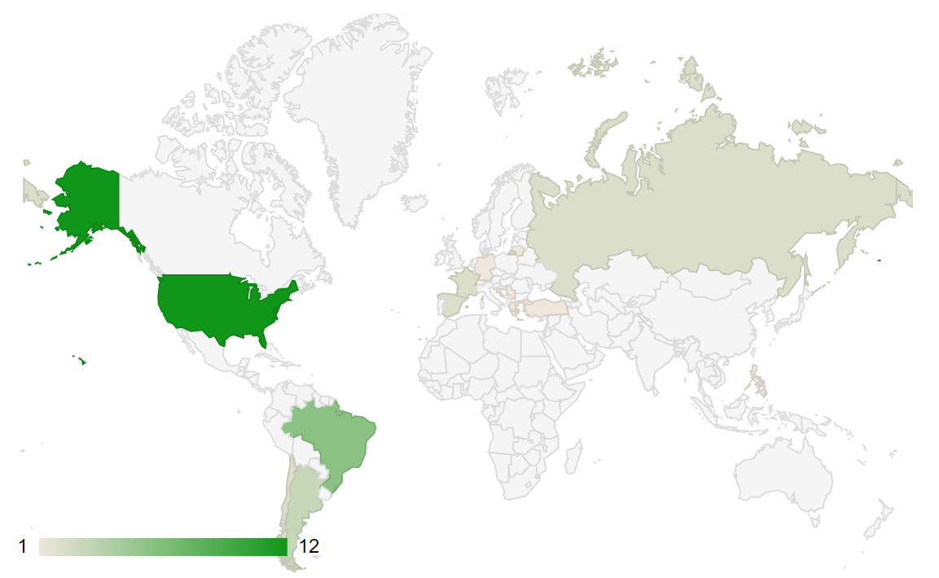
the location on the world map all of the Basketball World Cup Champion countries

Slide 12
Thank you

