Slide 1
Cloud Data Modeling - Mongo dB
CS777 11/02/2022
Yiduo Feng

Slide 2
1.Introduction of Mongo DB - Document Database
A document database is a type of non-relational database. A document is a record in a document database. Documents typically store information about an object and any associated metadata. Documents store data in field-value pairs. Values ​​can be of various types and structures, including strings, numbers, dates, arrays, and so on. The format of document storage can be JSON, BSON and XML. A collection is a set of documents. Documents in a collection usually have a similar structure. All documents in a collection do not need to have consistent fields. Some document-based databases provide format validation, so a collection's fields can also be fixed if desired.

Slide 3
1.Introduction of Mongo DB
MongoDB is a document-based NoSQL. MongoDB is written in C++, and the popular open source database(MySQL is also developed in C++.) Released in 1983, C++ is a widely used computer programming language.It is a general-purpose programming language that supports multiple programming patterns. Cloud Database MongoDB provides users with the capabilities of NoSQL databases as a service, which shows great advantages in terms of flexibility and ease of use, high availability, fully managed operation and maintenance, and data security and reliability.
MongoDB is not a new database. As far as I know, MongoDB has been widely used in China's e-commerce field as early as a few years ago, and it has officially positioned itself as a general-purpose database on its official website. MongoDB is actually somewhat similar to MySQL in terms of data processing. database.

Slide 4
2. Advantages of MongoDB
- Flexible - adding fields is convenient and fast
As we known, when we use a normal relational database, we need to create a data table before inserting the database content. Even in the dataframe we have already learned, we need to establish a schema to standardize the data type of each column in advance.
Database
Build Tables
Set Schema
Insert
》
》
》

Slide 5
2. Advantages of MongoDB
- Flexible - adding fields is convenient and fast
MongoDB does not need to build a table for pre process, and it also doesn’t need to specify each data type for field in the table, so that means we can insert document directly.
Database
Build Tables
Set Schema
Insert
》
》
》

Slide 6
2. Advantages of MongoDB
- Natural high availability support
The current open source database Mysql, when the master server in the same shard replication set (assuming one master and two slaves) abnormally or the instance exits abnormally, it needs to rely on a third-party MHA plug-in to realize the election of the new master. If there is no third-party MHA plug-in, or the third-party MHA plug-in is abnormal, the new master node cannot be elected, resulting in a write failure.
Compared with Mysql's dependence on third-party MHA plug-ins, the mongodb database has its own natural high-availability election function. The specific architecture diagram is as follows->

Slide 7
- Natural high availability support
2. Advantages of MongoDB
Engine Room Client
As shown in the figure on the right, when the master node is abnormal, the keep-alive messages of the two mongod slave nodes will detect the exception, and then the two slave nodes will conduct a new round of master node voting (raft protocol). When the master node is abnormal, and the remaining two nodes can vote normally. Because the raft majority requirement is met, a new master node will be quickly selected among the two master nodes.
real-time synchronization
Mongod(master)
real-time synchronization
Mongod(slave)
vote
Mongod(slave)

Slide 8
- Data Consistency and Security Guarantee
2. Advantages of MongoDB
Engine Room Client
W:1
request
answer
On the right is a scenario that I provided with low data consistency requirements
oplog synchronization
Mongod(master)
oplog synchronization
Mongod(slave)
Mongod(slave)

Slide 9
- Data Consistency and Security Guarantee
2. Advantages of MongoDB
Engine Room Client
W:3
request
answer
On the right is a scenario that I provided with high data consistency requirements
This shows that its writing is consistent. For the database, the most important thing is actually writing, because only writing data needs to ensure data consistency. If it is only reading data, the data will not change when reading.
Mongod(master)
Mongod(slave)
Mongod(slave)

Slide 10
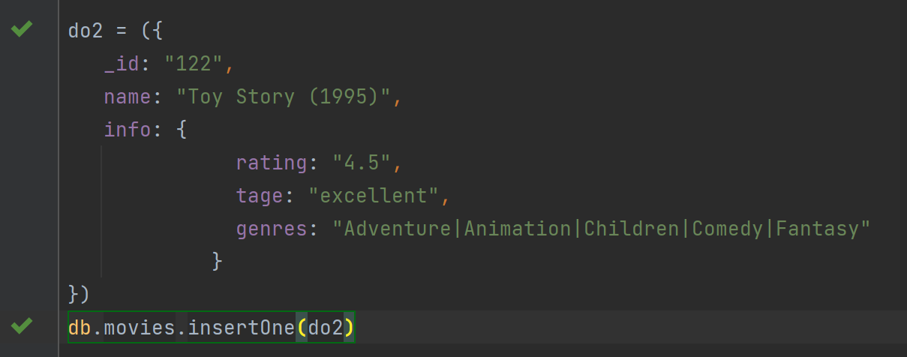
In MongoDB official website, it described this model is “the model uses embedded documents to describe a one-to-one relationship between connected data. Embedding connected data in a single document can reduce the number of read operations required to obtain data.”
3. Model One-to-One Relationships with Embedded Documents

Slide 11
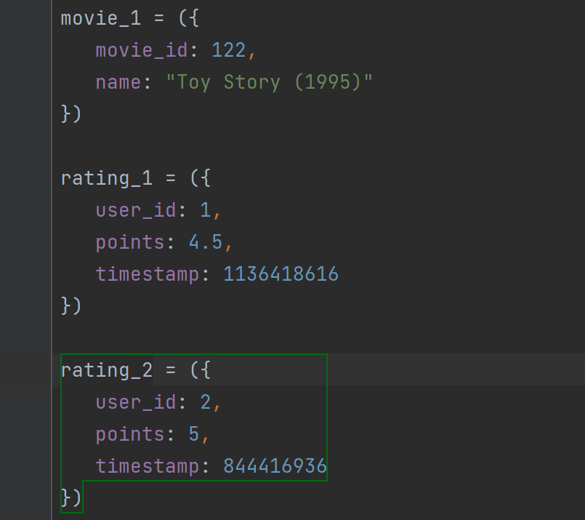
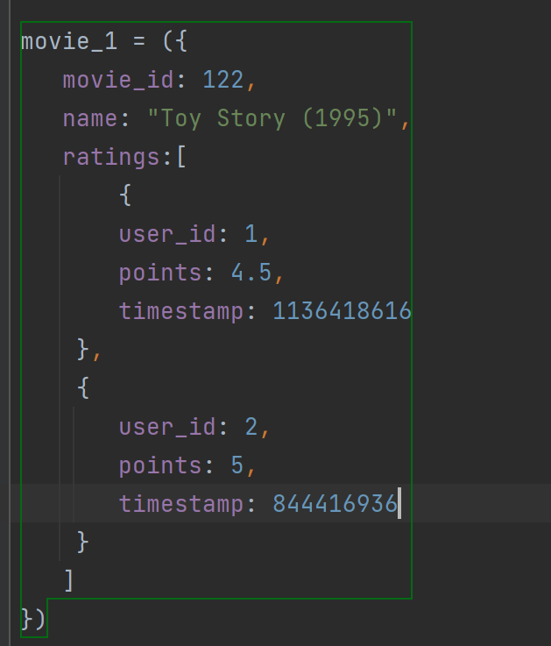
5. Model One-to-Many Relationships with Document References
This model “uses embedded documents to describe a one-to-many relationship between connected data. Embedding connected data in a single document can reduce the number of read operations required to obtain data”

Slide 12
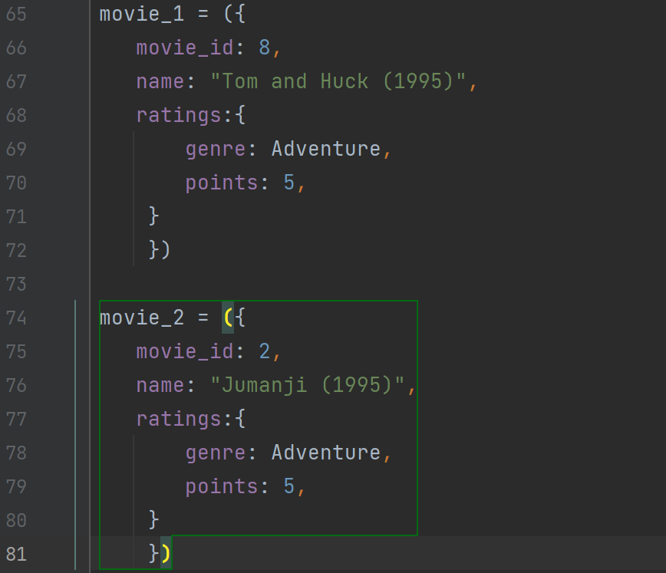
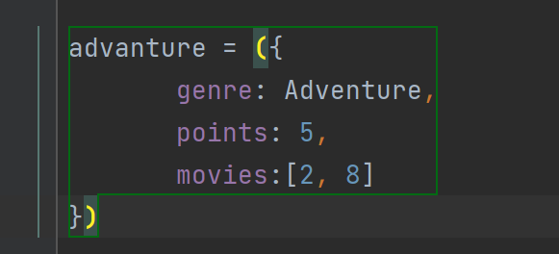
3. Model One-to-One Relationships with Embedded Documents
This model “uses references between documents to describe one-to-many relationships between connected data. ”

Slide 13
Conclusion
MongoDB's non-relational document database has great advantages in inserting and organizing data. MongoDB's high concurrency, high performance, schema free, natural high availability support, and perfect data consistency and security guarantees are irreplaceable advantages for many databases at present. Although MongoDB is not currently a mainstream database, its embedded model can quickly clean up useless and duplicate data for complex documents.

Slide 14
References
[1] “MongoDB.” Wikipedia, Wikimedia Foundation, 28 Oct. 2022, https://en.wikipedia.org/wiki/MongoDB.
[2] Model One-to-One Relationships with Embedded Documents - MongoDB Manual, https://www.mongodb.com/docs/manual/tutorial/model-embedded-one-to-one-relationships-between-documents/.
[3] Model One-to-Many Relationships with Embedded Documents - MongoDB Manual, https://www.mongodb.com/docs/manual/tutorial/model-embedded-one-to-many-relationships-between-documents/.
[4] Model One-to-Many Relationships with Documents References - MongoDB Manual, https://www.mongodb.com/docs/manual/tutorial/model-embedded-one-to-many-relationships-between-documents/.
[5] “Movielens.” GroupLens, 8 Dec. 2021, https://grouplens.org/datasets/movielens/.
[6] “MongoDB vs Mysql.” MongoDB, https://www.mongodb.com/zh-cn/compare/mongodb-mysql.
[7] Shitalpande. “What Is Document Database.” Numpy Ninja, Numpy Ninja, 29 Jan. 2022, https://www.numpyninja.com/post/what-is-document-database.

Slide 15
Thank you

