Slide 1
Facial Age and Gender Recognition
CS767 (Prof. Farshid Alizadeh-Shabdiz) Final Project Report Yiduo Feng 04/25/2023

Slide 2
Data Description
The dataset used in this analysis contains a total of 23,705 face images, each with corresponding information on age, gender, race, and pixel values.
The dataset has 5 columns: age, gender, race, pixel values, and an image name column.
The images in the dataset are in grayscale format and have a resolution of 48x48 pixels.
In this analysis, we will be using the pixel values column to train a model to predict the age of individuals based on their face images.
The pixel values will be preprocessed and normalized before being fed into the model.

Slide 3
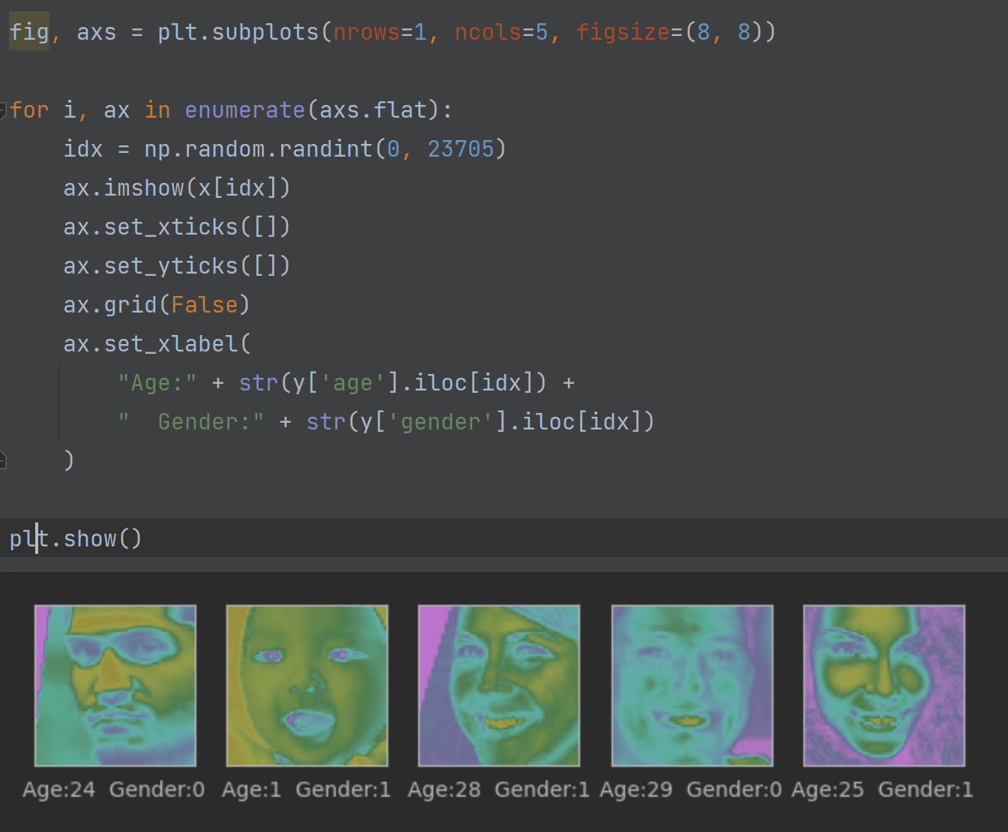

Slide 4
Data Preprocessing
Before training a deep learning model, it's important to preprocess the data to ensure that it's in a suitable format.
In this project, we start by checking for missing values in the dataset using the isnull() function.
I check for missing values in the "age", "gender", "ethnicity", "img_name", and "pixels" columns.
Next, we create separate dataframes for the input features (x) and the target variables (y) using the drop() function.
I then preprocess the "age" column of the y dataframe by binning the age values into 10-year intervals using the cut() function. We also convert the age values to categorical variables using the to_categorical() function.
I preprocess the "gender" and "ethnicity" columns of the y dataframe in a similar manner, converting them to categorical variables using the to_categorical() function.
Overall, these preprocessing steps help to ensure that the data is in a suitable format for training the deep learning model, and that the target variables are appropriately encoded for classification tasks.

Slide 5
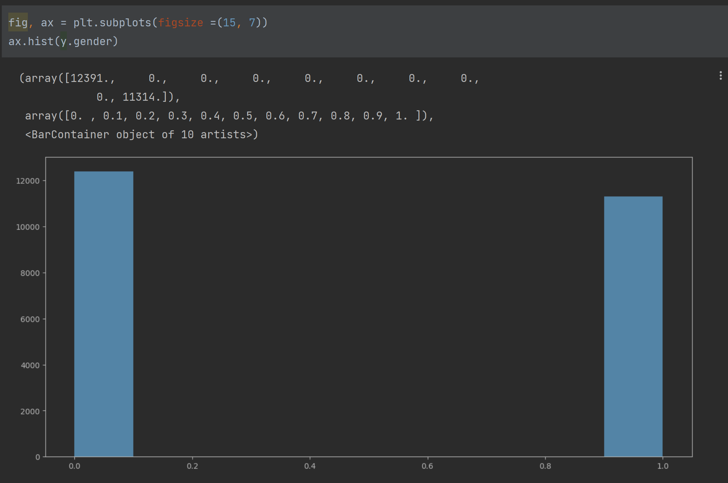
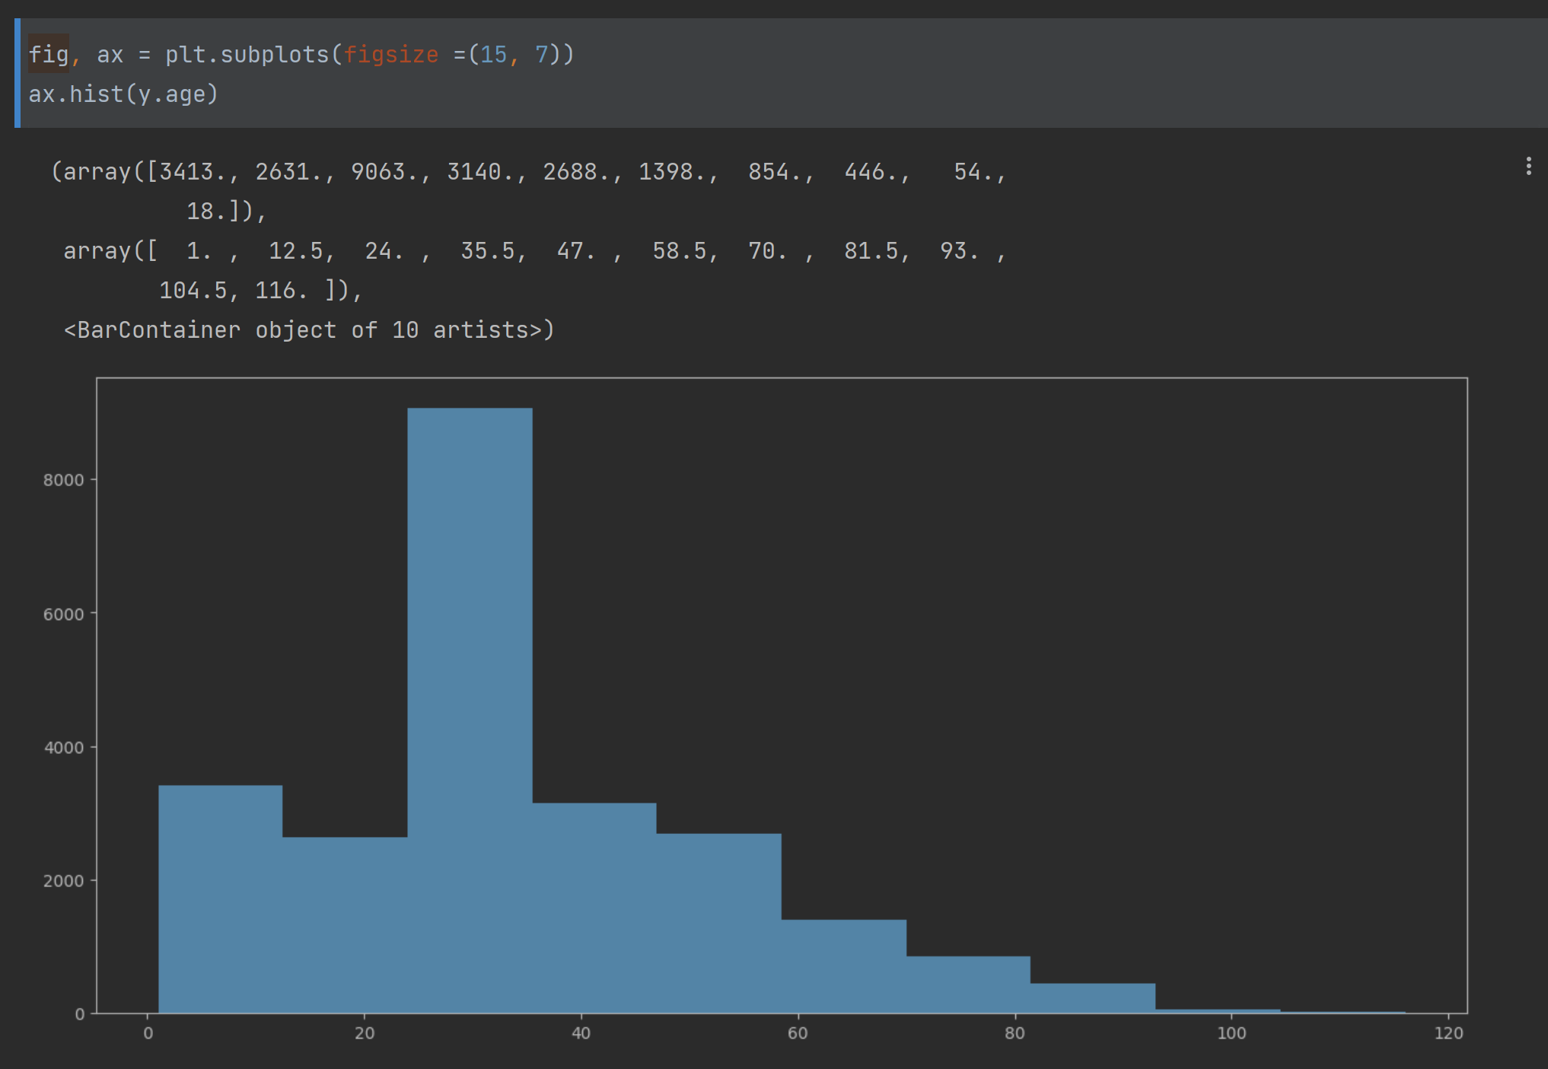
Data distribution

Slide 6
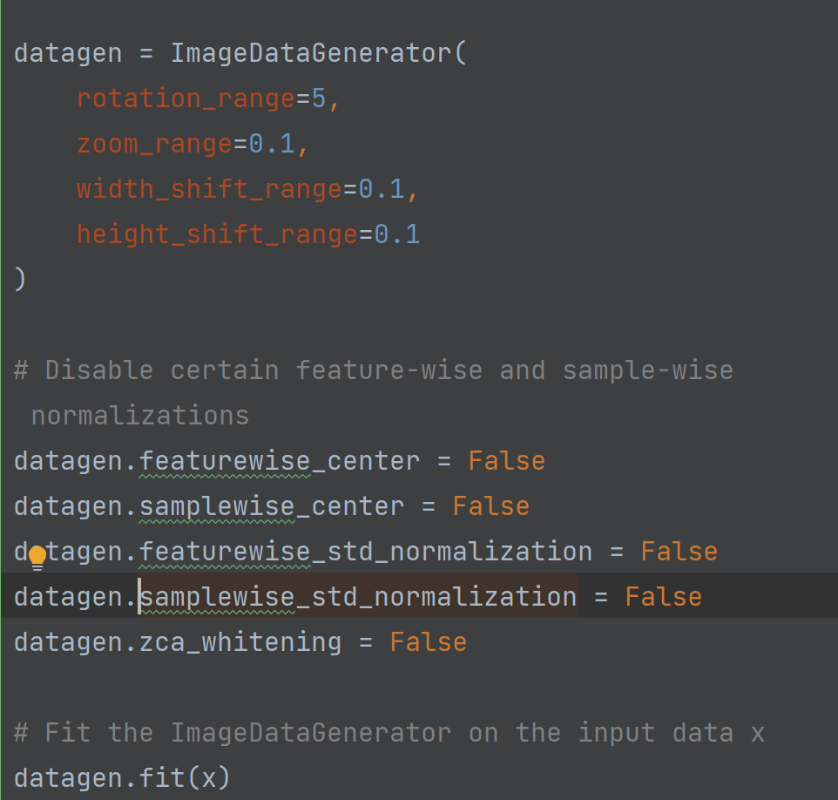
The code is used to create an ImageDataGenerator object in Keras, which is used for data augmentation in image classification tasks. Data augmentation helps to increase the diversity of the training dataset by applying random transformations to the original images, which can help to improve the performance of the model and reduce overfitting.
The 'ImageDataGenerator' object is created with several parameters to specify the types of transformations to be applied, including rotation, zoom, and shifts in width and height. These parameters are set to small values, as they are intended to introduce small variations in the images and not drastically change their appearance.
Additionally, some feature-wise and sample-wise normalizations are disabled, including feature-wise centering, feature-wise standardization, sample-wise centering, and sample-wise standardization. ZCA whitening is also disabled, which is a type of normalization that reduces redundancy in the image data.

Slide 7
CNN Model
3 convolutional layer
2 BatchNormalization layer
3 MaxPool2D layer

Slide 8
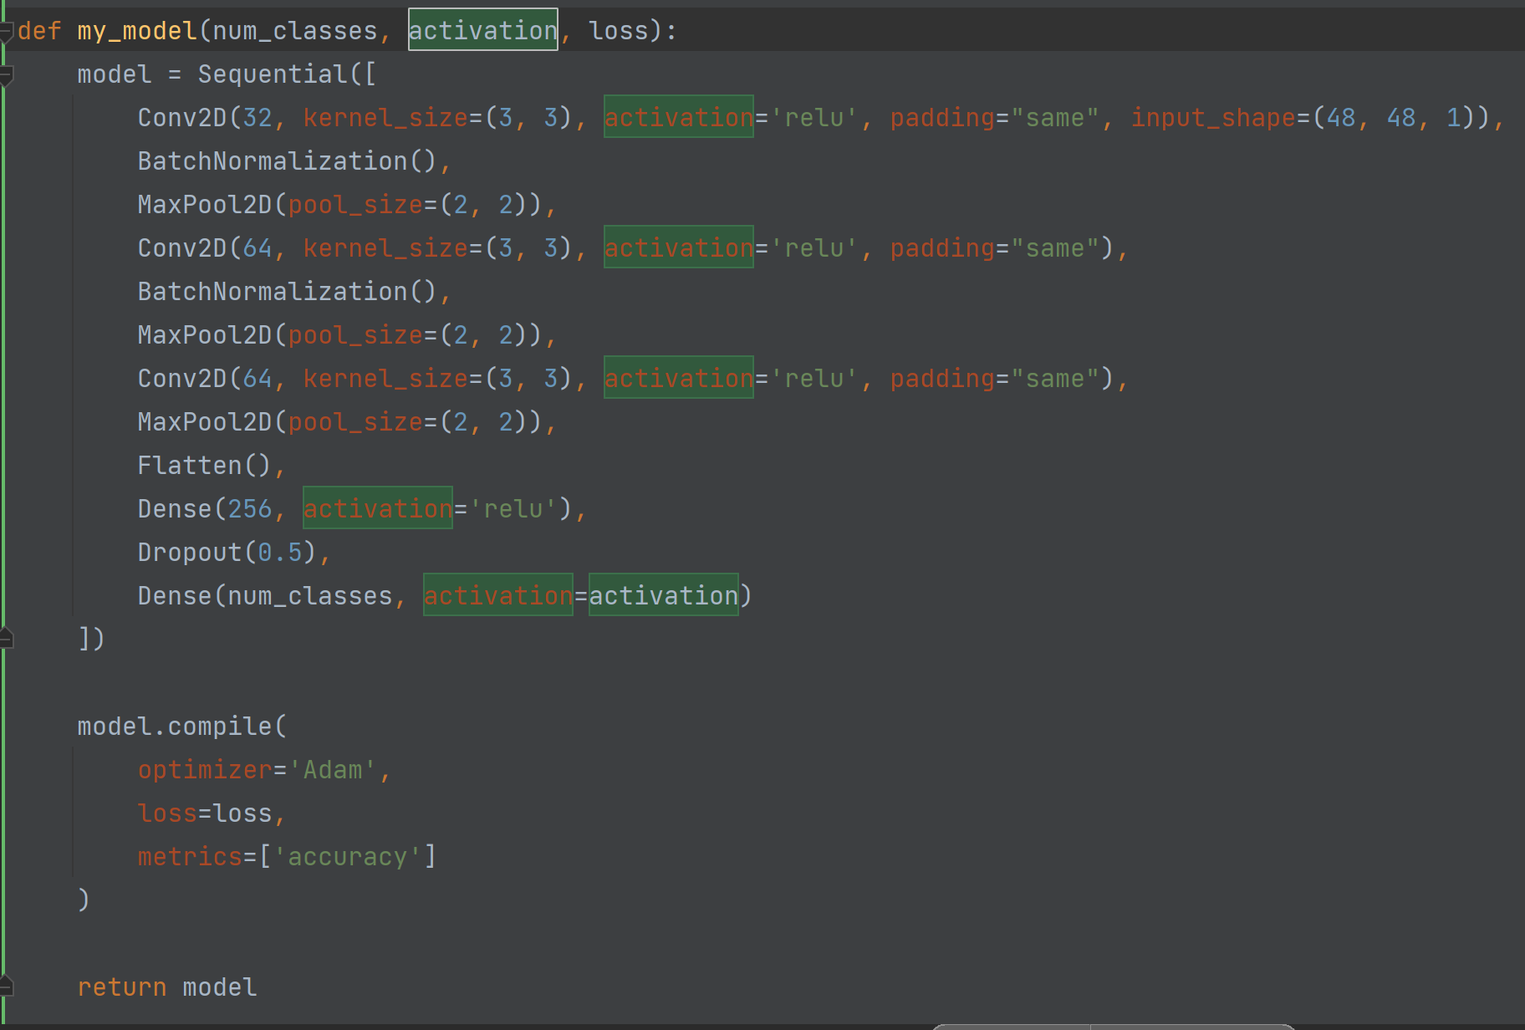
CNN Model
In my CNN Model, I define a convolutional neural network (CNN) model to predict the age of people from their face pictures.
The model architecture consists of three convolutional layers, followed by a dense layer and a dropout layer.
The first convolutional layer has 32 filters, each of size 3x3. It uses the ReLU activation function, and the padding is set to 'same' to ensure that the output has the same shape as the input.
The BatchNormalization layer is added to normalize the activations of the previous layer.
The MaxPool2D layer is then added with a pool size of 2x2, to reduce the dimensionality of the output.

Slide 9
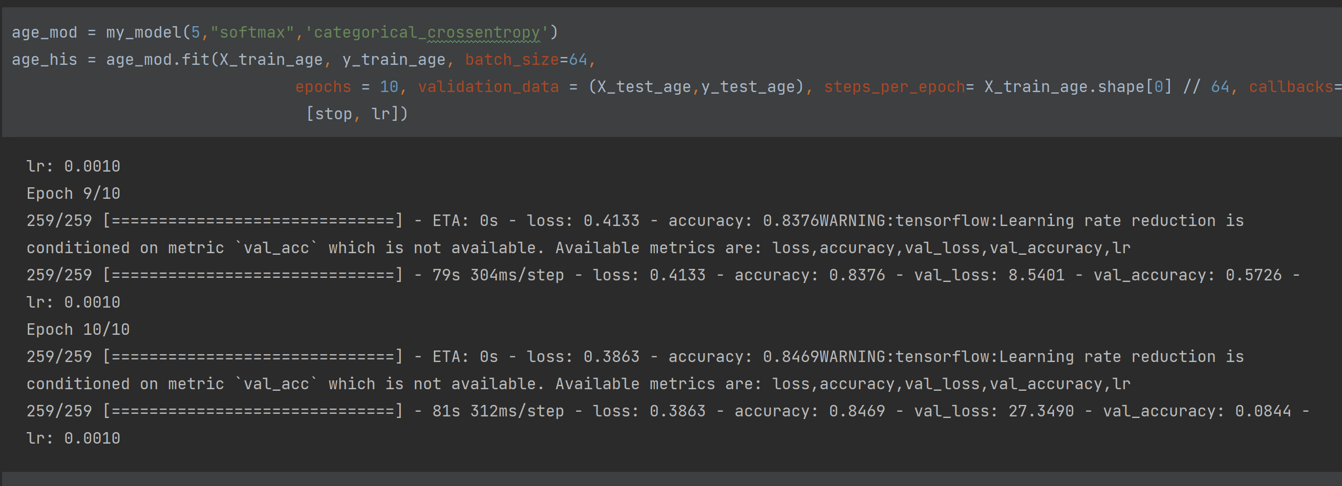
Age prediction
The training process is monitored using two callbacks, 'EarlyStopping' and 'ReduceLROnPlateau'. 'EarlyStopping' monitors the validation loss and stops the training process if there is no improvement in the validation loss for 10 consecutive epochs. 'ReduceLROnPlateau' monitors the validation accuracy and reduces the learning rate if there is no improvement in validation accuracy for 3 consecutive epochs. These callbacks help to prevent overfitting and ensure that the model is trained efficiently.
The neural network model is created using the 'my_model' function, which takes the number of classes ('10') as input, along with the activation function ('softmax') and the loss function ('categorical_crossentropy'). The model is trained for 10 epochs with a batch size of 64. The training history is stored in the variable 'age_his'.

Slide 10
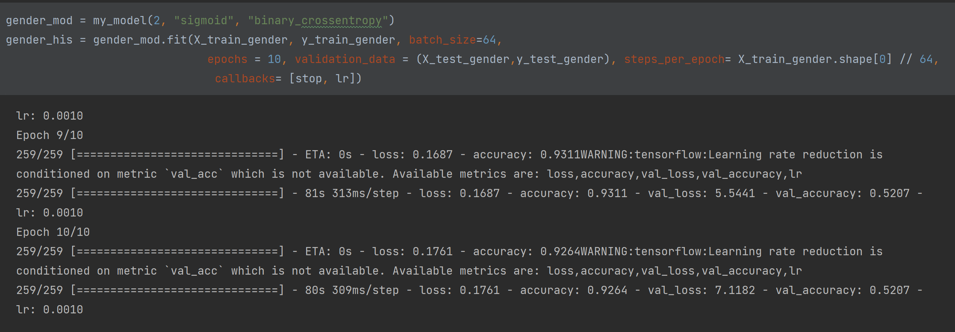
Gender prediction

Slide 11
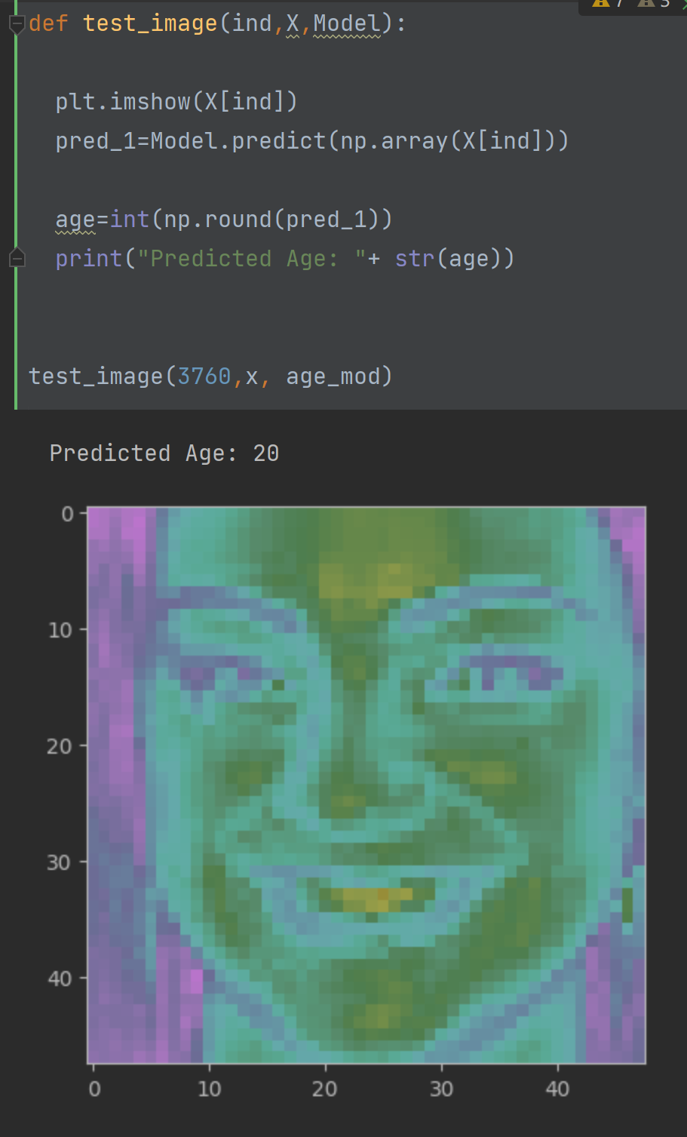
Test result
Use the model built and input the pixels of pictures.

Slide 12
Conclusion
This project involves using a deep learning model to predict the age of individuals based on their face images. The model architecture consists of several convolutional and dense layers, with a softmax activation function and categorical cross-entropy loss function used for training. The dataset used in this project contains over 23,000 face images, each with corresponding information on age, gender, race, and pixel values. The pixel values column is used to train the model, and the images are preprocessed and normalized before being fed into the model. Overall, this project has the potential to provide valuable insights into the relationship between age and facial features, and to develop a useful tool for age prediction based on face images.

Slide 13
Thank you

