Slide 1

YieldShield
Arc
USDC-backed protection
for EURC and cirBTC
Circle Developer Grant
20 October 2026
Notes:
Title: YieldShield Arc — USDC-backed protection for EURC and cirBTC. Circle Developer Grant, 20 October 2026.
Cover illustration generated with OpenAI image generation on 20 October 2026. The sculptural arch, two discs and coral base are decorative metaphors, not a product screenshot, token logo or financial model. Original prompt and source file are recorded in docs/grants/deck/README.md. All cover typography remains editable.
Arc testnet prototype. Contracts are unaudited. Test tokens have no monetary value. Application remains unsubmitted for founder review.

Slide 2
YieldShield Arc
A fixed exit value in USDC
Holders keep exposure to EUR or BTC.
They choose when to return to USDC.
EURC or cirBTC
Initial audience
Asset exposure
Fixed USDC claim
Arc treasury, lending,
wallet and agent builders
Keep upside
Choose a funded exit
Arc testnet. Unaudited. Test tokens have no monetary value.
02
Notes:
Source: saved Circle application, problem and solution fields, 20 October 2026. Claim is fixed in USDC at entry. This does not preserve EUR purchasing power or eliminate protocol, oracle or stablecoin risk. Pilot audience is proposed, not existing traction.

Slide 3
YieldShield Arc
The reserve model
EURC / cirBTC
USDC
Asset holder
YieldShield pool
Capital provider
Fixed claim
150%
Risk + reward
Value set at entry
by the oracle
Earn gain fees
Receive surrendered assets
Bear their downside
USDC reserved per claim
Illustration: a 100 USDC claim requires 150 USDC of backing at entry.
Reserve requirement does not replace an independent audit.
03
Notes:
Source: contracts/src/ShieldPool.sol, protect/_protect and requiredBacking; config/deployment.json. Illustrative 100/150 USDC values explain the deployed 150% collateral requirement, not current market balances. Capital providers bear asset losses. No return is promised.

Slide 4
YieldShield Arc
Two exits before maturity
Protected position
Keep the asset
Take the USDC claim
Pay 12% of realized gain only
Surrender the asset for the fixed claim
10% provider 1% creator 1% protocol
No price read needed for this exit
At maturity: anyone can settle; holders claim USDC and providers receive remaining assets.
04
Notes:
Source: ShieldPool.sol, exitAsset/partialExitAsset, exitBacking/partialExitBacking, settleExpired and claimBacking. Asset exits need a valid current price. Backing exits do not require a fresh price. Fee split is 10/1/1 percent of positive realized gain. Terms are for the featured deployment.

Slide 5
YieldShield Arc
Built on Circle assets and Arc
WORKING TODAY
PROPOSED GRANT WORK
Arc testnet
App Kit Bridge
EURC
cirBTC
USDC
Protected assets
Reserve + gas
Ethereum
Sepolia
Base
Sepolia
Chronicle price references
USDC + EURC to both destinations
Planned bridges run separately after an exit or claim. Pools remain on a single chain.
05
Notes:
Current assets and oracle: config/deployment.json and ShieldOracles.sol. USDC uses its 6-decimal ERC-20 interface for accounting and also pays native gas on Arc; EURC has 6 decimals, cirBTC 8. Planned: Arc domain26 to Ethereum Sepolia0 and Base Sepolia6. USDC uses TokenMessengerV2.depositForBurn. EURC uses CrossChainTokenService.crossChainTransfer after TokenManager approval. Sources: docs/grants/CCTP_ROUTE_VALIDATION_2026-10-20.md; https://developers.circle.com/cctp/expanded-assets/concepts/cctp-differences ; https://docs.arc.io/app-kit/bridge . These integrations are future milestones.

Slide 6
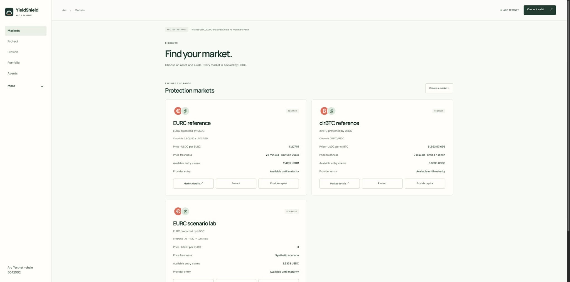
YieldShield Arc
The deployed testnet product
3
working markets
72
contract tests passed
arc.yieldshield.ai
Project-controlled test wallets. No external users or revenue. Tests are not an audit.
06
Notes:
Source: docs/E2E_REPORT_2026-10-20.md, deployed site and config/deployment.json. Screenshot captured from the live markets page on20Oct2026, no wallet connected. Three markets: EURC reference, cirBTC reference, EURC scenario. 72 contract tests,31unit checks,12browser scenarios across runs,8confirmed Arc journey transactions. Runtime/config/receipt checks are not an audit or explorer source verification. No external adoption claimed.

Slide 7
YieldShield Arc
A pilot with measurable outcomes
20
10
30
invitations
external testers
complete journeys
Five discovery interviews
At least three teams
Both exits, maturity
and provider claims
8 / 10
Target: complete a core flow without live help.
Publish failures and fixes, then seek follow-on integrations.
Future targets. No tester or partnership commitments claimed.
07
Notes:
Source: docs/grants/ARC_PILOT_PLAN.md and saved application milestone3.30journeys:10assetexits,10USDCbackingexits,5maturitysettlements/claims,5providerjourneys.20invitations,5interviews,10externaltestersfrom>=3teams.8/10independentcompletiontarget.Twofollow-onexpressionsofinterestarealearningtarget.Recruitmentandordinarysupportbeyond30engineeringhoursareself-funded.

Slide 8


YieldShield Arc
The founders
David Hawig
Santiago
Balaguer
Founder
Managing Director
Cofounder
Product Lead
Former Web3 Foundation ecosystem director
Founded and exited two startups
15 years in product
5 years in crypto
Hawig Ventures UG, Germany. Self-funded. No grants or investment received.
08
Notes:
Photos: existing Drive presentation YieldShield_V0.13_Robinhood.pptx, slide13 Team/Partnerships, file1s74o5XRnIDTBbQAaa99iY1M_tRgiG3Ow. Original images unchanged. Bios supplied in the saved Circle application. David full-time on YieldShield, Santiago based in Berlin. Founders own the work and review AI-assisted development.

Slide 9
YieldShield Arc
$16,000 across four milestones
$11,000 core work
$5,000 conditional mainnet
Deliverable | Acceptance / target | Hours | Budget
Bridge exits | 4 transfers + recovery / week 3 | 35 | $3,500
Agent integration | Unsigned tools / week 6 | 45 | $4,500
Pilot + hardening | 10 testers, 30 journeys / week 9 | 30 | $3,000
Capped mainnet | After audit + legal review | 50 | $5,000
Mainnet requires a separately funded independent audit and legal review. Existing work is not billed.
09
Notes:
Source: saved Circle grant milestones.160hours total at$100/hour. M1 35h/$3500, M2 45h/$4500, M3 30h/$3000, M4 50h/$5000. Targets3/6/9weeks afteracceptance. M4 estimatedQ12027onlyafterindependentauditandlegalreviewoutsidegrant. Protocolrevenue:1%ofrealizedgain, noyieldpromises. No incentives/liquiditymining/token.

