Slide 1
How Indexes
Accelerate Queries
From full scans to covering indexes
SKILL Application Test
A query, its data structure, and the work it performs
1/20

Slide 2
Start with one query and a fixed result
SELECT created_seq, amount_cents
FROM orders
WHERE tenant_id = 42
ORDER BY created_seq DESC
LIMIT 20;
200,000 synthetic orders
100 tenants; 1,980 matching rows
created_seq = creation order
amount_cents = amount in cents
payload = 64 bytes per row
Measure the work
Keep the result fixed
Count SQLite virtual-machine (VM)
instructions. Time full result retrieval:
3 warm-ups, then 11 executions.
Report the median with a warm cache.
Verify identical rows and order
after every index change.
The access path is the experimental
variable; the requested result stays fixed.
2/20

Slide 3
An index stores an additional order over the data
Row-ID order
Tenant-key order
Row ID | Tenant | Sequence | Amount
17 | 42 | 16 | 8100
28 | 7 | 27 | 6400
66 | 42 | 65 | 2200
91 | 12 | 90 | 3500
Tenant | Row ID
7 | 28
12 | 91
42 | 17
42 | 66
These illustrative keys place tenant 42’s row IDs 17 and 66 next to each other.
The row IDs locate the corresponding records in the original table.
3/20

Slide 4
A B-tree routes the search through a few pages
30 | 60
8 | 16 | 24
35 | 42 | 51
68 | 77 | 95
Search key 42
Compare separator keys, descend into the middle range, and find the matching entry.
30 < 42 < 60: follow the middle child, then locate 42 among 35, 42 and 51.
Illustrative keys; each node represents a storage page.
4/20

Slide 5
High fan-out keeps the tree shallow
Index page type | Pages | Entries | Storage
Internal | 6 | 845 | 24 KiB
Leaf | 846 | 199,155 | 3.305 MiB
Fan-out is the number of child links in an internal page.
A three-level structure
Work follows the access path
The measured index has a root,
an internal level and leaf pages.
Its longest path contains 2 edges.
A lookup routes to a small region.
A full scan visits the index or table
sequentially across its entries.
5/20

Slide 6
Without an index, filter and sort the table
Scan 200,000 rows
Keep tenant 42
1,980 rows
Sort by sequence
Return 20 rows
EXPLAIN QUERY PLAN reports:
SCAN orders
USE TEMP B-TREE FOR ORDER BY
Baseline: 617,851 virtual-machine instructions to retrieve the 20 rows.
6/20

Slide 7
A tenant index removes most filtering work
CREATE INDEX idx ON orders(tenant_id);
Search tenant 42
Fetch 1,980 records
Sort and return 20
The equality constraint is searchable
The requested order remains separate
SEARCH orders USING INDEX idx
(tenant_id=?)
A temporary B-tree still supplies ordering.
Measured work falls to
23,792 instructions.
7/20

Slide 8
A composite index groups and orders together
CREATE INDEX idx ON orders(tenant_id, created_seq);
Tenant | Created sequence | Illustrative key order
41 | 199800 | Previous tenant
42 | 100 | Start of tenant 42
42 | 95000 | Same tenant, increasing sequence
42 | 199943 | Recent row inside the same range
43 | 15 | Next tenant
Equality on tenant selects one contiguous range; sequence orders the entries within it.
8/20

Slide 9
An ordered index can stop after the first 20 matches
Seek tenant 42
at its largest sequence
Walk entries
in descending sequence
Stop after
20 returned rows
SEARCH orders USING INDEX idx (tenant_id=?)
The order comes from the index
Early termination changes the workload
The plan no longer reports
USE TEMP B-TREE FOR ORDER BY.
Measured instructions: 150.
The query retrieves a small tail of
one tenant’s ordered range.
9/20

Slide 10
A covering index supplies every requested value
CREATE INDEX idx ON orders(tenant_id, created_seq, amount_cents);
Index field | Role in this query
tenant_id | Equality search
created_seq | Requested order and output
amount_cents | Output without a table lookup
The plan reports USING COVERING INDEX; measured work is 129 instructions.
10/20

Slide 11
Column order determines the searchable prefix
SELECT sum(amount_cents)
FROM orders INDEXED BY idx
WHERE tenant_id = 42
AND created_seq BETWEEN 80000 AND 119999
Index order | Searchable region | VM instructions
tenant_id, created_seq | One tenant within the sequence range | 1,991
created_seq, tenant_id | Sequence range across tenants | 200,808
These paths are selected with INDEXED BY to isolate key order in the experiment.
11/20

Slide 12
Coverage depends on the requested output columns
Selected values | Plan | Table records needed
created_seq, amount_cents | USING COVERING INDEX | No
created_seq, amount_cents, payload | USING INDEX | Yes
The index already holds
The extra value lives in the table
Tenant, sequence and amount are
inside the composite key.
Adding payload requires row lookups.
This version executes
170 instructions.
12/20

Slide 13
A partial index represents a useful subset
CREATE INDEX idx ON orders(tenant_id, created_seq, amount_cents)
WHERE status = 'open';
Index | Rows represented | Index storage
Partial active index | 20,045 | 0.336 MiB
Full: (status, tenant_id, created_seq, amount_cents) | 200,000 | 4.641 MiB
The query includes status = 'open', so the partial index contains every eligible row.
13/20

Slide 14
An expression can change the usable search constraint
Predicate | Observed plan | VM instructions
tenant_id = 42 | SEARCH ... (tenant_id=?) | 5,953
tenant_id + 0 = 42 | SCAN ... COVERING INDEX | 801,994
Same answer, different access path
Make the intended access visible
Both queries count the same
1,980 matching rows.
Keep the indexed equality directly
searchable, or design an index for
the actual expression being queried.
14/20

Slide 15
Read the query plan as a physical route
Plan detail | What to look for
SCAN | Traversal through the selected table or index
SEARCH ... (tenant_id=?) | A constrained lookup into a key range
USING COVERING INDEX | Requested fields supplied directly by the index
USE TEMP B-TREE FOR ORDER BY | A separate structure supplies sorting
Pair the plan with returned rows and measured work; each explains a different part of execution.
15/20

Slide 16
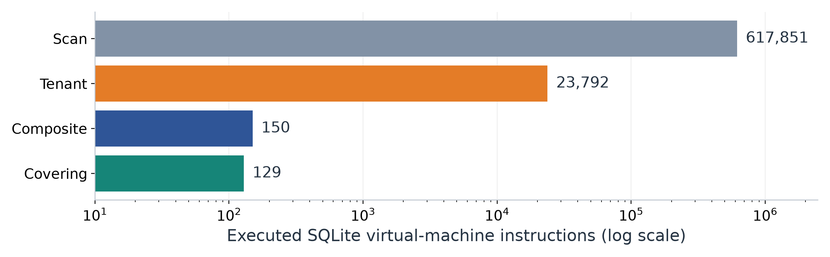
The same result can require radically different work
Progressively remove work
From the baseline to coverage
Search a tenant, preserve the order,
then supply the output columns
inside the index.
617,851 → 129 instructions.
All four cases return identical rows
in identical order.
16/20

Slide 17
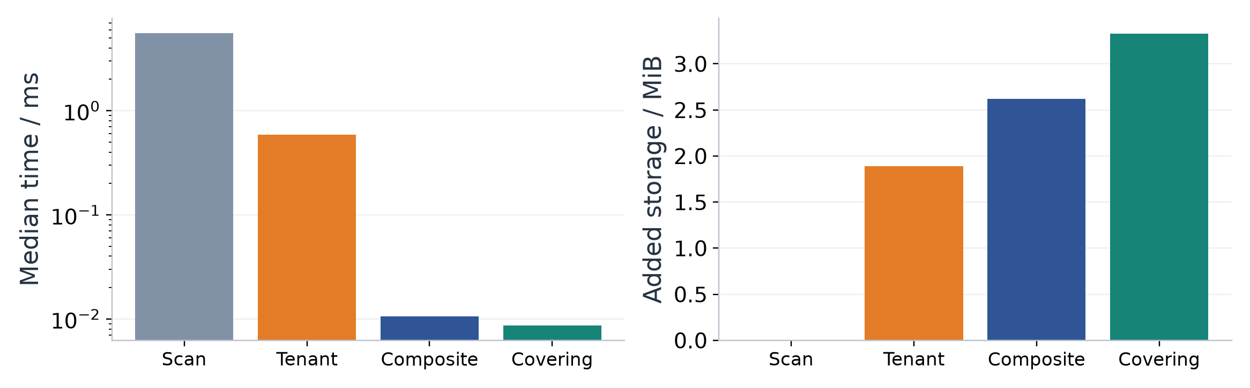
Latency and storage reveal different costs
Median warm-cache times
The added order takes space
SQLite 3.53.1; in-memory database.
200,000 rows; 11 timed executions
after 3 warm-ups per query.
Each index stores another key order.
The covering form also carries
amount_cents for direct output.
17/20

Slide 18
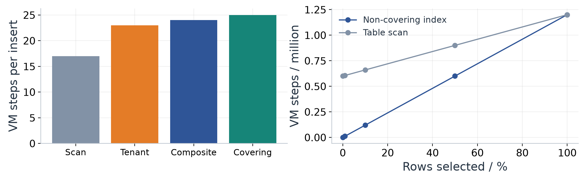
Index maintenance and broad reads also consume work
Each insert maintains every index
A broad query touches more records
The left panel counts instructions
for the same 5,000-row transaction,
rolled back after measurement.
The right panel forces each access path
and fetches payload from the table.
At 100%, both traverse the full dataset.
18/20

Slide 19
Build indexes through a repeatable query experiment
Step | Concrete action
1 Define the query | Fix predicates, ordering, output columns and row limit.
2 Capture the baseline | Save EXPLAIN QUERY PLAN, results and work measurements.
3 Choose the key | Place equality/range/order fields to match the access path.
4 Measure the trade-off | Check read work, storage and write maintenance.
5 Refresh statistics | Use ANALYZE or PRAGMA optimize, then inspect the plan again.
For each query, compare candidate indexes against that query’s fixed baseline result.
19/20

Slide 20
Choose the index that matches the work to be done
Query requirement | Index property to evaluate
Selective equality | A usable leading key
Ordered limited results | Order after equality-constrained key fields
Output without row lookups | Coverage of every selected value
Active subset | A partial-index predicate implied by the query
Frequent writes or broad reads | Maintenance cost, storage and actual access work
An index helps by narrowing, ordering or supplying data along the query’s actual path.
SQLite documentation: Query Planning · EXPLAIN QUERY PLAN · Partial Indexes
20/20

