Slide 1

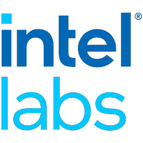

IDIO: Network-Driven, Inbound Network Data Orchestration on Server Processors
Mohammad Alian, Siddharth Agarwal, Jongmin Shin, Neel Patel, Yifan Yuan, Daehoon Kim, Ren Wang, Nam Sung Kim

Slide 2
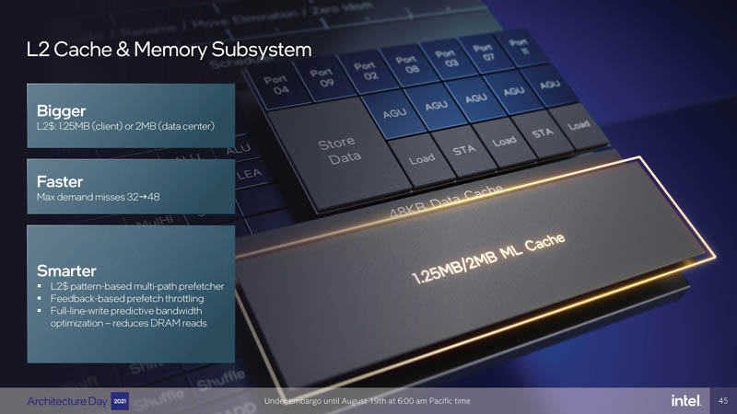
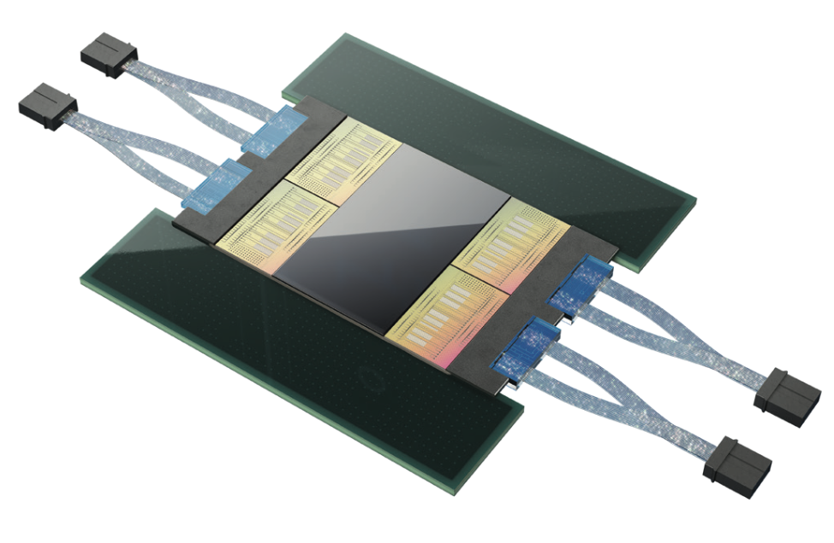
Connectivity in Future Datacenter Servers
Trends:
NICs w/ Tbps connectivity + evolution of cache hierarchy
Implication:
High pressure on the memory subsystem
Requires re-examination of Direct Cache Access (DCA) technology for network data
Ayar Lab’s TeraPHY Optical I/O Multi-Chip Package

Slide 3

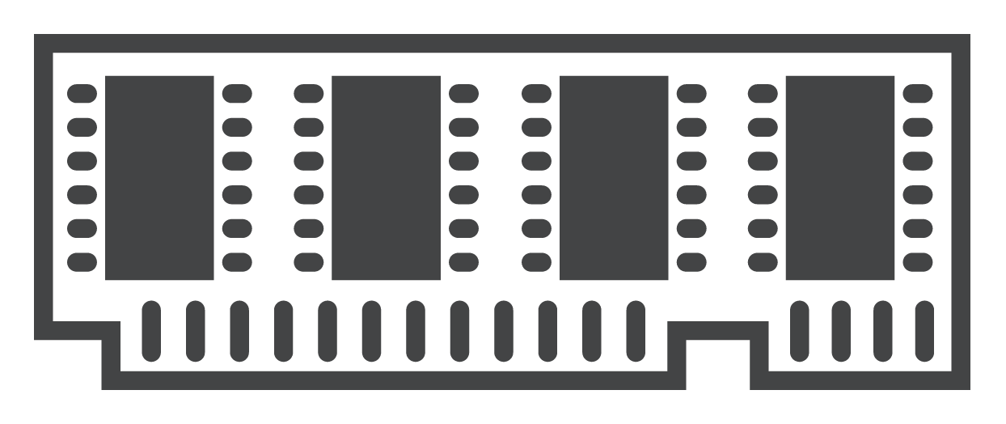
Direct Cache Access (DCA)
* Or DDIO for Intel’s Implementation
NIC
CPU
PCIe
LLC
DDIO ways
DDR
DRAM

Slide 4
Cache Hierarchy Evolution
NIC
CPU
256KB
PCIe
MLC
…
MLC
DRAM
LLC
Inclusive
2.5MB per core
DDR
Broadwell
Microarchitecture
DRAM

Slide 5
Cache Hierarchy Evolution
NIC
CPU
1MB
PCIe
MLC
…
MLC
DRAM
1.375MB per core
LLC
DDIO ways
Non inclusive
Core
Core
DDR
Skylake-X/SP
Microarchitecture
DRAM
DCA still the same!

Slide 6
Our Work: Intelligent Placement of RX Network Data in the Memory Hierarchy
NIC
CPU
1MB
PCIe
MLC
…
MLC
IDIO
IDIO
1.375MB per core
LLC
IDIO ways
Non inclusive
Core
Core
DDR
Three synergistic mechanisms
Self-invalidating I/O buffer
Network-driven MLC prefetching
Selective Direct DRAM Access (DDA)
DDA
DRAM

Slide 7
Outline
Background & Motivation
Demystifying network applications
Movement of RX network data in a non-inclusive cache hierarchy
Observations
Useless MLC writebacks
DMA bloating phenomenon
Sensitivity to network rate
Intelligent Data Direct IO (IDIO)
Self-invalidating I/O buffers
Network-driven MLC prefetching
Selective direct DRAM access
Experimental results
Conclusion

Slide 8
Outline
Background & Motivation
Demystifying network applications
Movement of RX network data in a non-inclusive cache hierarchy
Observations
Useless MLC writebacks
DMA bloating phenomenon
Sensitivity to network rate
Intelligent Data Direct IO (IDIO)
Self-invalidating I/O buffers
Network-driven MLC prefetching
Selective direct DRAM access
Experimental results
Conclusion

Slide 9
Inclusive vs. Non-Inclusive Caches
Inclusive Cache
Non-inclusive Cache (simplified)
Private
MLC
Shared
LLC

Slide 10
Data Movement in a Non-Inclusive Cache Hierarchy Running a Run-to-Completion SW stack
CPU
Demand by core for processing
NIC
8
1
Core
Core
7
RX Desc
Ring
2
6
3
5
4
Conflict → MLC writeback
Private
MLC
Non-DDIO Ways
DDIO Ways
PCIe Write
7
6
1
4
Shared
LLC
5
2
8
5
Write-Allocate
3
Conflict → LLC writeback (DMA Leak)
DRAM

Slide 11
Data Movement in a Non-Inclusive Cache Hierarchy Running a Run-to-Completion SW stack
Demand by core for processing
NIC
MLC Writebacks
8
1
9
Core
Core
7
RX Desc
Ring
2
6
3
CPU
5
4
Conflict → MLC writeback
5
3
Private
MLC
4
2
Non-DDIO Ways
DDIO Ways
PCIe Write
7
6
1
9
9
Shared
LLC
8
Write-Update
💡 Observation! Non-inclusive cache hierarchy breaks isolation between I/O and application data
💡 Observation! Unnecessary MLC writeback of consumed DMA buffers
DRAM

Slide 12
Summary of Observations
& Proposed Solution
Current DCA implementation has three shortcomings in a non-inclusive hierarchy:
❌ Inefficient use of large MLC
❌ High rates of (useless) writebacks from MLC to LLC
❌ Breaking the isolation between application and network data
Proposed solution*: Intelligent Data Direct I/O (IDIO)
Three synergistic mechanisms
Network-driven MLC prefetching
Self-invalidating I/O buffer
Selective direct DRAM access
When to prefetch?

Slide 13
MLC and LLC Writebacks: Sensitivity to Network Rate
Ring buffer size
is 1024
Receive a burst of
1024 packets
Million WB
Per Sec
Network BW
Burst of network Data!
💡Beneficial to
prefetch to MLC

Slide 14
Outline
Background & Motivation
Demystifying network applications
Movement of RX network data in a non-inclusive cache hierarchy
Observations
Useless MLC writebacks
DMA bloating phenomenon
Sensitivity to network rate
Intelligent Data Direct IO (IDIO)
Self-invalidating I/O buffers
Network-driven MLC prefetching
Selective direct DRAM access
Experimental results
Conclusion

Slide 15
Self-Invalidating I/O Buffers + MLC Prefetch
CPU
Burst is Detected!
Demand by core for processing
NIC
1
Core
Core
RX Desc
Ring
2
3
Prefetch to MLC
Private
MLC
4
Self Invalidate
Non-DDIO Ways
DDIO Ways
PCIe Write
1
4
Shared
LLC
2
Write-Allocate
3
MLC writebacks are eliminated
DDIO space is extended to private MLC
DRAM

Slide 16
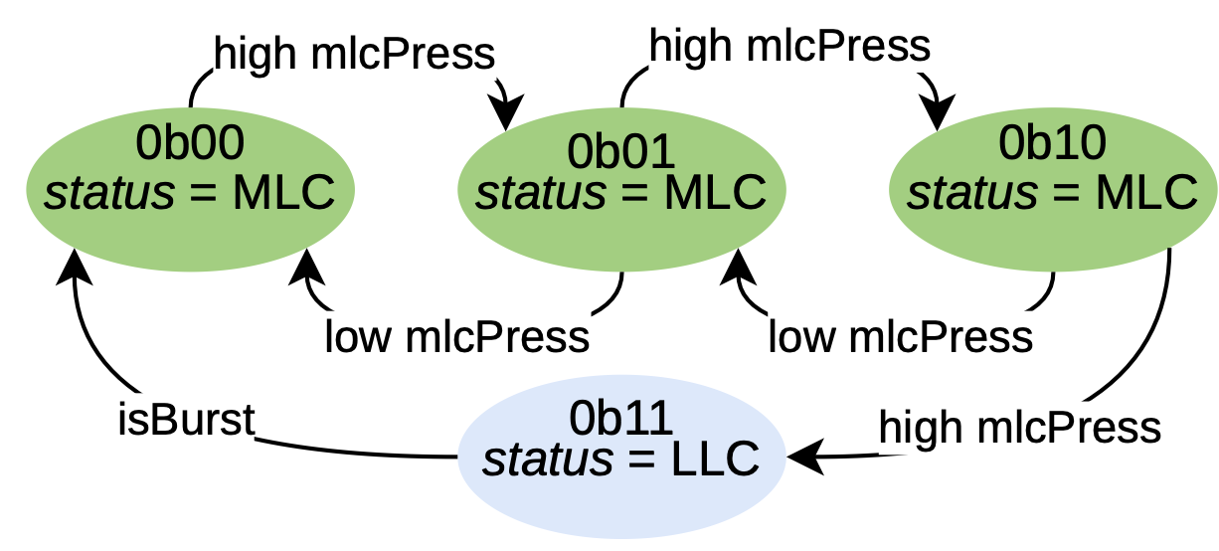
Requirements
Details in the Paper
Timely invalidation to ensure correctness
Software knows when a DMA buffer is consumed
Execute cache invalidation instructions to invalidate DMA buffer
Examples:
Data Cache Invalidate by Modified Virtual Address (DCIMVAC) instruction in ARM_v7
Data Cache Block Invalidate (DCBI) in PowerPC
Moderate MLC prefetching
MLC pressure calculated over a 1us interval

Slide 17
Outline
Background & Motivation
Demystifying network applications
Movement of RX network data in a non-inclusive cache hierarchy
Observations
Useless MLC writebacks
DMA bloating phenomenon
Sensitivity to network rate
Intelligent Data Direct IO (IDIO)
Self-invalidating I/O buffers
Network-driven MLC prefetching
Selective direct DRAM access
Experimental results
Conclusion

Slide 18
Methodology
Applications
DPDK micro network applications, run to completion (Touch-Drop, L2Fwd)
Motivational results from real HW
2 nodes
Intel Xeon Gold 6242 CPU, 1MB MLC, 36MB LLC, 2 DDIO ways, 96GiB DDR4-3200 DRAM
Nvidia/Mellanox ConnectX-5 Dual 100Gb Ethernet NIC
Implementation of IDIO on gem5
2 full-system nodes, running Linux (kernel 5.4.0)
Modeled after a high-performance O3 CPU w/ non-inclusive cache hierarchy
Enabled userspace networking by running DPDK!
100 Gbps Ethernet connectivity

Slide 19
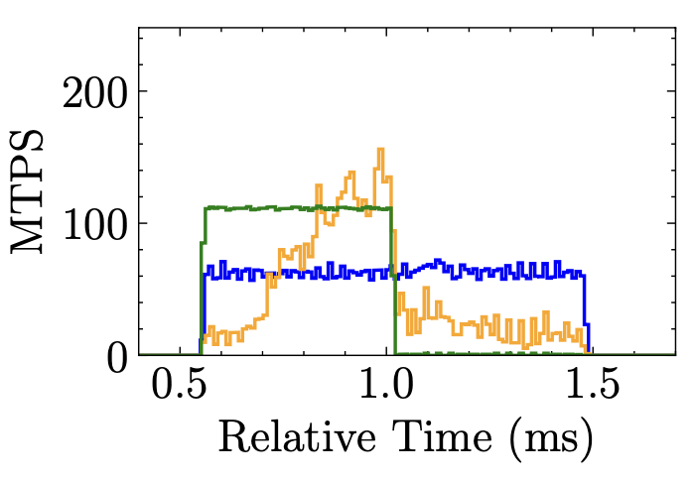
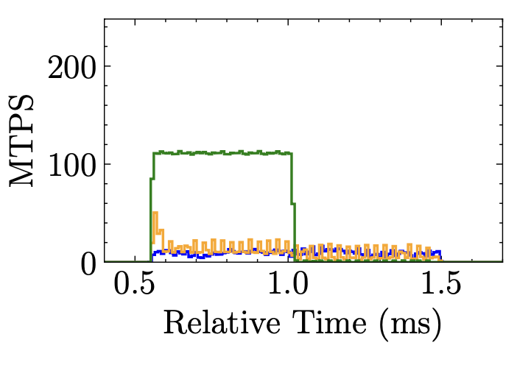
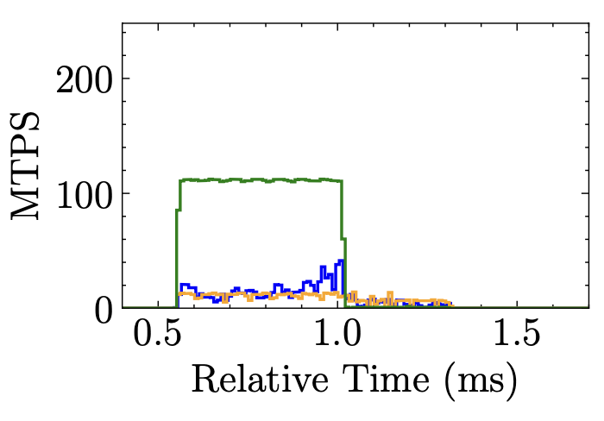
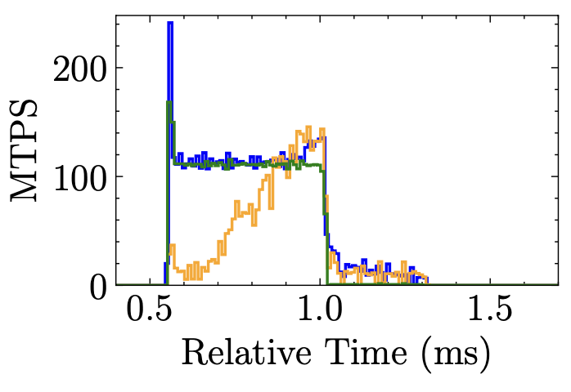
DDIO vs. Inv vs. MLC prefetch vs. IDIO
Baseline (DDIO)
MTPS → Million Transactions Per Second
Touch-Drop application
Self-Invalidate
Only
+
MLC prefetch
Only
IDIO

Slide 20
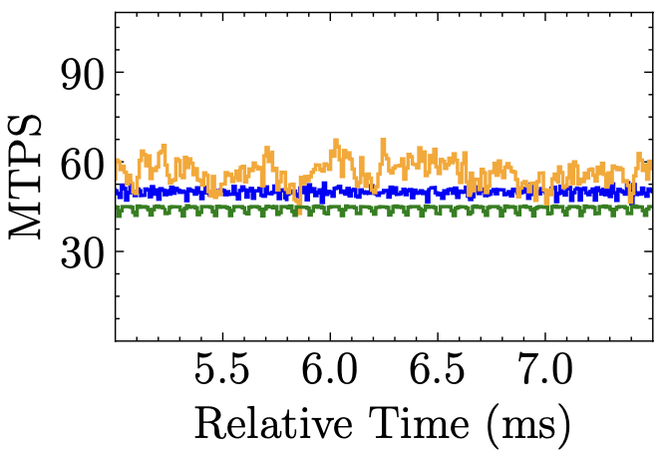
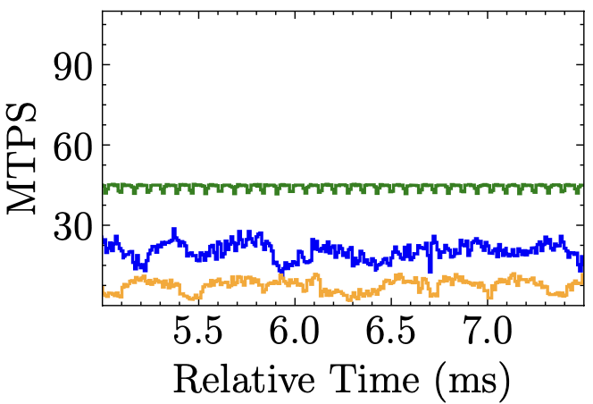
Steady Load
MTPS → Million Transactions Per Second
Touch-Drop application
Baseline (DDIO)
IDIO

Slide 21
Conclusion
IDIO: Network-Driven, Inbound Network Data Orchestration on Server Processors
Mohammad Alian, Siddharth Agarwal, Jongmin Shin, Neel Patel, Yifan Yuan, Daehoon Kim, Ren Wang, Nam Sung Kim
Three key shortcomings of current DCA implementation in a non-inclusive cache hierarchy:
❌ Inefficient use of large MLC
❌ High rates of writebacks from MLC to LLC
❌ Breaking the isolation between application and network data
Proposed solution: Intelligent Data Direct I/O (IDIO)
Three synergistic mechanisms
Self-invalidating I/O buffer
Network-driven MLC prefetching
Selective direct DRAM access
Evaluation using gem5 capable of running DPDK with 100Gbp+ bandwidth
Data movement reduction: 84% MLC and LLC writeback reduction
LLC isolation: 22% performance improvement in a co-running scenario
Tail latency reduction: 38% reduction in 99th latency

