Slide 1




A Network-Centric Hardware/Algorithm Co-Design to Accelerate Distributed Training of Deep Neural Networks
Youjie Li¹, Jongse Park², Mohammad Alian¹, Yifan Yuan¹, Zheng Qu³, Peitian Pan⁴, Ren Wang⁵, Alexander Schwing¹, Hadi Esmaeilzadeh⁶, Nam Sung Kim¹
¹UIUC, ²Georgia Tech, ³THU, ⁴SJTU, ⁵Intel, ⁶UCSD

Slide 2
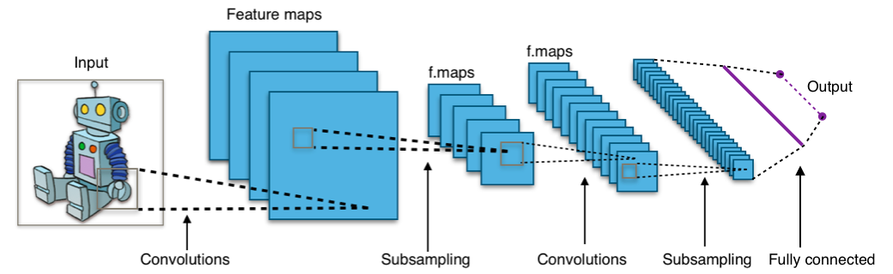
Deep learning is growing exponentially!
Training time (weeks or months)
Training data size (hundreds of TB)
DNN model complexity (hundreds of MB)

Slide 3


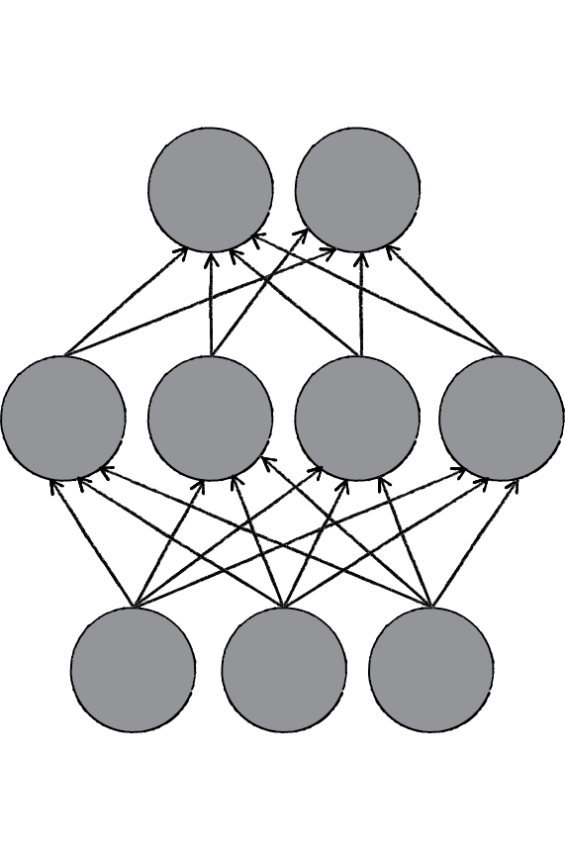




Distributed learning is essential!
Parallelizing the learning task over multiple nodes.
Aggregator
Weights
DNN
Model
Replica
Gradient
Data
Partition
Worker
Worker
Worker
Worker

Slide 4
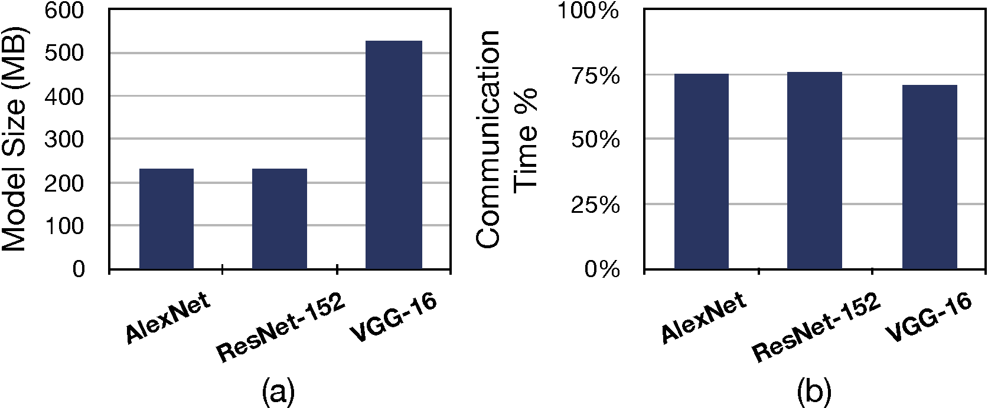
Significant communication overhead in distributed learning!
INCEPTIONN framework
Synchronous training equivalent to TensorFlow
Five Nodes
10 Gb Ethernet
OpenMPI 2.0
Titan Xp GPUs
CUDA 8.0

Slide 5
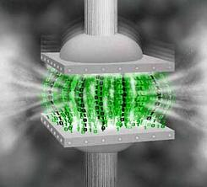
How to reduce communication?
Straightforward Solution: Compression

Slide 6
Challenges for compression
Challenge #1: Expensive compression overhead
Challenge #2: Limited compressibility of weights
Train AlexNet with 16-bit FP truncation | Accuracy
Baseline without truncation | 80.2 %
Weight truncation Only | 00.9%
Gradient truncation Only | 79.7%

Slide 7
INCEPTIONN
A hardware/algorithm co-design to accelerate distributed training
Gradient-centric, decentralized training algorithm
Hardware-friendly lossy gradient compression algorithm
In-network accelerator for compression

Slide 8

In-network acceleration
Pushing the compression to network
Conventional practice:
INCEPTIONN:
Light overhead
FPGAs or
ASICs
Network Interface Card
General-purpose processors
Heavy overhead

Slide 9
Hardware-friendly lossy gradient compression
Requirements:
High compression ratio
Hardware-friendliness for acceleration
Minimal loss in training accuracy
Solution:
Customized lossy compression algorithm for gradients

Slide 10

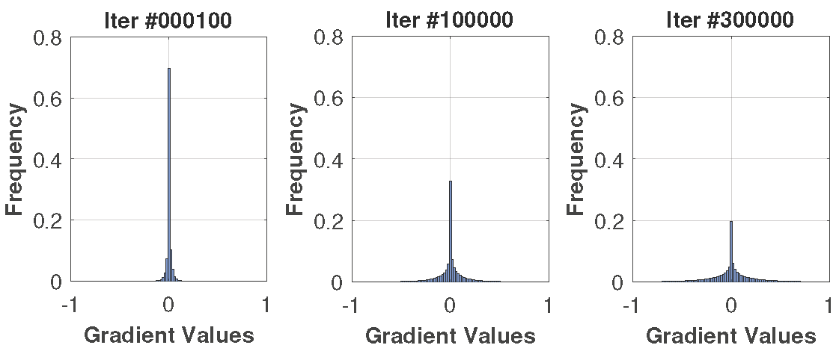
Why gradients?
High error resilience
Limited range and skewness to zero
Early
Middle
Late
AlexNet gradient distribution

Slide 11
Key ideas for lossy gradient compression algorithm
Remove exponents in FP representation by setting it to a constant
Remember the diff by shifting on mantissa with a concat’ed 1
Compress more aggressively as values are close to zeros

Slide 12
Compression with worker-aggregator approach
Aggregator
Limitations
Less opportunities for compression
Performance bottleneck at aggregators
Weights
Gradient
Worker
Worker
Worker
Worker

Slide 13
Gradient-centric decentralized training
Approach
Communicate only gradients
Evenly distribute aggregation to the workers
Worker
Worker
Advantages
Maximize opportunities for compression
Balanced load for compression/decompression
Gradients
Worker
Worker

Slide 14
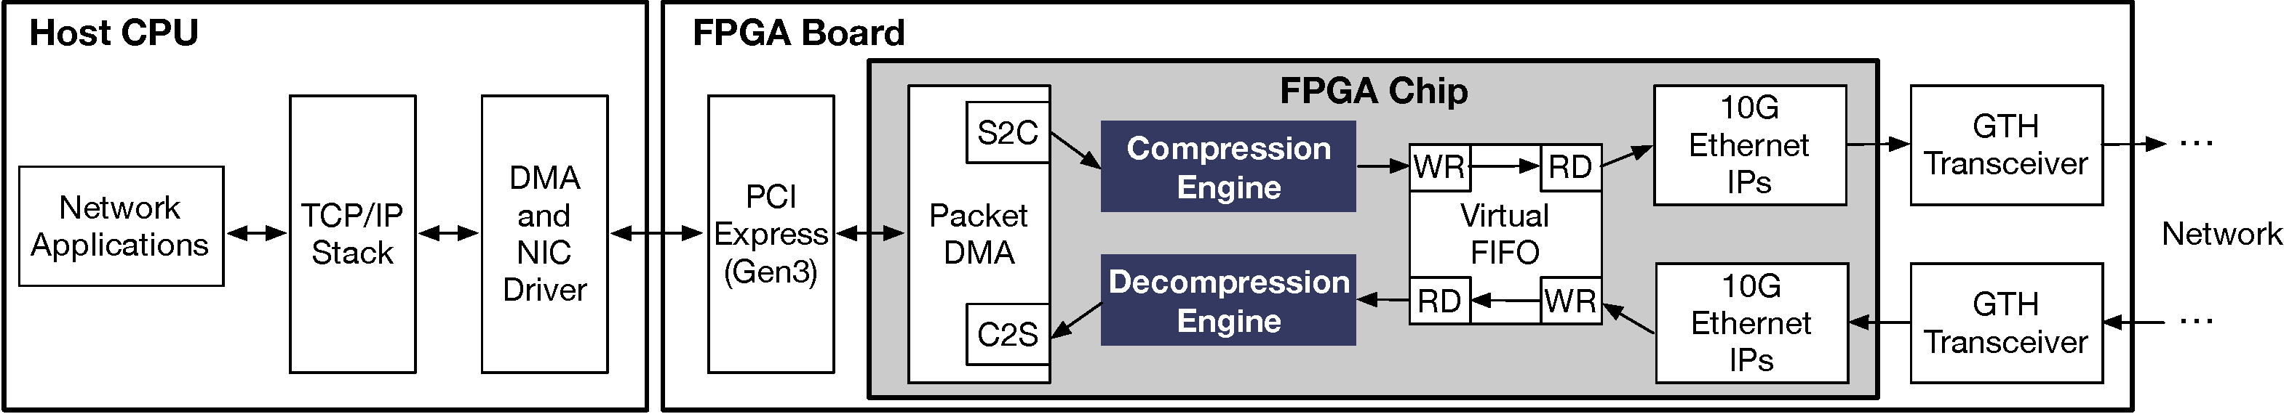
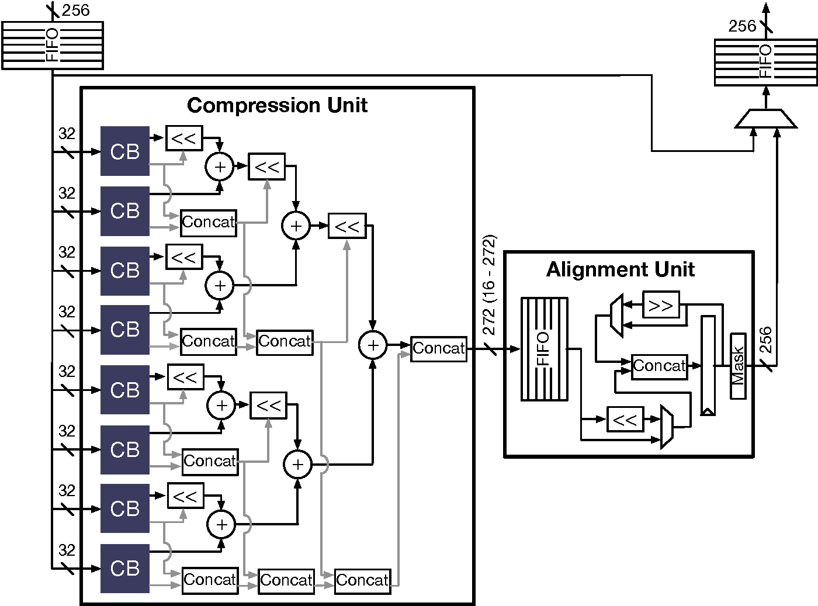
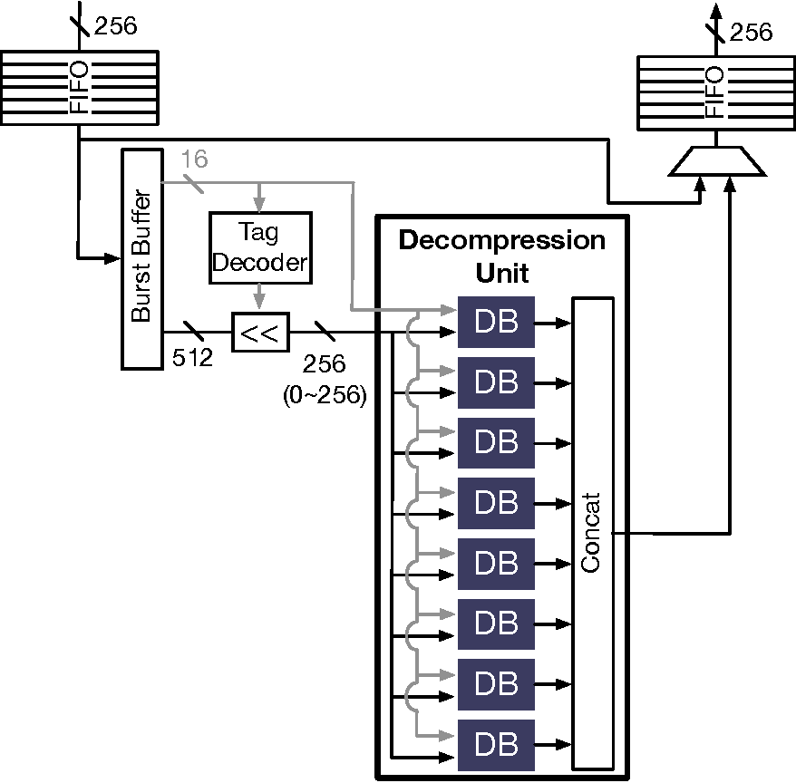
Implementation

Slide 15
Evaluated DNN models and system specifications
Name | HDC | AlexNet | ResNet-50 | VGG-16
Model size | 5 MB | 230 MB | 100 MB | 525 MB
Dataset | MNIST | ImageNet
Mini-batch size | 25 | 64 | 32 | 64
Training data size | 60,000 | 1,281,167
System specifications
Number of nodes | 4
System software | C++, CUDA 8.0, Intel MKL 2018, and OpenMPI 2.0.2
CPU | Intel Xeon CPU E5-2640 @2.6 GHz
GPU | NVIDIA Titan Xp
FPGA | Xilinx VC709 board
Network | 10 Gb Ethernet

Slide 16
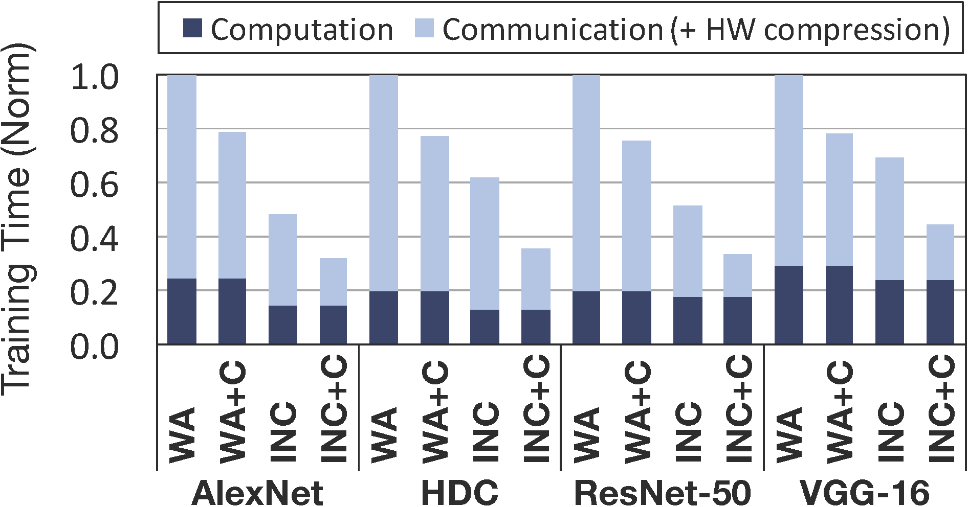
Training runtime comparison
WA: Worker-aggregator
INC: INCEPTIONN
WA+C: WA with compression
INC+C: INC with compression
INC+C offers 76% lower communication time compared to the WA baseline
INC+C offers 2.2~3.1x system-level speedup over the WA baseline

Slide 17
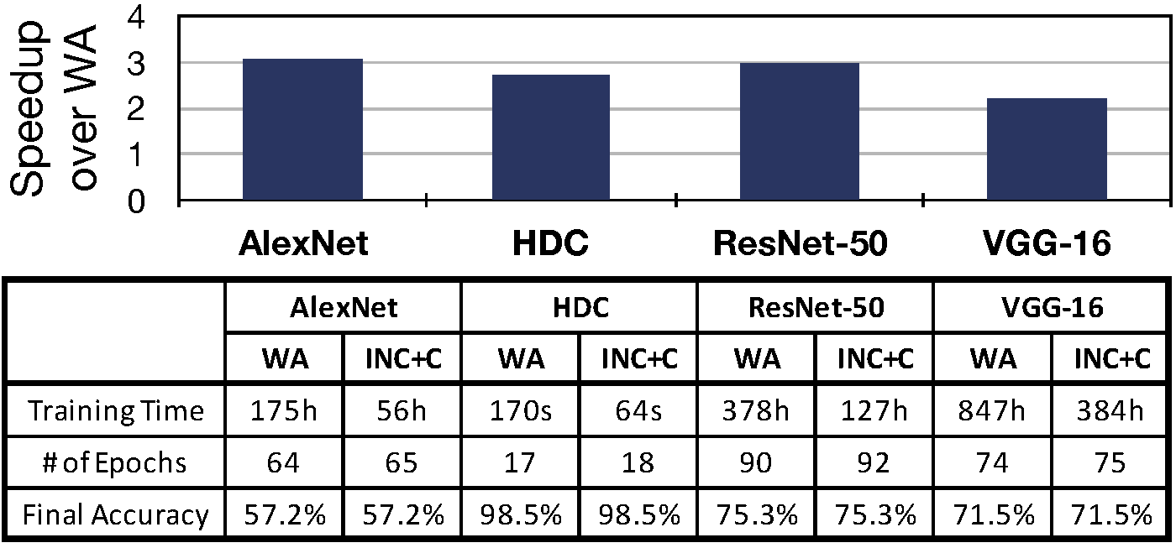
Impact on final training accuracy
Only 1 or 2 more epochs are required to match the same level of accuracy

Slide 18
Conclusion
INCEPTIONN
Hardware-algorithm co-designed in-network acceleration solution to reduce the communication overhead in distributed DNN training
Gradient-centric, decentralized training algorithm
Lossy gradient compression algorithm
In-network acceleration for compression

