Slide 1
Intel Accelerators Ecosystem: An SoC-Oriented Perspective
Yifan Yuan¹, Ren Wang¹, Narayan Ranganathan¹, Nikhil Rao1², Sanjay Kumar¹, Philip Lantz¹, Vivekananthan Sanjeepan¹, Jorge Cabrera¹, Atul Kwatra¹, Rajesh Sankaran¹, Ipoom Jeong², Nam Sung Kim²
1: Intel Labs, 2: UIUC
ISCA 2024

Slide 2
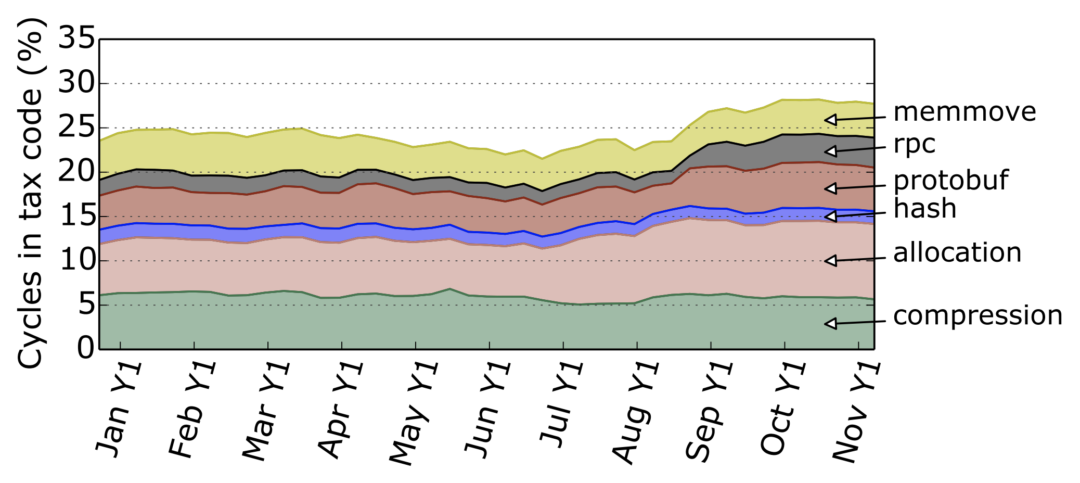
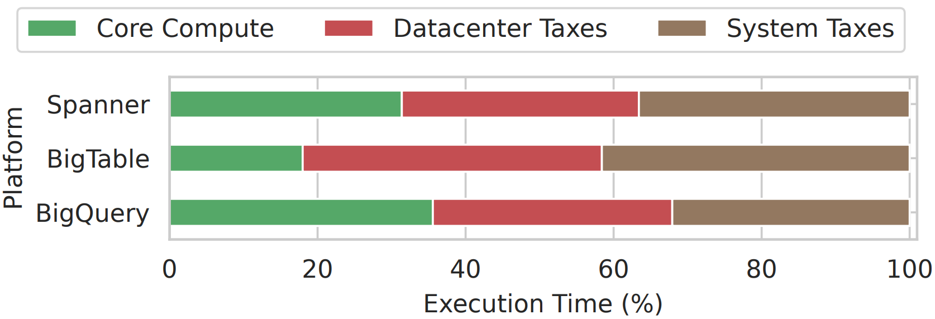
Motivation: Datacenter and Systems Taxes
The cost of CPUs running fundamental infrastructure and systems software
The datacenter tax has been important as datacenters scale up in size and complexity
There’s been a tax inflation over time!
27% to more than 40% CPU cycle consumption today
Profiling a Hyperscale Big Data Processing, ISCA 2023
Profiling a warehouse-scale computer, ISCA 2015
Notes:
Data center tax: memory related operations, remote procedure calls and protocol buffers, cryptography etc.
System tax: OS, networking and storage stacks, and fleet wide library functions
We use the term data center tax to refer to both data center tax and system tax
To make thing even worse, there’s been a tax inflation over the past years.
As disclosed by google last year, in many scenarios, the tax rate increases significantly from around 25 percent to more than 40 percent!
Many datacenter tax related operations are relatively simple and repetitive operations.
This trend motivated developing domain specific accelerators to reduce data center tax

Slide 3
Why On-chip Acceleration in CPU Complex?
Not all workloads are created equal…
Different users have different needs
Domain-specific acceleration addresses the requirements of high-value workloads across specific solution segments
Discrete accelerators don’t fit into all workloads
Longer communication overhead to the host CPU
Limiting its applicability to (relatively) fine-grained workloads
Not able to exploit CPU’s powerful memory system
Discrete accelerators usually consume extra energy and cost
Notes:
There are various types of accelerators for many different workloads,
Different workloads have different needs, domain specific accelerators can address
currently most of which are PCIe based off-chip accelerators,

Slide 4
Requirements and Design Philosophy for CPU-Accelerator SoCs
Flexible and easy accelerator programming
Flexibility to dispatch tasks to accelerators (Sync, async or even transparently)
No need for explicit memory management (DMA memory mapping, pinning, etc. )
Agile CPU-accelerator interaction
Fast task dispatch and from CPU to accelerator
Immediate notification from Accelerator to CPU upon task completion
Options of data locations (cache/memory) for efficient processing
Scalable accelerator sharing and virtualization
Shared by many cores; virtualized to multiple instances to serve different tenants
QoS control and telemetry capabilities
Notes:
To meet the performance, utility, usability and energy demands of hyperscale's, we need a tight on-chip CPU-accelerator SoC design, and we also need HW-SW co-designed ecosystem that provide both hardware features and software stacks to make the SoC successful.
Hardware features are essential to enable faster CPU-accelerator communication, and more scalable accelerator resource sharing, which are important for large scale hyperscalers and broad range of services
Software stacks include libraries, compliers, OS support such as drivers Intel is at the unique position,
Intel is at a unique position to design such on-chip accelerators given its ownership of X86 CPU architecture and experience with off-chip acclerators such as QAT.
Over the years, Intel has learns valuable insights on the key requirements and design philosophy of CPU-accelerator SoCs. Before we delve into the details of the 4 on-chip accelerators we are going to cover in this paper, let’s first discuss high level design requirements and philosophy that guide our design and implementation.
QoS across applications/tenants are important, telemetry for debugging and performance analysis is also essential

Slide 5
On-chip Acceleration on Xeon processors
Intel® Advanced Matrix Extensions
(Intel® AMX)
Intel® Dynamic Load Balancer
(Intel® DLB)
Intel® Data Streaming Accelerator
(Intel® DSA)
Intel® In-Memory Analytics Accelerator (Intel® IAA)
Intel® QuickAssist Technology
(Intel® QAT)
Up to
8.6x
higher speech recognition inference performance with built-in AMX BF16 vs. FP32
Up to
96%
lower latency at the same throughput for Istio-Envoy Ingress with Intel® DLB vs. software for Istio Ingress gateway
Up to
1.7x
higher IOPs for SPDK-NVMe with built-in Intel® DSA vs. ISA-L software
Up to
2.1x
higher RocksDB performance with Intel® IAA vs Ztsd software
Up to
84%
fewer cores to achieve same connections/s on NGINX with built-in QAT vs. out-of-box software
Elevated workload performance
See backup for workloads and configurations. Results may vary​.
Notes:
With those requirements and learnings, Intel has embarked on a multi-year journey to design a new scalable Xeon SoC architecture with 4 on-ship accelerators, namely,
DLB for networking and microservices workloads, dynamically redistributing data loads across cores
DSA, for networking, storage, ML/HPC, optimizing streaming data movement and transformation
IAA for database KVS workloads, accelerating analytics primitives, CRC, compression
QAT, Networking, storage, security workloads, accelerating cryptography and compression

Slide 6
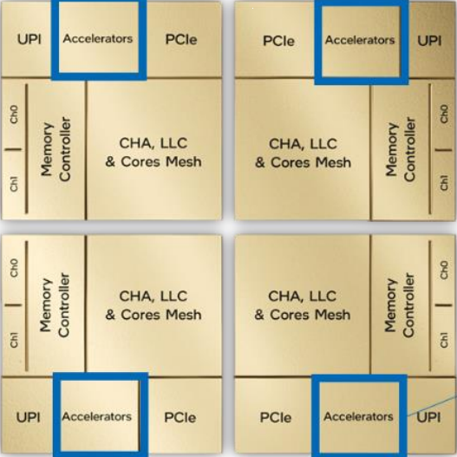
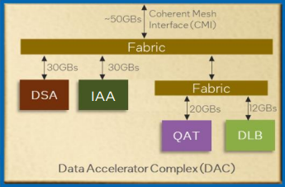
4th Gen Intel® Xeon® Processor Data Accelerator Complex (XCC)
Data Accelerator Complex: Houses Intel DSA, Intel IAA, Intel QAT, and Intel DLB
Data Accelerator Complex
XCC clusters 1x Intel DSA, 1x Intel IAA, 1x Intel QAT and 1x Intel DLB device into a single DAC. Instantiates that DAC 4 times.
Each accelerator is designed to operate independent of one another.
CMI is the common path used by accelerators to access upstream CPU cache and memory.
Accesses from downstream SW to the accelerators will also use CMI.
Each DAC has a separate and dedicated CMI.
Data Accelerator Complex
Notes:
Illustrates an XCC (eXtreme Core Count) version of the SPR SoC chiplet. It introduces Data Accelerator Complex (DAC) as a dedicated tile to host the 4 accelerators and a cache coherent interconnect to the rest of the SoC. The accelerators can access system cache/memory with cache-coherent support.

Slide 7





New SoC level capabilities
Efficient Core-accelerator Interaction
Virtualization and Multi-tenant Support
Batch Processing
Sync/asyc mode
QoS Control
Shared virtual memory space with CPU, no need for explicit memory management
Scalable IO virtualization (S-IOV) enables accelerators to be used by multiple tenants in a scalable way
Capabilities of processing a batch of descriptors, reducing job submission overhead
Programming models support both synchronous and asynchrous processing
Simple descriptor-based job submission and completion
New x86 instructions for submission and completion check
Bandwidth provisioning, bandwidth cap across group
Work dispatch priority, traffic classes
Notes:
Intel on-chip accelerators has several new SOC level capabilities that address the requirement posted before.
The first one is its efficient core-accelerator communication. Software uses simple descriptor to submit task to accelerators and check the completion records., This can be done with new x86 instructions
On chip accelerators support shared virtual memory, meaning the software doesn’t need to manage the memory explicitly, such as pinning a specific page. Also, multiple tenants can easily share a single accelerator instance.
New On-chip accelerators support flexible programming models, for example, tasks can be processed the tasks in a batch to reduce submission overhead. Programmers can also choose synchronous or asynchronous mode to manage the latency.
Last, accelerators also have QoS control support to control priorities. This can be easily tuned by the software.

Slide 8
Intel Accelerator interfacing Architecture (AiA)
MOVDIR/MOVDIR64B
Directly and immediately write data to the designated memory location (bypassing caches)
Efficient accelerator invocation (descriptor passing)
ENQCMD/ENQCMDS
Atomically enqueue data (descriptor) to the designated memory location (MMIO register)
Offload work queue management to hardware, facilitate shared work queue operations
Uinterrupt, Umonitor, Umwait, PAUSE
Signaling and synchronization of accelerators from user space, functionally similar to their kernel-space counterparts.

Slide 9
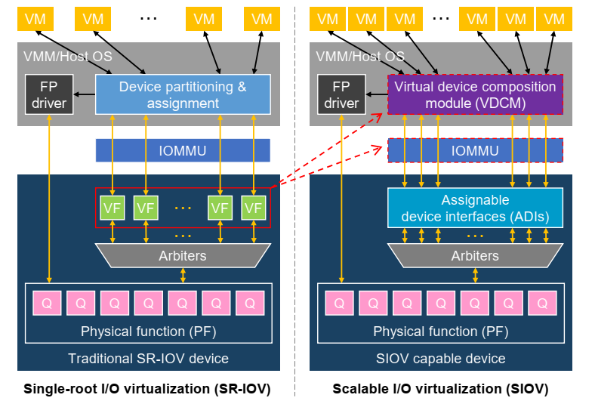
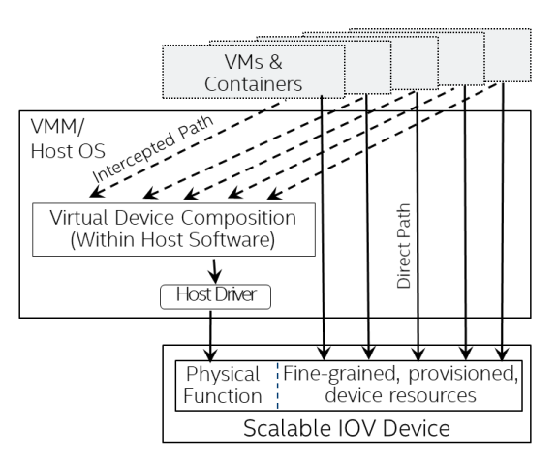
Intel Scalable IO Virtualization (S-IOV)
Single root IO Virtualization (SR-IOV) is not scalable or flexible
S-IOV move non-performance-critical virtualization logics from device to CPU and IOMMU
S-IOV exposes only HW queues (ADIS) for dynamic and flexible VF composing in SW
Can scale a single device to support thousands of functions
Notes:
Single root IO virtualization has been the standard method for device virtualization.
It allows a physical function to spawn multiple virtual functions, each VF assigning to a VM or container
However, HW virtualization stack is not flexible nor scalable (for example, up to 64 or 128 VFs)
Intel proposed Scalable IO vitualization (S-IOV). The basic idea os S-IOV is to move non-performance-critical stacks to SW and IOMMU

Slide 10
Intel Accelerator Programming Models (DSA)
Do next compute task
Do next compute task
Do next compute task
zzz
CPU
CPU
CPU
Intel DSA Descriptor
Intel DSA Descriptor
Load from mem
Load from mem
Store to mem
Load from mem
Store to mem
Load from mem
Store to mem
Load from mem
Done
Done
Memory
Memory
Intel DSA
Memory
Intel DSA
Store to mem
Store to mem
A
Pure Software
B
DSA Sync Mode
C
DSA Async Mode
Notes:
DSA expose two programming models to the software users.
Let’s see pure software first. In software, you have to issue instructions to load from to store to the memory, and then start the next task
With DSA sync mode, the CPU can simply submit the descriptor to the DSA HW, and while waiting for the DSA to complete the task, the CPU is keeping idle, or entering some low-power state. The CPU can move on to the next task, upon the completion of DSA task, which can be notified by interrupt of polling.
With DSA async mode, after submitting the descriptor to the DSA HW, the CPU can continue to work on the next task simultaneously. The next task can be software running on the CPU, or another DSA descriptor to the DSA HW.

Slide 11
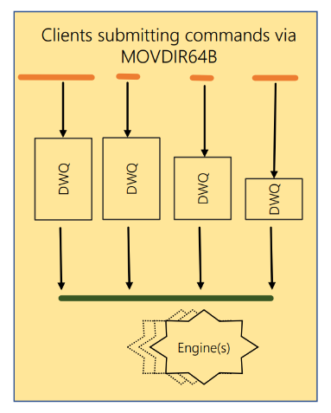
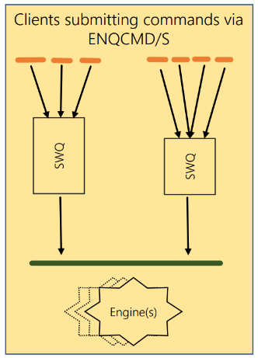
Intel Data Streaming Accelerator (DSA)
Provide cache-coherent memory operations: Data move, fill, compare, flush, CRC, etc
High performance and scalability
User-Friendly:
Flexible programming models
Rich software ecosystems
Can be application-transparent
DWQ
SWQ
DSA architecture and interface
DWQ (Dedicated Workqueue) by single clients (MOVDIR64B)
SQW (Shared Workqueue) by multiple clients (ENQCMD)
ENQCMD returns status of SWQ occupancy (accept/reject)
Notes:
DSA is an on-chip accelerator in the Intel Xeon CPU package and can do various data movement and transformation operations.
DSA can provide high throughput with low latency for the transformation operations, and can be scaled to support many users
DSA is also user-friendly, and can be even application-transparent.
Here is a deeper explanation of the WQs.
First is DWQ.
It’s intended to be used by single client, which can be either a process or a VM
A user can use the new MOVDIR64B instruction to write the descriptor to the MMIO region with low overhead
Also, the software need to manage the queue occupancy, or say, how many on-the-fly descriptors should be issued.
Different from DWQ,
Shared work queue or SWQ is intended to by used by many clients.
The software can use the new ENQCMD to write descriptors, without explicitly managing the inter-client contention.
The ENQCMD instruction returns a status of whether the descriptor is accepted by the SWQ HW.

Slide 12
Intel DSA Software Stacks and Enablements
Intel® DML
Data mover Library
High-level APIs for users to take advantage of DSA
Hiding hardware details
Intel ® DTO
DSA Transparent Offloading Library
Users can use DSA transparently (with configuration/tunning knobs)
NO code modification/re-compilation!
Notes:
As we mentioned, easy and flexible programming model is important, here we highlight two libraries that facilitate DSA’s adoption in applications. DML and DTO
DML, stands for data mover library.
It provides a set of high-level APIs for user, hiding the low-level DSA hardware details
DTO is DSA transparent offloading library
It intercepts the default system functions like memcpy and replace them with the corresponding DSA functions adaptively. User don’t even need to recompile their program!

Slide 13
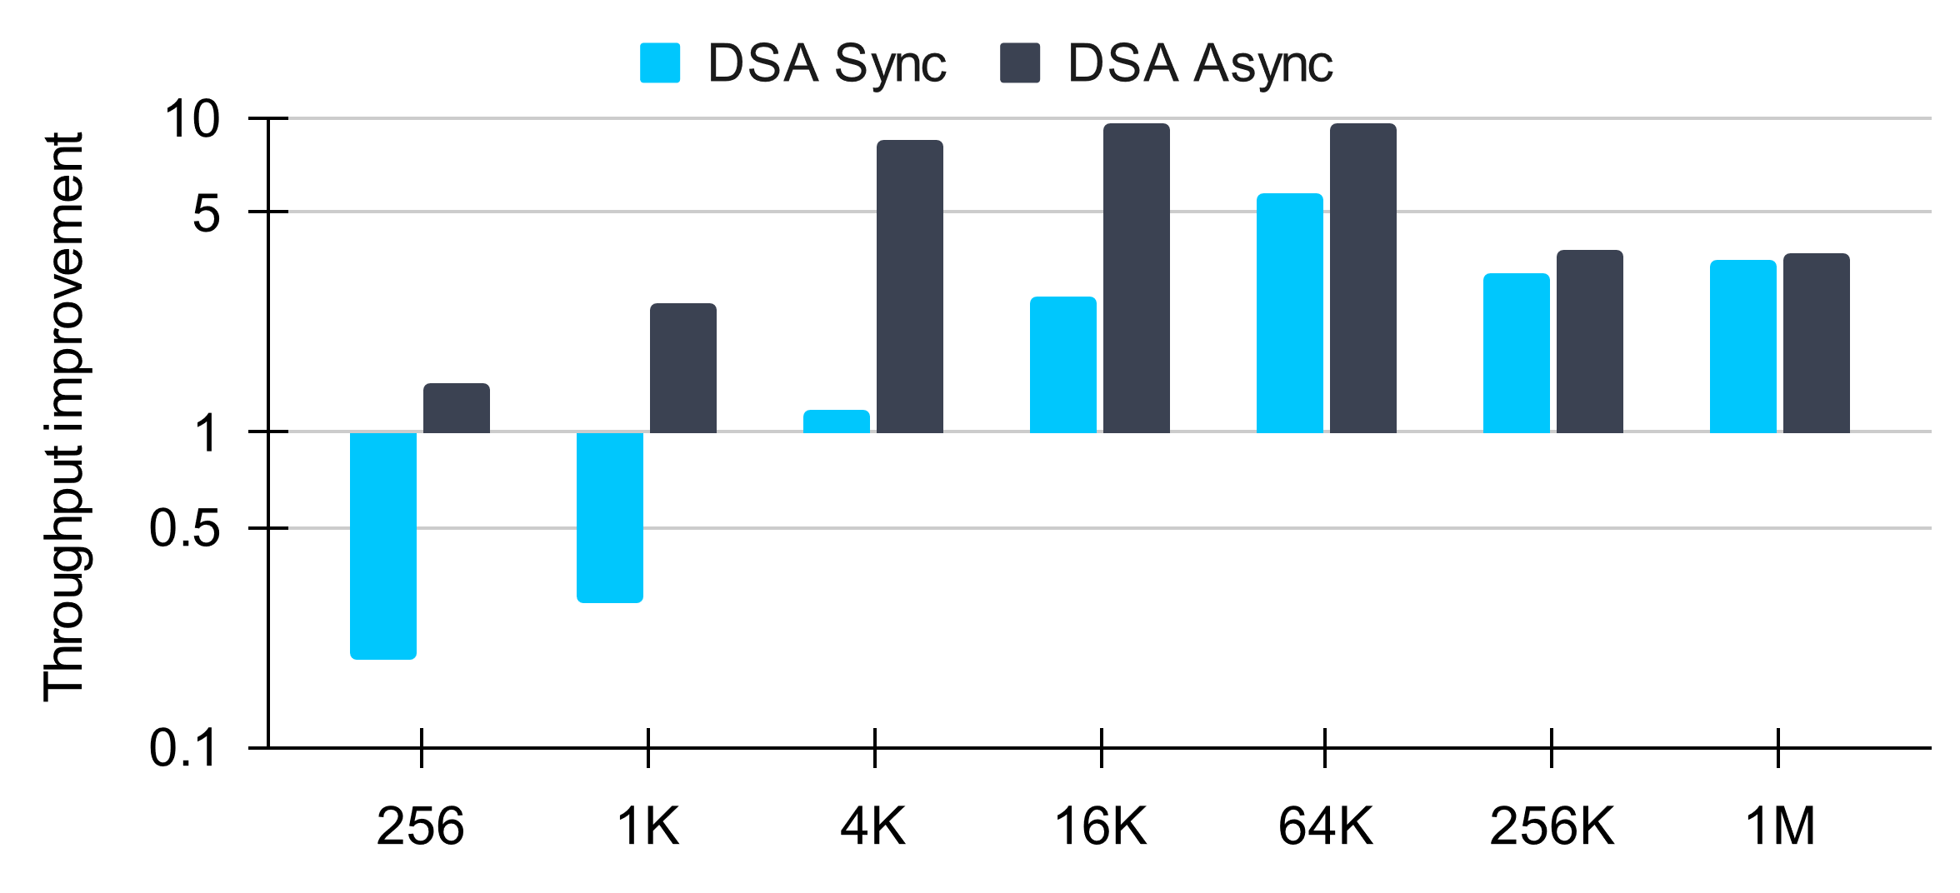

Performance: Throughput Improvement vs 1 CPU core
DSA can offer more than 5-core savings
DSA async provides more benefits
Notes:
This slide show some performance numbers of DSA. These numbers are measured from the open-source DSA-perf-micros benchmark on an Intel 4th gen Xeon processor.
For simplicity we only show the memory move performance in this presentation.
The chart shows the throughput of a single DSA instance, normalized to that of a single CPU core.
As we can see, as long as the data transfer size is not very small, DSA always has notable throughput benefit over CPU core, and this can lead to as high as more than 5 CPU core saving.
Also, since more tasks are processed by the DSA HW, operating DSA in async mode always provides more benefits. But this may require more software changes.

Slide 14
Intel® QuickAssist Technology (QAT) Introduction
Hardware acceleration of :
Cryptographic Ciphers, Hash, Public Key Exchange, Data Compression (Lookaside for Xeon)
History
QAT has been evolving as a discrete device for years
SPR is 4th major generation of QAT, and the first on-chip one
~16 unique Lookaside IP’s delivered - Integrated in Xeon
Deployed widely in network infrastructure, enterprise & cloud
Host Interface
SVM
DMA Controllers
Work/User
Queue
Ciphers,
Hash & CRC
Public Key
Data Compression
More functions in future platforms
Intel® Key Protection Technology
Notes:
5G infrastructure in US/EMEA/PRC, Cisco, F5, Juniper etc
DellEMC, IBM, NetApp, Microsoft etc

Slide 15
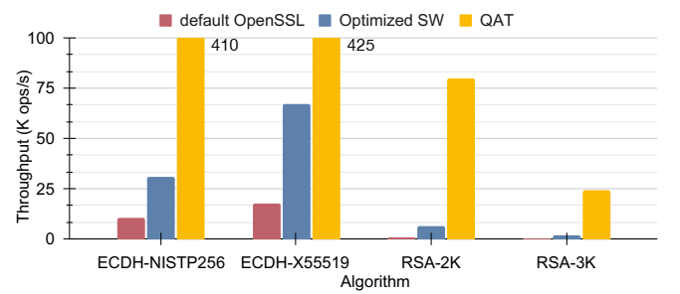
QAT Performance – Crypto Application
Public Key Cryptography performance with QAT
QAT offload provides significant improvement over most optimized SW
Notes:
Use official QAT Engine Library with 4 QAT instances to offload 4 OpenSSL algorithms.
providing at least more than 35% improvement with 1 QAT instances.

Slide 16
More details in the paper
Detailed new SoC architecture features and explanation
Accelerators details:
Micro architecture and interface
Functionalities,
Software and libraries
Usages and performance

Slide 17
Summary and Call to Actions
Overview the requirements and design philosophy of On-chip Accelerator.
Introduce the 4 accelerators and new SoC capabilities
Intel DLB, QAT, DSA and IAA.
Shared virtual memory, Accelerator Interfacing Architecture (AiA); Scalable I/O Virtualization (SR-IOV)
Future Work and Call to Action
We call on researchers and members of industry to discover creative uses of these generalized accelerators
Utilize the high degree of scalability enabled through these on-chip accelerators' design
New research toward inter-accelerator interaction and QoS
Unified accelerator interface and software stack
Notes:
DLB: Brand-new accelerators for queue management in networking and more
Impressive offloading performance and flexible programming models
QAT: Mature concept with new capability and better performance
Boost crypto and (de)compression workload
Rich ecosystem that facilitate QAT usage
DSA: Broadly applicable data movement and transformation operations at high throughput and low latency
Seen examples through networking via OVS, storage NVMe-OF acceleration, and media transport
Easy integration via DTO or already integrated frameworks like DPDK or SPDK
IAA: Great support for high throughput and low latency compression and data analytics operations
Demonstrated benefits in QPS, memory bandwidth, and memory usage through RocksDB and ClickHouse

Slide 18
Notices & Disclaimers
Performance varies by use, configuration and other factors. Learn more on the Performance Index site.
Performance results are based on testing as of dates shown in configurations and may not reflect all publicly available updates. See backup for configuration details.
No product or component can be absolutely secure.
Your costs and results may vary.
Intel technologies may require enabled hardware, software or service activation.
Availability of accelerators varies by SKU. Visit https://ark.intel.com/content/www/us/en/ark/products/series/228622/4th-generation-intel-xeon-scalable-processors.html
Intel does not control or audit third-party data. You should consult other sources to evaluate accuracy.
© Intel Corporation. Intel, the Intel logo, and other Intel marks are trademarks of Intel Corporation or its subsidiaries. Other names and brands may be claimed as the property of others.

Slide 19
Questions?

