Slide 1





Unlocking the Power of Inline Floating-Point Operations on Programmable Switches
Yifan Yuan¹, Omar Alama², Jiawei Fei^{2, 3},
Jacob Nelson⁴, Dan R. K. Ports⁴, Amedeo Sapio⁵,
Marco Canini², Nam Sung Kim¹
¹UIUC, ²KAUST, ³NUDT, ⁴Microsoft Research, ⁵Intel
^{04/05/2022}
Notes:
Thanks for the introduction. Hi everyone! Today I’m going to introduce our work, ” Unlocking the Power of Inline Floating-Point Operations on Programmable Switches
”. This is joint work of UIUC, KAUST, microsoft research, NUDT, and intel.

Slide 2
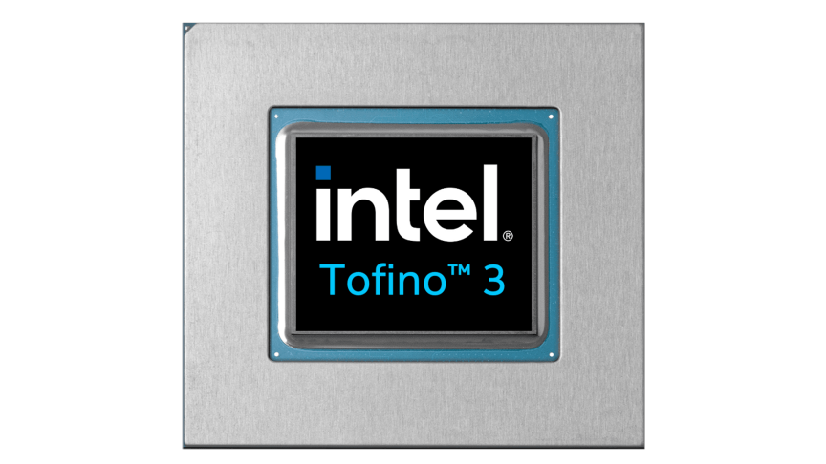

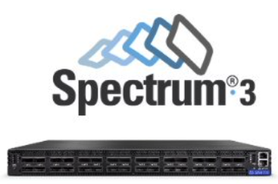
Background & Motivation
We are living in the era of programmable network.
Networking switches with programmable pipeline, a.k.a. programmable switches, have been prevailing.
Programmable switches provide basic compute capability, great programmability and flexibility, while keeping line-rate forwarding.
Notes:
With the recent trend of SDN and programmable hardware, the network itself, especially networking devices, has been given more programmability.
Specifically, network switches with programmable pipeline have gained much attention.
There are already many programmable switches, such as Intel Tofino,
Broadcom Trident,
and NVIDIA spectrum.
This popularity comes from the programmable switch’s simple architecture, great flexibility with high-level languages like P4, and high line-rate performance.

Slide 3






Background & Motivation
Programmable switches have been applied to accelerate/offload a wide range of networking and distributed applications.
NetChain (NSDI’18), DistCache (FAST’19)
NOPaxos (OSDI’16), Eris (SOSP’17)
NetCache (SOSP’17), HULA (SOSR’16)
Jaqen (Security’21), Poseidon (NDSS’20)
Cheetah (SIGMOD’20), NETACCEL (CIDR’19)
SwitchML (NSDI’21), ATP (NSDI’21)
Are we still missing anything?
Notes:
As a result, the community has seen a wide range of applications being offloaded or accelerated by programmable switch.
These applications include but are not limited to caching,
Consensus or coordination,
Load balancing,
Security,
Database,
And distributed machine learning.
Having that said, are we still missing anything in the programmable switch?

Slide 4
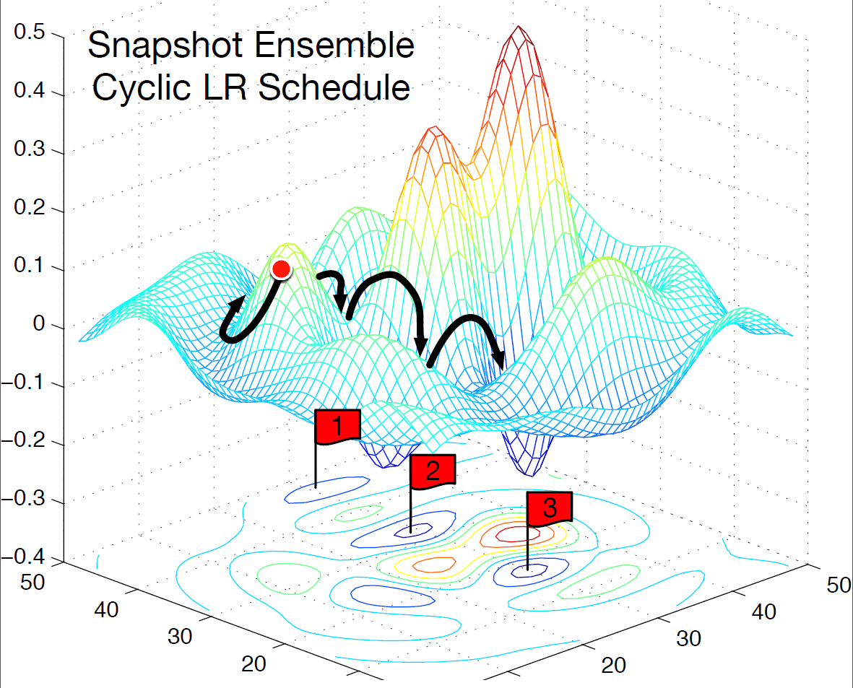
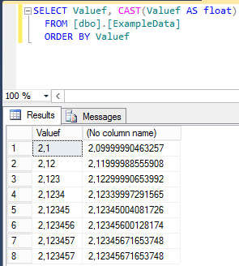
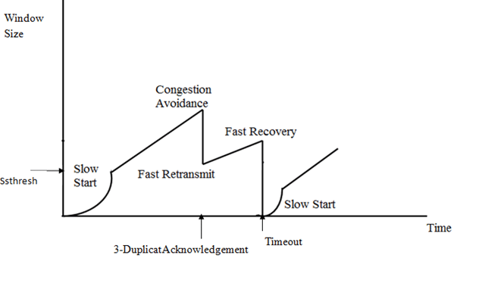


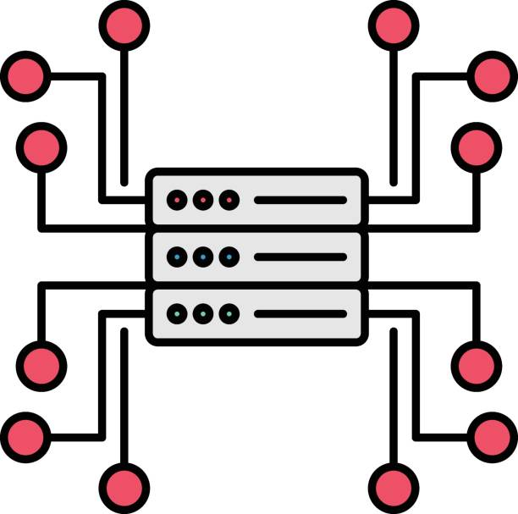
Background & Motivation
Protocol-independent switch architecture (PISA), the de-facto programmable switch paradigm, has no support for floating point (FP) data formats, which are common in many use cases.
Training gradient is FP!
Datatype can be FP!
Calculating estimation needs FP!
It will be great if we can enable FP operations on PISA switch!
Notes:
In this work, we find that floating point data format is not well supported by protocol independent switch architecture, the most popular programmable switch paradigm.
Floating point is everywhere. For example, in distributed ML training, workers need to exchange gradient data for model update.
In a database query, the targeted data column can be in floating point format.
In some network congestion control algorithm, floating point operations are needed for bandwidth estimation.
Hence, floating point operations are really desirable in PISA switch for further application acceleration.

Slide 5
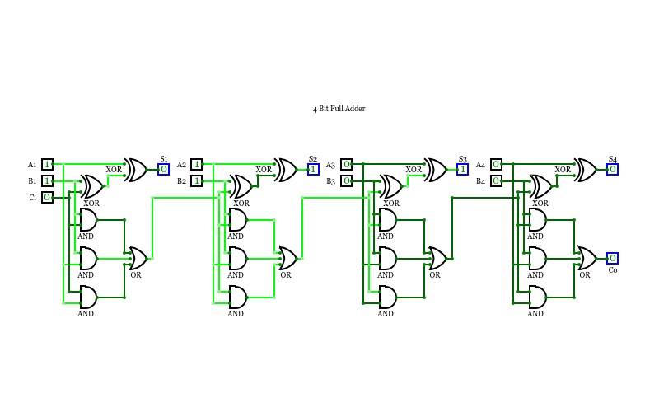
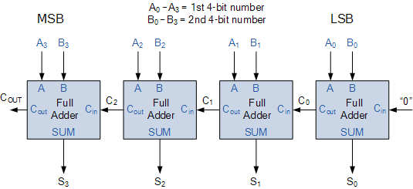
Challenges
The goal of this work is to let PISA switch support FP operations efficiently.
Why does the current PISA switch not support FP operation?
Let’s see how arithmetic operation works under the hood at first!
Integer (fixed point)?
C = A +/- B, done. Easy and simple.
Notes:
So, in this work, we are committed to efficient floating point support on PISA switch.
Obviously, one question off the top of our mind is, why does the current PISA have no fp support.
Let’s see how those arithmetic operations work at the hardware level.
For integer or say fixed point, it’s easy and simple – you simply add or sub two numbers in binary format.
Regarding the hardware, both block level
And logic-gate level are straightforward – only a few full adders connected back-to-back,

Slide 6
Challenges
Why does the current PISA switch not support FP operation?
Let’s see how arithmetic operation works under the hood at first!
FP?
Sign
1 bit
Biased Exponent
5 bits (k = 5)
Mantissa (Significand)
10 bits
Implied “1” for mantissa
Sign = 0
Exponent = 2⁴ + 2⁰ = 17
Bias = 2^{k-1} - 1 = 2⁵⁻¹ – 1 = 15
Biased_exp = 17 – 15 = 2
Mantissa = 2⁻¹ + 2⁻² + 2⁻³ = 0.875
-1⁰ x 2² x (2⁰ + 0.875) = 7.5
Notes:
Then, how about floating point?
Typically, a floating point number consists of 3 parts. Taking a 16-bit half-precision fp number as an example,
We have 1-bit sign,
Biased exponent, which is 5 bits in this case,
And mantissa or say significand, which is 10 bits in this case.
For the sign bit, 0 indicates it’s a positive number
For the exponent, the value represented in binary is 17,
and considering the bias,
the actual exponent value is 2.
For the mantissa, it always represents a value in the range of [0, 1], so here we have 0.875.
Finally, all these values can be assembled by the formula,
to represent the fp value.
Note that, since the mantissa is always normalized to the range, there is an “implied one” in front of the mantissa, saving storage space.

Slide 7
Challenges
Why does the current PISA switch not support FP operation?
Let’s see how arithmetic operation works under the hood at first!
FP?
C = A +/- B
A (7.5)
+
B (2.5)
Notes:
Then, let’s talk about a simple floating point addition.
Let say we want to calculate A plus B.

Slide 8
Challenges
Why does the current PISA switch not support FP operation?
Let’s see how arithmetic operation works under the hood at first!
FP?
C = A +/- B
Exp_{A}
Man_{A}
Extract
Exp_{B}
Implied “1”
Man_{B}
Notes:
The first step is to extract the fields from the numbers.
Note that, since in this example, we are dealing with positive numbers, we ignore the sign bit for simplicity.
During the extract step, we should also recover the “implied 1” in the mantissa, so that it can represent the correct value.

Slide 9
Challenges
Why does the current PISA switch not support FP operation?
Let’s see how arithmetic operation works under the hood at first!
FP?
C = A +/- B
Exp_{A}
Man_{A}
Extract
Align
Exp_{B}
Man_{B}
>> 1
Exp_{A} – Exp_{B} = 1
Notes:
The next step is to align the two mantissas based on the exponent difference.
To avoid precision loss, we always right-shift the mantissa with smaller exponent to drop its least significant bits.
Here, we will right-shift the mantissa_b by 1 bit.

Slide 10
Challenges
Why does the current PISA switch not support FP operation?
Let’s see how arithmetic operation works under the hood at first!
FP?
C = A +/- B
Exp_{A}
Man_{A}
Extract
Align
Add/sub
+
Exp_{B}
Man_{B}
=
Man_{C}
Notes:
After alignment,
we can do the actual add or sub for the two mantissas.
Here, we can have Mantissa_c’s value.

Slide 11
Challenges
Why does the current PISA switch not support FP operation?
Let’s see how arithmetic operation works under the hood at first!
FP?
C = A +/- B
Exp_{A}
The first “1” should always be at the 5th bit, as the implied “1”
Exp_{B}
Man_{C}
Extract
Align
Add/sub
Renormalize
Exp_{C}
= Max(Exp_{A}, Exp_{B}) + (5 - 4)
>> (5 - 4)
Notes:
And Then, we need to renormalize the mantissa_c so that it’s still in the right range.
Specifically, the first “1” should always be at the 5th bit, as the implied “1”, but now, it’s on the 4th bit.
Hence, we right-shift the mantissa by 1 bit,
and, similarly, adjust the exponent value to reflect the mantissa’s change.

Slide 12
Challenges
Why does the current PISA switch not support FP operation?
Let’s see how arithmetic operation works under the hood at first!
FP?
C = A +/- B
Exp_{C}
Man_{C}
Extract
Align
Add/sub
Renormalize
Assemble
Implied “1” for mantissa
C = 10
Notes:
And finally, we assemble these components back
to the standard floating point format,
which is C equals to 10.
Also note that, the leading ”1” of mantissa is implied again.

Slide 13
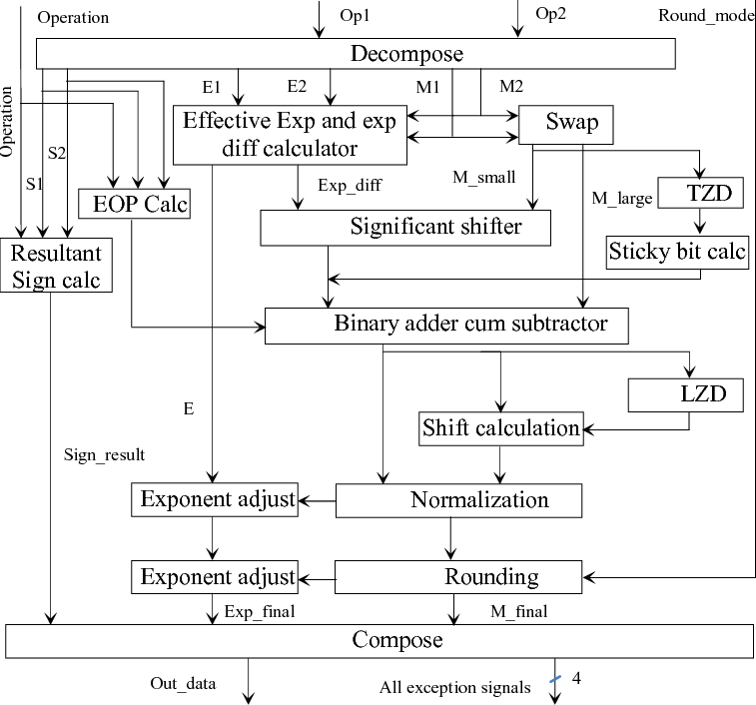
Challenges
Why does the current PISA switch not support FP operation?
Let’s see how arithmetic operation works under the hood at first!
FP?
C = A +/- B
Every single block is complicated!
Extract
Align
Add/sub
Renormalize
Assemble
FP operations are not single-clock-cycle.
Notes:
These steps make the underlying hardware extremely complicated as well.
Here is a high-level block diagram of a typical floating point adder.
Even a single block is complicated.
For example, this block already represents the entire integer adder!
In other words, a floating point operation cannot be done in a single clock cycle anyway.

Slide 14
Challenges
Going back to PISA architecture…
Fully-pipelined streaming design (cannot go backward, cannot stall)
ONE single action per stage
ONE access per memory location per packet
Match + Action
Memory
ALU
…
…
…
…
Programmable Parser
Programmable Match-Action Pipeline
FP cannot be done in single pipeline stage anyway!
Block diagram credit: Xin jin, et al., NetCache: Balancing Key-Value Stores with Fast In-network Caching (SOSP’17)
Notes:
Then, let’s take a look at the standard PISA architecture,
As shown in this diagram.
The programable parser will extract the designated fields from a network packet.
These fields will be fed to the programmable pipeline,
And in each stage, the fields will be matched with the values stored in the stage’s memory, and the corresponding action will be taken.
Overall, this is a fully pipelined streaming design for line-rate forwarding guarantee.
In each pipeline stage, only one operation can be done for a single data.
Also, only one memory access to a memory location is allowed for each packet.
In other words, it’s extremely difficult, if not impossible, to put the floating point operation into a single pipeline stage.

Slide 15
Challenges
Other programmable switch paradigms instead of PISA?
Switch with specific arithmetic support (e.g., Mellanox SHARP)?
High-performance (throughput, latency, and scalability)
Fixed functionalities, inflexible for emerging numerical formats (FP16, bfloat, MSFP, etc.)
FPGA-based “switch”?
Flexible enough
Not as high-performance (overall-throughput) as ASIC
PISA has the potential of balancing performance and flexibility.
Notes:
Of course, there are other programable switch paradigms, which may support floating point number.
For example, we have switches with dedicated arithmetic units, which can achieve high performance.
But this fixed functionality leads to inflexibility of supporting emerging floating-point formats.
On the other hand, FPGA-based switch offers enough flexibility,
But its performance remains a big concern.
Hence, PISA is still the desirable platform for this purpose for balanced performance and flexibility.

Slide 16


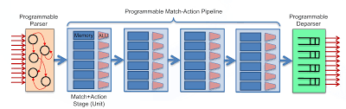
FPISA: Native FP representation and operations in PISA
FP
PISA
+
= ?
Notes:
So, having floating point format and PISA paradigm,
How can we combine them together?
In this work, we propose the FPISA mechanism, which enables native floating point support in commodity PISA

Slide 17
FPISA: High-level idea
Decompose an FP’s representation (storage) and operation to mutual-independent, PISA-friendly steps.
Keep the intermediate FP representation in PISA, until we need to get back to the end-host(s).
Leverage networking-specific hardware units for FP sub-operations.
Notes:
Here comes the overview of FPISA mechanism,
Basically, we have three main ideas.
First, we decompose the floating point representation and operations into mutual-independent steps and allocate them to PISA pipeline stages
Second, we don’t recover the standard floating point format in the switch, until we need to get back to the end-host.
Third, we leverage the networking hardware for floating point operations.

Slide 18
FPISA: FP representation and storage in PISA
We decouple the three components of a FP number and store them separately in PISA pipeline.
Notes:
Let me first introduce the floating point representation in PISA.
Specifically, given a floating point number,
how can we store it in PISA’s pipeline stages.
The idea is decoupling.

Slide 19
FPISA: FP representation and storage in PISA
We decouple the three components of a FP number and store them separately in PISA pipeline.
Notes:
We put the 8-bit exponent in a pipeline stage’s memory
At the same time,

Slide 20
FPISA: FP representation and storage in PISA
We decouple the three components of a FP number and store them separately in PISA pipeline.
Notes:
We combine the sign bit and mantissa,

Slide 21
FPISA: FP representation and storage in PISA
We decouple the three components of a FP number and store them separately in PISA pipeline.
encoded in 2’s complement
Notes:
And put them into a subsequent pipeline stage.
Note that, this will be encoded in 2’s complement for convenient add/sub operation.

Slide 22
FPISA: Delayed normalization
Suppose we want to calculate V₁ + V₂ + V₃ = V₄
Exp₁
Man₁
Cannot go back to adjust exponent!
Exp₂
Man₂
+
Notes:
The next design aspect is delayed normalization.
Suppose we want to aggregate 3 numbers in the switch.
And we have this PISA pipeline,
With a single direction.
We have the first value,
deployed in the two stages.
And when the second value comes in,
after calculating the mantissa sum,
We cannot renormalize it, and go back to adjust the exponent value.

Slide 23
FPISA: Delayed normalization
Suppose we want to calculate V₁ + V₂ + V₃ = V₄
We delay the step “renormalization” until we need to get the result back to the end-host(s).
Exp₁
Man₁
Exp₂
Man₂
Exp₃
Man₃
Exp
+
Man
+
Notes:
Instead, We propose to keep this temporary exponent and mantissa value inside the switch, until we really need it on the end-host.
This means, during the aggregation of v1
V2,
And v3, we simply conduct the extract, algin, and add/sub, keep the aggregated mantissa as is.
Until we finished the aggregation,
we pull the exponent and mantissa out of the stages’ memory,

Slide 24
FPISA: Delayed normalization
Suppose we want to calculate V₁ + V₂ + V₃ = V₄
We delay the step “renormalization” until we need to get the result back to the end-host(s).
Exp₄
Man₄
Exp
Man
Notes:
And then,
we have the following pipeline stages dealing with the renormalization and assemble steps,
So that we can get the result V4 with standard floating point format.

Slide 25
FPISA: Leverage networking hardware
For renormalization, we need to find how many leading “0” we have in the operated mantissa, so that we can shift it and adjust the exponent.
How can we do this efficiently and quickly?
Notes:
The third idea is to use the networking hardware for floating point operations.
Recall that in the renormalization step, we need to count the leading “0”s, which is impossible with simple ALU functionalities of PISA.
Instead, we use the TCAM-based longest-prefix match table in the PISA pipeline, which is originally used for IP routing.

Slide 26
FPISA: Leverage networking hardware
For renormalization, we need to find how many leading “0” we have in the operated mantissa, so that we can shift it and adjust the exponent.
How can we do this efficiently and quickly?
Counting leading “0”s!
Notes:
Let’s take a closer look at this table.
For the match field, we can have IP address with mask, and the action is to decide how to forward this packet.
How is the IP address related to leading “0”s counting?
So, let’s see the IP address 64.0.0.0, with a mask of 2 bits. In binary format, this is one “0” plus one “1”, plus 30 “doesn’t care” bits.
Similarly, the IP address 32.0.0.0/3 equals to two “0” and one “1”, and “doesn’t care” bits.
So on and so forth.
In this way, we are actually emulating leading ”0” counting!
Hence, we build our match table as follow, where the corresponding shift actions can guarantee the correct position of the implied “1”.

Slide 27
Are we done?
We implement FPISA with P4 in Intel’s Tofino-1 and find it not efficient enough.
Example-1: saturated VLIW instruction slots –> limited data parallelism
Notes:
Having these design aspects in mind, we implement FPISA mechanism in P4 language on an Intel Tofino-1 silicon.
We find that the current implementation is not really efficient because of some hardware limitations.
First, we find that the VLIW instruction slot is saturated, limiting the number of floating point operations we can have per packet.
Specifically, in the Tables like leading “0”s counting table, we have entries like this.

Slide 28
Are we done?
We implement FPISA with P4 in Intel’s Tofino-1 and find it not efficient enough.
Example-1: saturated VLIW instruction slots –> limited data parallelism
Enhancement: 2-operand shift instruction –> “shift [operand0] [operand1]”
Each action is a single instruction stored in the small buffer!
Notes:
And each action is mapped to an instruction in the instruction buffer, since the count of shift bits is hardcoded in each instruction.
Hence, we propose a two-operand shift instruction, so that one left-shift instruction and one right-shift instruction will handle all the cases.

Slide 29
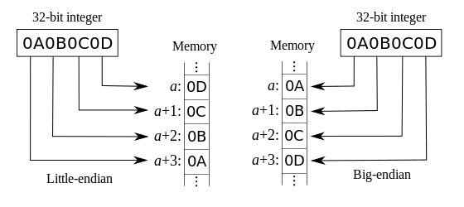
Are we done?
We implement FPISA with P4 in Intel’s Tofino-1 and find it not efficient enough.
Example-1: saturated VLIW instruction slots –> limited data parallelism
Enhancement: 2-operand shift instruction –> “shift [operand0] [operand1]”
Example-2: CPU-network endianness difference -> conversion overhead on end-host
Enhancement: byte-wise shuffling in switch pipeline/parser
Evaluation shows that our enhancements add negligible overhead to the current PISA hardware, while at least 8x cheaper than FPU.
Endianness conversion rate that a core can achieve and that is desired to achieve 100Gbps line-rate.
Notes:
A second example is endianness conversion.
Networking devices and end-host CPU has different byte-wise order of data,
our experiment shows that converting such byte-wise ordering on the end-host is very expensive.
However, this should be cheap in the switch hardware, since it’s just shuffling the wire connections at the circuit level. That’s also our proposed enhancement.
Our circuit level evaluation shows that, our enhancements add negligible overhead to the existing PISA switch architecture, and is much cheaper than standard floating point hardware in terms of power and area consumption.

Slide 30
Usecase: In-network aggregation for distributed ML training
What’s the procedure of data communication in state-of-the-art frameworks?
Note: we focus on the most popular “data parallel” mode.
Aggregated Gradient Vector
Need quantization (to fixed point) on the end-hosts!
In-switch Aggregation
Update local model, run next iteration….
Need to recover to FP on the end-hosts!
Gradient Vector
Local computing on each worker
Notes:
In this work, we take the distributed ML training as an example to evaluate FPISA’s benefit.
Let’s take a look at the state-of-the-art method first.
There will be worker machines, each with its local copy of the model and local partition of training data.
Each training iteration, every worker machine will use its local data to train the model,
And generate a gradient vector.
Note that, the gradient is in floating point format, and we have to quantize them on the end-host before the next step.
Then, these gradient vectors will be sent out,
And aggregated in the network switch,
The aggregated gradient vector will be broadcasted to each worker machine,
where they will be converted back to floating point again,
And for next training iteration.

Slide 31
Evaluation
Given the aforementioned hardware limitation, we develop a C program exactly simulating FPISA addition behavior (both FP32 and FP16) for model convergence evaluation.
We also leverage the SwitchML (NSDI’21) framework to evaluate the (emulated) end-to-end training time speedup in a real cluster.
Notes:
Due to the hardware limitation, we develop a software simulation library that behaves like FPISA’s in-switch addition, and evaluate it on multiple ML models training to see its impact on models training convergence.
For FPISA’s speedup compared to the quantization-based fixed point solution, we also leverage the state-of-the-art SwitchML framework in a real cluster with real ML models.

Slide 32
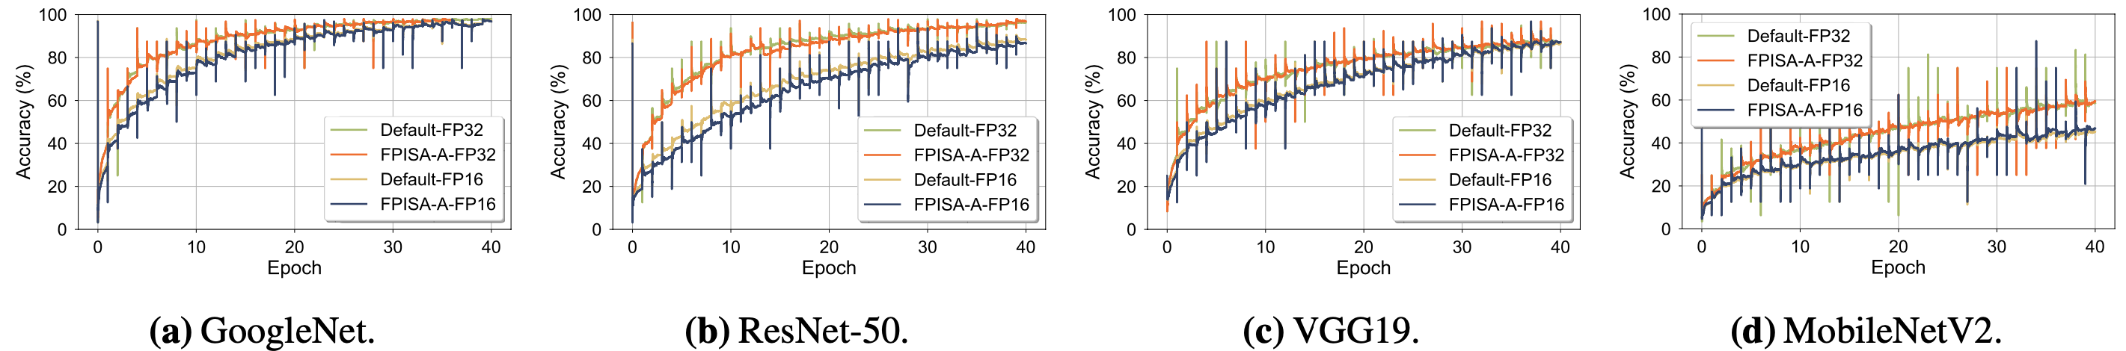
Evaluation – Training accuracy and convergence
We apply FPISA’s addition (both FP132 and FP16) to models training, and compare the accuracy curves against the ones generated with default standard FP addition.
FPISA has negligible impact on trained model’s convergence.
Notes:
Let’s first see the FPISA’s impact on training convergence and accuracy. We compare the end-to-end accuracy curves of standard addition and FPISA addition in both FP32 and half precision FP16.
From these plots, we can find that for both FP32 and FP16, FPISA’s curve highly overlap with the standard curve.
Hence, the errors introduced by FPISA doesn’t really affect the training convergence.

Slide 33
Evaluation – Training time speedup
We compare FPISA’s training time with fixed point based SwitchML, which conducts quantization with 2 or 8 CPU cores.
End-to-end training time speedup of FPISA compared to the default SwitchML with 8 cores.
Notes:
We then evaluate the training speedup. For the fixed point based SwitchML, we use 2 or 8 CPU cores for endianness conversion and floating point quantization in SwtichML experiments.
This plot shows FPISA’s speedup than SwitchML. When using 8 CPU cores on each end-host, we observe that FPISA can be as high as 35% faster than SwitchML.

Slide 34
Evaluation – Training time speedup
We compare FPISA’s training time with fixed point based SwitchML, which conducts quantization with 2 or 8 CPU cores.
> 40% drop with limited hardware in SwitchML for quantization!
End-to-end training time speedup of FPISA compared to the default SwitchML with 2 cores.
FPISA can bring training speedup as well as efficient end-host resource usage compared to the state-of-the-art solutions.
Notes:
This improvement will be more significant if we have limited end-host CPU resource, or say 2 cores.
Note that this will lead to more than 40% drop regarding the training time, meaning switchML consumes lots of end-host compute resource.
Hence, we argue that FPISA is a high-performance and efficient approach.

Slide 35
More details in the paper
FPISA’s error and precision analysis.
Error-tolerance and numerical characteristics of gradient aggregation in distributed training.
GPU’s potential for gradient quantization.
Additional FP features and advanced FP operations in PISA.
……
Notes:
Due to the time limit, I’m not able to cover every aspect of our work. Please refer to the paper for more details.

Slide 36
Conclusion
Floating point is an important format that is desirable to be supported on modern programmable dataplane with low cost and high flexibility.
We Propose FPISA approach and a couple of cheap hardware enhancements, which, together, store and operate floating-point numbers in common PISA pipeline.
Our evaluation on distributed ML training shows that FPISA can significantly facilitate the application execution and reduce end-host resource usage.
Notes:
To recap, due to the design and implementation complexity, today’s PISA-based programmable switches typically do not support floating point operations, which are common and important in many distributed and networking applications.
To this end, we propose FPISA, along with a few hardware enhancements, that enables PISA pipeline to operate floating point data natively, with acceptable approximation.
Using distributed ML training as an example, we demonstrate that, compared to the state-of-the-art fixed-point based solution, FPISA-based in-network aggregation can significantly reduce both the training time, and end-host resource usage.

Slide 37

Questions? Contact me!
yifany3@Illinois.edu
Notes:
Thanks for your attention, and I’m happy to take questions.

Slide 38
Usecase: In-network aggregation for distributed ML training
In distributed ML training, local compute accelerators (e.g., GPU, TPU) performance improvements have so far outpaced network bandwidth increases.
Newer, larger ML models spend more time on communication.
In-network aggregation is a promising solution for training acceleration.

Slide 39
Implementation
We implement FPISA with P4 in Barefoot’s Tofino-1 architecture.
Where does the error come from (compared to default addition)?
It supports ONE FP per packet. But for integer, we can have up to 64. Why?
C = A + B (one in switch’s register, one in packet)
Steps:
Compute exponent difference
If exp_A < exp_B, swap so B < A
exp_C = exp_A
Align: Right-shift mantissa_B (by exponent difference)
Compute mantissa_C = mantissa_A +/- mantissa_B
Normalize C
Detect carry / count leading zeros
Adjust exponent to match
Shift mantissa appropriately (could be right or left shift)
Round
Add in rounding factor
Adjust exponent to match
Stateful ALU
Left shift/overwrite instead
Shifter with VLIW instructions
Stateful ALU
TCAM (like LPM in IP forwarding)
ALU
Shifter with VLIW instructions

Slide 40
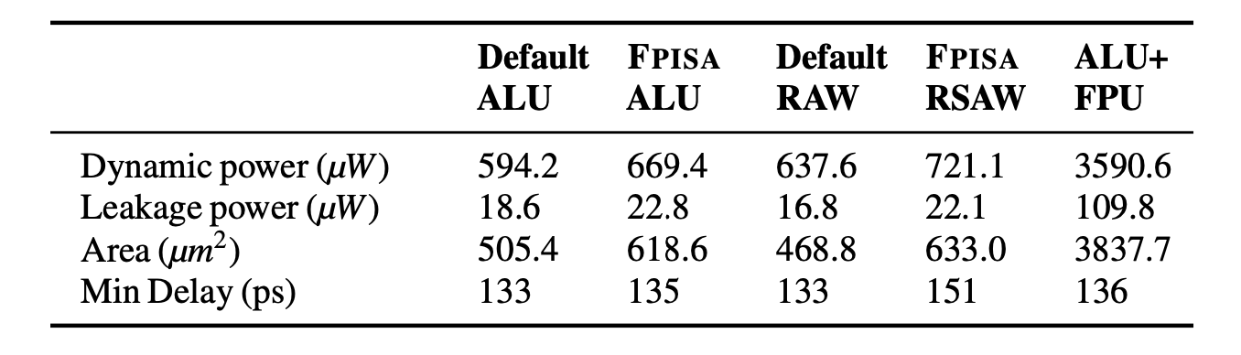
Hardware Improvement
Existing: “shift [operand0] 1”, “shift [operand0] 2” …….. -> operand0 >> fixed value
“Align” and “normalization” require ~32 VLIW instructions, saturating instruction slots of a single pipeline stage, leading to under-utilization of other hardware components.
Desired instruction : “shift [operand0] [operand1]” -> operand0 >> operand1
Little-effort enhancement 😀
Existing: 1 single operation per data per pipeline stage
Cannot do “shift + add” for mantissa. We do left-shift instead.
It will be great to have “shift + add” as one step in a stage so that we don’t have to left-shift (we can do swap!), eliminating one error source of tofino addition.
Practical and mid-effort enhancement 🙂
Existing: software-handled endianness conversion
High overhead (even on GPU).
Zero-cost in hardware (simple wire shuffle)😀
<35% overhead than existing hardware, ~8x cheaper than FPU

