Slide 1
Gun Deaths in the USA 2012-2014
Yifan Zhang- Student no: s4686474
This presentation showcases cases of gun violence from different perspectives in the USA between 2012 and 2014.

Slide 2
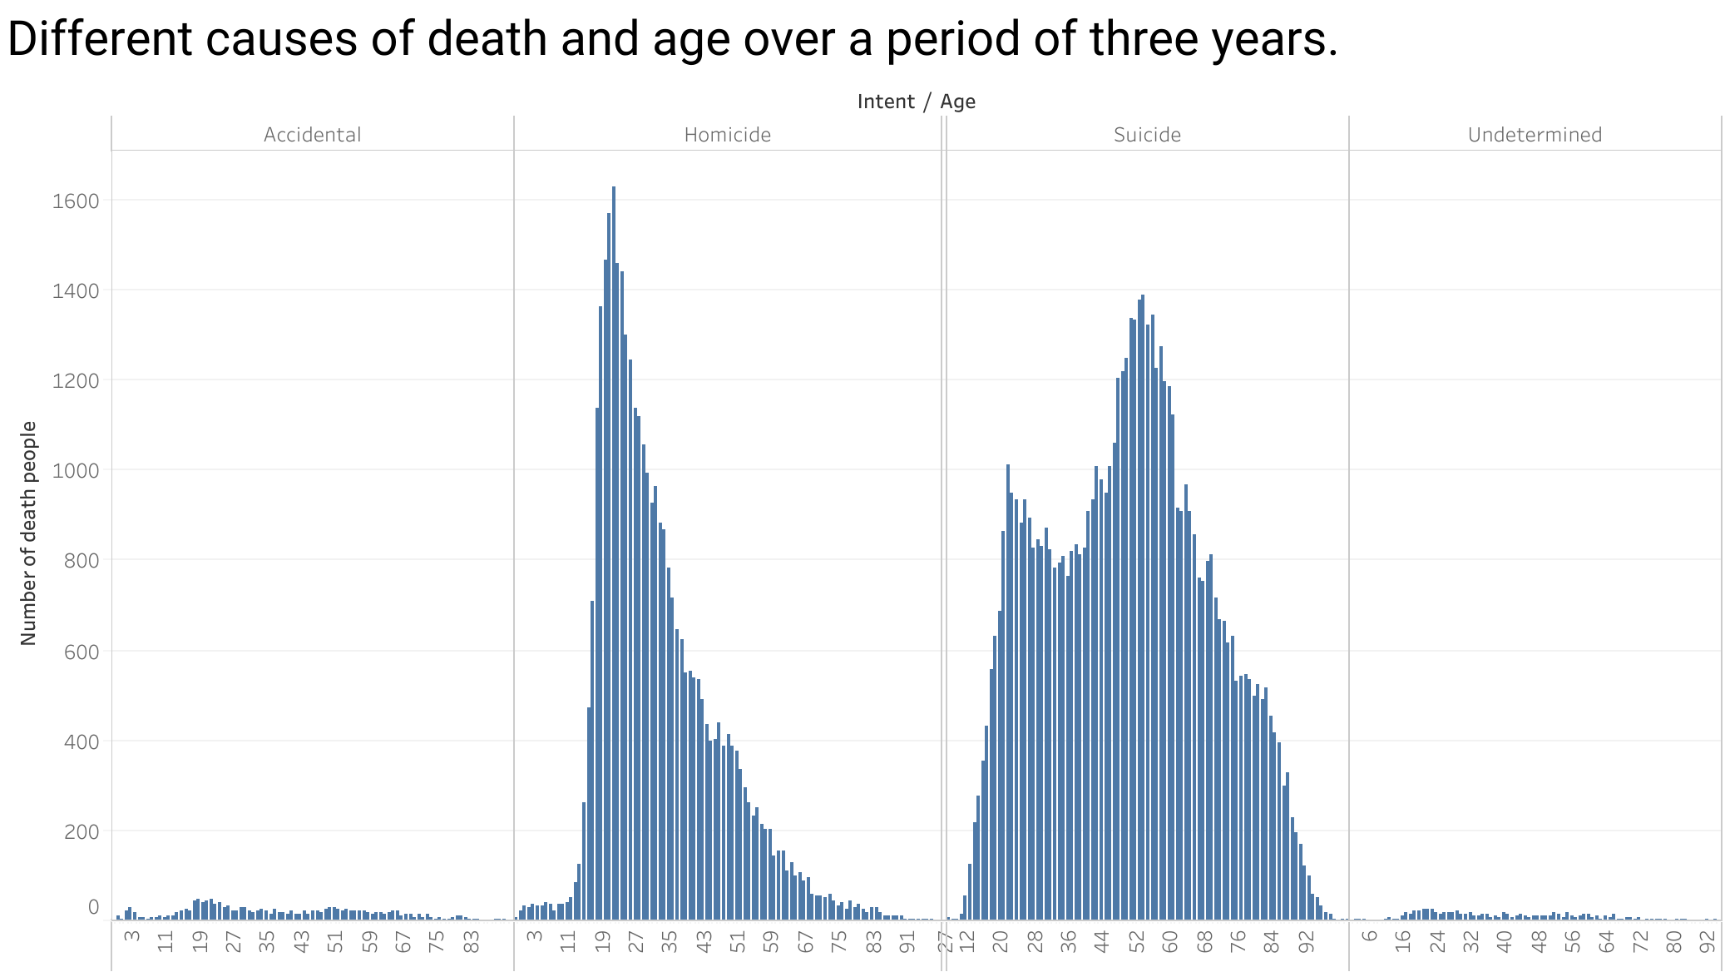
Key Graphic 1
This bar graph displays the age distribution of deaths by different causes, with the highest number of homicides occurring in the age group between 18-28 years, while the majority of individuals who died by suicide were between the ages of 48-61 years.

Slide 3
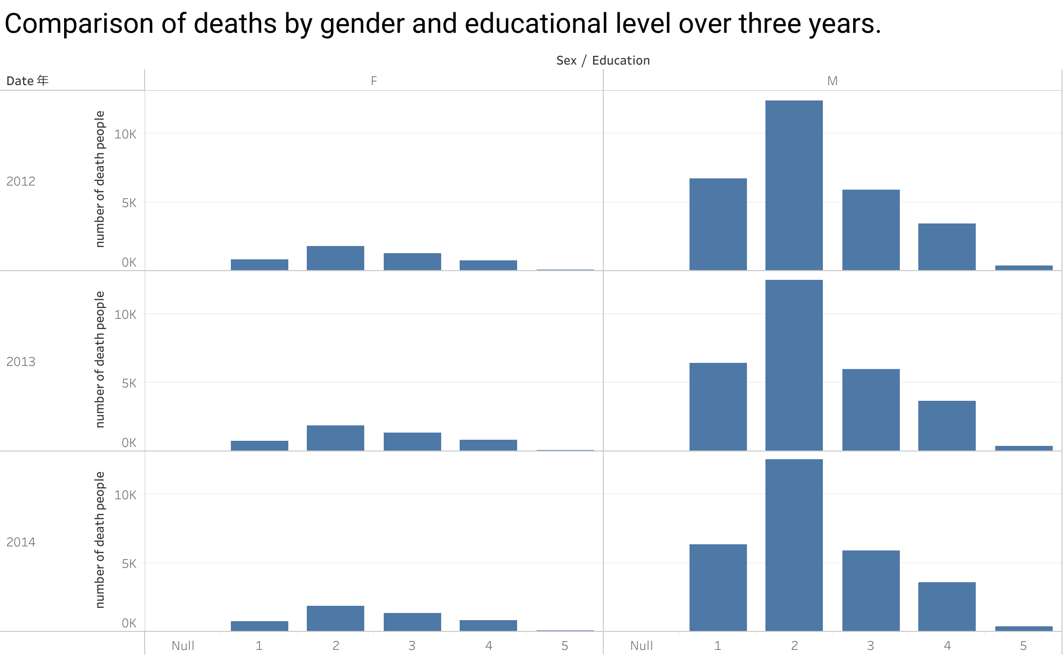
Through these three different bar graphs from different years, we can clearly observe that the highest number of deaths occurred in the educational level 2 category, followed by a significantly higher number of deaths in males compared to females.

Slide 4
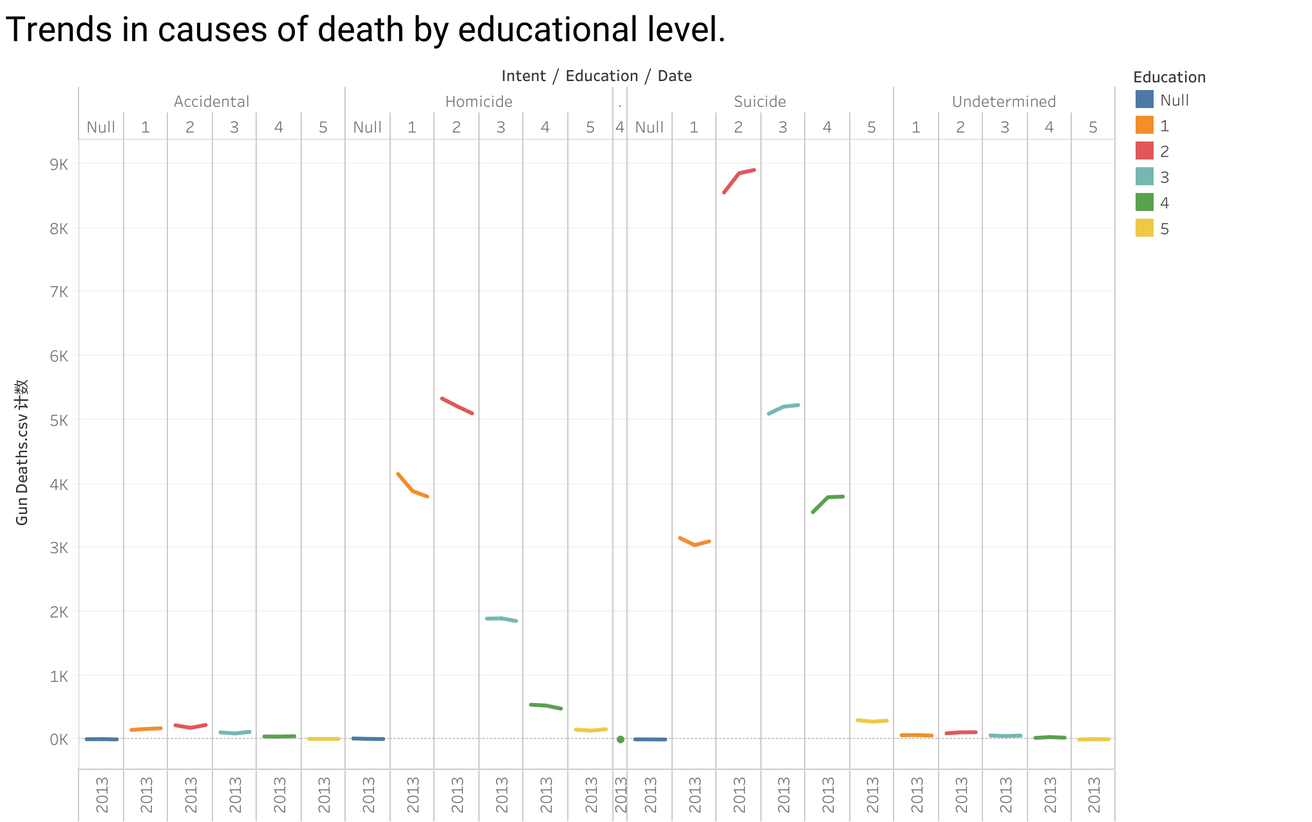
This graph clearly shows the changing trends in causes of death among individuals with different educational levels over a period of three years.

