Slide 1
Gun Deaths in the USA 2012-2014
Yifan Zhang- Student no: s4686474
This presentation showcases cases of gun violence from different perspectives in the USA between 2012 and 2014.

Slide 2
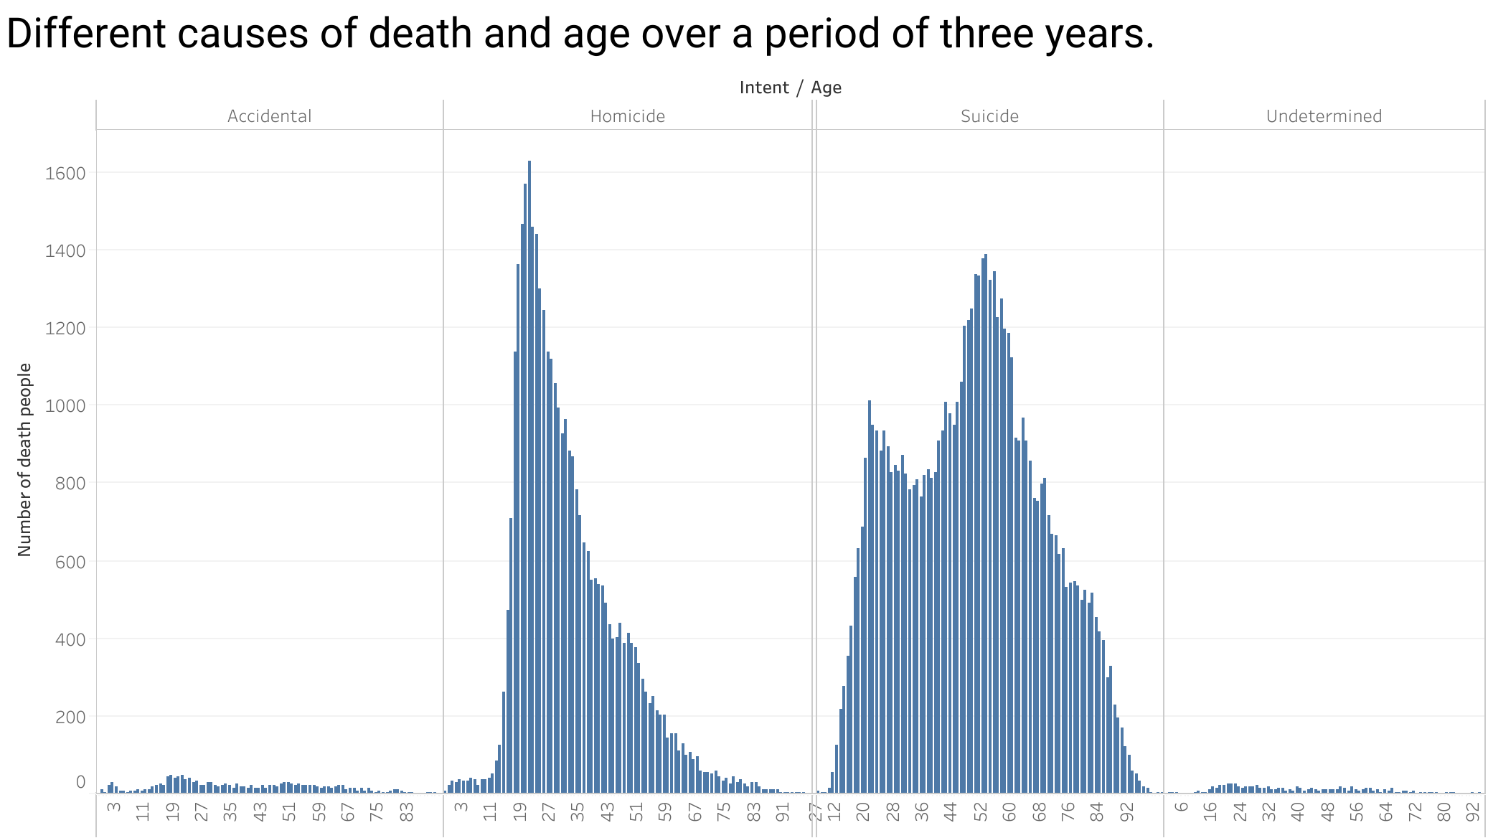
What factors may contribute to the higher incidence of homicides among the 18-28 age group and the higher incidence of suicides among the 48-61 age group?
Notes:
This bar graph displays the age distribution of deaths by different causes, with the highest number of homicides occurring in the age group between 18-28 years, while the majority of individuals who died by suicide were between the ages of 48-61 years.

Slide 3
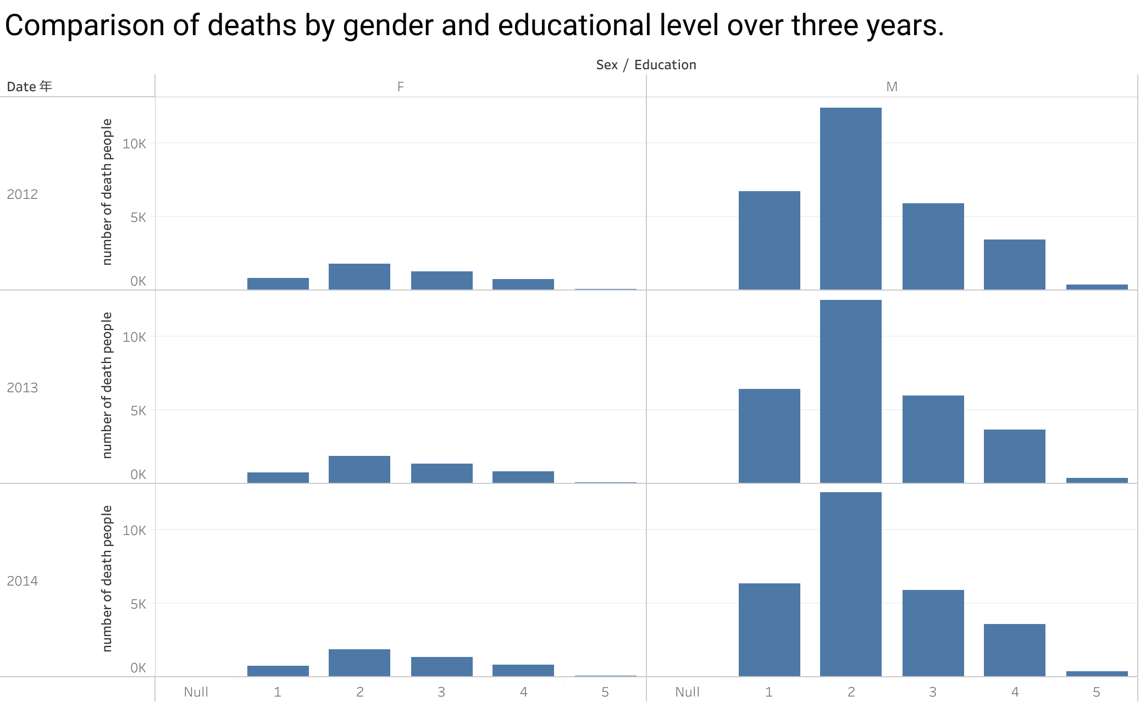
What factors contribute to the higher mortality rates observed among individuals with educational level 2 and how can this be addressed?
Notes:
Through these three different bar graphs from different years, we can clearly observe that the highest number of deaths occurred in the educational level 2 category, followed by a significantly higher number of deaths in males compared to females.

Slide 4
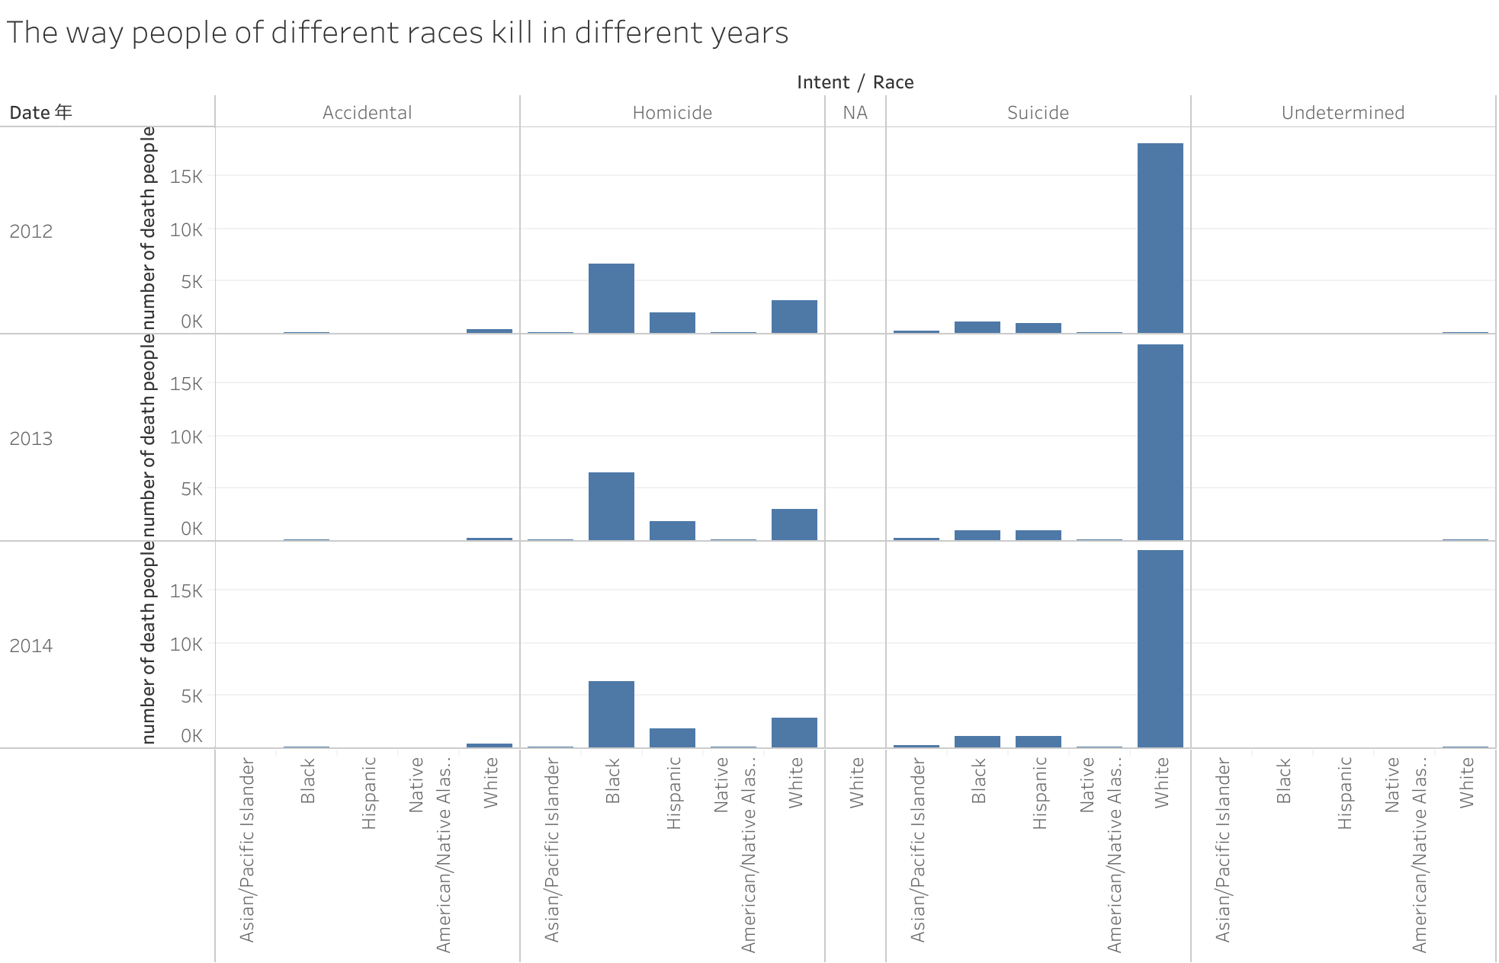
What factors could contribute to the higher rate of suicide among white individuals compared to other races during a three-year period?
Notes:
By our analysis, the number of whites who committed suicide during this three-year period far exceeded the number of deaths of other race of people

