Slide 1
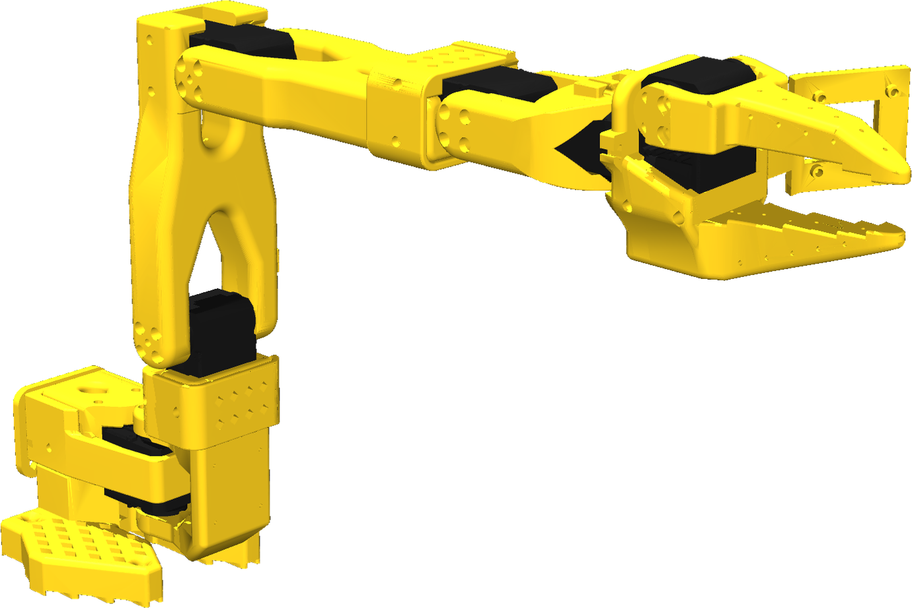
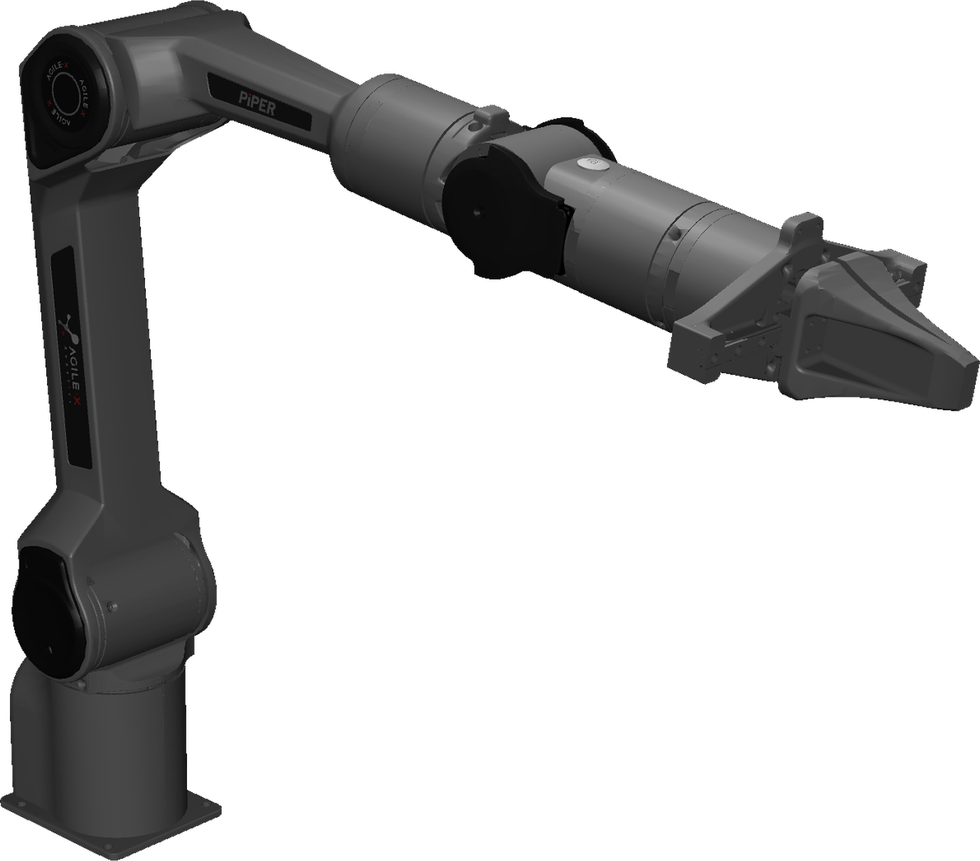
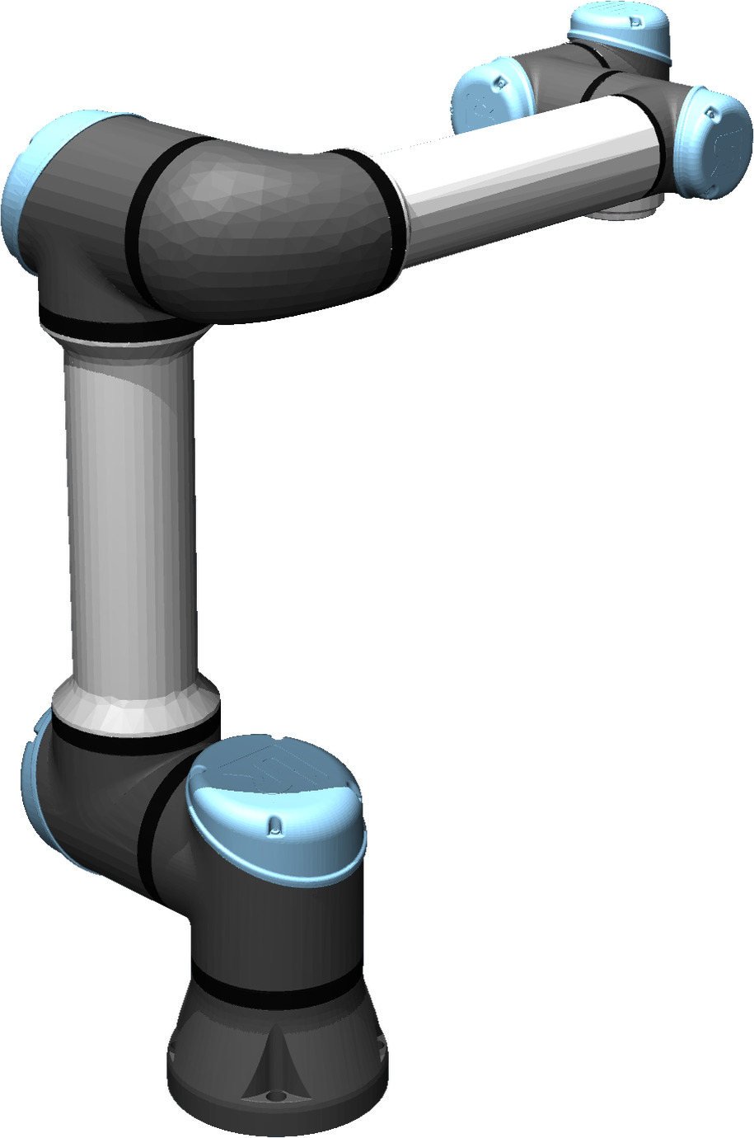
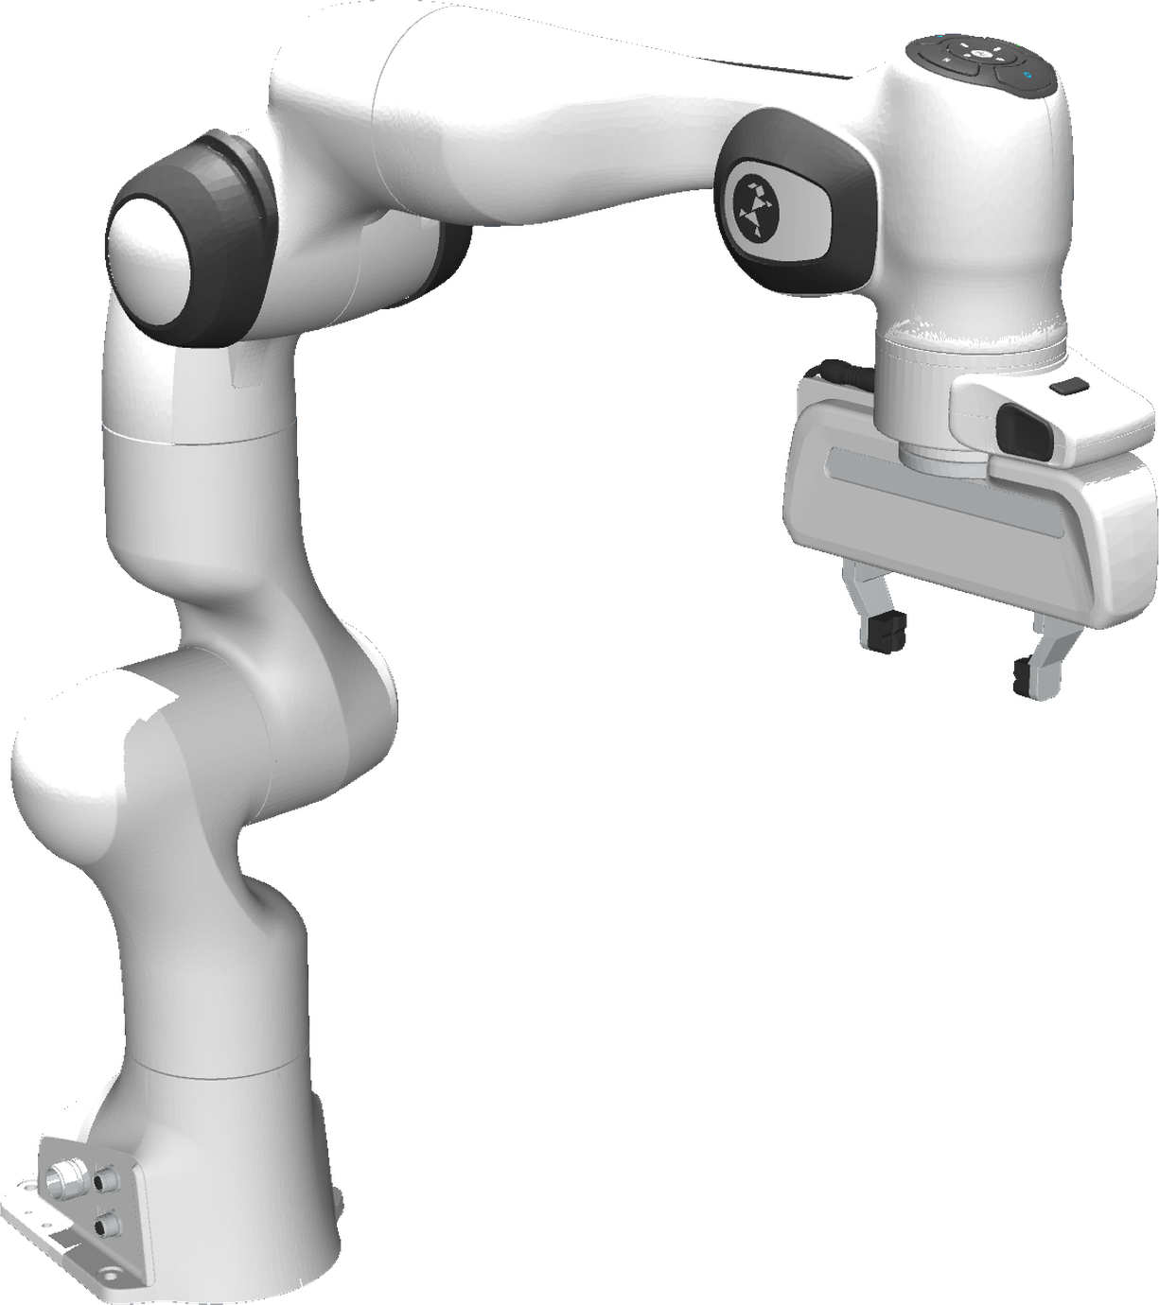
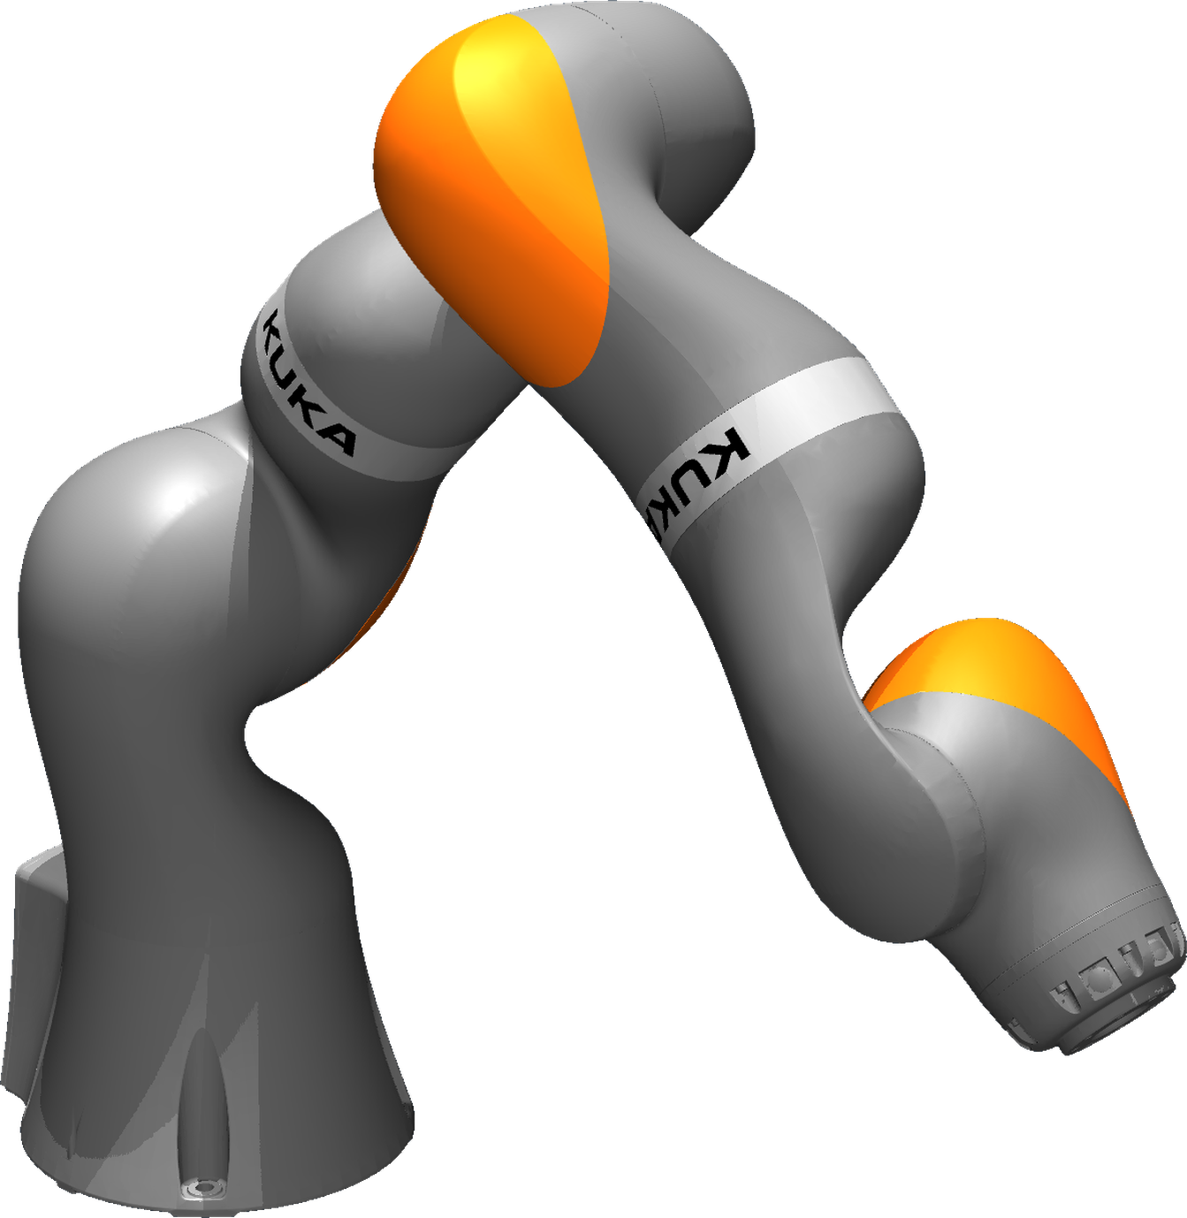
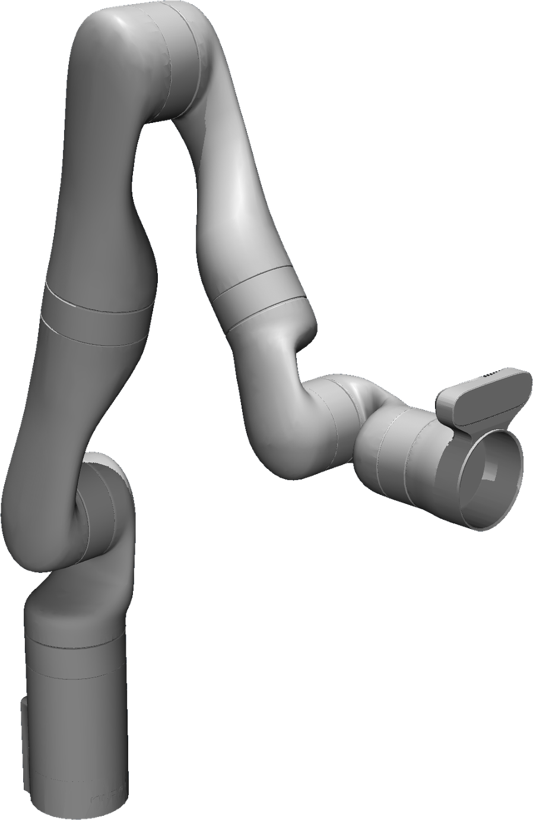
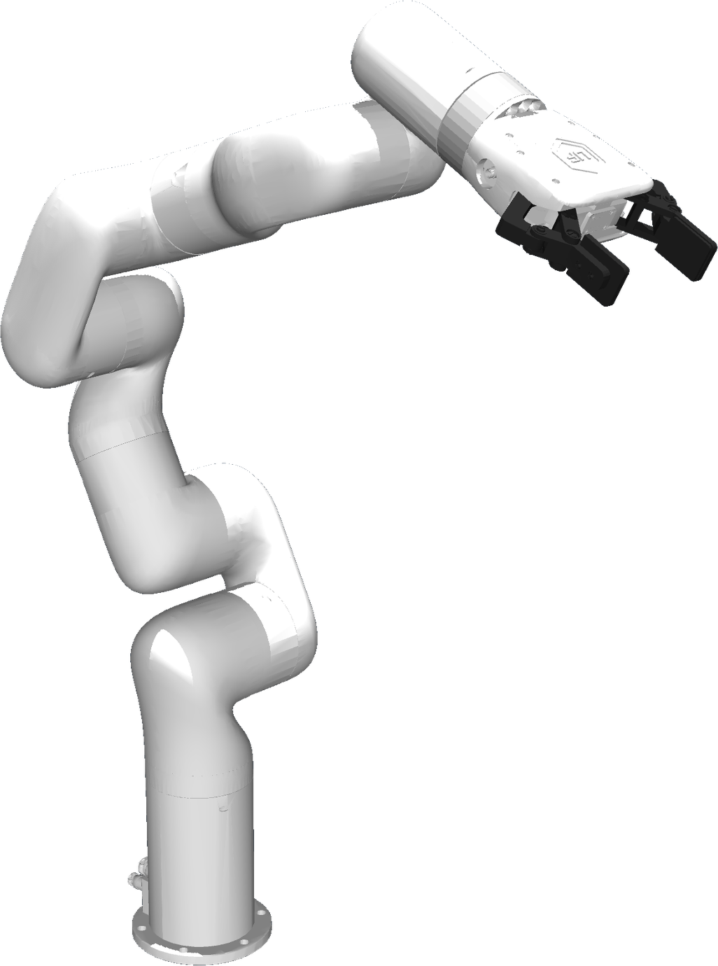
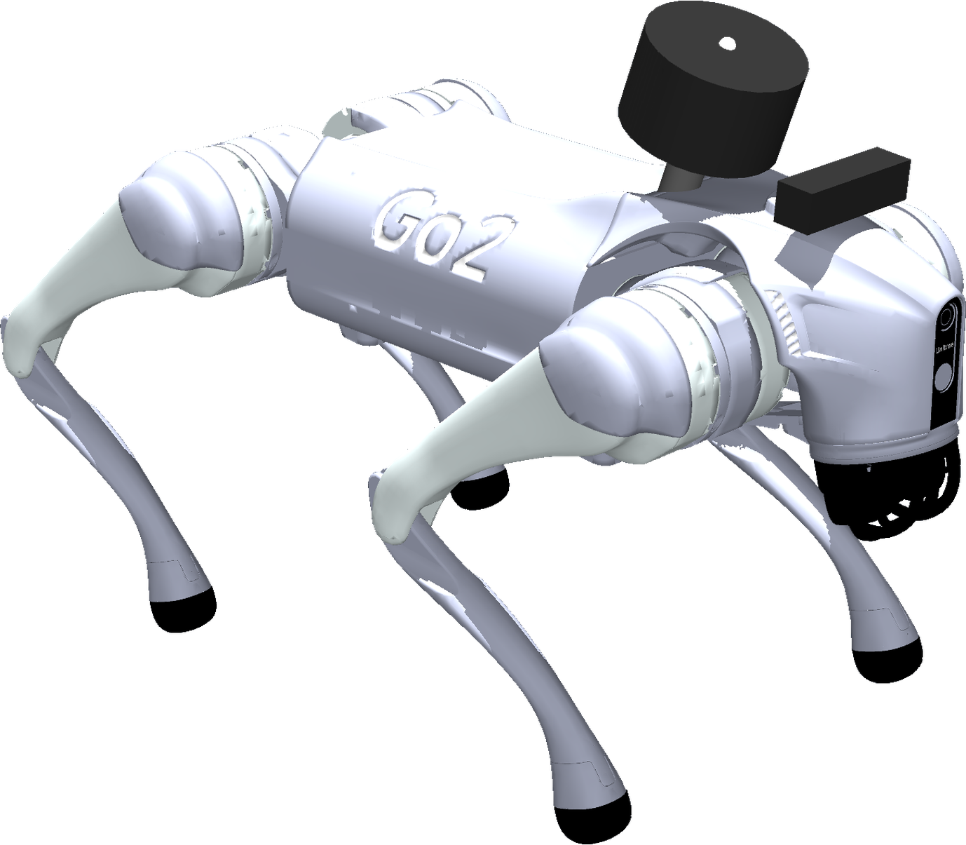
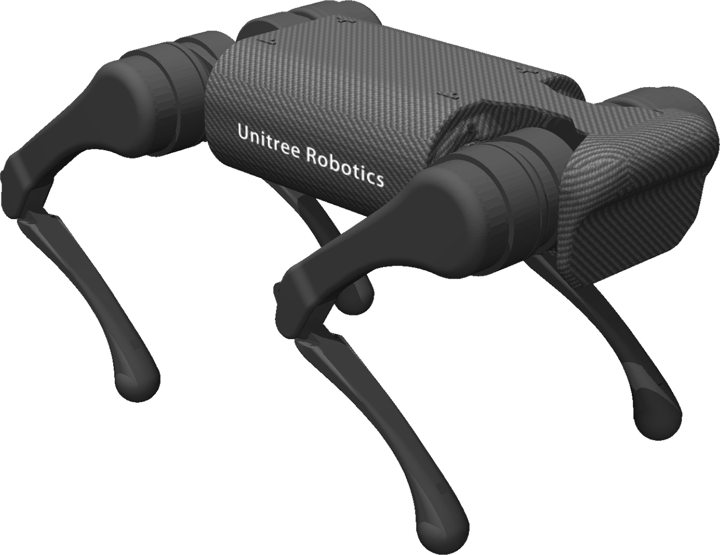
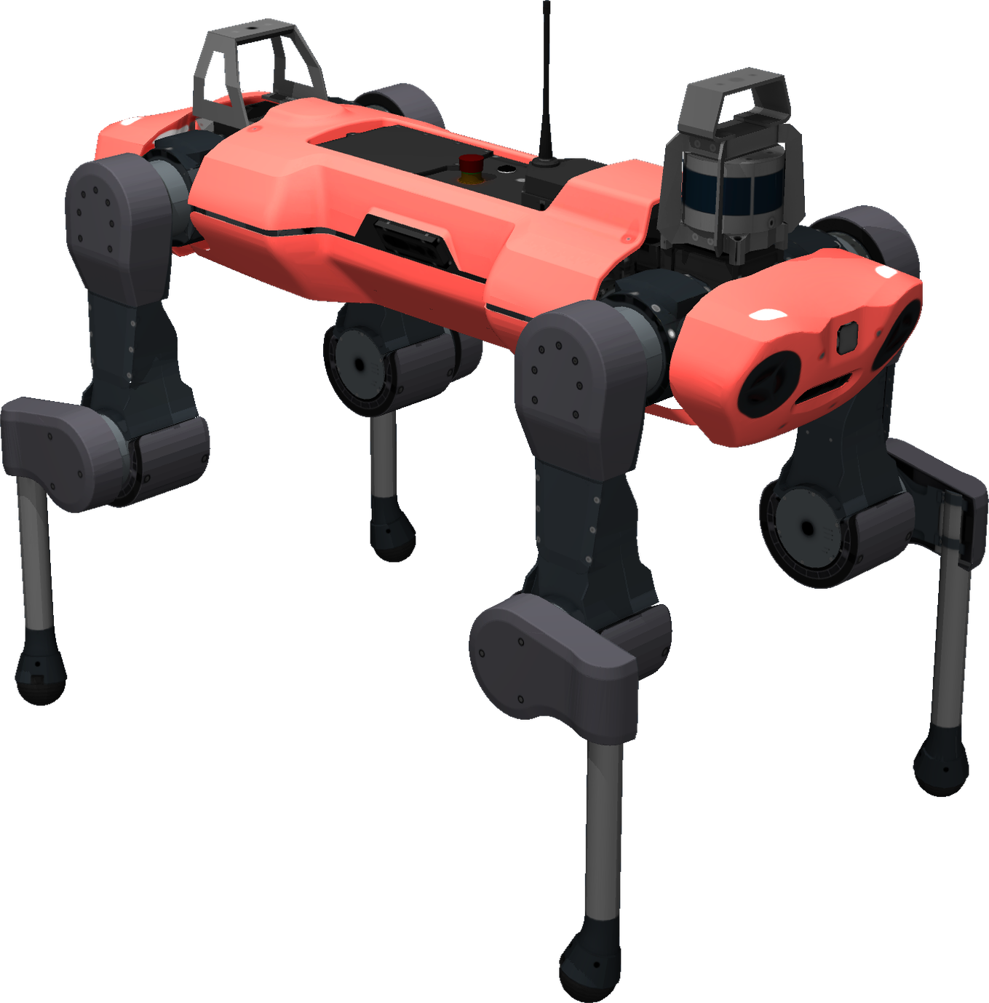
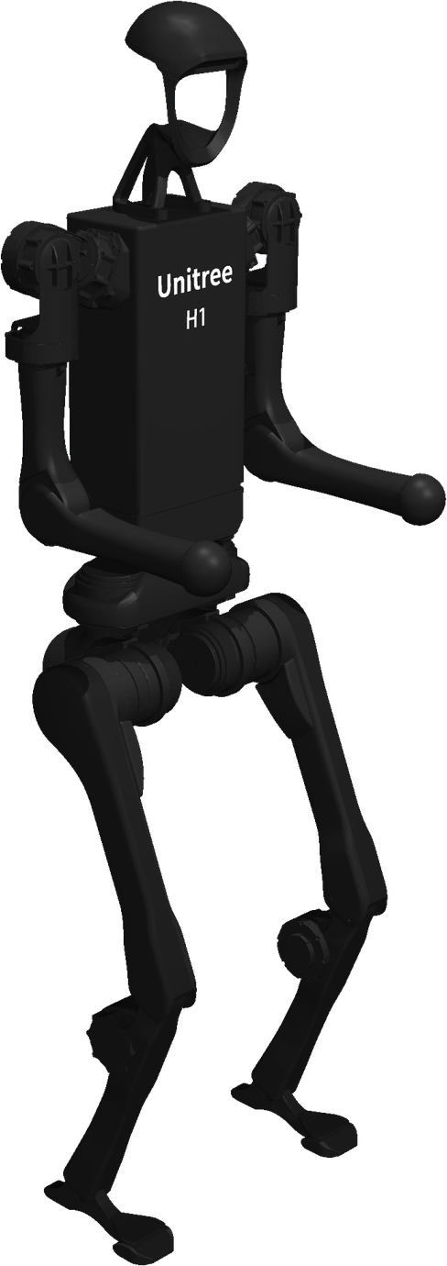
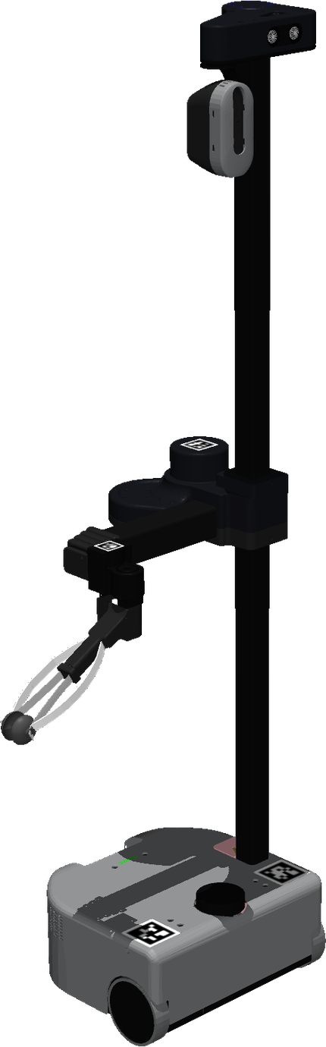
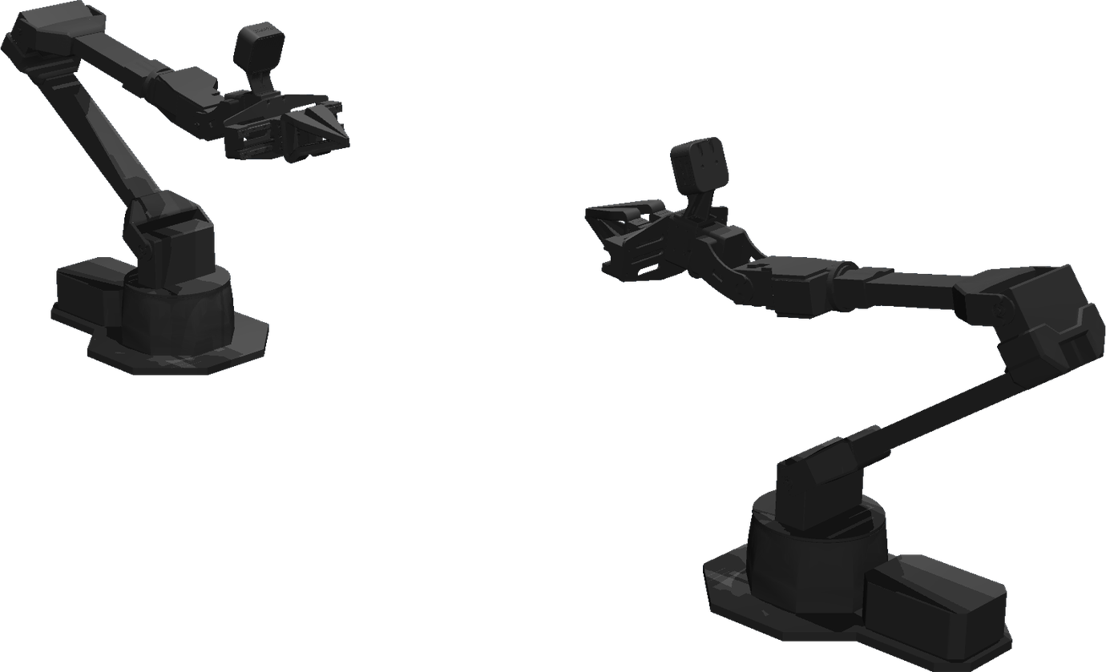
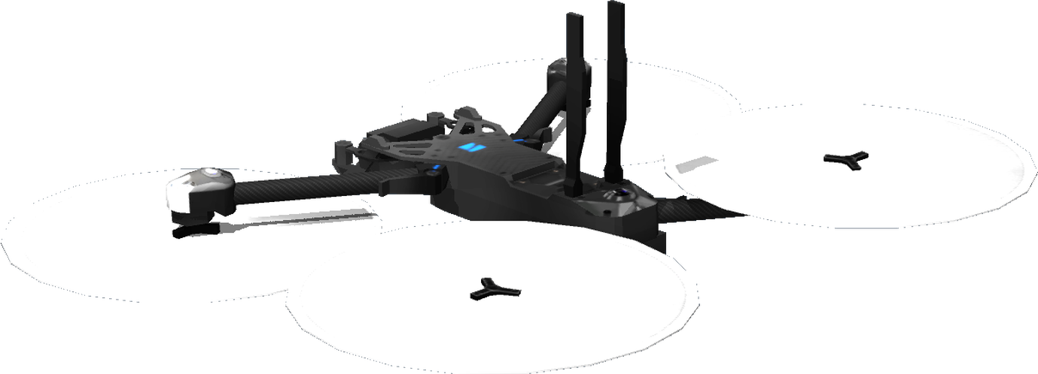
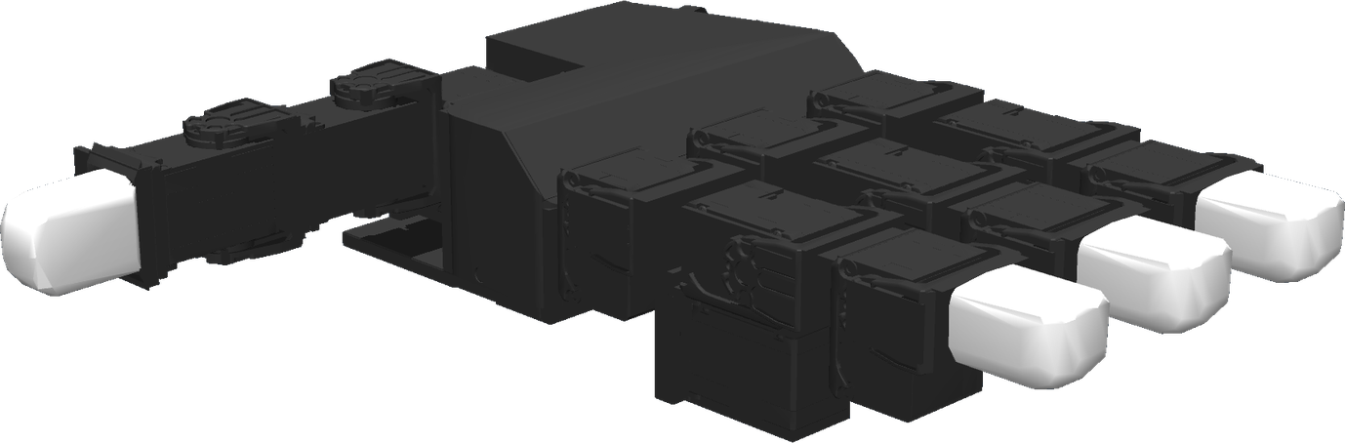
AUTOADAPTER 2.0 / MORPHOLOGY OVERVIEW
15
7
Robot Platform Taxonomy
ROBOTS
TYPES
15 robots across 7 embodiment types
FIXED ARM
FIXED ARM
FIXED ARM
FIXED ARM
FIXED ARM
SO-101
AgileX PiPER
UR5e
Franka Panda
KUKA
LBR iiwa 14
FIXED ARM
FIXED ARM
QUADRUPED
QUADRUPED
QUADRUPED
Kinova Gen3
UFACTORY xArm7
Unitree Go2
Unitree A1
ANYmal-C
AERIAL
HUMANOID
HAND
MOBILE
BIMANUAL
Skydio X2
Unitree H1
LEAP Hand
Hello Robot
Stretch 2
ALOHA 2
Fixed serial arms (7)
Quadrupeds (3)
Aerial quadrotor
Humanoid biped
Dexterous hand
Mobile manipulator
Bimanual manipulator
MuJoCo model renders · Images not to scale
Native PowerPoint layout · 281 × 178 mm
Notes:
PowerPoint-native poster asset. The typography, cards, labels, dividers and legend remain editable. Each robot is a separate high-resolution transparent MuJoCo render. Physical slide size: 280.85 × 177.87 mm, approximately one tenth of A1 area. Images are not to scale.

