Slide 1
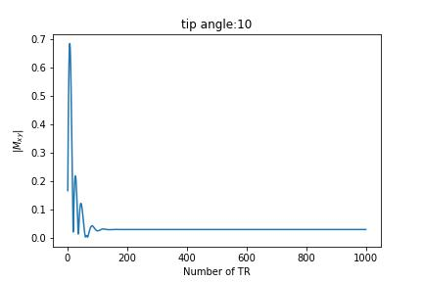
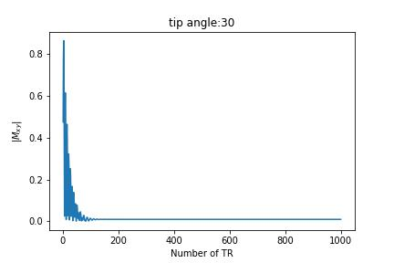
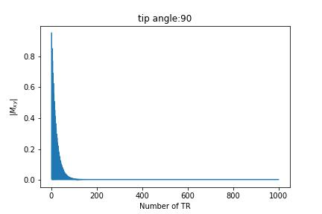
Part 1
For bSSFP with no phase cycling ( Δ𝜙=0 ) Off-resonance = 0
T1 = 1.0 s
T2 = 0.1 s
TR = 0.01 s
TE = 0.005 s
Tip angle (°) | Steady-state Mxy
10 | 0.05527
30 | 0.01857
90 | 0.00499

Slide 2
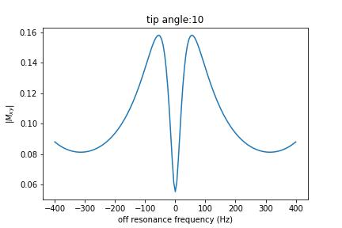
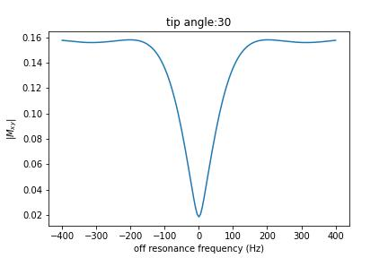
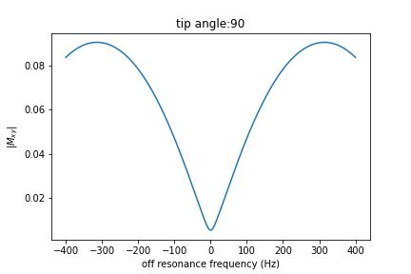
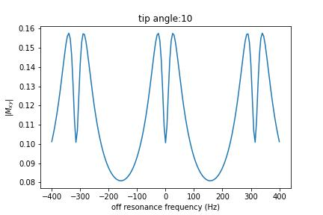
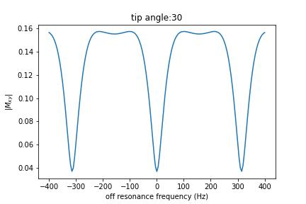
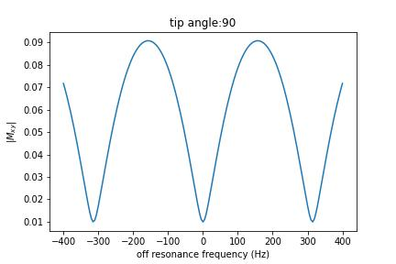
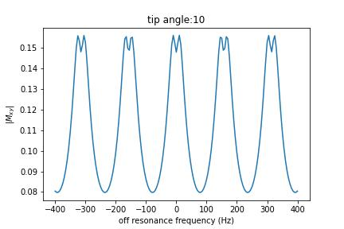
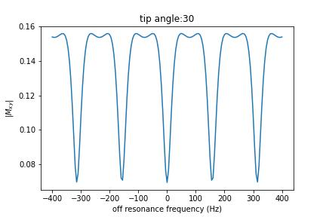
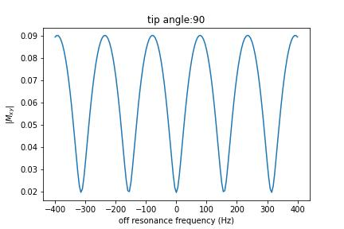
Larger tip angle
Part 2
bSSFP with no phase cycling ( Δ𝜙=0 ) Off-resonance range (- 400 ~ 400 Hz)
Different tip angle and TR for
T1 = 1.0
T2 = 0.1
TR = 0.01
Longer TR
TR = 0.02
TR = 0.04

Slide 3
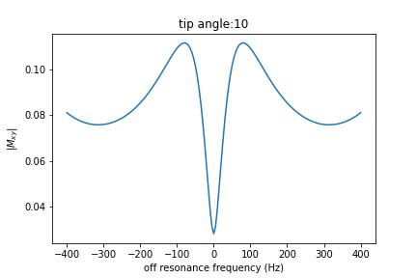
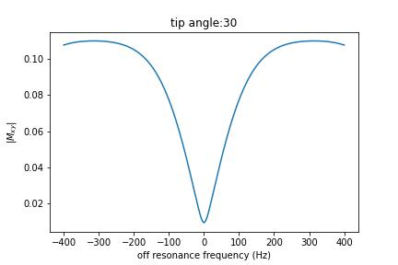
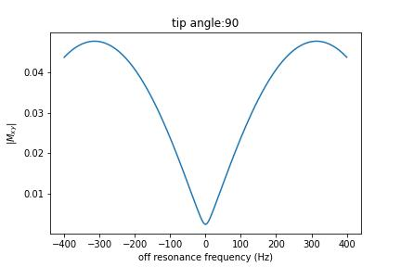
Part 2
bSSFP with no phase cycling ( Δ𝜙=0 ) Off-resonance range (- 400 ~ 400 Hz)
Different T1 values for
TR = 0.01
TE = 0.005
T1 = 1.0
T2 = 0.1
T1 = 2.0
T2 = 0.1

Slide 4
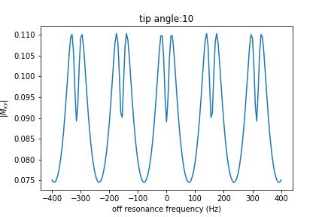
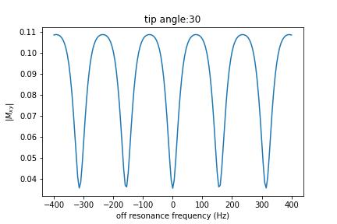
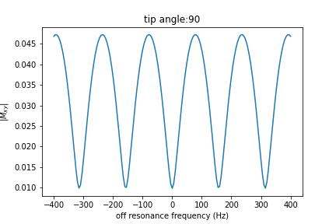
Part 2
bSSFP with no phase cycling ( Δ𝜙=0 ) Off-resonance range (- 400 ~ 400 Hz)
Different T1 values for
TR = 0.04
TE = 0.02
T1 = 1.0
T2 = 0.1
T1 = 2.0
T2 = 0.1

Slide 5
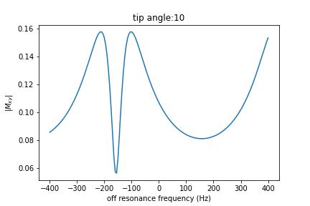
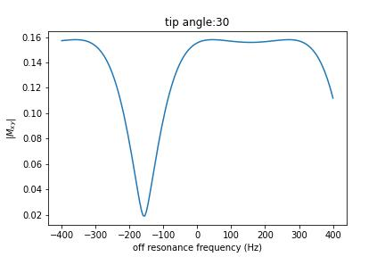
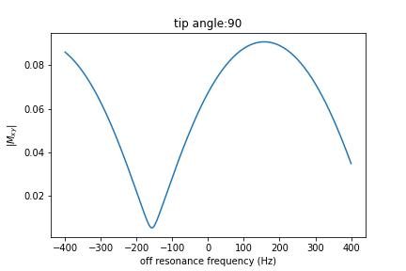
Part 3
bSSFP with phase cycling ( Δ𝜙=90 ) Off-resonance range (- 400 ~ 400 Hz)
T1 = 1.0
T2 = 0.1
TR = 0.01
TE = 0.005

Slide 6
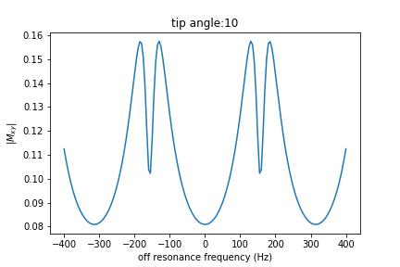
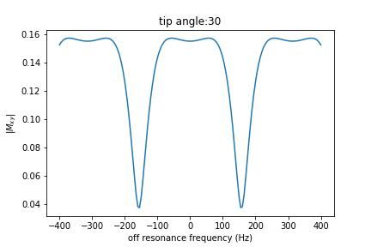
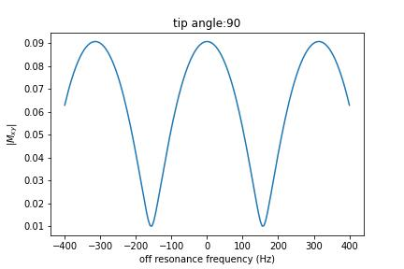
Part 3
bSSFP with phase cycling ( Δ𝜙) Off-resonance range (- 400 ~ 400 Hz)
( Δ𝜙= 0 )
( Δ𝜙=180 )
T1 = 1.0
T2 = 0.1
TR = 0.02
TE = 0.005

Slide 7
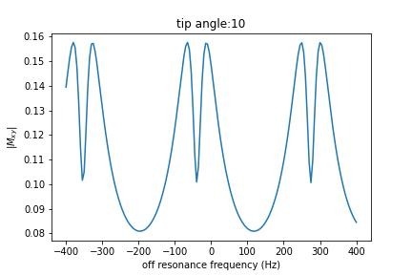
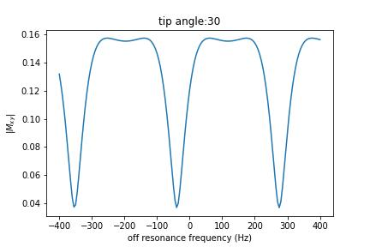
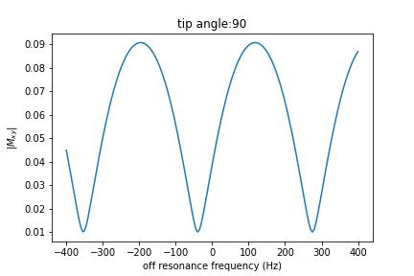
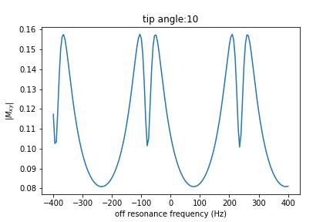
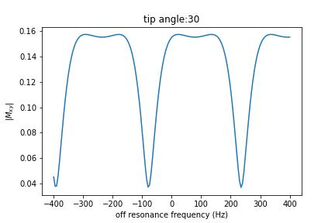
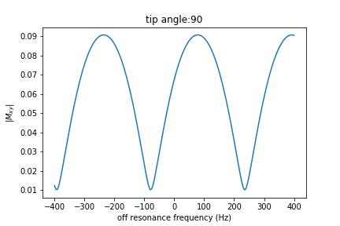
( Δ𝜙= 0 )
( Δ𝜙=45 )
( Δ𝜙=90 )

