Slide 1



Software Requirements
Engineering
Course Final Presentation
Group 1 fiSSure

Slide 2
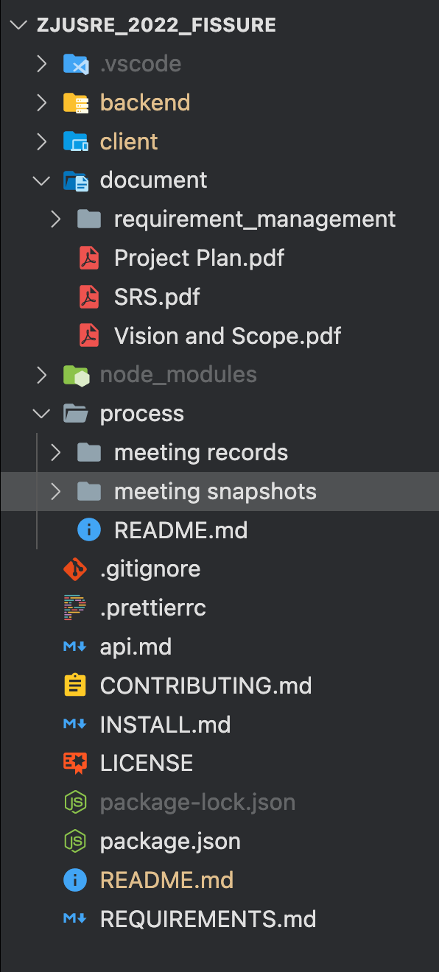
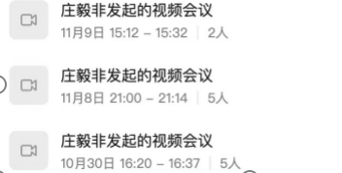




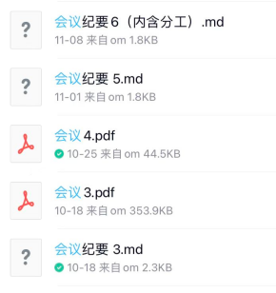
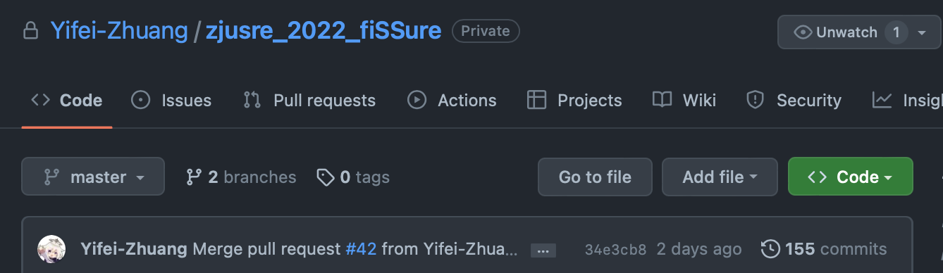

Team Workflow & Management
Meeting: Online & Offline Meeting
Online Meeting Tool: DingTalk
Meeting Records: Markdown
Version Control: Github & Git
Github Repo: https://github.com/Yifei-Zhuang/zjusre_2022_fiSSure (now private)
Two Branches: master and dev. Pull request will be reviewed before merged
Project Document: Latex
MileStone Document: Overleaf Latex

Slide 3

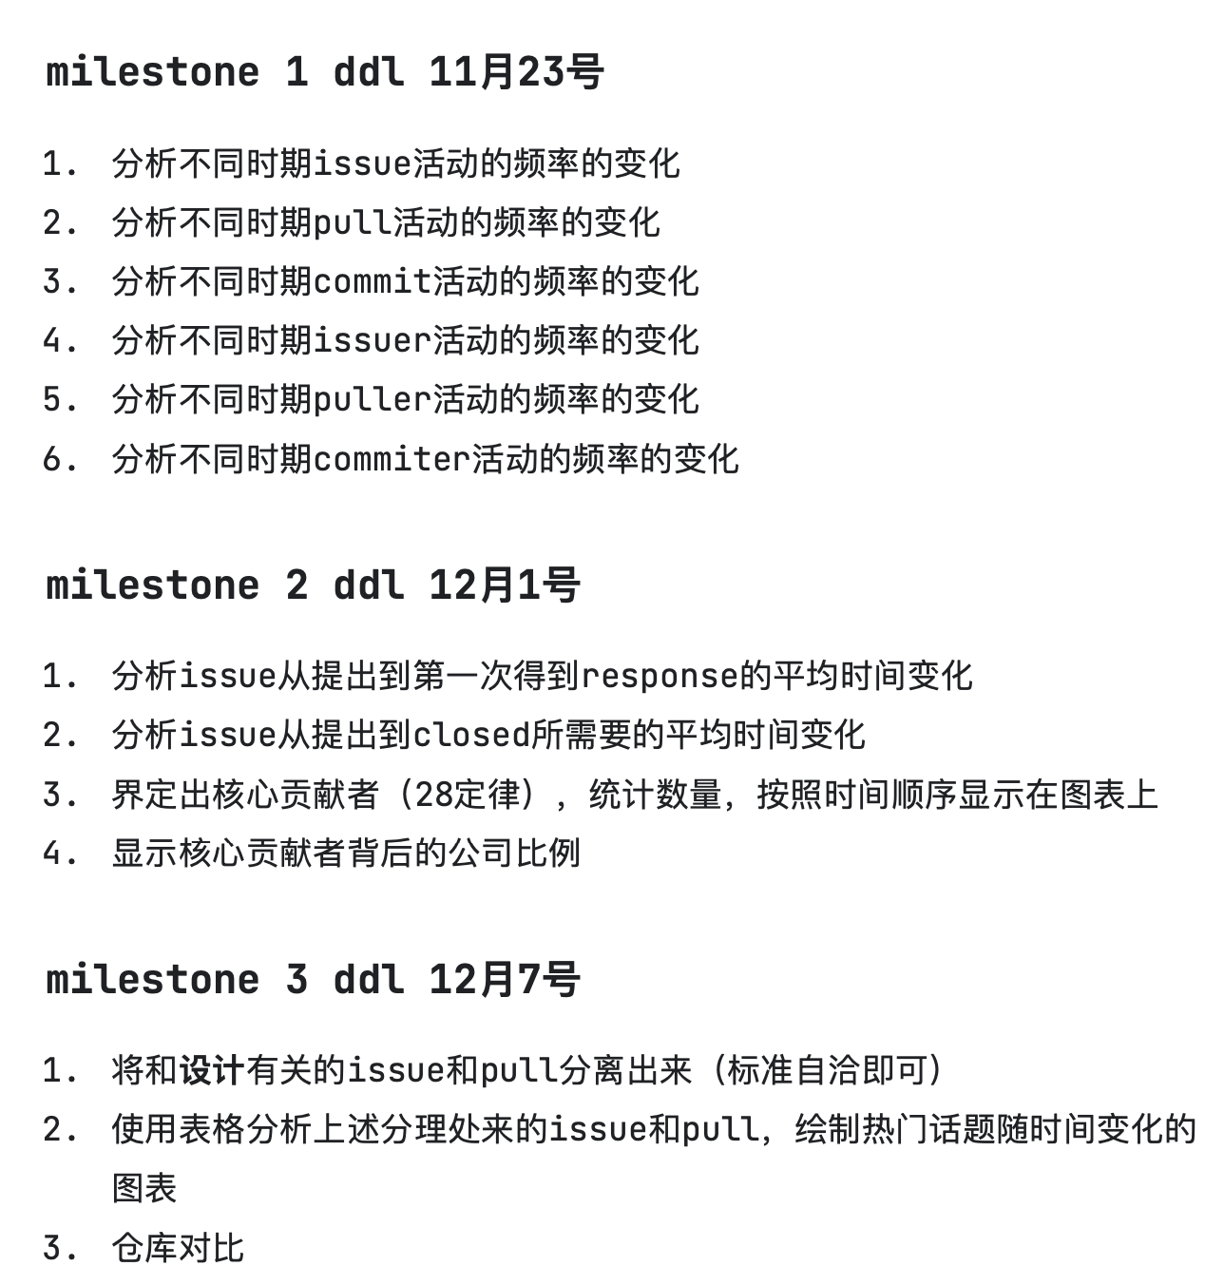
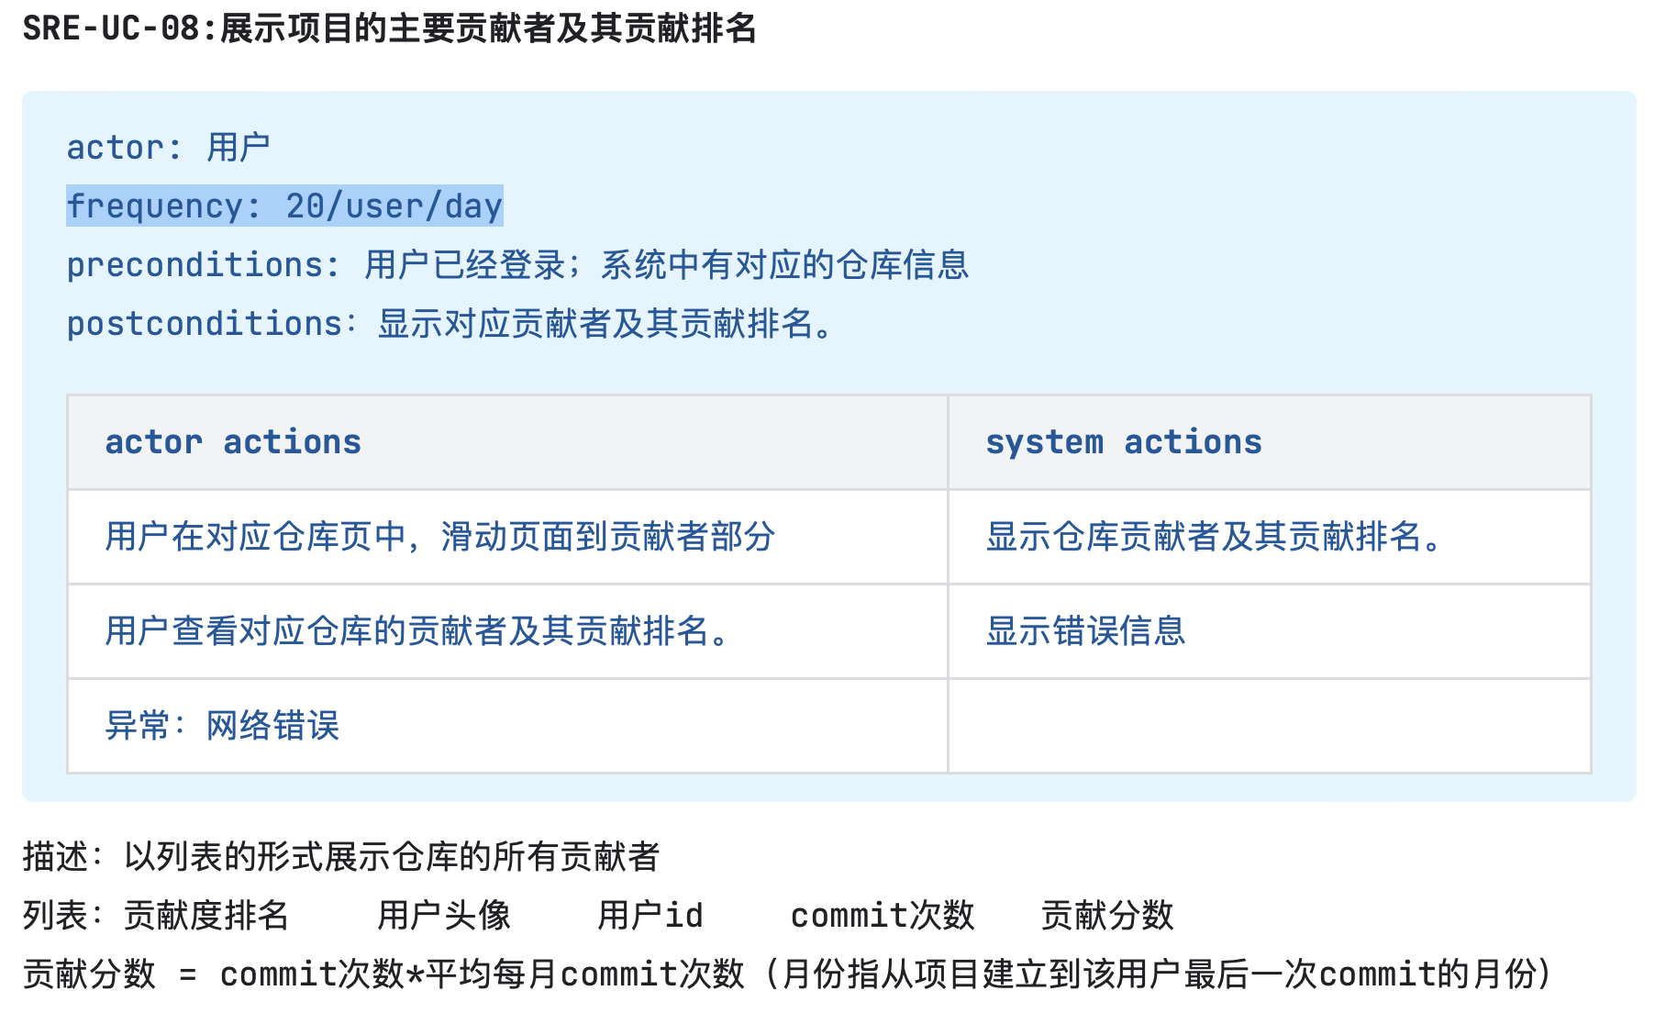
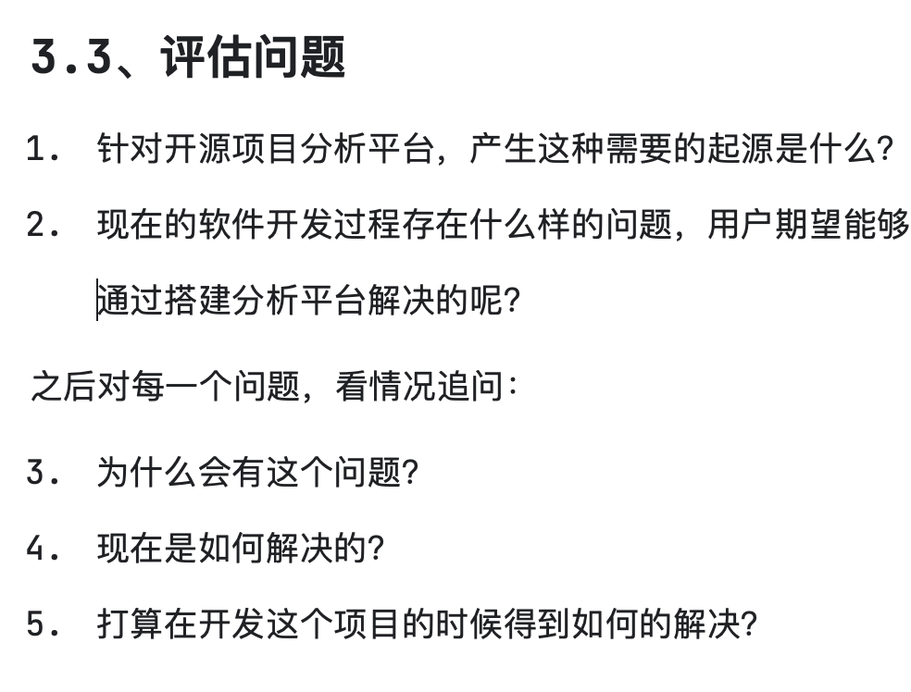
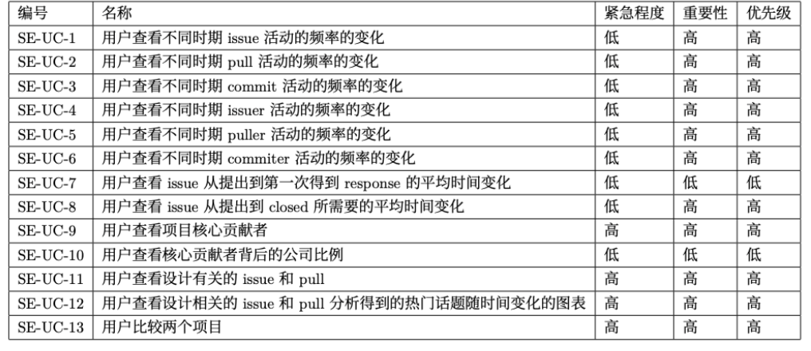
Requirement Analysis & Iteration
Initial Analysis: pingcap ossinsight
Output: Vision & Scope Document, Team Workflow & ManageMent
Referred: Slide 01, Slide 02
Requirement Workshop:
Question design:
Ambigous Requirements
Confirm Requirements
Requirement Priorities
After Workshop
Prioritize Requirements
Establish software development milestones
Output: SRS V2.0

Slide 4
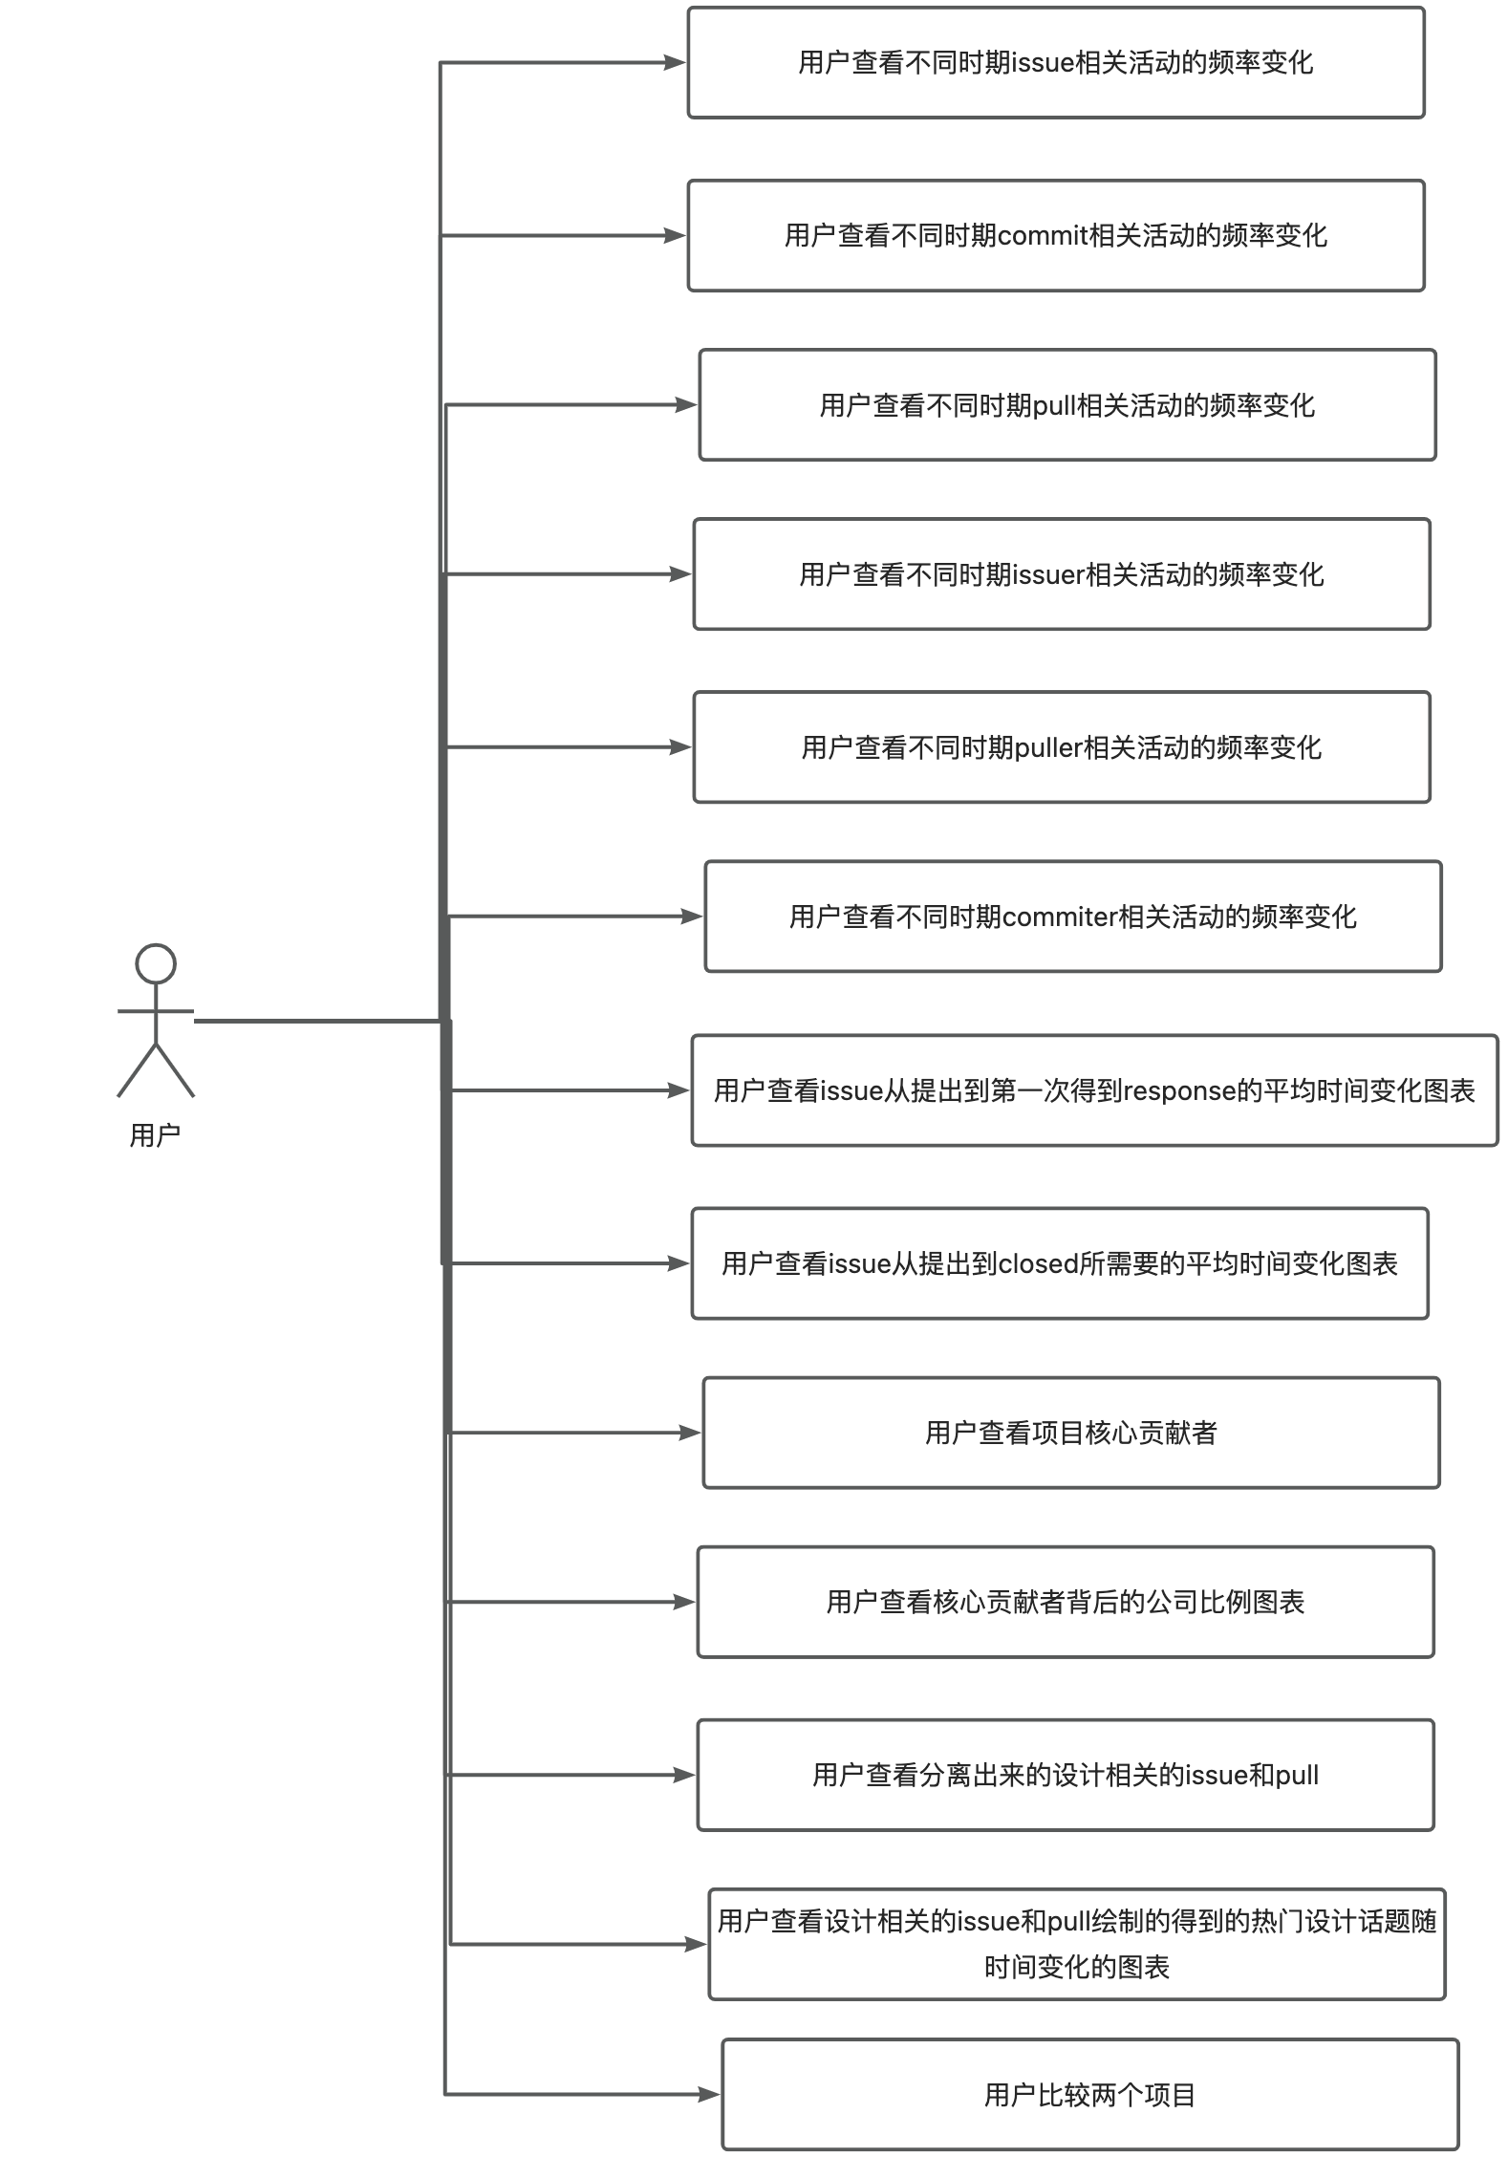
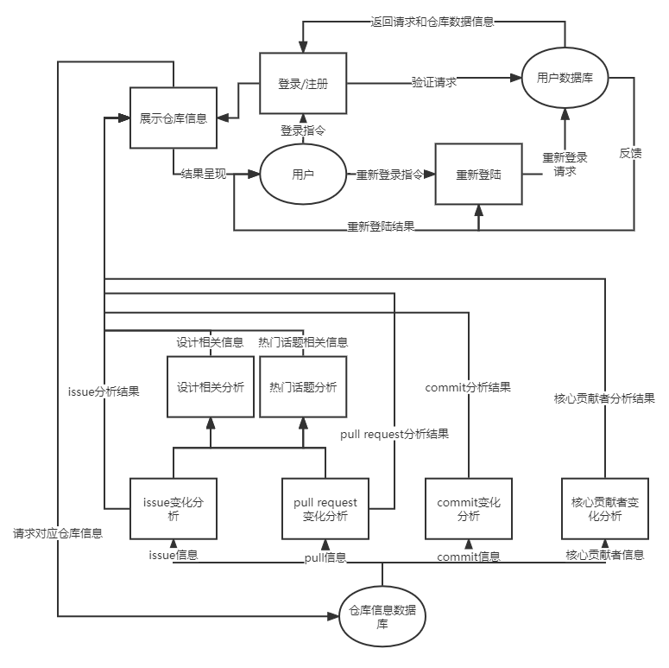
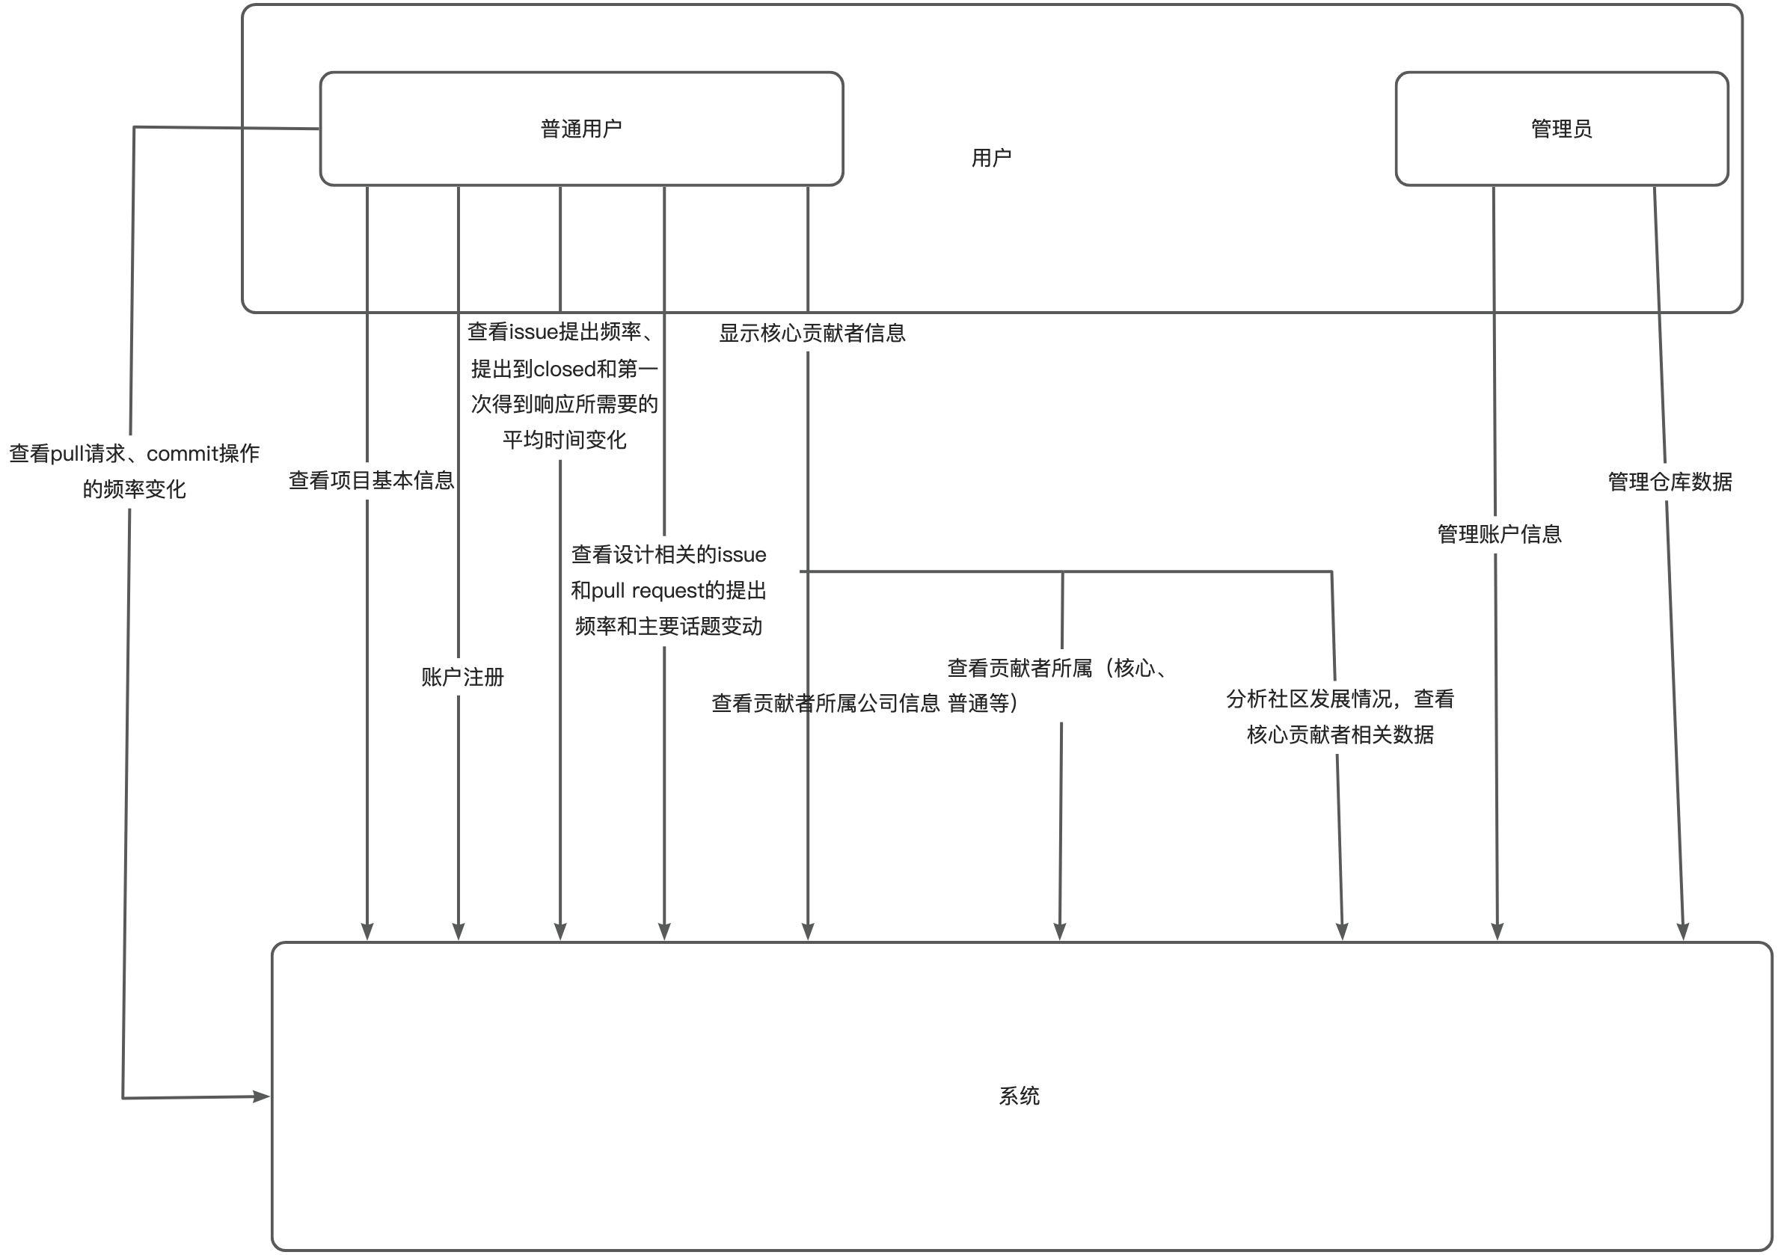
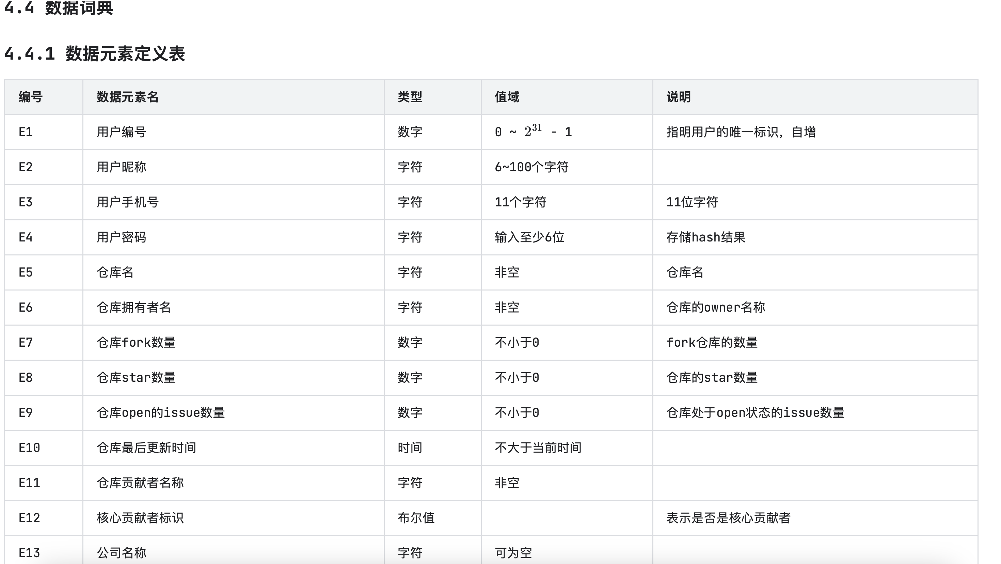
Requirement Documenting
Specify Requirements
Use Cases
Use Case Diagram
Use Case Table
Context Diagram
Data Requirements
Data Directory
Dataflow Dirgram
Non Functional Requirements
Constrains
External interface reqs
Performances
Quality attributes
.....

Slide 5
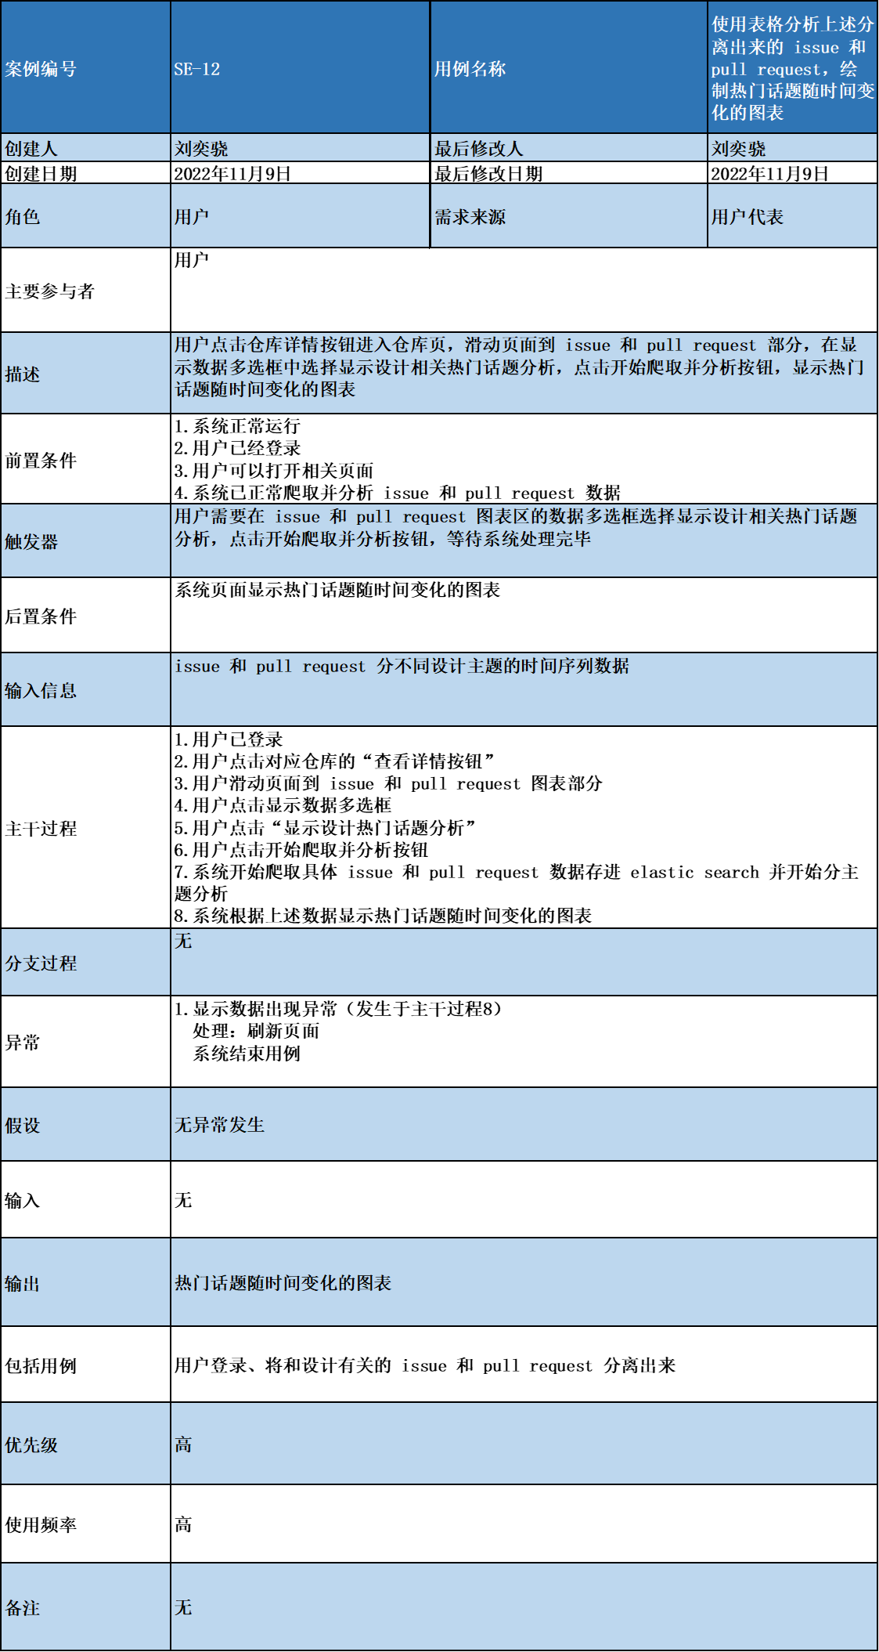
Design & Coding
Ideal Requirement For Topic Evaluating
后端
前端
Version 1
使用NLP进行较为精确的查询 （❌）
Version 1
折线图或词云图展示（❌）
Verion 2
使用Elastic Search对设计话题进行模糊查询 （✅）
Verion 2
使用时间轴 + 饼图进行可视化（✅）

Slide 6

Summing Up
Teamwork Management
In-Time Meeting
Make use of strengths
Set Buffering
Requirements
Requiremtns needs iteration
Standard Modeling Language is Important (i.e. UML)

Slide 7


THANK YOU

