Slide 1
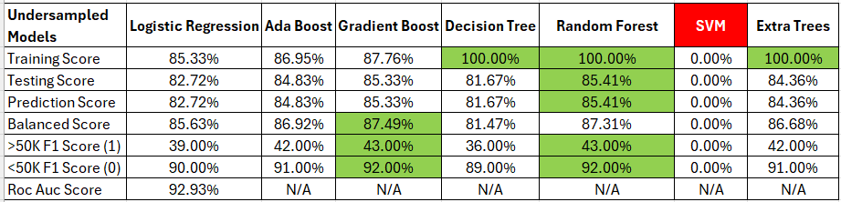
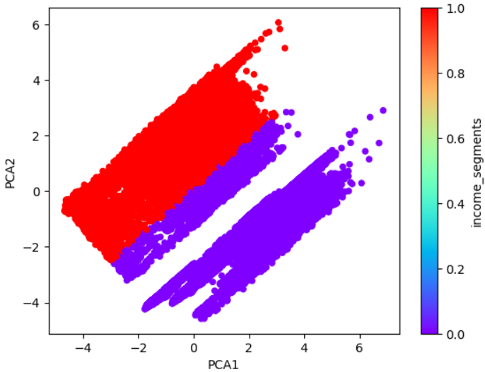
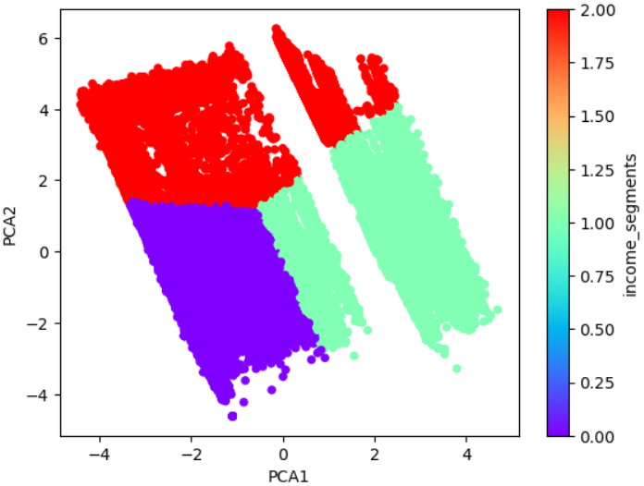
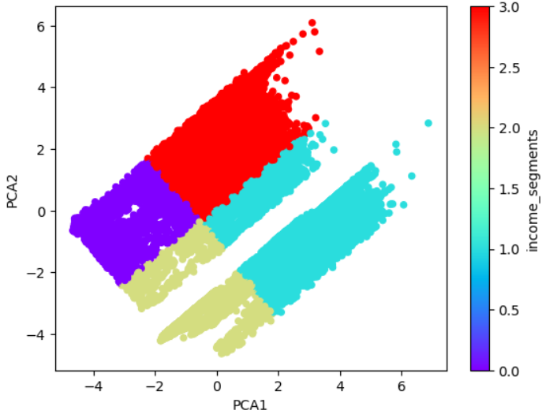
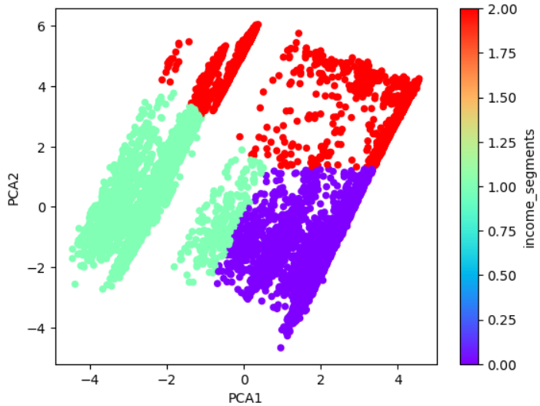
Census Income Analysis – Kala Sivasubramanian
Preprocessing Used Standard Scalar to scale data Used category encoding for categorical columns Dataset is very skewed, only 6% of rows are 1, 94% are 0 | Models Logistic Regression, Random Forest Classifier, Support Vector Classifier (SVM took forever to run!), Decision Tree, Gradient Boost & Ada Boost, Extra Trees
Exploratory Data Analysis PCA Analysis – 4 clusters, low explained variance (0.14+0.13) 5 clusters with under-sampling, 3 with over sampling, same expl var Tried both under and over sampling | Results & Conclusions In general, Random Forest had the best F1 scores (54%-98%), Gradient Boost was a close second (53%-98%) Undersampled Random Forest had the best balanced accuracy score (87%) PCA analysis was not effective at reducing dimensionality Tried 500 estimators for Random Forest, worse perf The balanced accuracy score seems to come at the expense of the F1 scores For future, get more balanced data directly from census site

