Slide 2

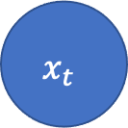
record
$$x_{t}$$
$$=$$
Dynamic
RE_DATE
gender
Static
age

Slide 3













$$x_{0}$$
$$x_{1}$$
$$x_{2}$$
$$⋯$$
$$x_{T_{1}}$$
$$z_{1}$$
Participant 1
$$x_{0}$$
$$x_{1}$$
$$x_{2}$$
$$⋯$$
$$x_{T_{2}}$$
$$z_{2}$$
Participant 2
$$⋮$$

Slide 4


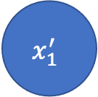


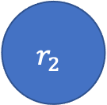
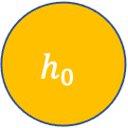

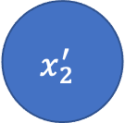
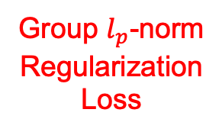
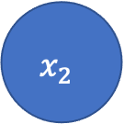


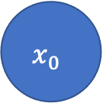
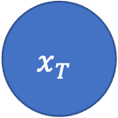
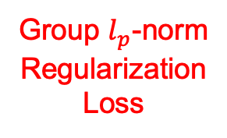
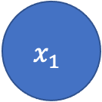
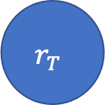
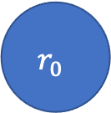

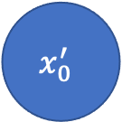

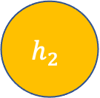
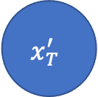
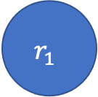
Predictor
$$y^{′}$$
Locality
Preserving
Loss
$$h_{0}$$
$$h_{1}$$
$$h_{2}$$
Prediction
Error
$$h_{T}$$
Encoder
Encoder
Encoder
Encoder
$$C_{0}$$
$$C_{1}$$
$$⋯$$
$$C_{T−1}$$
$$C_{T}$$
$$x_{0}$$
$$x_{1}$$
$$x_{2}$$
$$x_{T}$$
Group $l_{p}$-norm
Regularization
Loss
Reconstruction
Loss
$$x_{0}^{′}$$
$$x_{1}^{′}$$
$$x_{2}^{′}$$
$$x_{T}^{′}$$
Decoder
Decoder
Decoder
Decoder
$$⋯$$
$$r_{0}$$
$$r_{1}$$
$$r_{2}$$
Group $l_{p}$-norm
Regularization
Loss
$$r_{T}$$

Slide 5
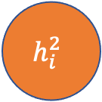

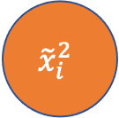
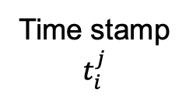

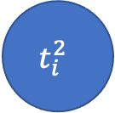
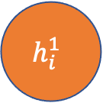

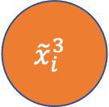
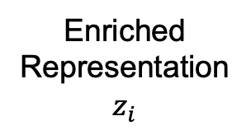
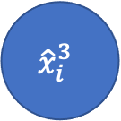
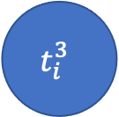
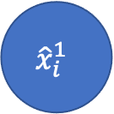
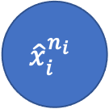
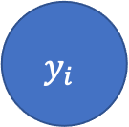
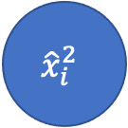

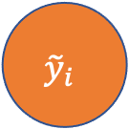
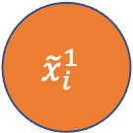

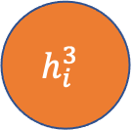
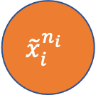
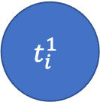
Prediction
Loss
$$y_{i}$$
$${\tilde{y}}_{i}$$
Predictor
$$h_{i}^{1}$$
$$h_{i}^{2}$$
$$h_{i}^{3}$$
Enriched
Representation
$$z_{i}$$
$$h_{i}^{n_{i}}$$
Encoder
Encoder
Encoder
Encoder
$$c_{i}^{1}$$
$$c_{i}^{2}$$
$$⋯$$
$$c_{i}^{n_{i}−1}$$
$${\hat{x}}_{i}^{1}$$
$${\hat{x}}_{i}^{2}$$
$${\hat{x}}_{i}^{3}$$
$${\hat{x}}_{i}^{n_{i}}$$
Reconstruction
Loss
$${\tilde{x}}_{i}^{1}$$
$${\tilde{x}}_{i}^{2}$$
$${\tilde{x}}_{i}^{3}$$
$${\tilde{x}}_{i}^{n_{i}}$$
Decoder
Decoder
Decoder
Decoder
$$⋯$$
$$t_{i}^{1}$$
$$t_{i}^{2}$$
$$t_{i}^{3}$$
$$t_{i}^{n_{i}}$$
Time stamp
$$t_{i}^{j}$$

Slide 6


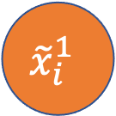




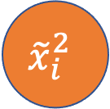
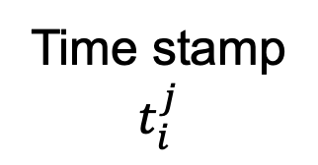
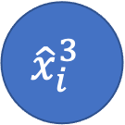
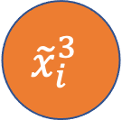













Prediction
Loss
$$y_{i}$$
$${\tilde{y}}_{i}$$
Predictor
$$h_{i}^{3}$$
Enriched
Representation
$$z_{i}$$
$$h_{i}^{1}$$
$$h_{i}^{2}$$
$$h_{i}^{n_{i}}$$
Encoder
$$c_{i}^{1}$$
Encoder
$$c_{i}^{2}$$
Encoder
$$c_{i}^{n_{i}−1}$$
Encoder
$$⋯$$
$${\hat{x}}_{i}^{1}$$
$${\hat{x}}_{i}^{2}$$
$${\hat{x}}_{i}^{3}$$
$${\hat{x}}_{i}^{n_{i}}$$
Reconstruction
Loss
$${\tilde{x}}_{i}^{1}$$
$${\tilde{x}}_{i}^{2}$$
$${\tilde{x}}_{i}^{3}$$
$${\tilde{x}}_{i}^{n_{i}}$$
Decoder
Decoder
Decoder
Decoder
$$⋯$$
$$t_{i}^{1}$$
$$t_{i}^{2}$$
$$t_{i}^{3}$$
Time stamp
$$t_{i}^{j}$$
$$t_{i}^{n_{i}}$$

Slide 7
















Features
$$⋯$$
Time
Points
$$X_{2}$$
$$X_{n}$$
$$X_{1}$$
$$z_{2}$$
Latent
Vector
$$z_{n}$$
$$z_{1}$$
$${\tilde{y}}_{2}$$
$${\tilde{y}}_{n}$$
Prediction
$${\tilde{y}}_{1}$$

Slide 8










Features
Latent
Vector
Time
Points
Prediction
$$X_{1}$$
$${\tilde{y}}_{1}$$
$$z_{1}$$
$$X_{2}$$
$${\tilde{y}}_{2}$$
$$z_{2}$$
$$⋮$$
$$X_{n}$$
$${\tilde{y}}_{n}$$
$$z_{n}$$

Slide 9








Features
Enriched
Representation
Time
Points
Prediction
$$X_{1}$$
$${\tilde{y}}_{1}$$
$$z_{1}$$
$$X_{2}$$
$${\tilde{y}}_{2}$$
$$z_{2}$$
$$⋮$$
$$⋮$$
$$⋮$$

Slide 10











$$h_{0}$$
$$h_{1}$$
$$h_{2}$$
$$h_{T}$$
Encoder
Encoder
Encoder
Encoder
$$C_{0}$$
$$C_{1}$$
$$⋯$$
$$C_{T−1}$$
$$C_{T}$$
$$x_{0}$$
$$x_{1}$$
$$x_{2}$$
$$x_{T}$$
$$x_{T}^{′}$$
$$x_{T}^{′}$$
$$x_{T}^{′}$$
Decoder
Decoder
Decoder
$$C_{0}^{′}$$
$$C_{1}^{′}$$
$$⋯$$
$$h_{T}$$
$$C_{T}^{′}$$
$$r_{0}$$
$$r_{1}$$
$$r_{2}$$

Slide 11




$$h_{0}$$
$$h_{1}$$
$$h_{2}$$
$$h_{T}$$
Encoder
Encoder
Encoder
Encoder
$$C_{0}$$
$$C_{1}$$
$$⋯$$
$$C_{T−1}$$
$$C_{T}$$
$$x_{0}$$
$$x_{1}$$
$$x_{2}$$
$$x_{T}$$
$$x_{T}^{′}$$
$$x_{T}^{′}$$
$$x_{T}^{′}$$
$$x_{T}^{′}$$
Decoder
Decoder
Decoder
Decoder
$$C_{0}^{′}$$
$$C_{1}^{′}$$
$$⋯$$
$$C_{T−1}^{′}$$
$$C_{T}^{′}$$
$$r_{0}$$
$$r_{1}$$
$$r_{2}$$
$$r_{T}$$

