Slide 1

Software Design Document Outline
Specification presentation of SEP group project
by
Yifei Pei

Slide 2

Structure
Overview of system and Architecture
FSM mechanism
Data Structure
GUI

Slide 3
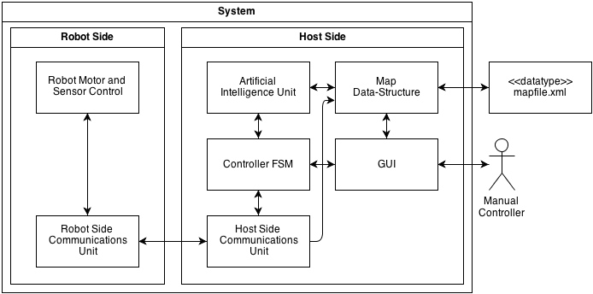
Overview
pipe-and-filter

Slide 4
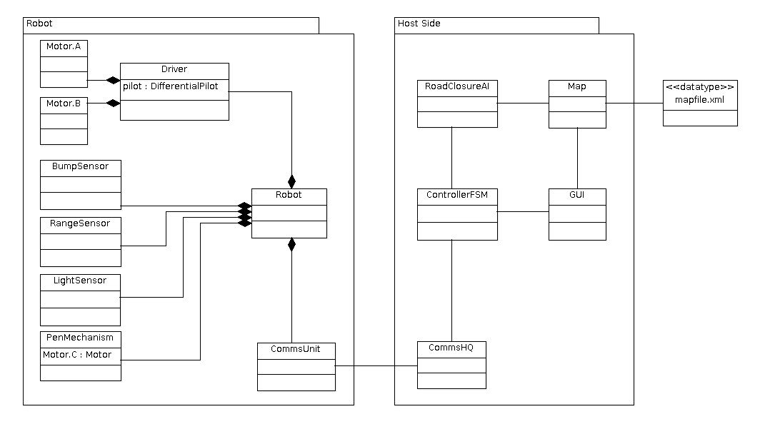
Architecture

Slide 5
FSM
Manual mode and AI mode
Straight forward and easy to debug
Big FSM for the whole system and small FSMs for different parts
AI part on Host but not on robot

Slide 6
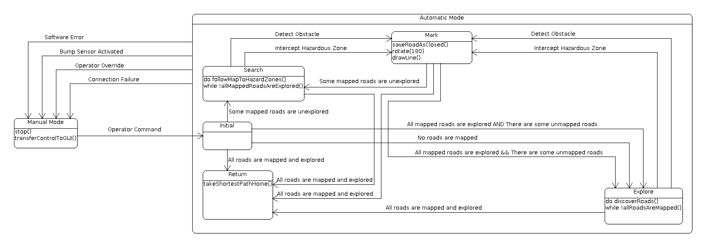
SoftwareFSM

Slide 7
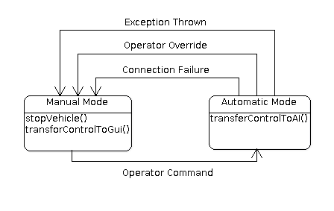
ControllerFSM

Slide 8
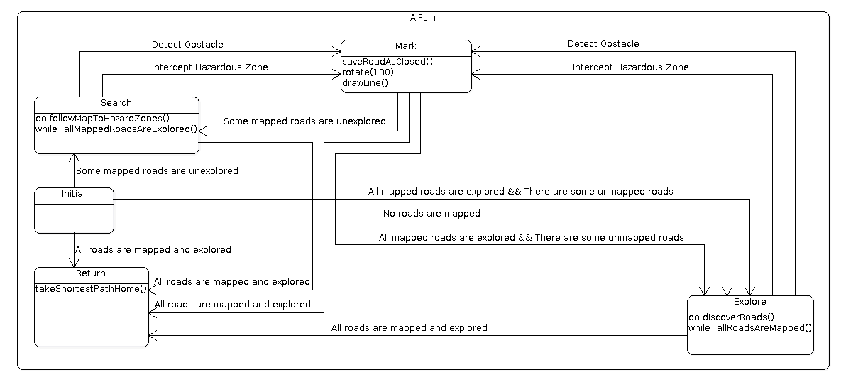
AIFSM

Slide 9
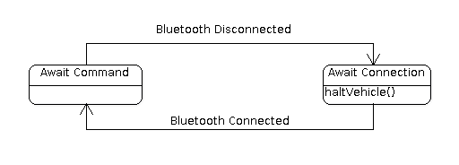
RobotSideFSM

Slide 10
Data Structure
Old Design
  ReadMap to read XML file and define map data
  SaveMap to save new maps
  DataDetecting to save mapping data
  Draw to draw the map on GUI

Slide 11
Data Structure
New Design
  Create a Map class to store the map data structure
  Use MapParser to do read and save
  Draw the map based on the map data structure

Slide 12
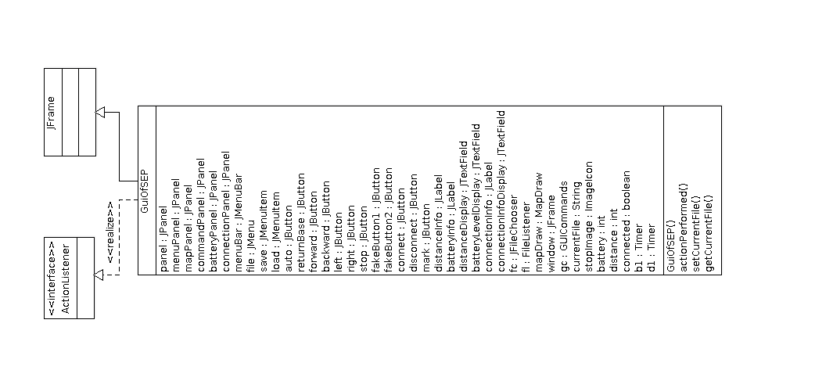
GUI

Slide 13
The End
Thanks
Q & A

