Slide 1
Software Project Management Plan
Presented by Abdulaziz Alhulayfi
Group 2

Slide 2
Structure of SPMP
Introduction
Project Organization
Risk Management Plan
Software Process Model
Work Plan
Supporting Plan

Slide 3
Introduction
Purpose and Scope
Assumptions and Constraints
Project Deliverables

Slide 4
Main Contents
Project Organization
Risk Management Plan
Software Process Model
Work Plan
Supporting Plans

Slide 5
Project Organization
The group is divided into six roles, each member is responsible for a particular aspect of the project:
Project Manager
Software Manager
Hardware Manager
Quality Control Manager
Testing Manager
Documentation Manager

Slide 6
Risk Management Plan
Risks are divided into six types. Risks types are:
Technology risks
Tools risks
Team risks
Requirements risks
Organizational risks
Estimation risks

Slide 7
Risk Management Plan (cont.)
Each risk has the following criteria:
Description
Probability
Three levels: Low/Moderate/High
Effect
Four levels: Tolerable/Moderate/Serious/Catastrophic
Avoidance Strategy

Slide 8
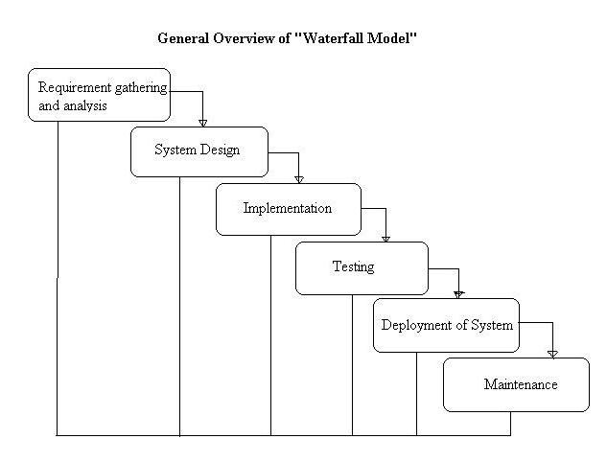
Software Process Model
The software process model used for this project is Waterfall Model.

Slide 9
Work Plan
Work Activities
Software Development
Documentation
Schedule Allocation
Resource Allocation
Milestones

Slide 10
Supporting Plans
Configuration Management Plan
Version Control
SVN submission
Documentation Plan
Testing Plan
Quality Assurance Plan

