Slide 1
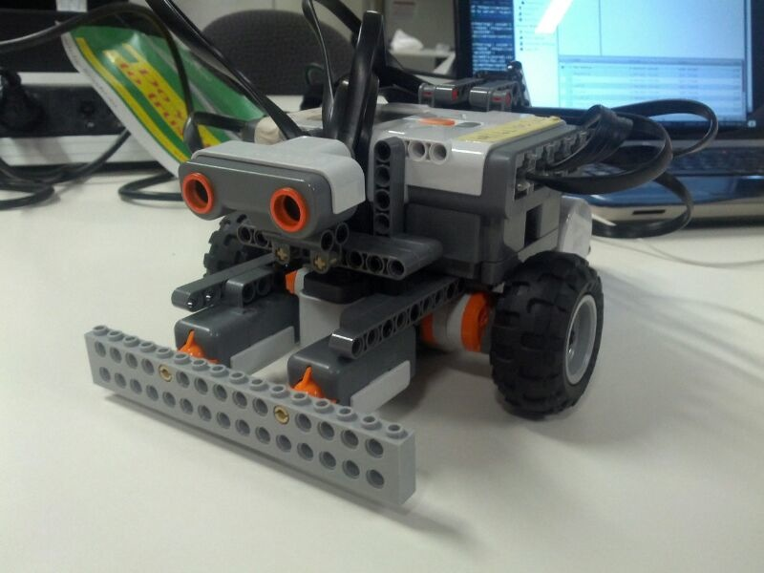
SEP Group 2 presentation
Final presentation for Road Closure Marking Robot Project
“Coding Pharaohs”:
Abdulaziz Alhulayfi
Yu Hone
Jianqiu Li
Matthew Nestor
Yifei Pei
Bowen Tao

Slide 2
Outline
Introduction of the Project Progress
Introduction of the Product
What we learnt from the Project

Slide 3
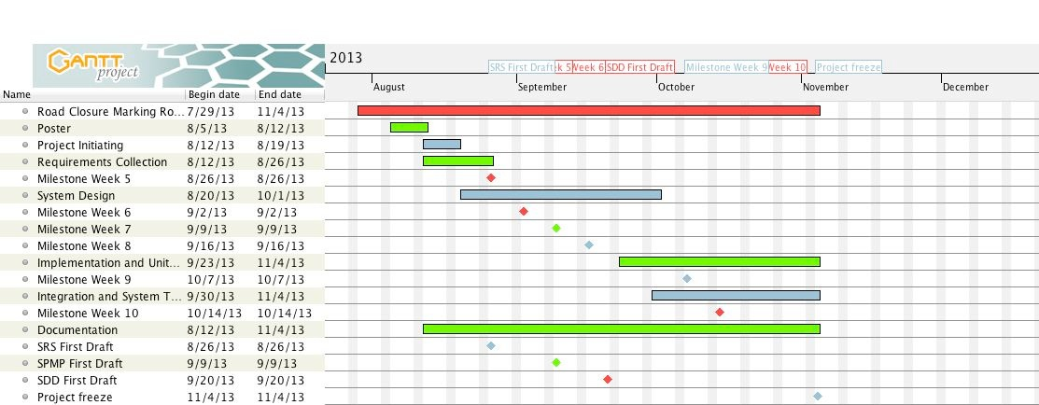
Look at the Schedule first

Slide 4
Detailed progress
Week 3 and Week 4 to collect requirements
Week 5 started to do milestones until Week 10
  Week 5-Week 8 milestones were good performed
  Week 9-Week 10 milestones were partial achieved
Week 5 till Mid-break was the design phase
For the rest of time we programming and programming and programming, and also testing ~~~

Slide 5
Visible Outcomes
SRS_First_Draft: Jianqiu Li and Yu Hong
SPMP_First_Draft: Abdulaziz Alhulayfi and Yifei Pei
SDD_First_Draft: Matthew Nestor and Bowen Tao
Final documentation and User Manual: Abdulaziz Alhulayfi
Testing Reports: everyone
and the whole system

Slide 6
Resources allocation
People
  People did what their responsibility lies
  Yu and Matt coded magnificently
Time
  A big chunk of time which was approximately 30% of the whole project spent on learning new things
  In the perspective of the project timeline, about half of the time was spent on design the system due to inexperience

Slide 7
Risk Management
Six types of risks
  Technology
  Tool
  Team
  Requirement
  Organisation
  Estimation

Slide 8
Risk Management Plan
Probability: Low/Moderate/High
Effect: Tolerable/Moderate/Serious/Catastrophic
Strategy: Steps to be followed to avoid risk occurrence
Risk Indicator: Circumstances that lead to risk occurrence

Slide 9
Quality Assurance and Testing
Provisional activity: we made a detailed risk management plan and V&V process to ensure things are done within frames
Standards: Documentation followed the rubrics provided by lecturers and the standard for Program is to pass tests
Testing: Make sure the program can achieve the designed functionality and the collected requirements

Slide 10
Testing
Unit testing
System testing
Plan and implementation

Slide 11
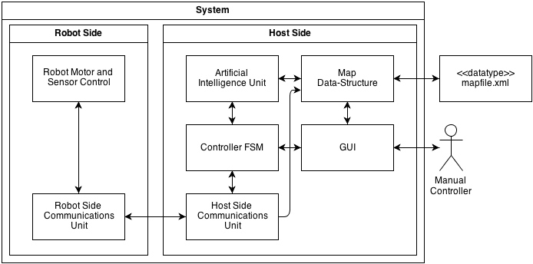
The product

Slide 12
Brief summary of requirements
The terminal goal: to mark road closures by robot on map
Host side and Robot side requirements
Host : GUI, manual control, emergency stop, display, save, load map, communication message.
Robot : Automatic movement, detecting road and intersections, identify obstacles and disaster zone
Safety and others

Slide 13
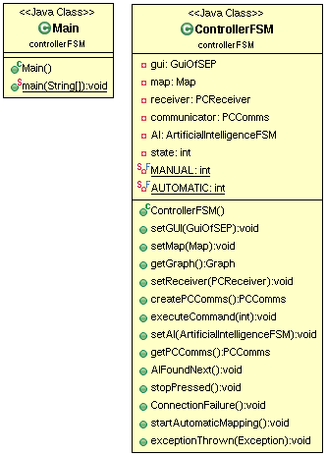
Brief summary of architecture
Overview
Highest level architecture uses MVC pattern
Pipe-and-filter for remote control
Selective Repeat for the communication pipeline
Finite State Machine for the control of robot events
Graph to manipulate the AI

Slide 14
Major features of product
Remote control
AI and AI view
Map update
Selective Repeat for the COMMS

Slide 15
What can be improved
The project phases and time frame was not good defined
  We spent too much time on system design phase which should have been done before mid-break
  Architecture ought to be subject to change, but the top level framework should be early defined
  Major mistake: data structure definition delayed

Slide 16
What can be improved
Quality control of the project did not consider time constraints
  The user interface did not primarily achieve the expected quality. However it took too much time for us to redefine it.
  Most goals did not have clear deadline of reasonable quality delivery, which delayed the whole project

Slide 17
What we can improve
Risk management plan was detailed and sufficient, but the execution of risk management lacks of practice
  We can’t keep a sheet of risk management plan in hands. Due to the poor experience in real project management, we cannot identify the risks immediately when it occurs.

Slide 18
What can be improved
People need time to adjust the status of working in a team and get familiar with teamwork conventions
  All our group members are deadline-oriented workers, who are likely to rush in final hours

Slide 19
Future?
Start to learn early, design early, and communicate much more frequently

Slide 20
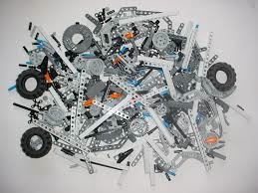
Thanks you all.
Any Questions?
“Knowledge is power”
–Francis Bacon

