Slide 1


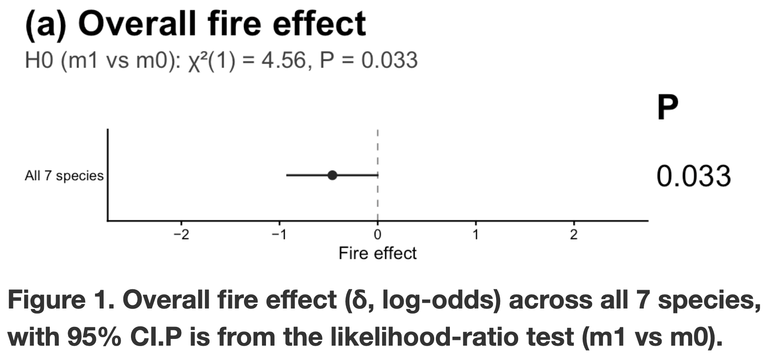
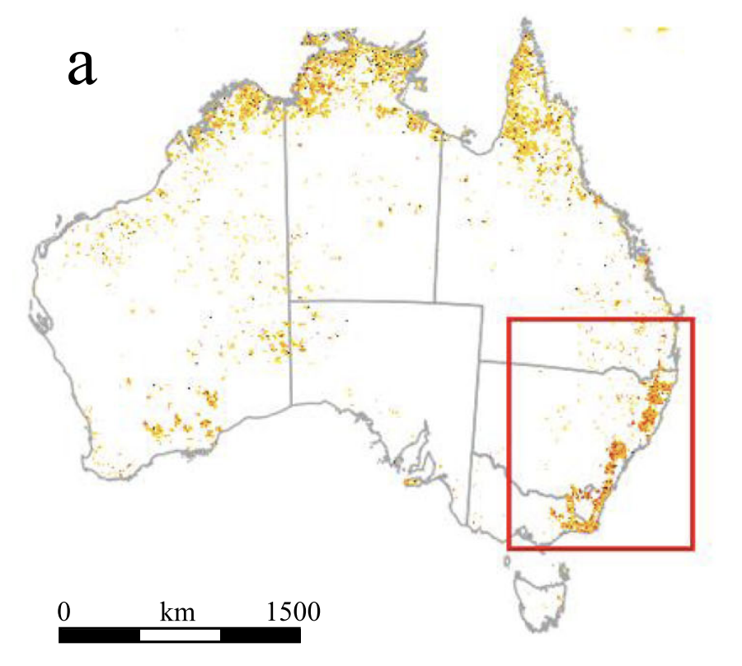
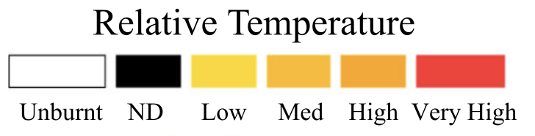
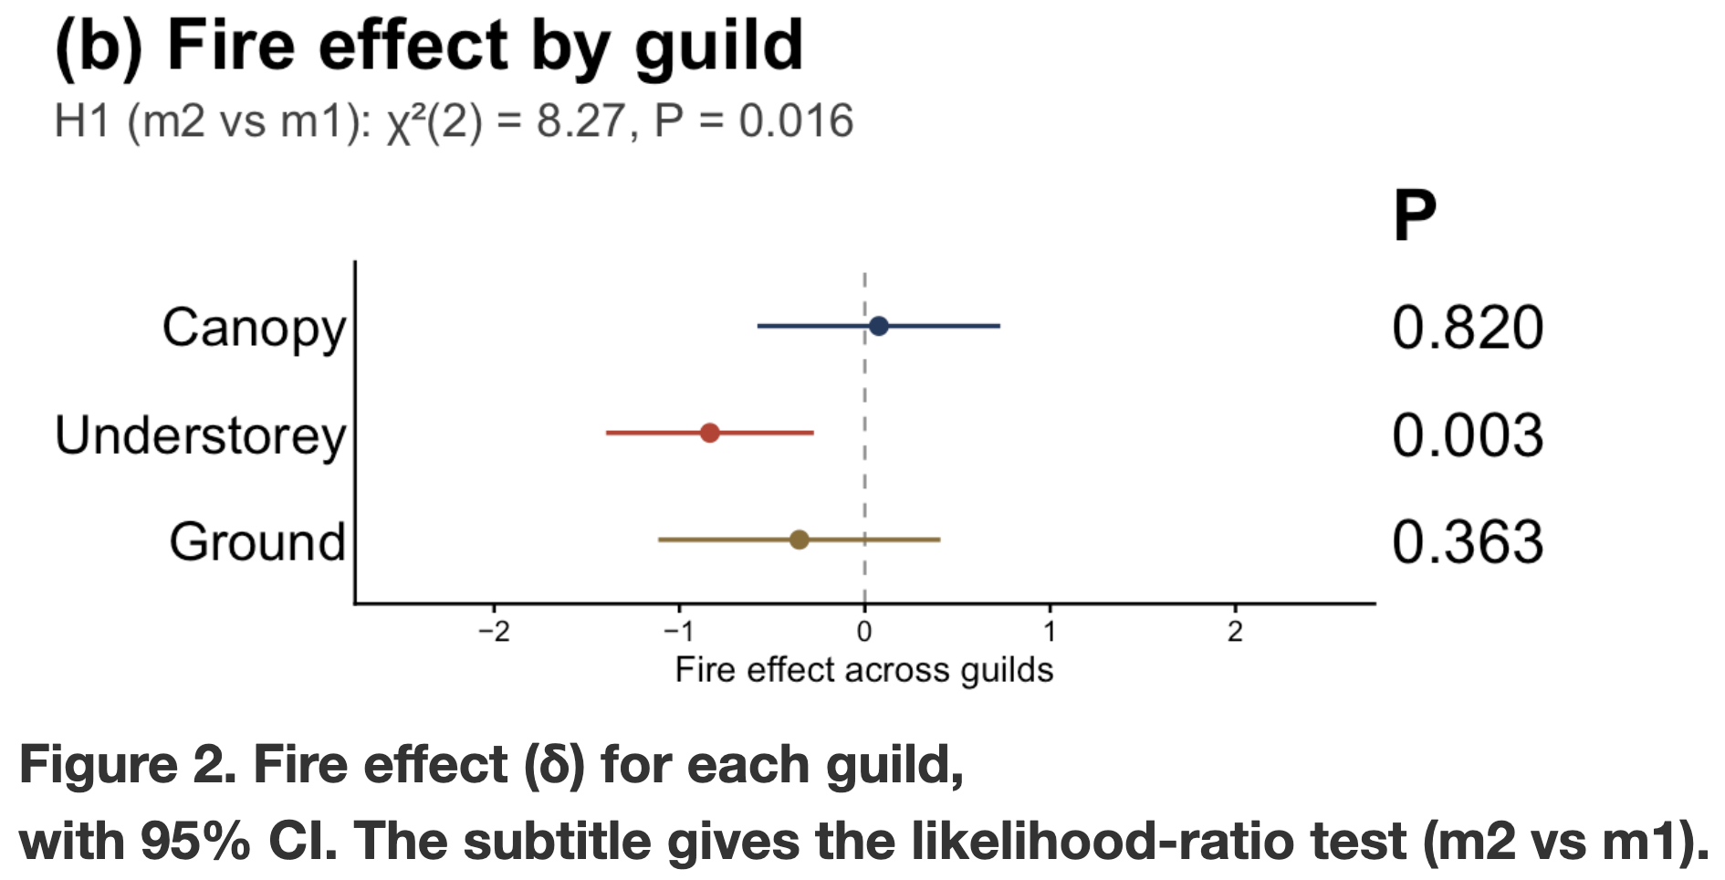
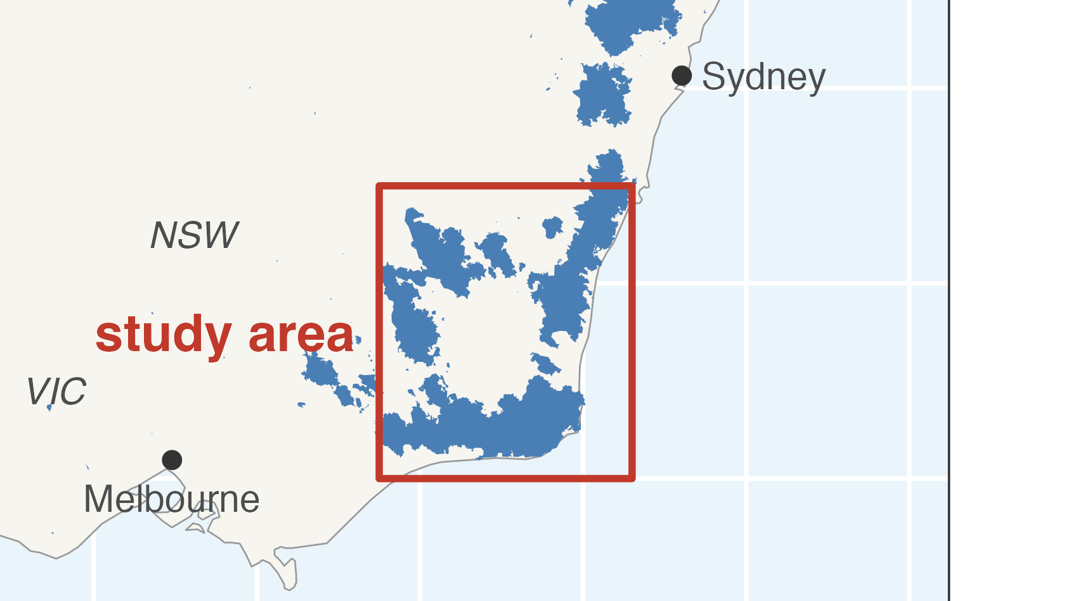
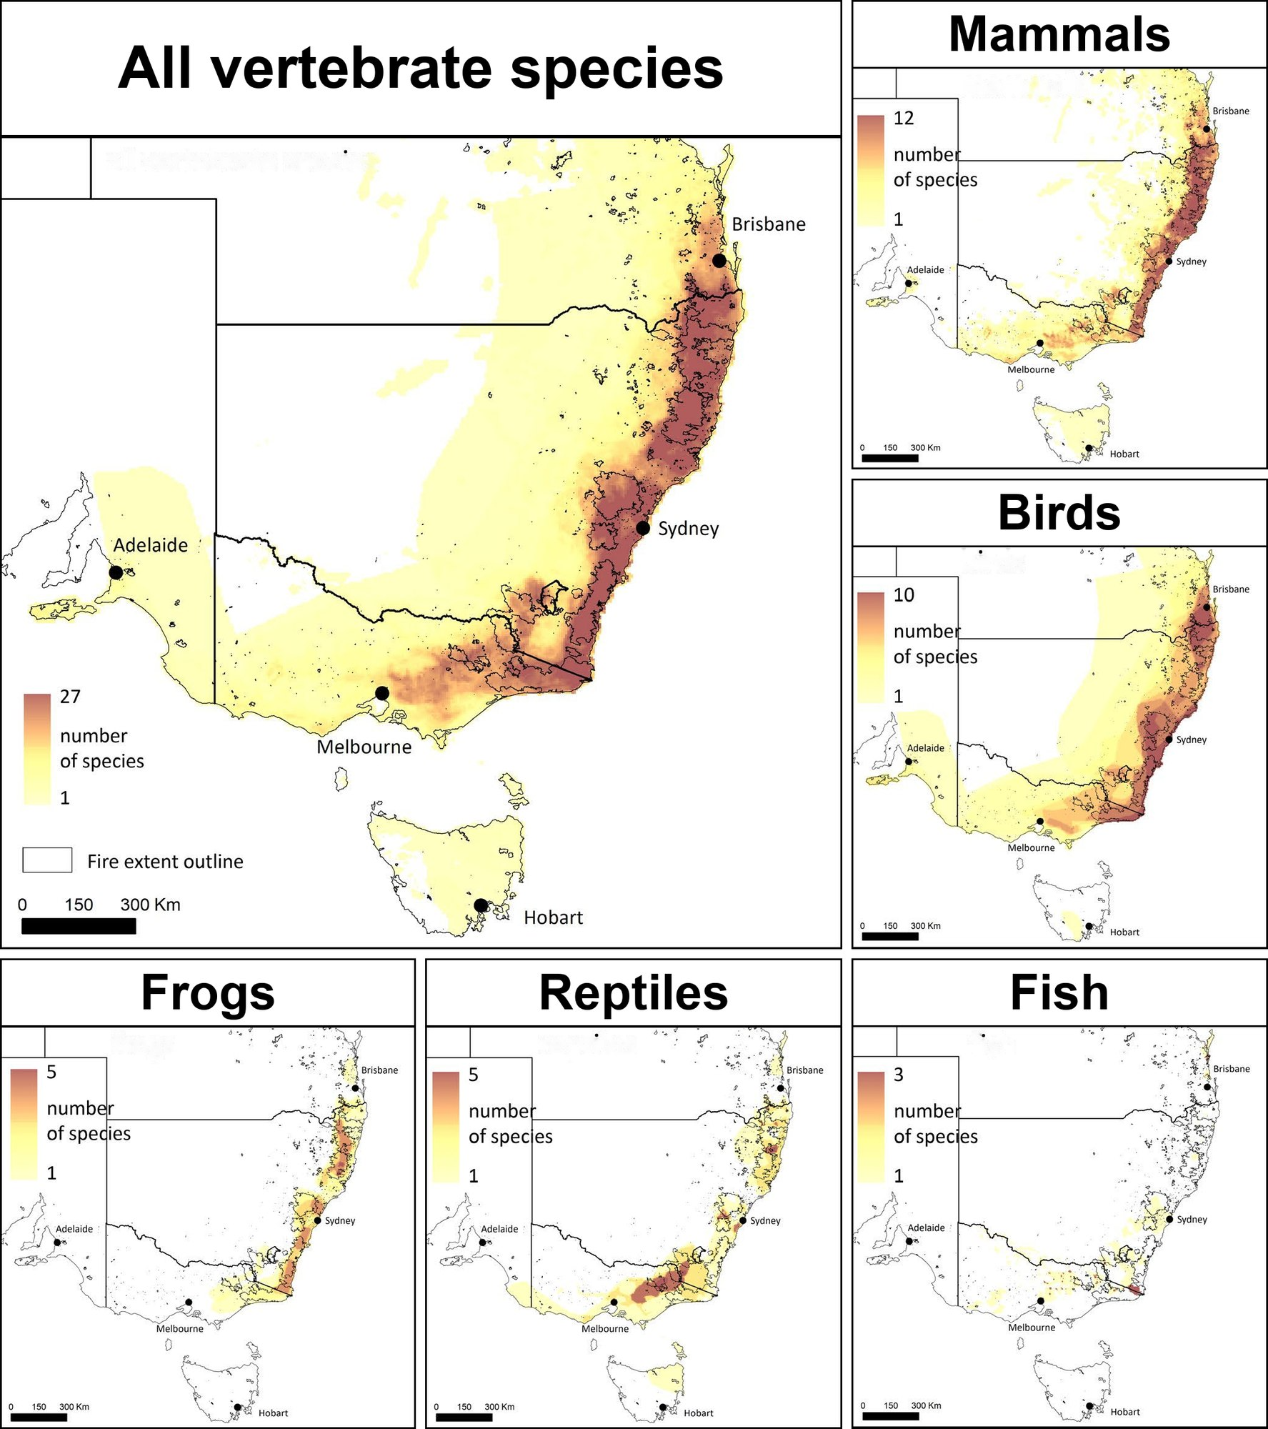
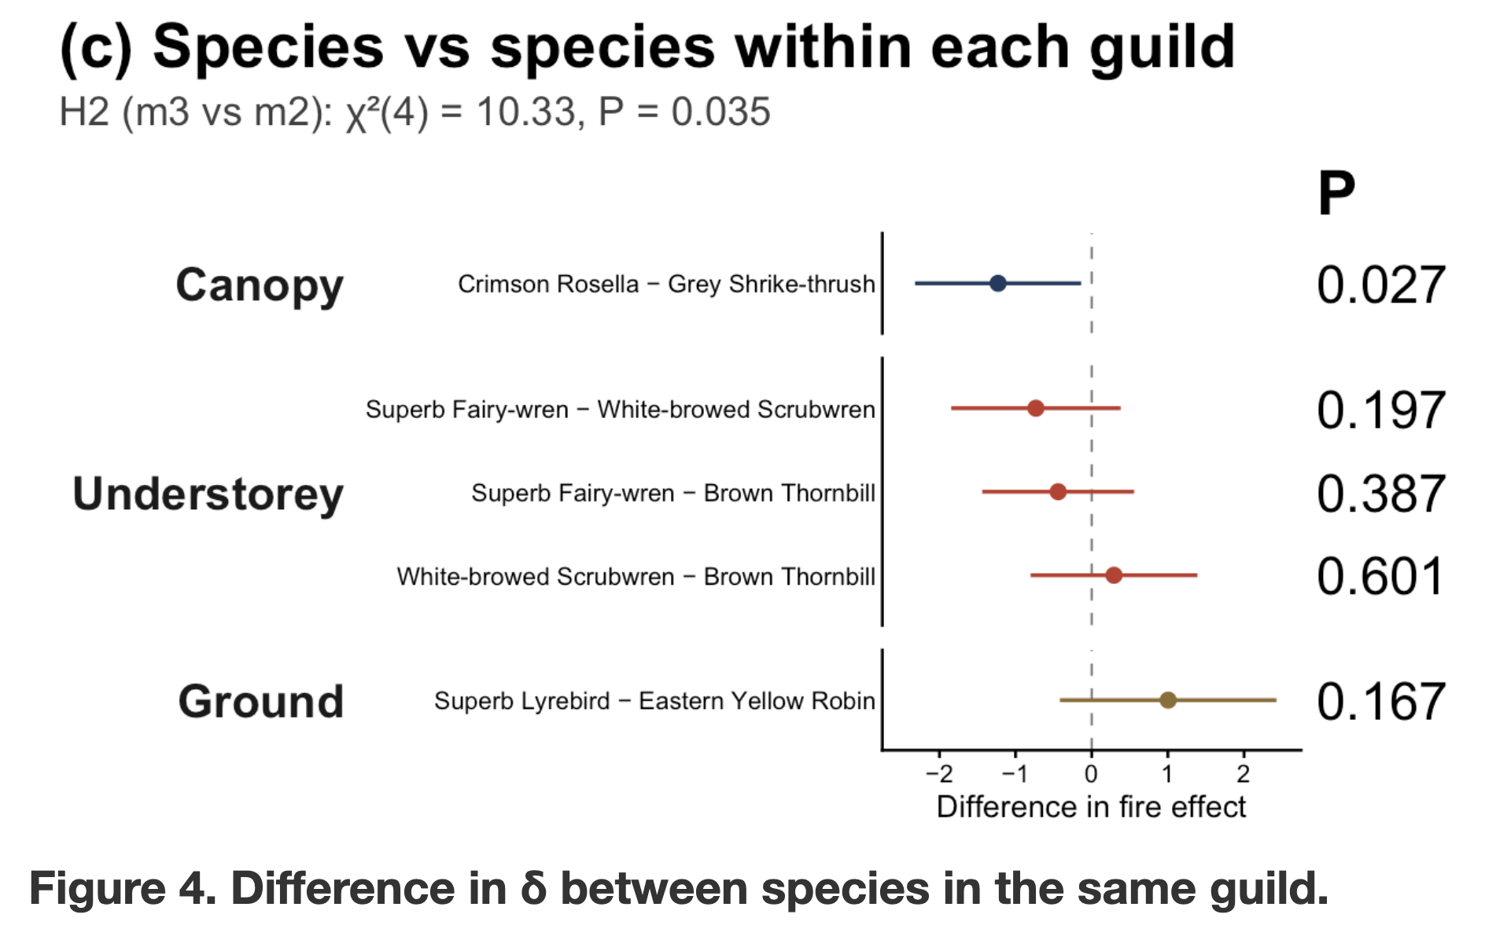
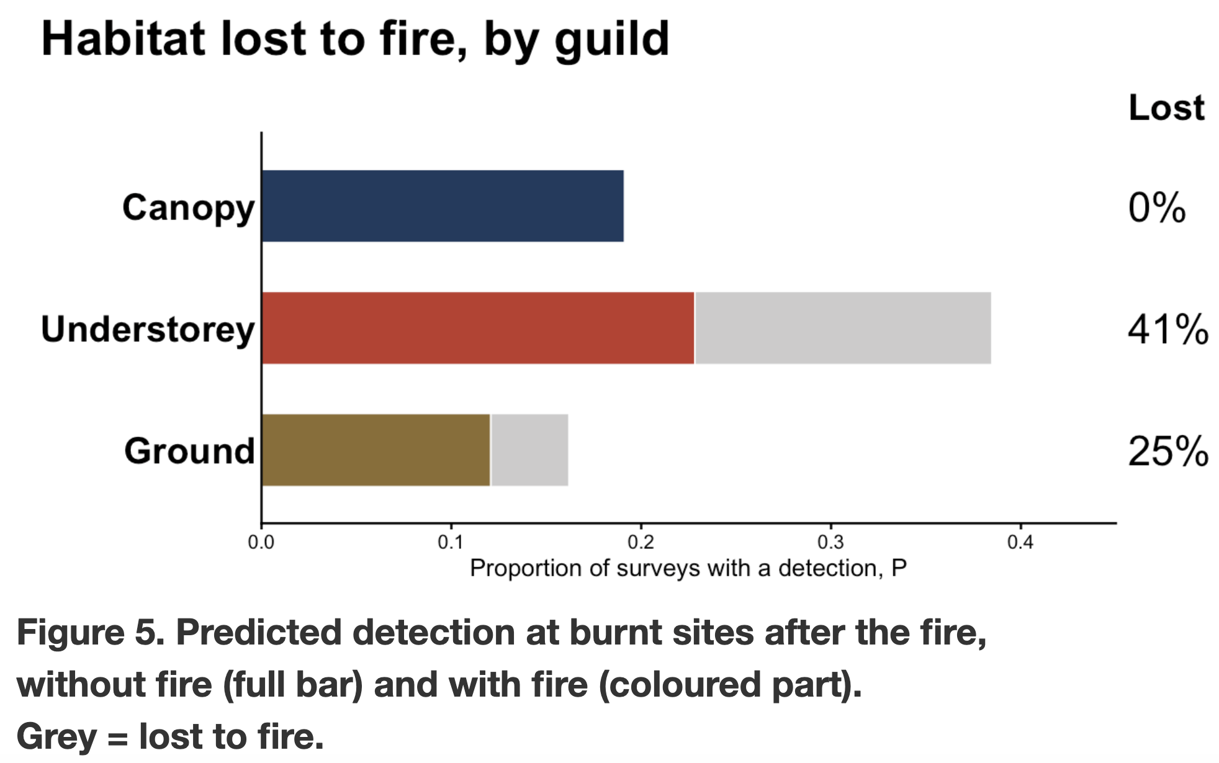
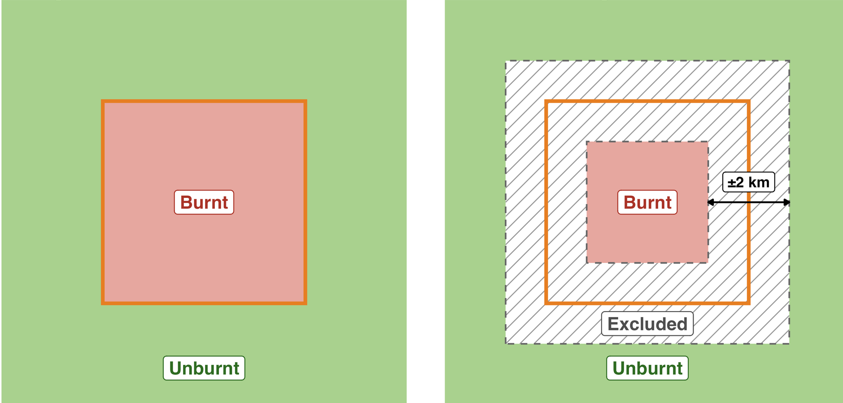
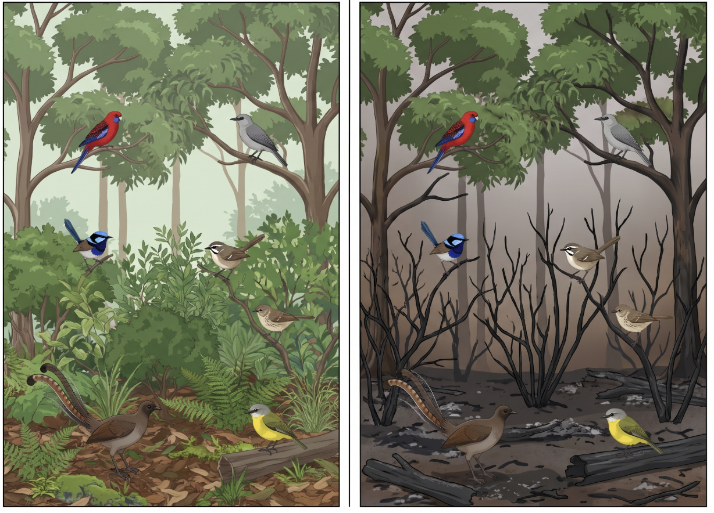
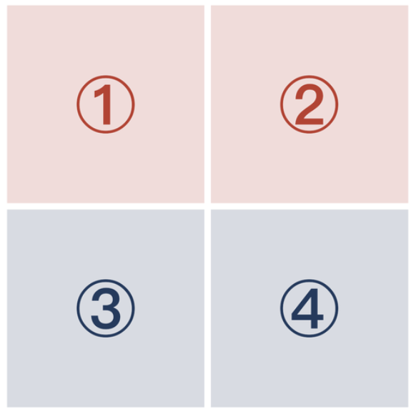
Fire’s effect on birds depends on where they live in the forest: a before– after study of forest birds after the 2019–20 bushfires
u8179158
Introduction
Hypotheses
Results
Fire in Australia
H | Predictions | δ
H0 | Fire affected birds. | One δ for all species
H1 | Different guilds have different fire effects. | 3 different δs for 3 guilds
H2 | Different species from one guild have different fire effect | Different δs within one guild
Fire is natural in Australia.
2019-2020 black summer was outside the normal range; big fires are becoming more frequent (Godfree et al., 2021)
Data
(Driscoll et al., 2024)
Burnt area & bird data
Temperature rise; high severity; species
Before 2015–19, After 2020–23, fire season removed.
Fire affected species
Map: National Indicative Aggregated Fire Extent Dataset
Study area: (Daly et al., 2026)
ALA dataset, Galah: 24000+ records of birds, standard 20-minute search, 4750 surveys at 1785 sites
Data filtering
Binary for burnt and unburnt: edge is confusing
Filter by excluding 2km around the edge
(Driscoll et al., 2024)
Fire affected birds differently
Forest only: exclude cities
Use all sites in studied area : 654 sites (172 burnt, 482 unburnt), 1,298 surveys
Results
Overall decline
Canopy remains; understorey affect; ground is more detectable
No species variation between ground and understorey
Canopy: Crimson Rosella eats seed from ground, nests on tree hollows
Understorey is hotspot of protection
Methods
Canopy: Crimson Rosella, Grey Shrike-thrush
Understorey: Superb Fairy-wren, White-browed Scrubwren, Brown Thornbill
Ground: Superb Lyrebird, Eastern Yellow Robin
Binomial GLMMs: same background, only fire terms change
Model | Fire term | N(δ)
m0 | None | 0
m1 | One common δ | 1
m2 | One δ per guild | 3
m3 | One δ per species | 7
Objectives
Before
After
Burnt
No fire: ② − ① = ④ − ③
H0 = m0 vs m1: fire effect
H1 = m1 vs m2: across guilds
H2 = m2 vs m3: across species within one guild
Limitations
Fire effect: δ =
(② − ①) −
(④ − ③)
Fire measured as burnt / unburnt only, no severity
One time window, can’t see recovery over time
Observation bias, detection ≠ presence
Unburnt
Ecology model: P = 1 − v − e/c
P = proportion of patches occupied
e/c = extinction-to-colonisation ratio
v = proportion of habitat destroyed by fire
To test whether species from different guilds react differently towards fire, using before–after, burnt-unburnt data from 2019-2020 fire area.
Godfree R.C. et al. (2021) Nat. Commun. 12, 1023. doi:10.1038/s41467-021-21266-5
Driscoll D.A. et al. (2024) Nature 635. doi:10.1038/s41586-024-08174-6
Daly G. et al. (2026) Aust. Zool. 45(3), AZ26005. doi:10.1071/AZ26005
Legge S. et al. (2022) Divers. Distrib. 28, 571–591. doi:10.1111/ddi.13428 (Fig. adapted, CC BY 4.0)
DAWE (2020) National Indicative Aggregated Fire Extent Dataset v20200623. CC BY.
BirdLife Australia, Birdata, via Atlas of Living Australia (dr359). CC BY-NC.

