Slide 1
Optimizing Proteomic Workflows: Impact of Analytical Decisions and Software Tools

Slide 2
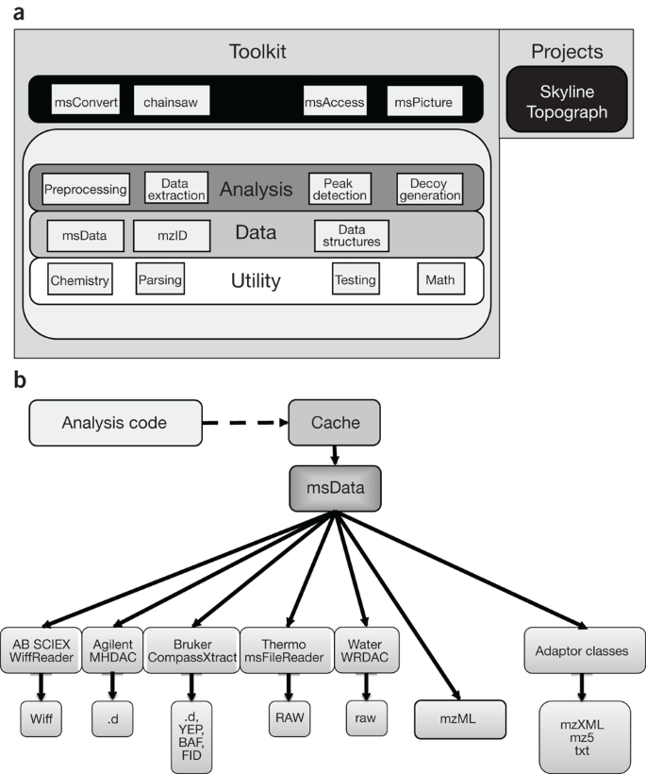
Visualisation of proteomics data using R
Mass spectrometry-based proteomics is a key tool for protein quantification, pathway analysis, protein characterization and visualization.
Through a modular plug-in interface, common open formats like mzML, mzXML, MGF, pepXML, and mzIdentML are converted into central msData structures, allowing seamless data processing and analysis across diverse datasets.(Chambers et al., 2012)
(Chambers et al., 2012)

Slide 3
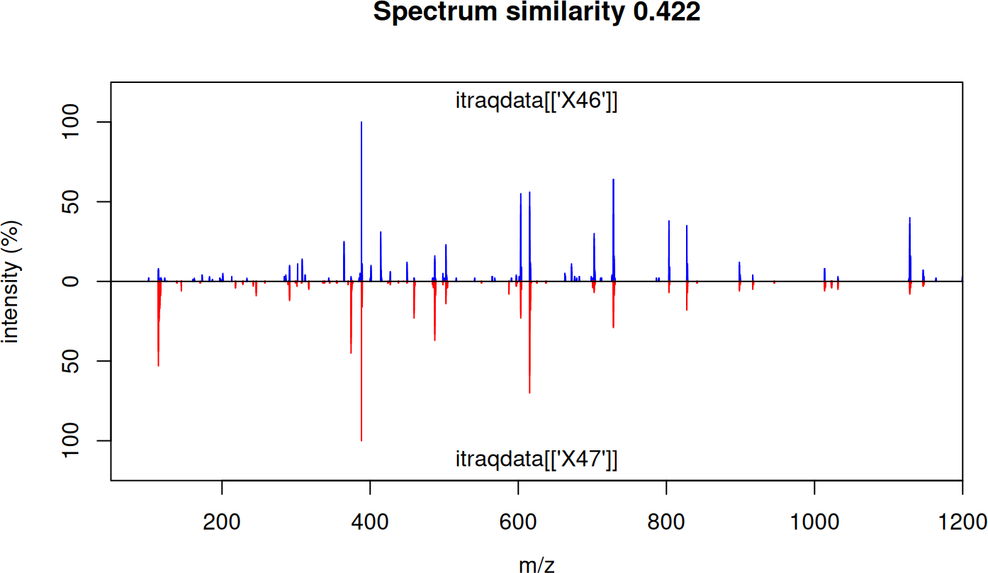
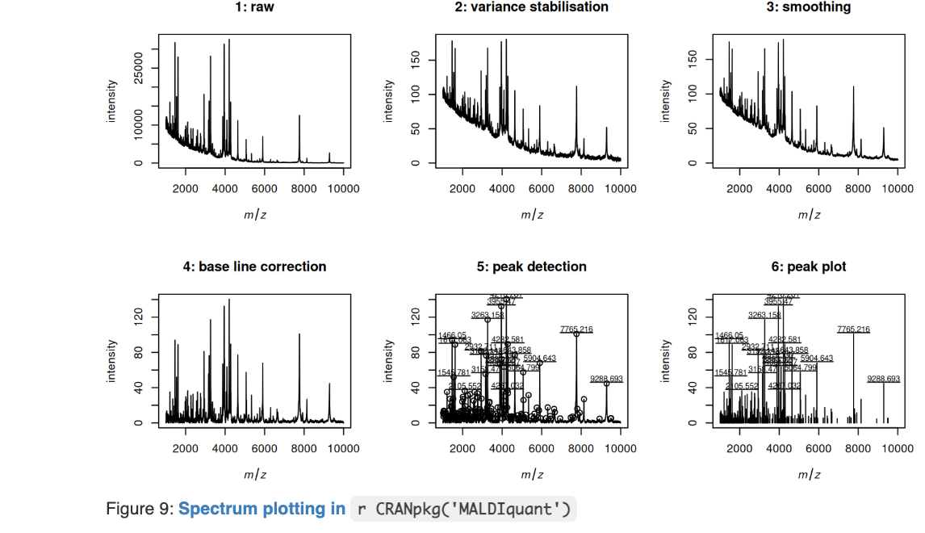
MALDIquant, BRAIN and MyclassifR are R packages to process and analyze different types of proteomic M1 mass-spectrometry data.
MALDIquant (Gibb & Strimmer, 2012)
Focused on MALDI-TOF spectra
Works with single or multiple spectra for peak detection, alignment, and preprocessing
Limited full LC-MS/MS workflows
BRAIN
Designed for peptide mass fingerprinting
Works with peptide sequences or mass lists
predicts theoretical spectra and interpreting MS results
MyclassifR
Applied in peaks identification, and pattern classification workflows for MALDI-TOF profiles
Using R for Proteomics Data Analysis, 2025

Slide 4
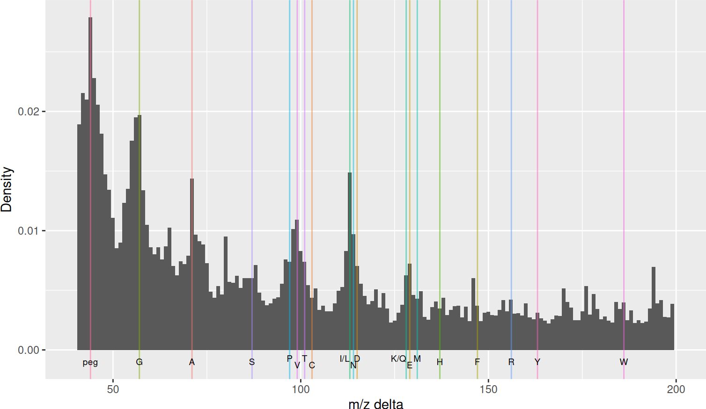
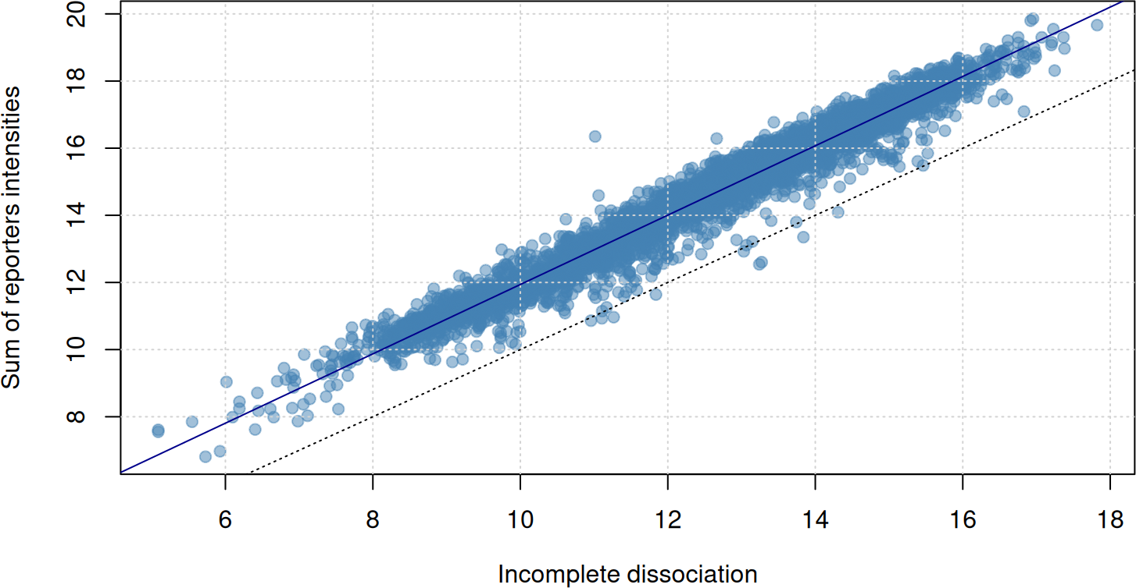
MSnbase: An R Toolkit for Processing, Visualizing, and Quantifying LC-MS/MS Proteomics Data
MSnbase provides a flexible and reproducible framework for mass spectrometry workflows. (Gatto & Lilley, 2012)
Supports multiple MS formats (e.g., mzML, mzXML, mzData)
Handles MS1 and MS2 spectra, including chromatograms and fragmentation data
Peak detection, filtering, and preprocessing tools
Quantitative analysis of peptides and proteins
Visualization of spectra, chromatograms, and QC metrics
Flexible data manipulation via efficient MSnExp and OnDiskMSnExp objects
Integration with other Bioconductor tools for downstream proteomics analysis
Using R for Proteomics Data Analysis, 2025
Using R for Proteomics Data Analysis, 2025

Slide 5
Objectives
Use the OrgMassSpecR package to evaluate how different missed-cleavage settings affect the accuracy and reliability of the analysis.
Explore package MSnbase and MzTab, and investigate the effect of normalization choices on QC and spectra analysis
Demonstrate data-dependent acquisition (DDA) analysis workflows using the MSnbase package, highlighting in data processing, visualization, and interpretation.
Apply MyclassifR to MALDIquant-processed spectra to evaluate classification performance, integrating robust quality control measures such as spectrum stabilization, and peak clustering checks.

Slide 6
Dataset for MSnbase analysis: PXD000001
PXD000001 is used because it is a publicly available, well-annotated LC–MS/MS DDA dataset containing TMT-labeled peptide quantification. Its compatibility with MSnbase makes it ideal for demonstrating peptide-level processing, protein summarization, and normalization in a reproducible DDA workflow.
PXD000001 includes:
Raw LC–MS/MS spectra
Processed mzTab peptide quantification files
Possible MSnbase and OrgMassSpecR analysis:
load and examine raw DDA spectra and peptide intensities
MS1 precursor scans
MS2 fragmentation scans
Chromatograms
Peptide-to-protein aggregation
Reporter ion quantification (TMT)
missed-cleavage analysis (OrgMassSpecR package)

Slide 7
Dataset for MALDIquant and MyclassifR
The Bruker “2010_05_19_Gibb_C8_A1” dataset is used for MALDIquant because it provides MALDI-TOF spectra collected on a Bruker flex instrument (MALDIquant reads TOF data primarily), making it suitable for demonstrating basic TOF spectra preprocessing and analysis.
MALDIquant analysis:
MS1 data
MALDI-TOF spectrum preprocessing (baseline, smoothing, calibration)
Peak detection and quantification
Spectral alignment and classification
The resuklts can be further qualified using MyclassifR package

Slide 8
Pipeline for MSnbase aggregation and normalization comparison
1. load ProteomeXchange dataset
2. Read peptide-level quantification data and Assign TMT reporter channels
3. Inspect peptide expression data
4. Filter and preprocess peptide data
5. Aggregate peptides to protein level, and plot protein-level intensities
combineFeatures() using sum, median, or mean
Compare different aggregation methods
6. Normalize peptide intensities (DIV_median versus VSN)
7. Select subset of proteins of interest, and prepare data for ggplot2
8. Melt data to long format; Visualize peptide-level trends per protein

Slide 9
Pipeline for missed-cleavage analysis using OrgMassSpecR
1. Load required packages and Retrieve experimental proteomics data
2. Load target protein sequence from FASTA
3. Digest protein with different missed-cleavage settings (MC0, MC1, MC2)
4. Extract experimental peptides and compare theoretical vs experimental peptides:
Count matches between filtered theoretical peptides and experimental peptides
calculate sequence coverage: matched residues / total protein residues
5. Plot results
Barplot: number of matched peptides vs missed cleavages
Histogram: peptide length distributions
Density plot: visualize length distribution differences across missed-cleavage settings
Table of missed cleavages, theoretical peptides, filtered peptides, experimental matches

Slide 10
Pipeline for MSnbase DDA analysis
1. MS1 Pre-processing
2. MS2 Precursor Extraction
3. MS2 → MS1 Matching (Precursor Validation)
Compute m/z tolerance.
Compare MS2 precursor m/z to MS1 peaks within m/z window.
Apply retention time tolerance
4. Spectrum Visualization
Plot the first MS2 spectrum to inspect fragmentation quality.
Generate Total Ion Chromatogram (TIC) from MS1 scans:
5. 3D MS1 Visualization
Select first 50 MS1 spectra.
Define a common m/z grid and interpolate each spectrum.
Generate a 3D waterfall/surface plot (m/z × RT × intensity).

Slide 11
Pipeline for MALDIquant and MyclassifR package
Load Libraries & Dataset
Preprocessing of Spectra
For each spectrum: Variance Stabilization; Smoothing; Baseline Correction
Peak Detection
Alignment & Matrix Generation
Visualization of Preprocessing Effects
Exploratory Data Analysis (PCA)
Visualize PC1 vs PC2 to observe clustering patterns.
Assess spectral similarity and identify outliers.

Slide 12
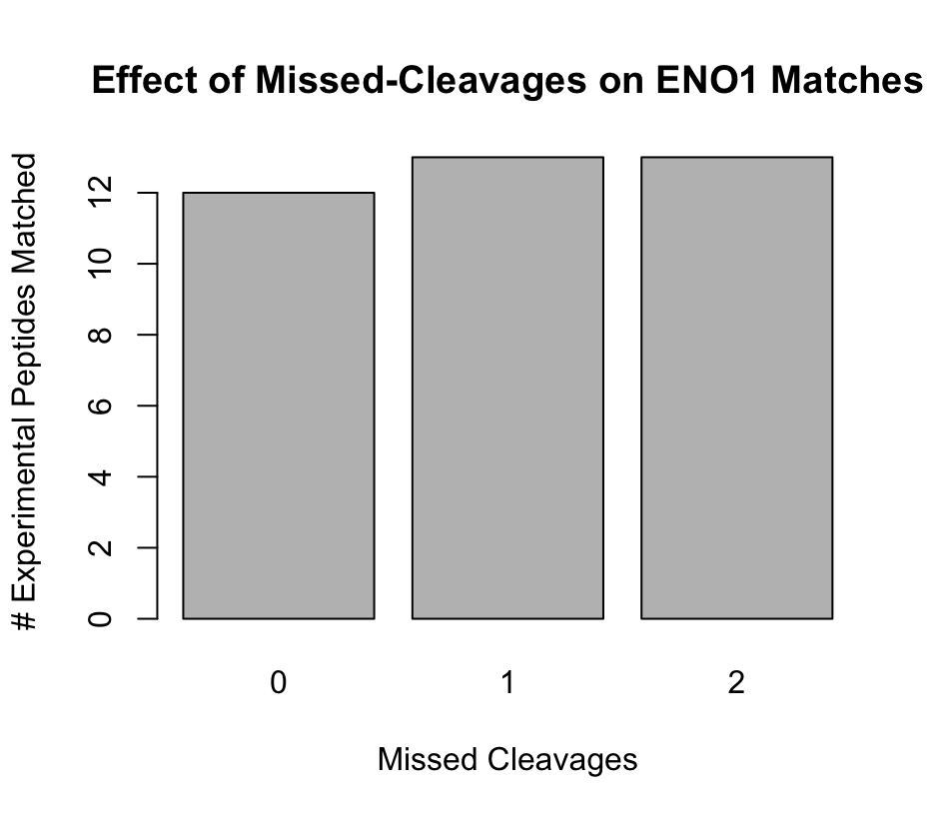
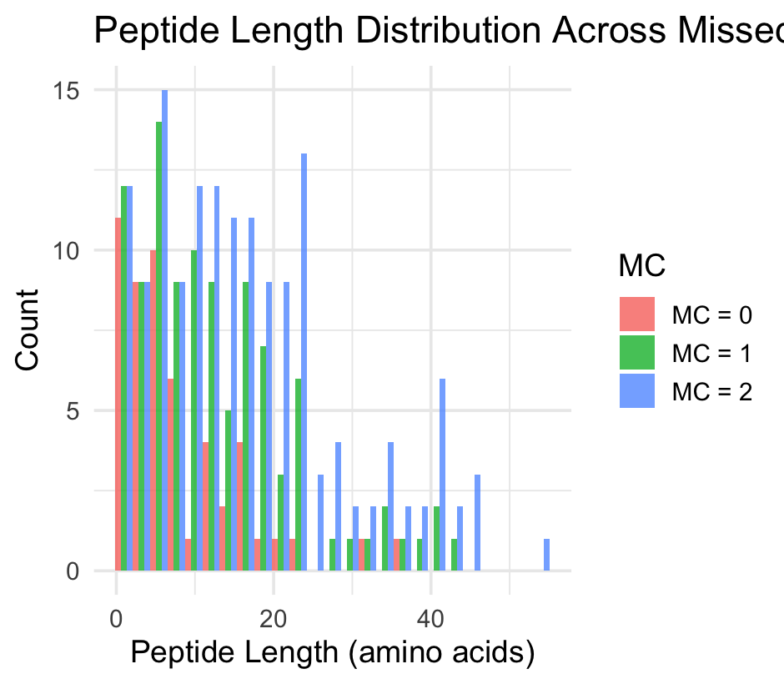
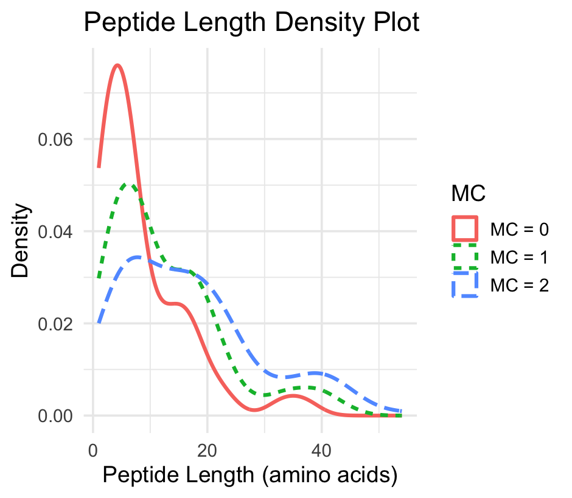
Peptide length analysis confirms that missed cleavages options increase peptide length and distribution, which affects the detection possibility
Bar Plot : MC0 has the least matches due to the strict digestion misses peptides observed in reality
Histogram: shows the frequency of theoretical peptide lengths for each MC. MC2 has the longest peptides, and MC1 has the middle length; while MC0 showed the shortest peptides, a narrower distribution.
Density plot: MC0 as expected, has the peaks at shorter lengths; while MC1’s peak shifts right, a broader distribution, and MC2 is further right, more and the most spread.
Longer peptides correspond to higher missed-cleavage numbers, but may include unmatched very long peptides

Slide 13
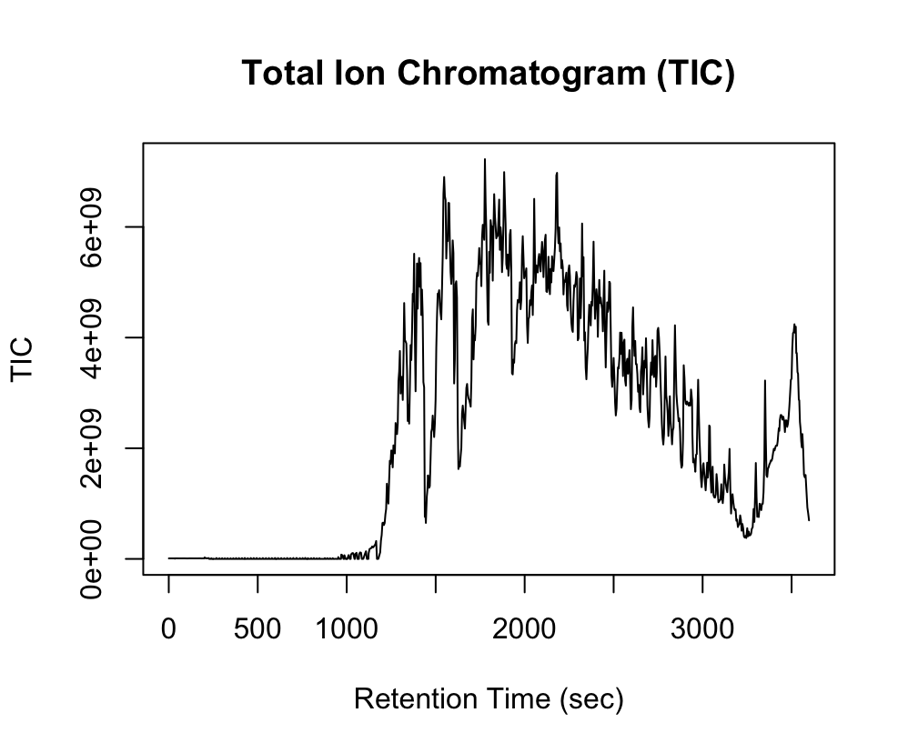
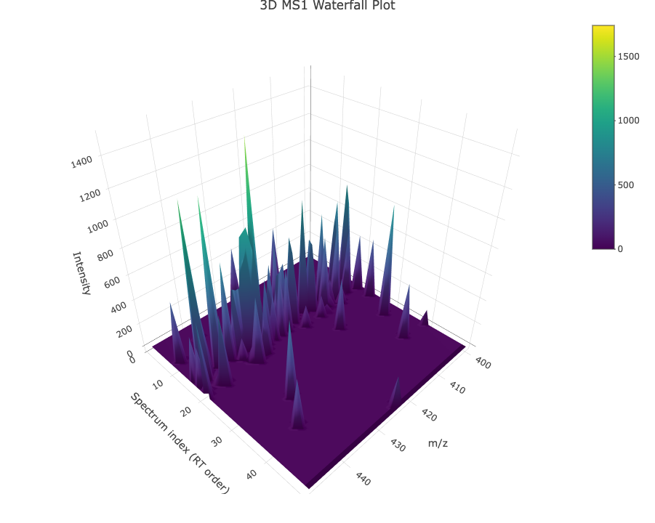
MSnbase DDA analysis
A TIC plot shows the total ion signal over retention time, and it suggests a relatively good chromatography:
Low baseline at early RT
Gradual signal rise as peptides elute
No sudden gaps, drops, or huge spikes
3D MS1 Visualization:
Select first 50 MS1 spectra
Generate a 3D waterfall plot (m/z × RT × intensity)

Slide 14
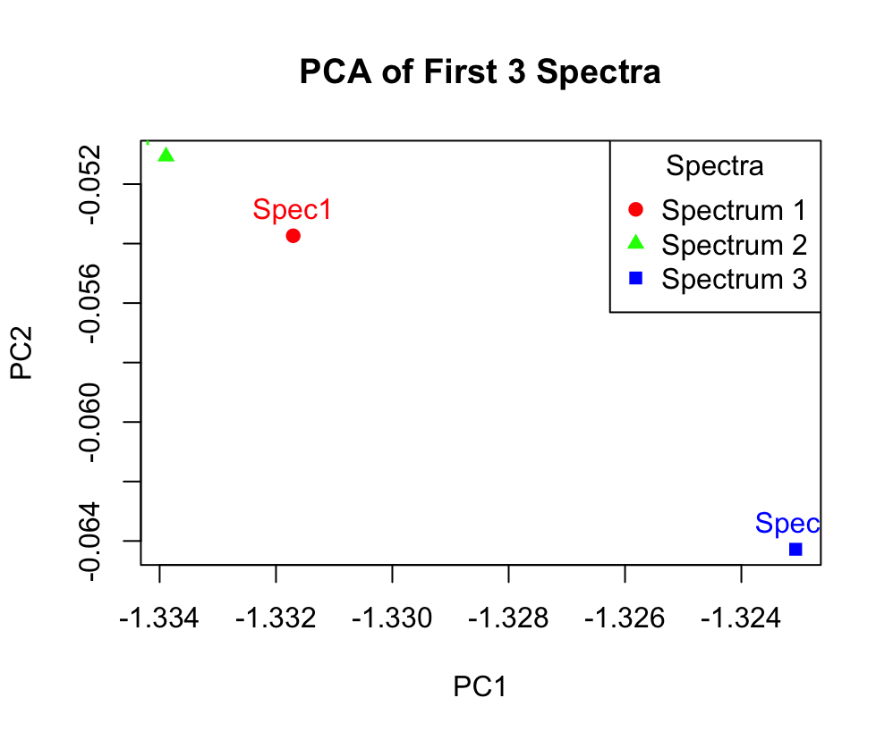
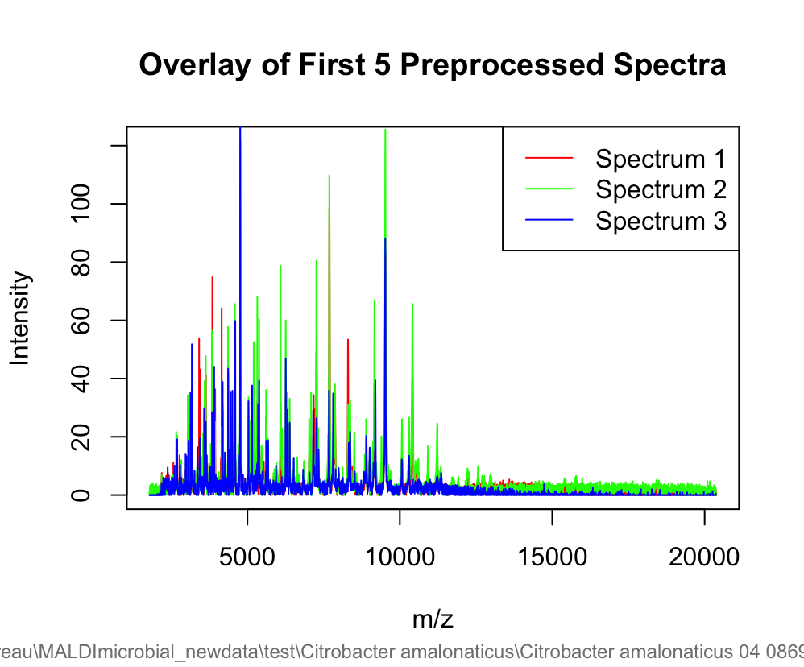
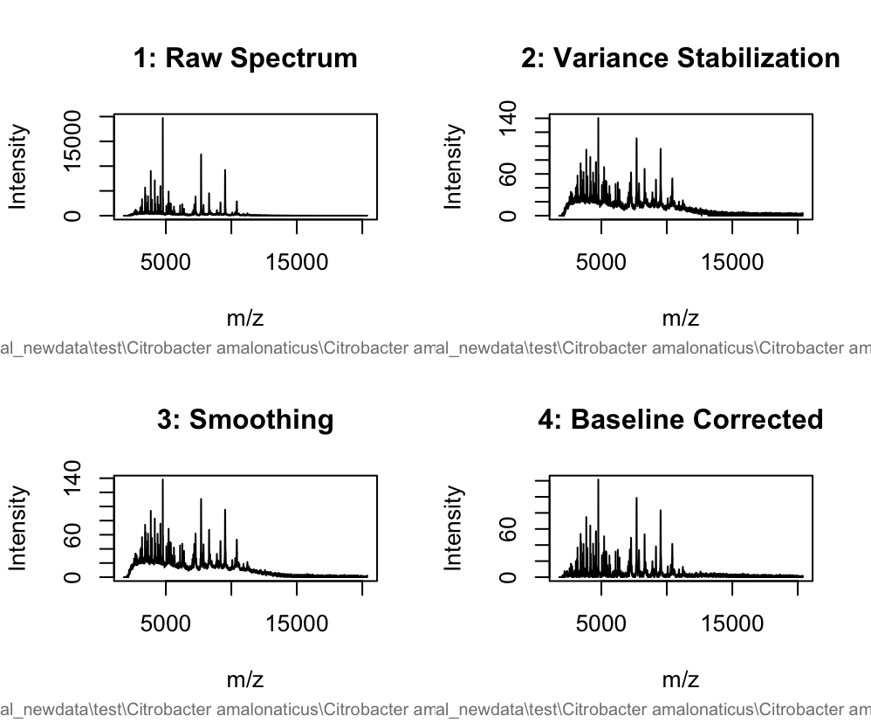
TOF data processing and analyzing
Overlay plot: put multiple spectra on the same graph after preprocessing for vial, quality, and outliners check.
PCA provides a quantitate view to explore similarity and clustering amongst the spectra. The results suggests:
spectra differ significantly for spectrum3; while spectrum 1 and 2 are more similar in peak intensity
The mean difference came from PC1, due to specie-specific peaks
The bottom intensity versus m/z plot shows the processing steps using MALDI quant, including peak smoothing and baseline removing.

Slide 15
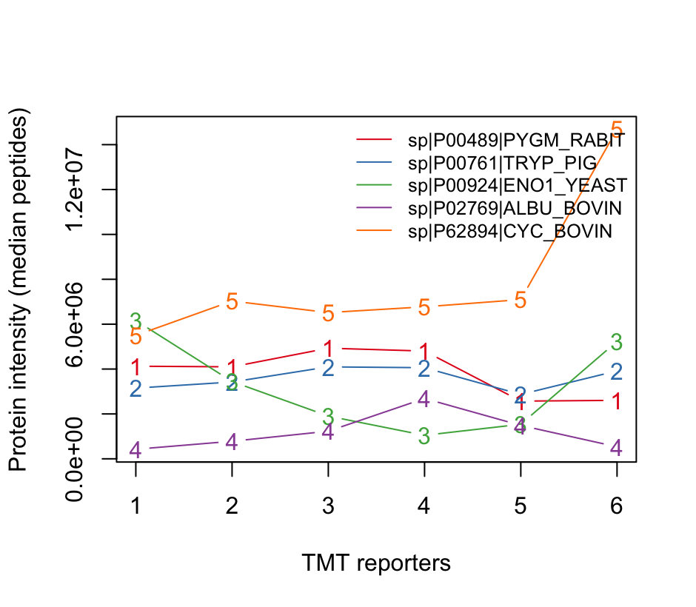
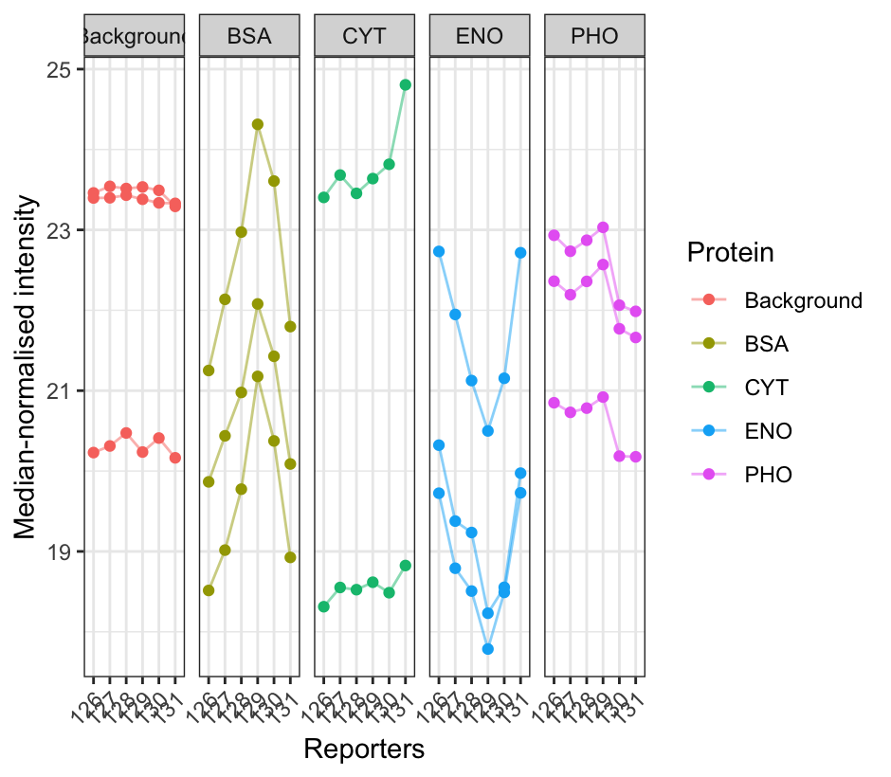
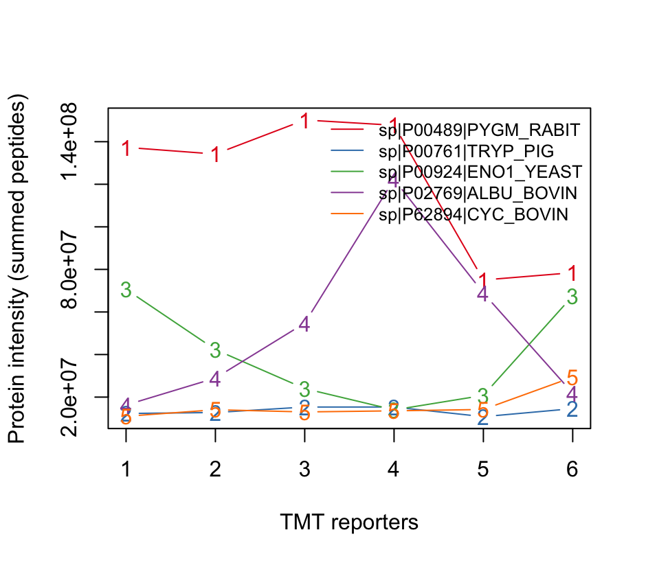
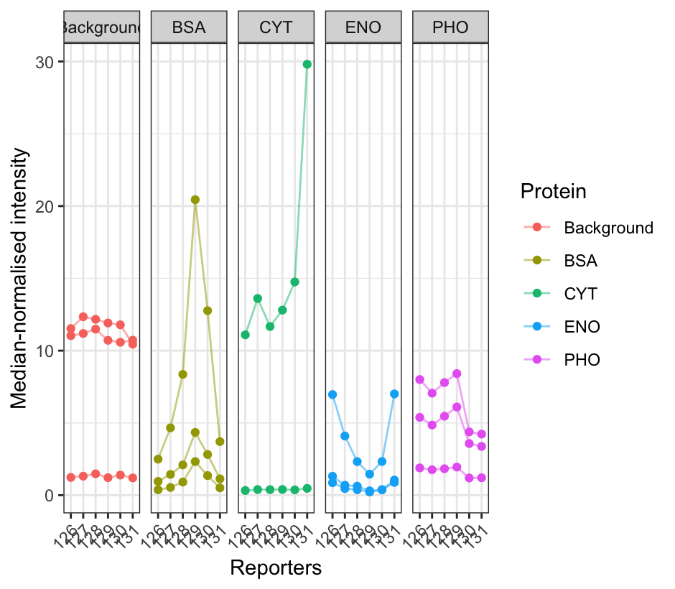
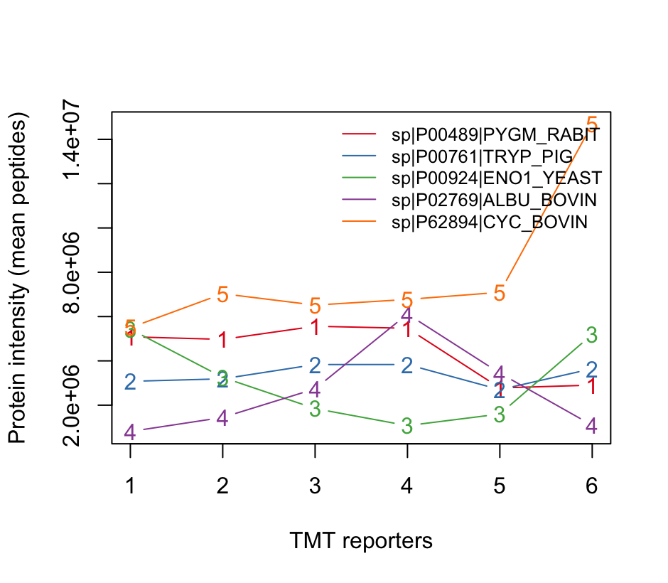
Proteomics TMT Data Analysis
Matplot-Median
Median normalization
gg-plot Normalization effects (On the left side):
VSN reduces variability between channels/peptides.
Background or contaminant proteins have inconsistent signals.
Strong proteins BSA shows consistent upward trends across channels.
Matplots (on the right side) compare the three aggregation methods by showing the variation of protein intensity across TMT channels:
Median and mean methods have outliners for the 5th labeled protein at channel 6; sum shows the highest bias for both 1st and 4th proteins, as the lines are fluctuated; the 4th protein might have bias or noise generally at channel 4
Matplot-sum
VSN normalization
Matplot-Mean

Slide 16
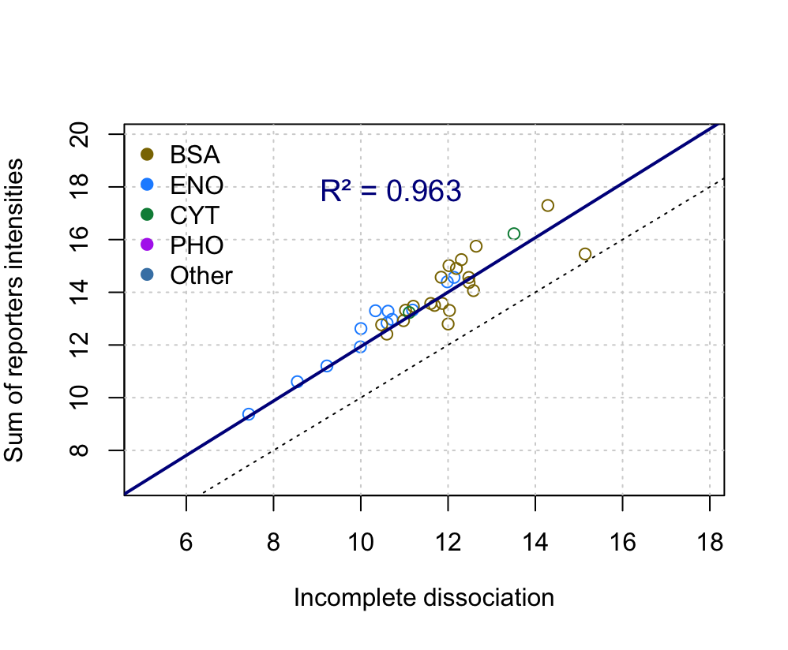
Proteomics TMT Data Analysis continue: highlight standards for Incomplete dissociation plot
Original incomplete dissociation plot
The plot compares:
x-axis: intensity of incomplete-dissociation reporter y-axis: sum of all TMT quantification reporter intensities
Standard proteins: (BSA, ENO, CYT, PHO)
The second plot annotates the proteins in the dataset, and has R^2 for the regression line; to better visualize sample quality and interference
Overall, the plots show low incomplete dissociation, and the standard proteins are clustered and lying near the main trend, indicating good fragmentation and accurate quantification processing
QC plot with standard protein highlighted

Slide 17
missed-cleavage analysis:MC1 is more optimal for trypsin digestion of ENO1
For peptides naturally have 1 missed cleavage: MC1 captures more experimentally observed peptides than MC0.
Very short peptides (MC0) and Very long peptides (MC2) may be lost during MS/MS or may be too large to detect efficiently or fragment poorly.
When comparing to experimental mzTab peptides of ENO1:
MC0 misses many peptides
MC2 adds longer peptides, some of which may not be observed in practice, so increasing bias

Slide 18
Proteomics TMT Data Analysis
The ggplots and Matplots compare the normalization and aggregation methods for protomeric LCMS data analysis.
The aggregation results align with the prediction that sum is sensitive to extreme peptides; mean is smoother but influenced by extremes; median is more reliable for protein-level values that reflect most peptides across all channels
Combined with normalization for better analysis choice:
Median aggregation + VSN normalization: robust protein quantification.
Sum aggregation + median normalization: may exaggerate high-intensity peptides.
In general, flat lines across channels indicate good labeling and normalization:
Confirms consistency
Distinguishes true biological changes from background noise

Slide 19
Data-Dependent Acquisition
DDA analysis is essential because it links MS1 precursor ions to MS2 fragmentation spectra, allowing accurate peptide and protein identification and QC steps. This helps to ensure that the fragmentation data used in downstream identification pipelines is reliable and biologically meaningful. (Aebersold & Mann, 2016)
3D MS1 visualization improves DDA analysis by providing a view of signal intensity across m/z and retention time. Unlike TIC plots, which collapse all ions into a single trace, 3D surfaces reveal peak shapes, sample complexity, ion suppression regions, and chromatographic behavior all together.
(Wang et al., 2023)

Slide 20
MyclassifR quantify analysis to develop machine learning going forward
The MALDI-TOF spectra were processed through stabilization, smoothing, and baseline correction to enhance reproducibility, confirmed by overlay plots.
Principal Component Analysis revealed that PC1 captured the key differences between spectra, highlighting the distinguished bacterial strains.
These features provide examples for future machine learning applications, where classifiers such as Random Forests or Support Vector Machines can leverage the aligned peak intensity matrix for accurate species-level identification.

Slide 21
Next Steps & Future Directions
Expand Precursor–MS1 Linking
Quantify precursor selection efficiency to identify low-intensity MS2 scans
Optimize ppm/RT tolerances for better matching (Gatto & Lilley, 2012)
Strengthen LC–MS Quality Control
Compare multiple runs to detect instability or batch effects
Build automated QC filtering, trimming, assembly, annotation workflows in R (Aebersold & Mann, 2016)
Machine Learning Expansion
Train models (Random Forest) to classify MS2 spectra qualities
Use precursor features (intensity, RT, noise) as predictors
Build a predictive QC model

Slide 22
Reflection
Working on proteomic processing and DDA analysis with the MSnbase package has significantly strengthened both my technical and analytical skills. I learned how to handle raw mass spectrometry data, perform quality control, visualize spectra, and extract meaningful biological insights. The process also taught me different statistical choices during preprocessing, normalization, and spectra peaks analysis before downstream interpretation.

Slide 23
Reference
Wang, R., Lu, M., An, S., Wang Jin-yin, & Yu, C. (2023). 3D-MSNet: a point cloud-based deep learning model for untargeted feature detection and quantification in profile LC-HRMS data. Bioinformatics, 39(5). https://doi.org/10.1093/bioinformatics/btad195
Gatto, L. & Lilley, K. S. (2012). MSnbase—an R/Bioconductor package for isobaric tagged mass spectrometry data visualization, processing, and quantitation. Bioinformatics, 28(2), 288–289.
Aebersold, R. & Mann, M. (2016). Mass-spectrometric exploration of proteome structure and function. Nature, 537, 347–355.
Chambers, M. C., Maclean, B., Burke, R., Amodei, D., Ruderman, D. L., Neumann, S., Gatto, L., Fischer, B., Pratt, B., Egertson, J., Hoff, K., Kessner, D., Tasman, N., Shulman, N., Frewen, B., Baker, T. A., Brusniak, M.-Y., Paulse, C., Creasy, D., & Flashner, L. (2012). A cross-platform toolkit for mass spectrometry and proteomics. Nature Biotechnology, 30(10), 918–920. https://doi.org/10.1038/nbt.2377
Gibb, S., & Strimmer, K. (2012). MALDIquant: a versatile R package for the analysis of mass spectrometry data. Bioinformatics, 28(17), 2270–2271. https://doi.org/10.1093/bioinformatics/bts447
Using R for proteomics data analysis. (2025, November 4). Bioconductor.org. https://bioconductor.org/packages/release/data/experiment/vignettes/RforProteomics/inst/doc/RforProteomics.html#Using_R_for_proteomics_data_analysis

