Slide 1
Using BIN to illustrate Geographic Speciation in Corydoras Catfish Across South America

Slide 2
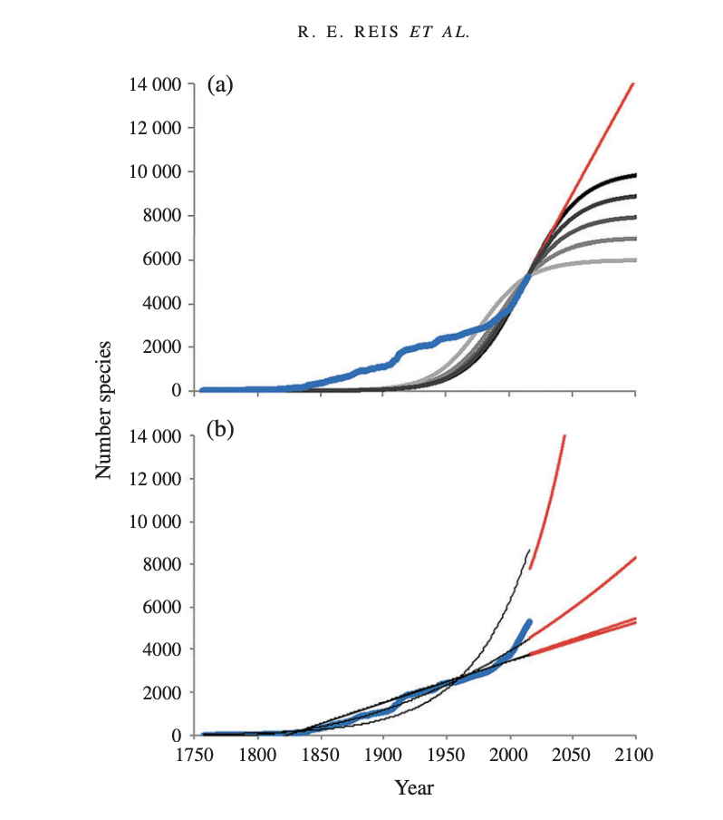
Studying biodiversity and speciation helps to understand where life came from, how it works, and how to protect it.
The species richness estimates for Neotropical freshwater fishes in South America, and a certain of which are currently undefined clearly. (Reis et al., 2016)
(Reis et al., 2016)

Slide 3
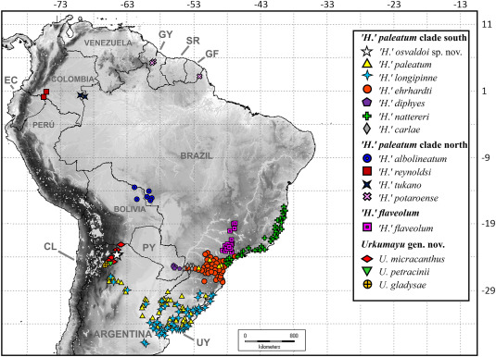
South America has the most biodiversity and speciation for the fresh-water fishes, due to geological barriers(rivers division)
Distribution map of Urkumayu, sister genus of corydoras (Alonso et al., 2024)
Major basins: Amazon, Orinoco, Paraná, São Francisco (Reis et al., 2016).
(Alonso et al., 2024)

Slide 4
DNA barcoding analysis on the Allopatric Speciation distribution map of corydoras species remains unclear
Previous experiments have applied Morphological Analysis, and DNA/16sRNA sequencing. (Dudgeon et al., 2006)
This study will be focusing on using corydoras BINs (a cluster of COI sequences) to address the distribution and speciation pattens.
DNA barcoding is a more rapid way for detecting cryptic species

Slide 5
Hypothesis
Corydoras populations in different regions will show distinct BIN compositions due to geographic isolation

Slide 6
Objectives
Apply ggplot to map the distribution of corydoras species on the South America map.
Plot a histogram to show and compare any unique species across different regions
Using NMDS test to address the dissimilarities between species at each site

Slide 7
Data Collection & Analysis Pipeline
1. Download BIN data from BOLD.
2. Clean and sort data in R.
3. Map BINs using ggplot2.
4. Build BIN × region matrix.
6. NMDS for ordination.

Slide 8
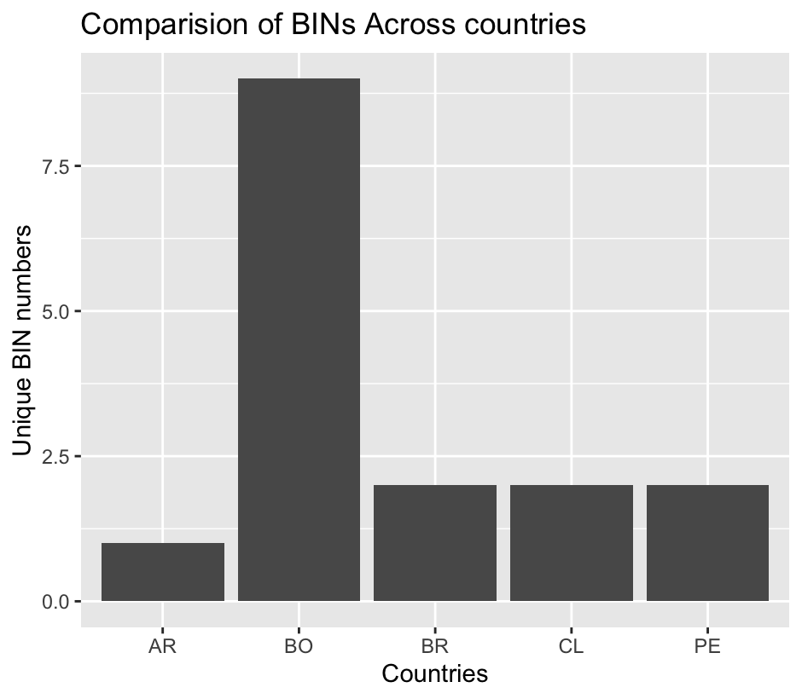
The histogram shows that Bolivia significantly contains the most Corydoras species/Bin numbers

Slide 9
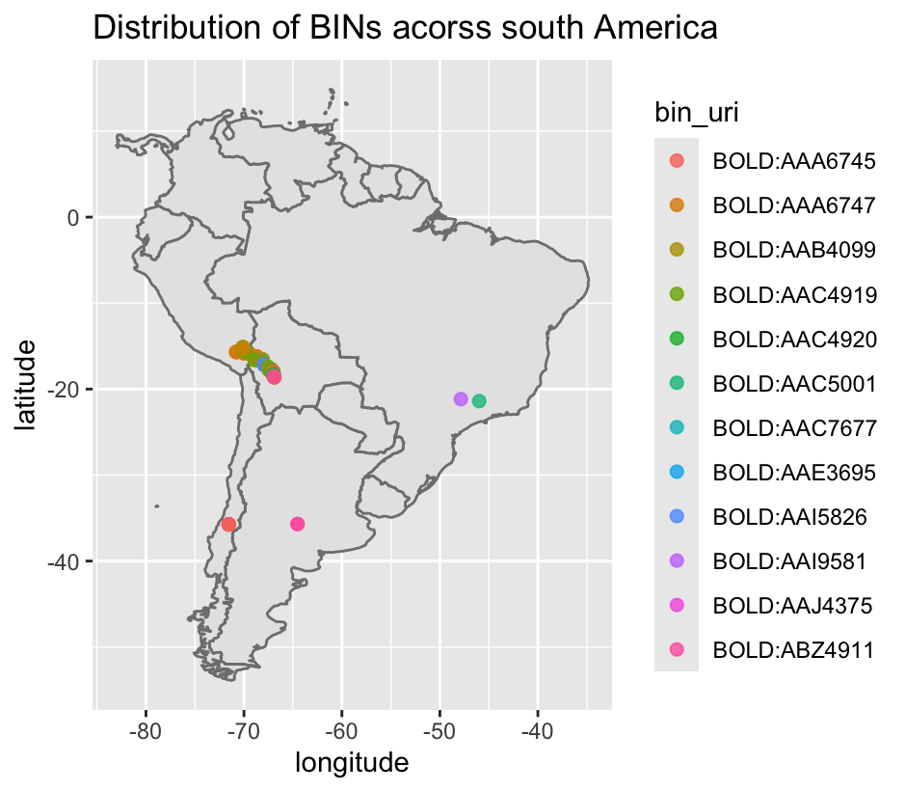
BIN Spatial Distribution suggests geographic isolation and the center west of South America has more Corydoras species then other regions

Slide 10
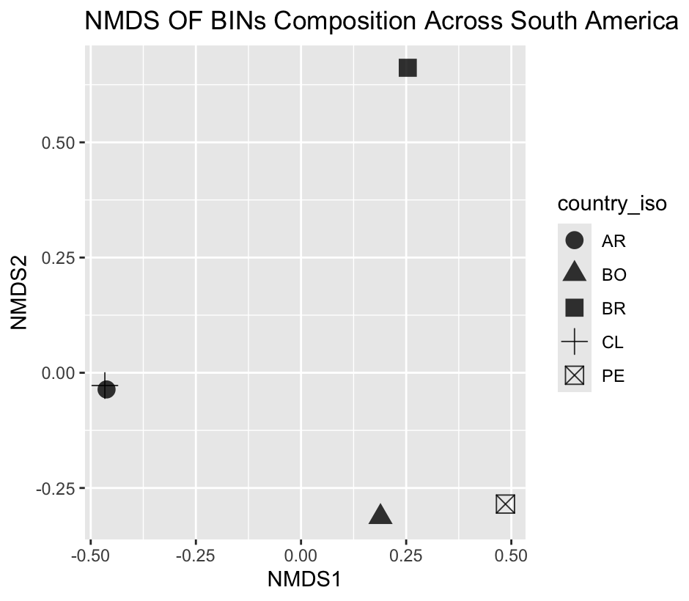
NMDS test for BIN Community Structure proves geographic isolation among regions

Slide 11
Catfish BINs analysis links to Geographic Speciation
Distinct BIN clusters in different basins, suggesting geographically genetic divergence in Corydoras.
New hypothesis: west center basins tend to have more unique corydoras species

Slide 12
Limitation of Bin analysis for this paper
Not ideal to for the Geological catfish speciation that happens in a short term.
Insufficient data for each testing site to study inter and inner region speciation pattern. No further T-test can be performed due to low variation.

Slide 13
Further study
Feasibility test：Compare the BINs speciation results to Morphological Analysis other DNA/RNA sequencing data
Parallel to Darwin’s finches study but using R software to do a Morphological Analysis for corydoras species

Slide 14
Conclusions
BINs illustrates speciation patterns and distribution in freshwater fishes (corydoras).
Distinct BIN composition supports geographic isolation.
Allopatric speciation evidence is found in Corydoras populations.

Slide 15
References
Dudgeon, D., Arthington, A. H., Gessner, M. O., Kawabata, Z.-I., Knowler, D. J., Lévêque, C., Naiman, R. J., Prieur-Richard, A.-H., Soto, D., Stiassny, M. L. J., & Sullivan, C. A. (2006). Freshwater biodiversity: importance, threats, status and conservation challenges. Biological Reviews, 81(02), 163–182.
Alonso, F., Terán, G. E., Aguilera, G., Montes, M. M., Sebastián, W., Calviño, P., Héctor Samuel Vera-Alcaraz, Cardoso, Y., Koerber, S., & Mirande, J. M. (2024). Integrative phylogeny of Corydoradinae (Siluriformes: Callichthyidae) with an emphasis on Northwestern La Plata species, including descriptions of a new genus and species. Zoologischer Anzeiger. https://doi.org/10.1016/j.jcz.2024.11.006
Reis, R. E., Albert, J. S., Di Dario, F., Mincarone, M. M., Petry, P., & Rocha, L. A. (2016). Fish biodiversity and conservation in South America. Journal of Fish Biology, 89(1), 12–47. https://doi.org/10.1111/jfb.13016

