Slide 3
Stock Return and Comapny Value
Focuing on S&P 500 Index

Slide 4
My task
Exploring whether the stock return follows well the Benford's Law
Exploring the relationship between stock return and book value of companies

Slide 5
Definition
Stock Return: Appreciation in the price plus any dividends paid, divided by the original price of the stock.
Book Value:The total amount a company is worth if all its assets are sold and all the liabilities are paid back.

Slide 6
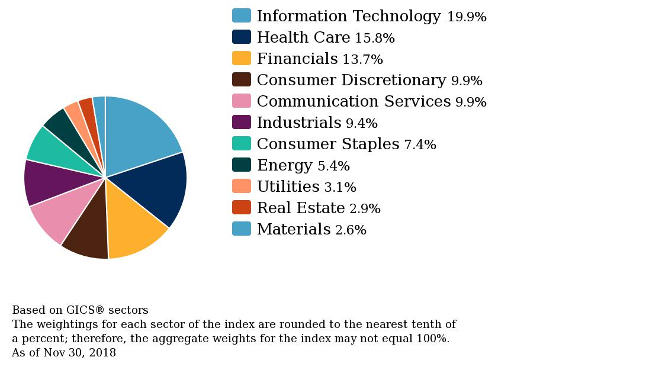
Weight of components

Slide 7
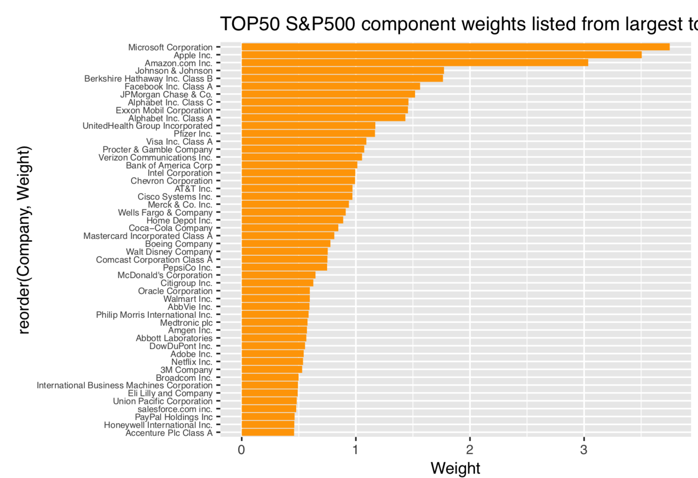
Top50 Components weight

Slide 8
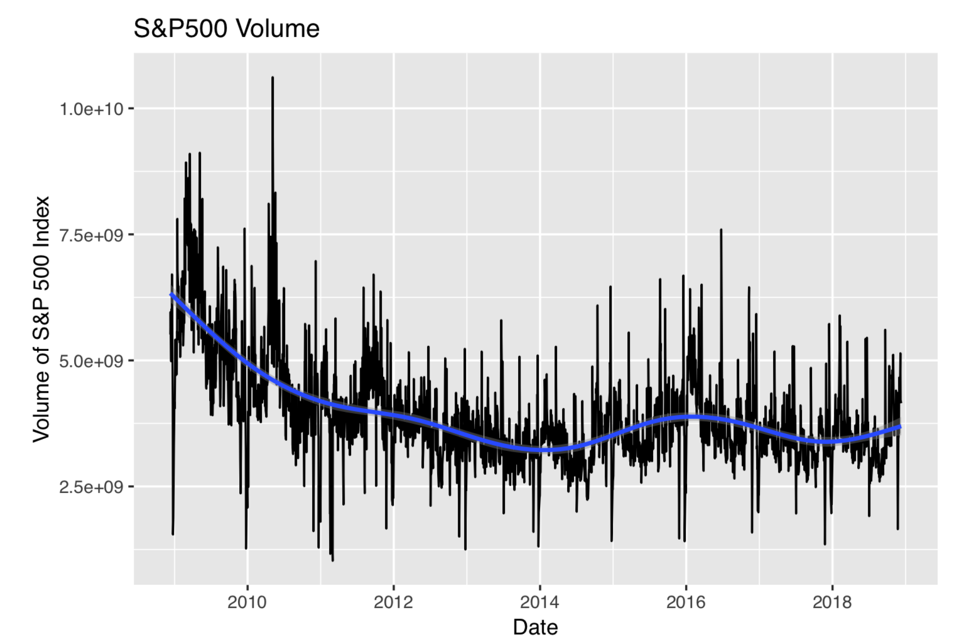
Volume of S&P 500

Slide 9
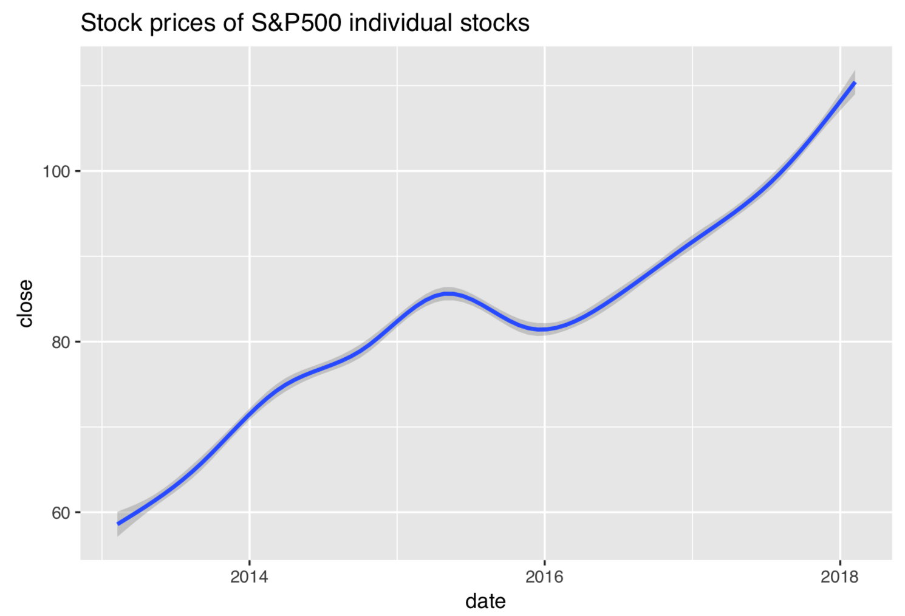
Price of component stocks

Slide 10
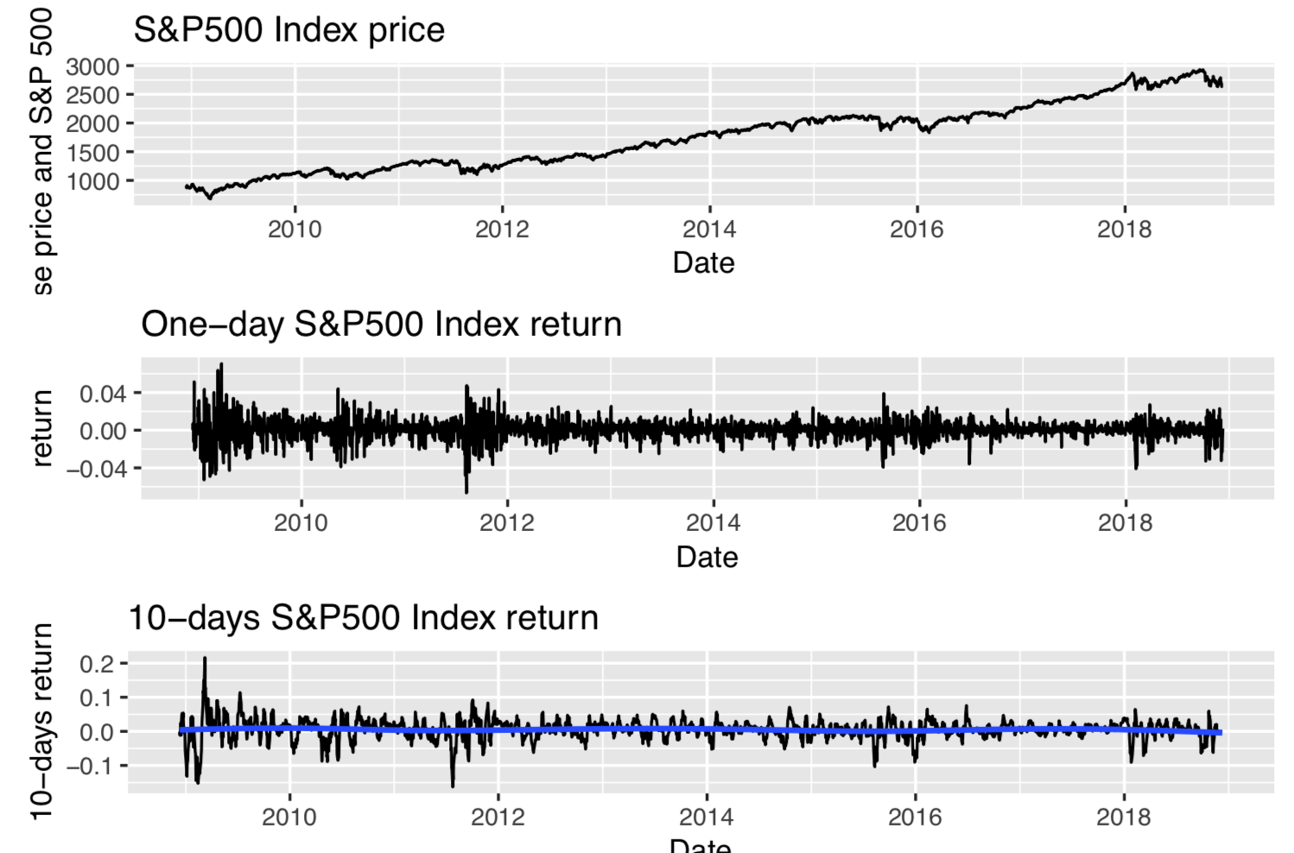
Index Price and Return

Slide 11
Analysis

Slide 12
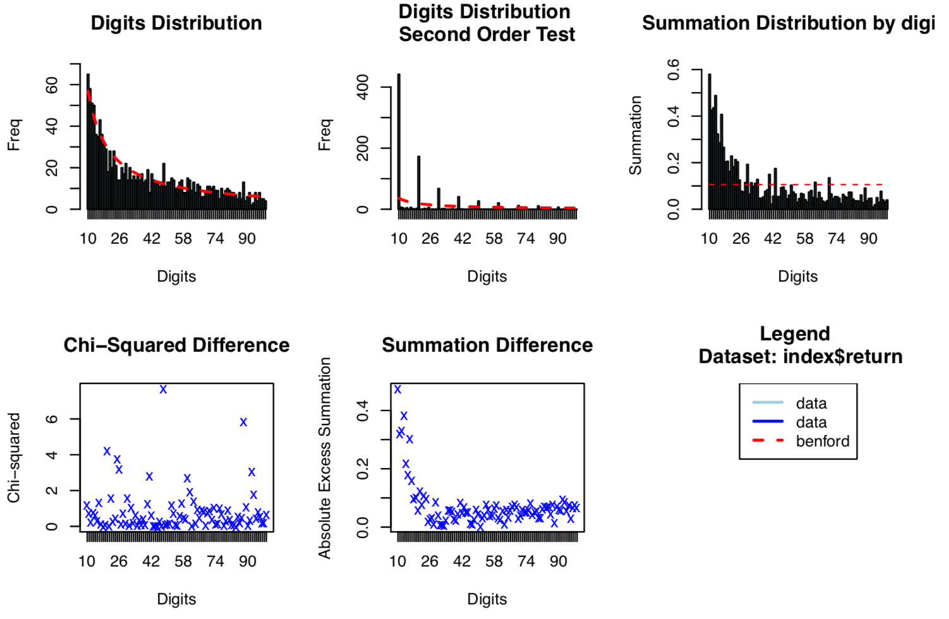
Benford: the index return follows the Benford's Law

Slide 13
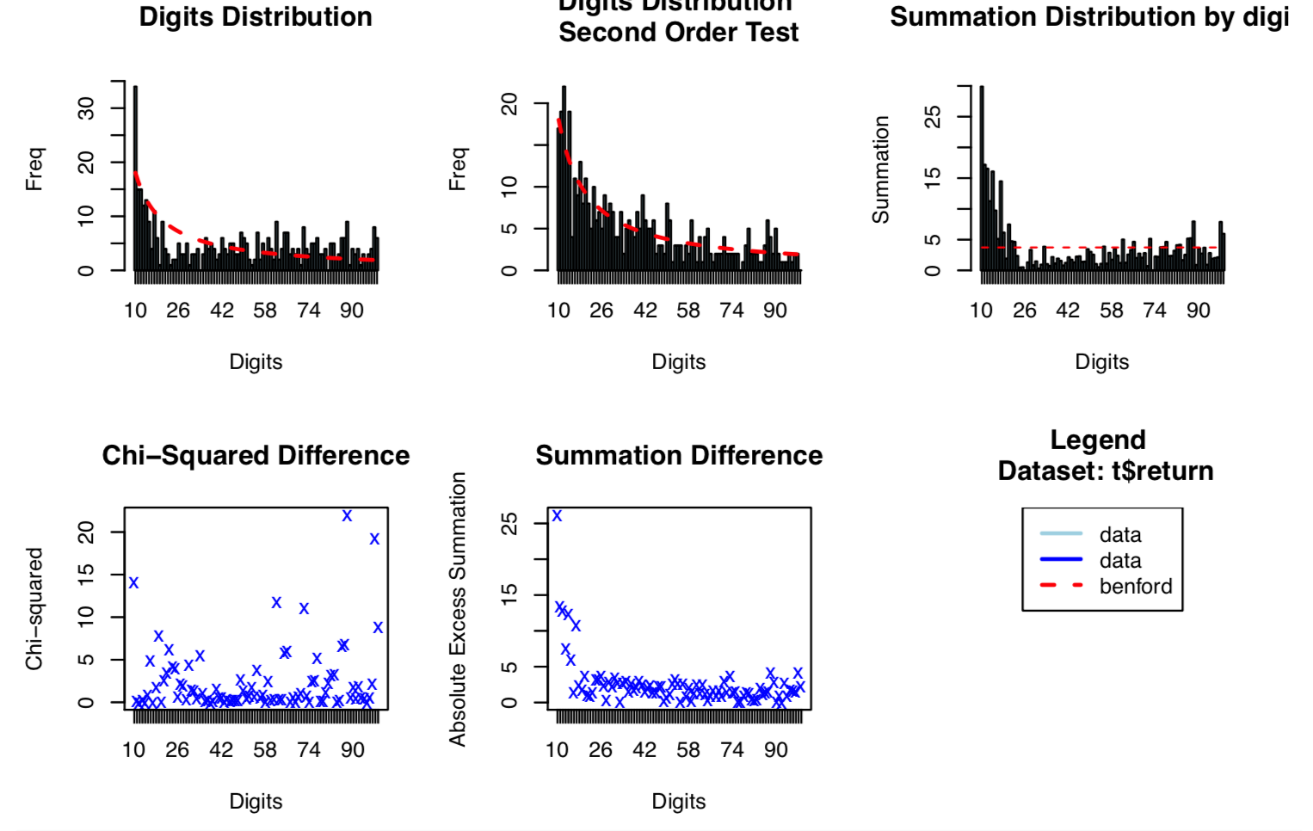
Benford: the distribution of components return doesn't follows the Benford's Law

Slide 14
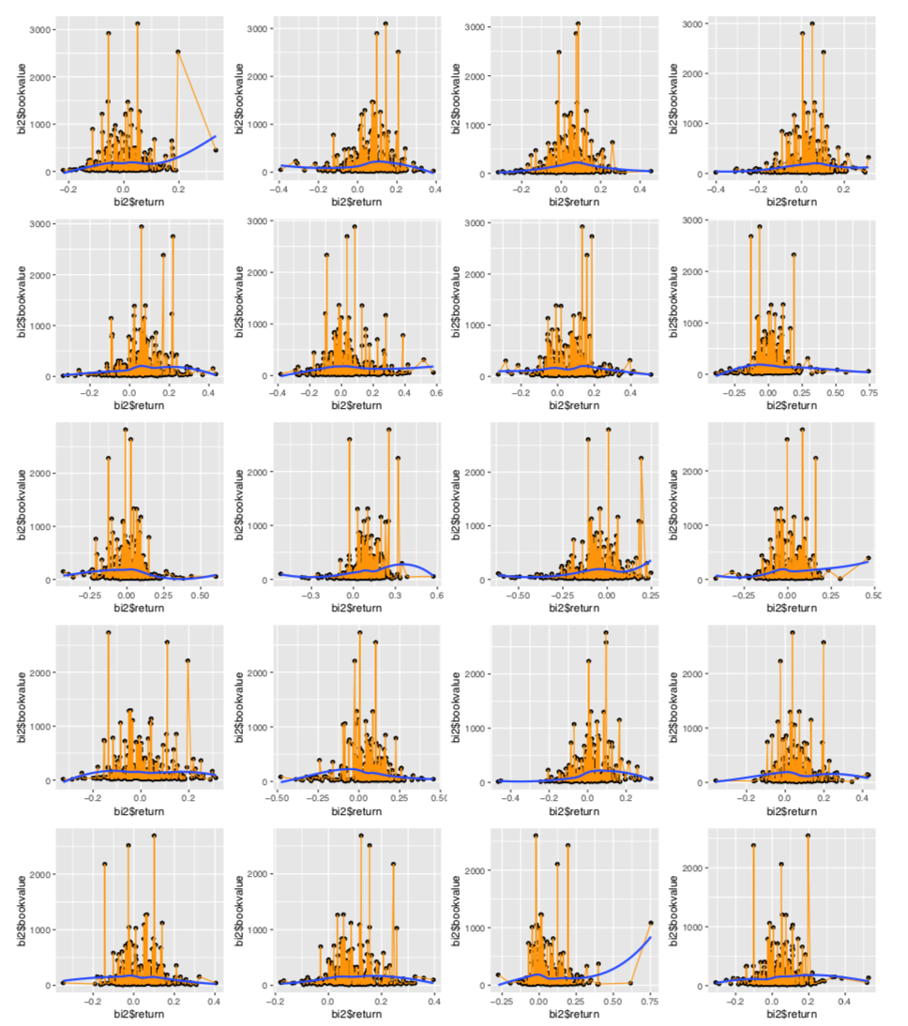
Book Value & Stock Return

Slide 15
The plots above shows that company value are related with stock return. Small companies are more likely to fluctuated wildly.
But we still need to do more than data visualization to figure out the relation.

Slide 16
Conclusion
Companies with small book value are more likely to have higher return, but also more likely to have lower return. In other words, small companies are more likely to fluctuated wildly.
From the Benford Analysis, we know that S&P500 Index Return follows well the Benford's Law, which is amazing. But the distribution of the return of every individual stock doesn't follow the Benford's Law.

Slide 17
Thank you!

