Slide 1
GCV Solar + Storage Valuation
NYISO N.Y.C. Zone | 2023 Backcast Revenue Analysis & Investment Recommendation
Prepared for Green Charge Ventures | E3 Applicant Exercise
2026

Slide 2
EXECUTIVE SUMMARY
Combined solar + storage is the recommended installation
$33.94/MWh
$18.9M
$2.5M
$21.4M
2023 avg. NYISO N.Y.C.
day-ahead price
Standalone solar
2023 backcast revenue
Standalone storage
2023 backcast revenue
Combined system
2023 backcast revenue
— Prices peak in winter (Feb, cold-snap heating demand) and again in summer (Jul, A/C peak); shoulder months (spring/fall) trough well below average.
— Solar earns slightly above the flat average because its output aligns with summer peak-price hours; it earns below average in winter.
— Storage value tracks price volatility, not price level — Jul and Feb (largest daily price swings) are its best months.
— Pairing solar + storage adds only a marginal energy-arbitrage benefit today (+0.03%) since inverter clipping is minimal, but the combined package's cheaper per-unit equipment pricing saves ~$35M in capex vs. building both standalone.
RECOMMENDATION
Combined Solar + Storage
— ~21-year simple payback — matches standalone solar, so storage is effectively "added for free" from a payback standpoint.
— ~$35M cheaper in capex than building solar and storage as two separate standalone projects.
— Better hedges the coming decade: storage's value should rise as solar buildout erodes solar's own capture price.
GCV Solar + Storage Valuation | E3 Applicant Exercise
2 / 11

Slide 3
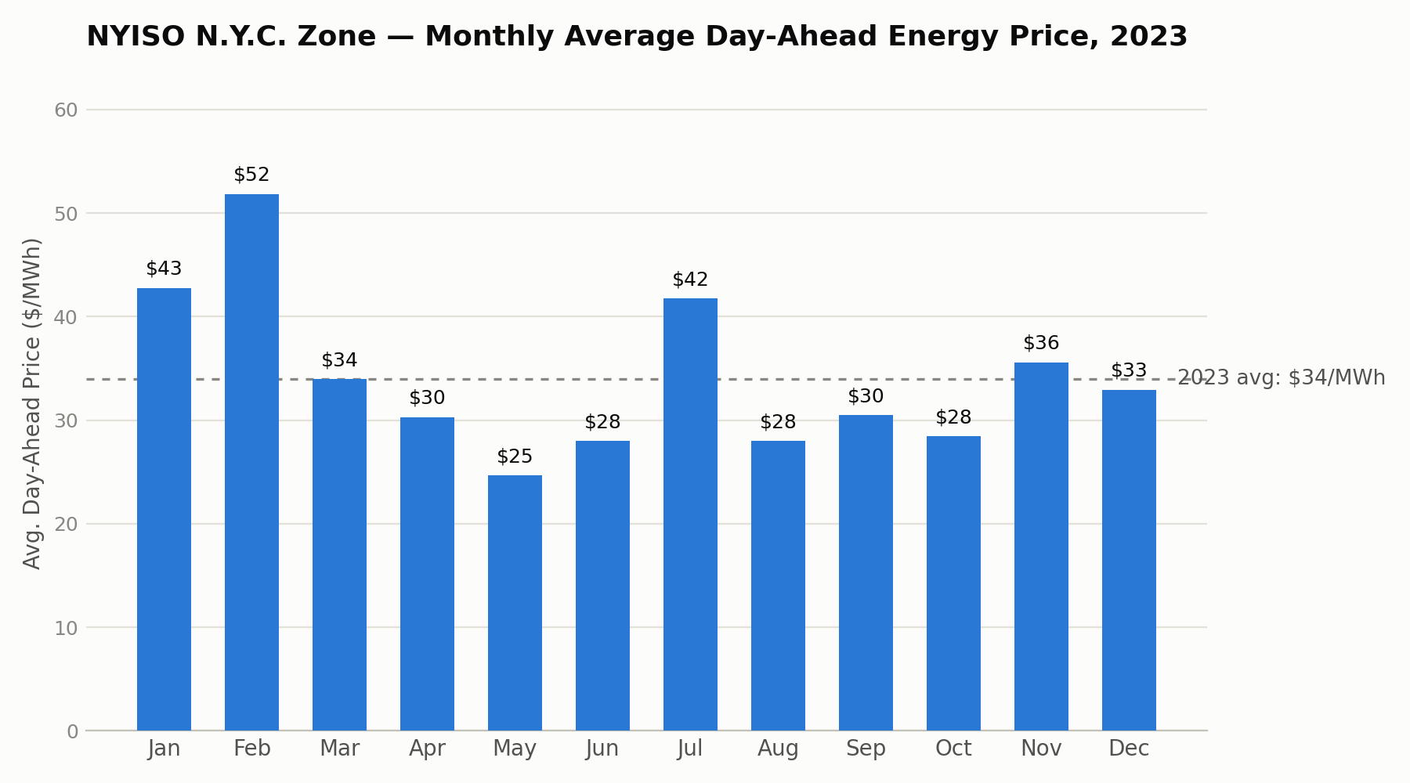
Q1A · HISTORICAL PRICES
2023 Monthly Average Day-Ahead Energy Price
— Annual average: $33.94/MWh.
— Winter peak: Feb ($51.84) and Jan ($42.77) — cold-snap driven heating & gas demand.
— Summer peak: Jul ($41.72) — A/C-driven peak demand.
— Shoulder-month trough: Apr–Jun & Aug–Oct sit near $25–30/MWh, when heating and cooling demand are both low.
— This "winter + summer peak, shoulder trough" shape drives which hours are most valuable for solar vs. storage (next slide).
GCV Solar + Storage Valuation | E3 Applicant Exercise
3 / 11

Slide 4
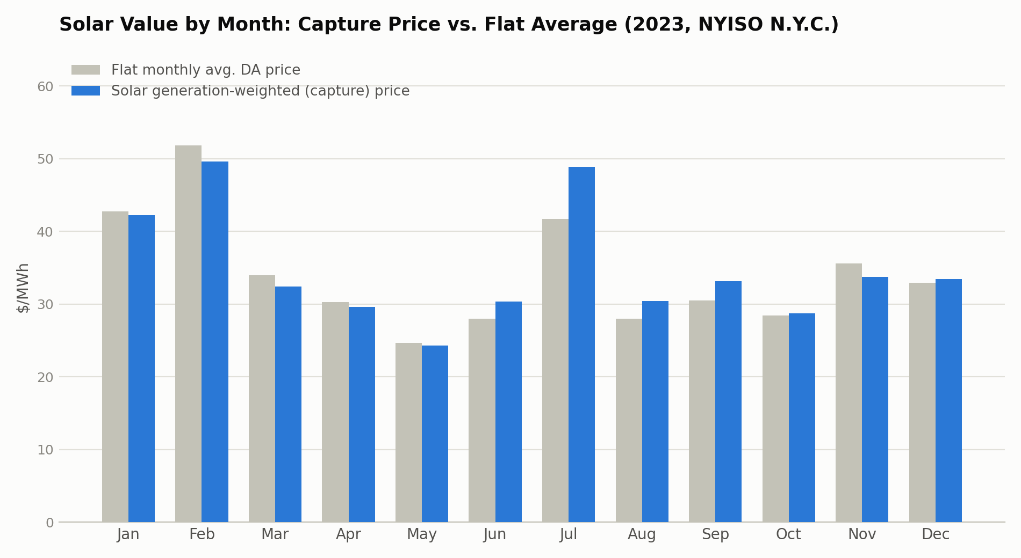
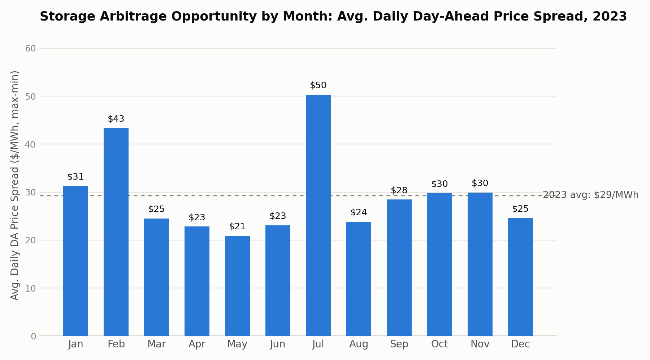
Q1B & Q1C · SEASONAL VALUE
Solar and Storage Peak in Different — and Overlapping — Months
Solar: most valuable May–Sep
Storage: most valuable in extreme-weather months
— Summer capture price runs 8–17% above the flat average (Jul: $48.89 vs. $41.72) — solar hours line up with A/C-driven peak prices.
— Winter capture price runs below flat average (95–99%) — winter price spikes hit before sunrise / after sunset, which solar misses.
— Jul ($50/MWh avg. daily spread) and Feb ($43/MWh) are far above the $29 annual average — driven by sharp heat-wave / cold-snap price spikes.
— Shoulder months (Mar–Jun, Aug–Dec) are weakest ($21–30) — mild weather means flatter daily price shapes and less arbitrage opportunity.
GCV Solar + Storage Valuation | E3 Applicant Exercise
4 / 11

Slide 5
Q2 · METHODOLOGY
Revenue Modeling Approach & Key Assumptions
Price basis: Real-Time (RT) prices used throughout — reflects the actual settlement value of energy at the time it is physically delivered.
Standalone Solar
Delivered output = min(Solar Shape × 300 MW-DC, 250 MW-AC inverter limit). Revenue = Σ(delivered MW × RT price).
Standalone Storage
4-hr duration (200 MWh ÷ 50 MW). 1 full cycle/day: charge the day's 4 lowest-price hours, discharge the 4 highest-price hours. Perfect real-time price foresight; round-trip efficiency = 100% (per given input); no degradation or cycling cost; energy arbitrage only (no capacity/ancillary revenue).
Combined Solar + Storage
Solar identical to standalone. Storage charges first from otherwise-clipped/curtailed solar (zero cost), then tops up from the grid at the day's lowest remaining prices; discharge unchanged.
All simplifications are intentional given the exercise's time-box (Q2b/2c each capped at ~1 hour); more rigorous operating assumptions are proposed in Q3b.
GCV Solar + Storage Valuation | E3 Applicant Exercise
5 / 11

Slide 6
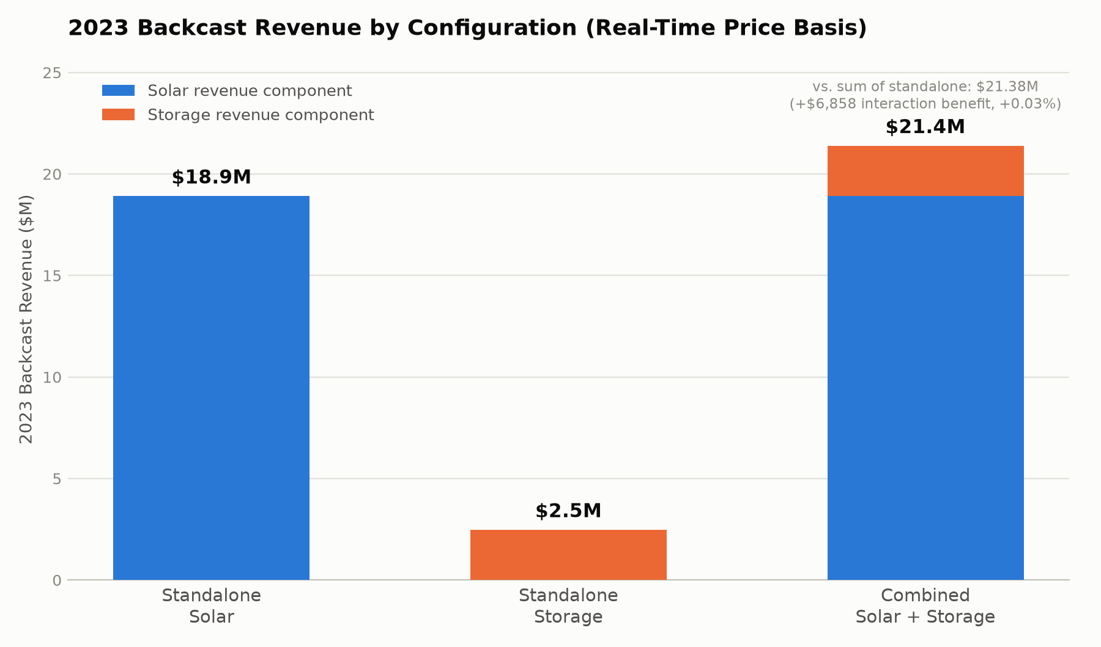
Q2 · RESULTS
2023 Backcast Revenue by Configuration
— Standalone Solar: $18.91M (551,454 MWh delivered; avg. capture price $34.29/MWh).
— Standalone Storage: $2.47M ($49.48/kW-yr, $12.37/kWh-yr) — energy arbitrage only.
— Combined System: $21.39M — essentially the sum of the two standalone revenues.
— Solar dominates the revenue stack for all three configurations; storage revenue from energy arbitrage alone is comparatively small.
GCV Solar + Storage Valuation | E3 Applicant Exercise
6 / 11

Slide 7
Q2C · SOLAR + STORAGE INTERACTION
The Pairing Benefit Is Real but Small Today
— In the combined system, storage can charge from solar output that would otherwise be clipped by the 250 MW inverter limit — at zero marginal cost.
— Gross DC solar generation: 551,826 MWh; clipped/curtailed: only 372 MWh (0.07% of gross) — the 300/250 MW (1.2x) DC:AC ratio isn't aggressive enough to cause meaningful clipping.
— Combined revenue ($21,391,036) exceeds the simple sum of standalone solar + standalone storage ($21,384,178) by just $6,857 (+0.03%).
TAKEAWAY
On this design, pairing solar and storage does not meaningfully change energy revenue vs. running them separately.
The real case for the combined system rests on lower blended equipment cost, not an energy-arbitrage synergy — see Q3c.
Looking ahead: as NY's solar buildout accelerates over the next decade, curtailment risk — and therefore this interaction benefit — should grow (see Q3a).
GCV Solar + Storage Valuation | E3 Applicant Exercise
7 / 11

Slide 8
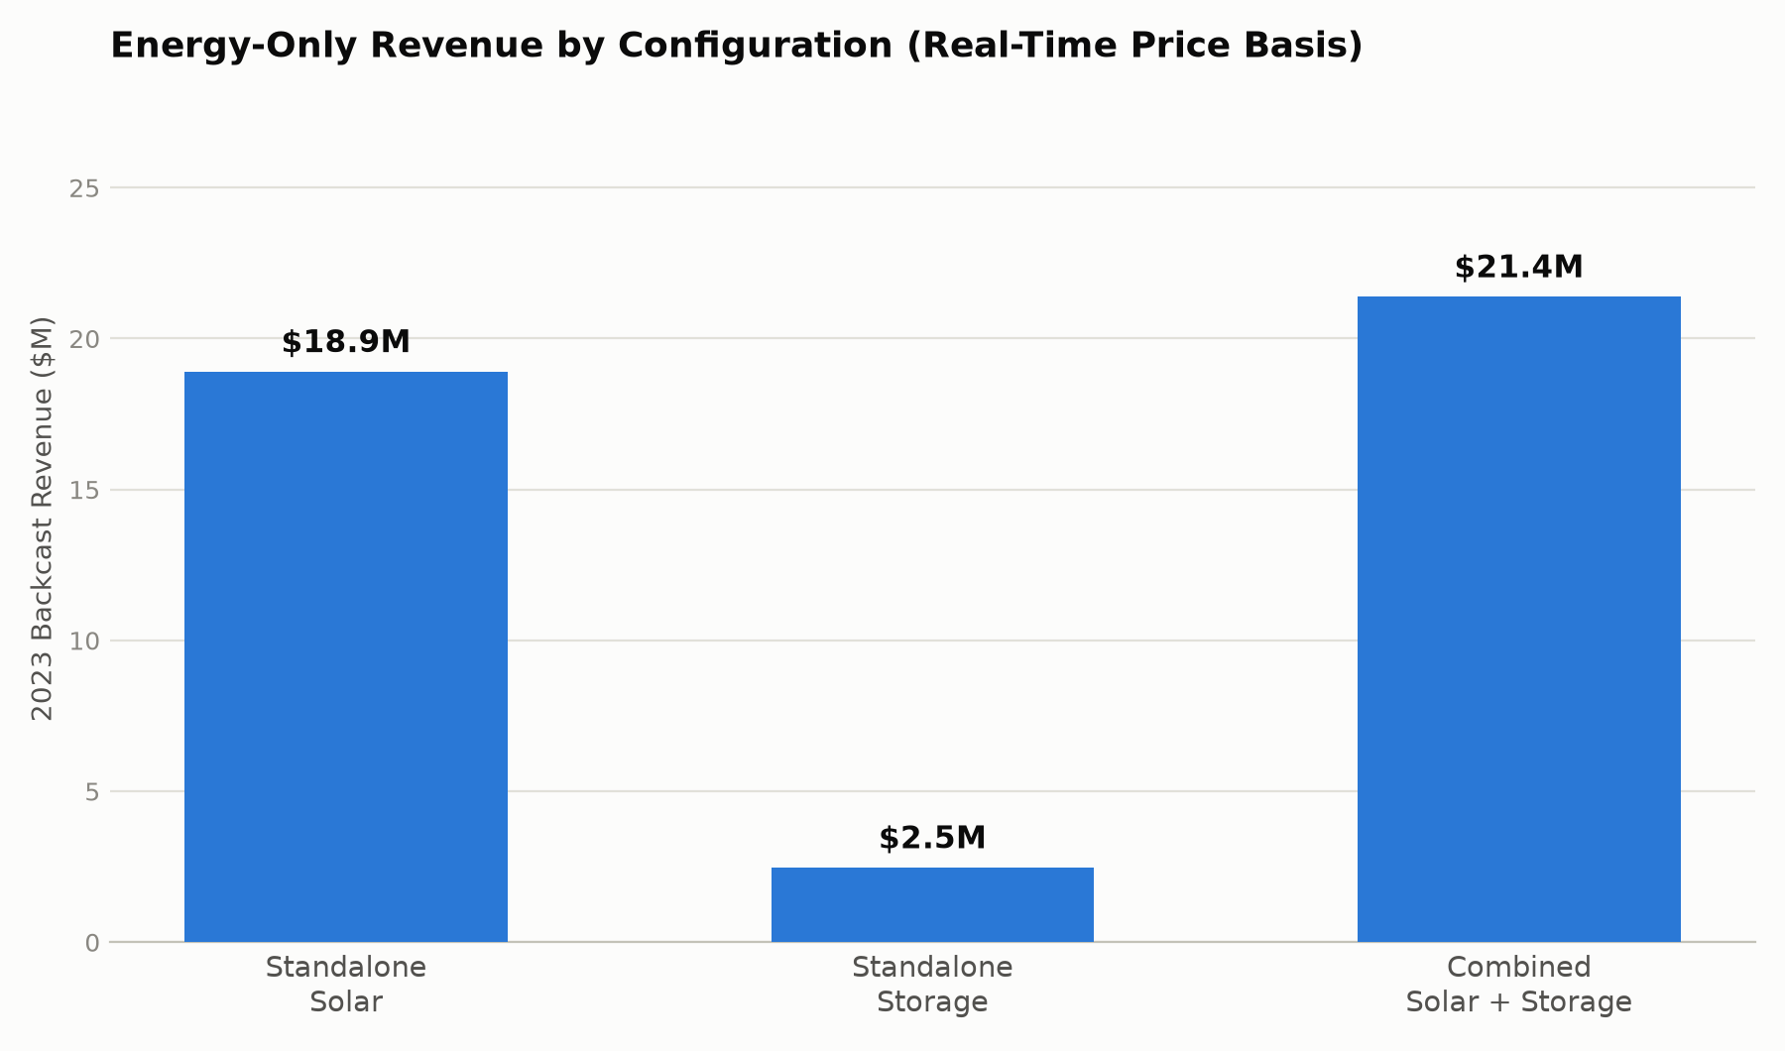
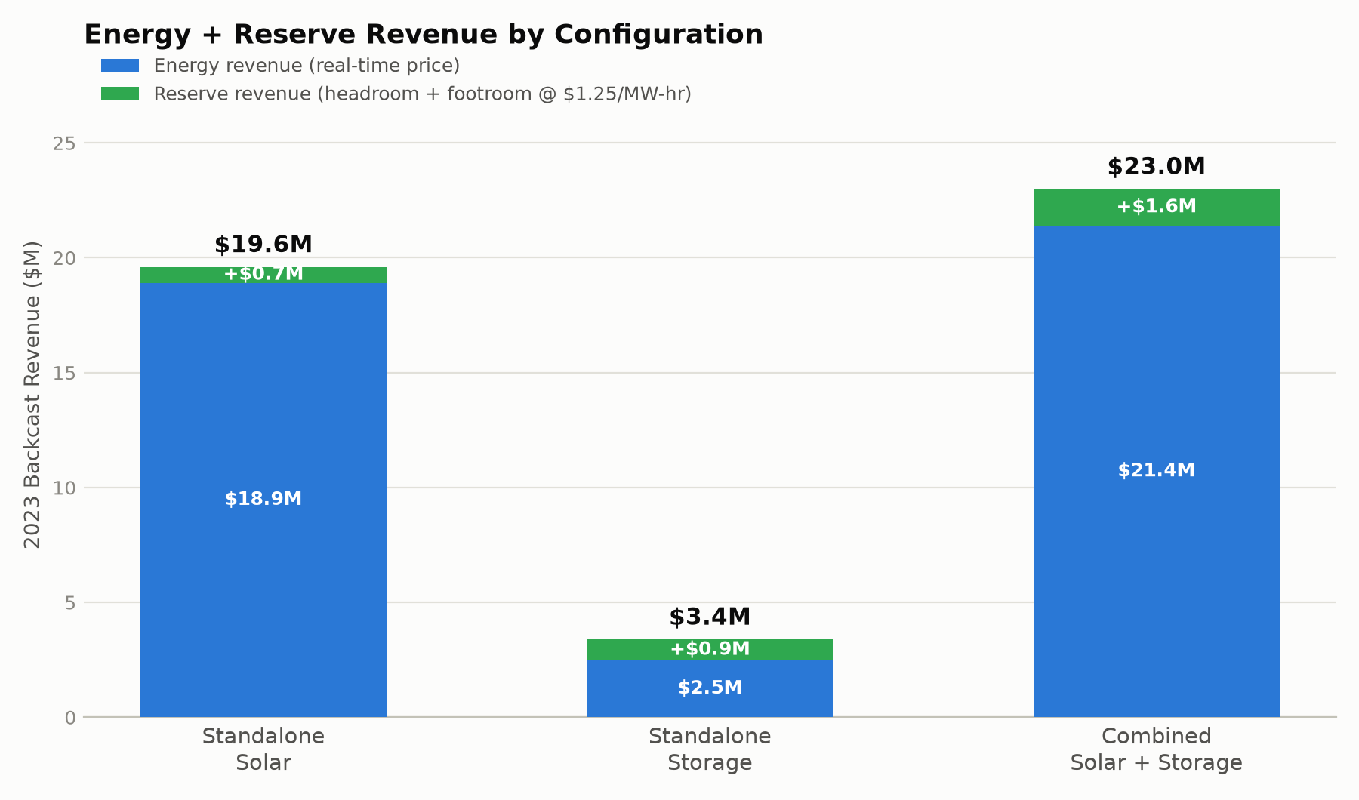
Q2D · RESERVE SCENARIO (EXTENSION)
Layering NYISO Reserve Revenue on Top of Energy Arbitrage
— Beyond the base exercise: estimates additional revenue from offering NYISO reserve capacity at $1.25/MW-hr (midpoint of the $1–1.5/MW range you flagged). Headroom = capacity to increase output on call; footroom = capacity to decrease output on call.
— Solar offers footroom only (already at its irradiance-limited max) = that hour's delivered MW → +$0.69M (+3.6%). Storage reuses the Q2b/c daily schedule (footroom while charging, headroom while discharging, both simultaneously while idle) → +$0.91M (+36.9%). Combined sums the two → +$1.60M (+7.5%).
Illustrative only: real NYISO reserve products carry response-time, minimum-run, and co-optimization rules stricter than modeled here — a more rigorous treatment is part of the Q3b follow-on scope.
GCV Solar + Storage Valuation | E3 Applicant Exercise
8 / 11

Slide 9
Q3A · FORWARD OUTLOOK
How Will Each Revenue Stream Evolve Over the Next Decade?
Standalone Solar
Standalone Storage
Combined System
Capture price likely erodes
Value likely increases
Interaction benefit should grow
— CLCPA mandates 70% renewables by 2030, 100% zero-emission grid by 2040 — a large wave of new solar enters NYISO.
— More solar depresses midday prices ("duck curve" / cannibalization), even as the overall price level may rise with electrification-driven demand.
— Same trend that hurts solar helps storage: steeper evening ramps widen the daily price spread storage arbitrages.
— NYC's Peaker Rule retirements tighten local capacity. Risk: storage cannibalization if buildout outpaces the opportunity.
— Today's interaction (+0.03%) reflects minimal clipping.
— As solar penetration rises, a co-located battery's ability to absorb otherwise-curtailed solar becomes more valuable — strengthening the strategic case for pairing.
GCV Solar + Storage Valuation | E3 Applicant Exercise
9 / 11

Slide 10
Q3B · PROPOSED FOLLOW-ON STUDY
A More Complete Revenue Forecast — 10 Additional Hours
1
Forward price shapes
~3 hrs
Replace the 2023 backcast with a forward-looking hourly price shape reflecting expected capacity additions/retirements and load growth (electrification, data centers), grounded in published NYISO / NYSERDA CLCPA outlooks.
2
Realistic operating assumptions
~2 hrs
Round-trip efficiency ~85–90% (not 100%), solar degradation (~0.5%/yr), battery degradation/augmentation, multi-cycle-per-day dispatch where economic.
3
Capacity & ancillary revenue
~2 hrs
Add NYISO capacity market (ICAP) and frequency regulation revenue — often the majority of a merchant battery's revenue stack. Q2d sketches an illustrative reserve add-on; a rigorous version (real product rules, co-optimization, capacity market) is still the single biggest gap.
4
Scenario / sensitivity analysis
~2 hrs
High/low cases on load growth, gas prices, and renewable build-out pace, given how uncertain the 10-year price path is.
5
Full pro forma
~1 hr
Layer in provided capex, O&M, financing, and ITC/IRA tax credit treatment to compute NPV/IRR rather than simple payback.
GCV Solar + Storage Valuation | E3 Applicant Exercise
10 / 11

Slide 11
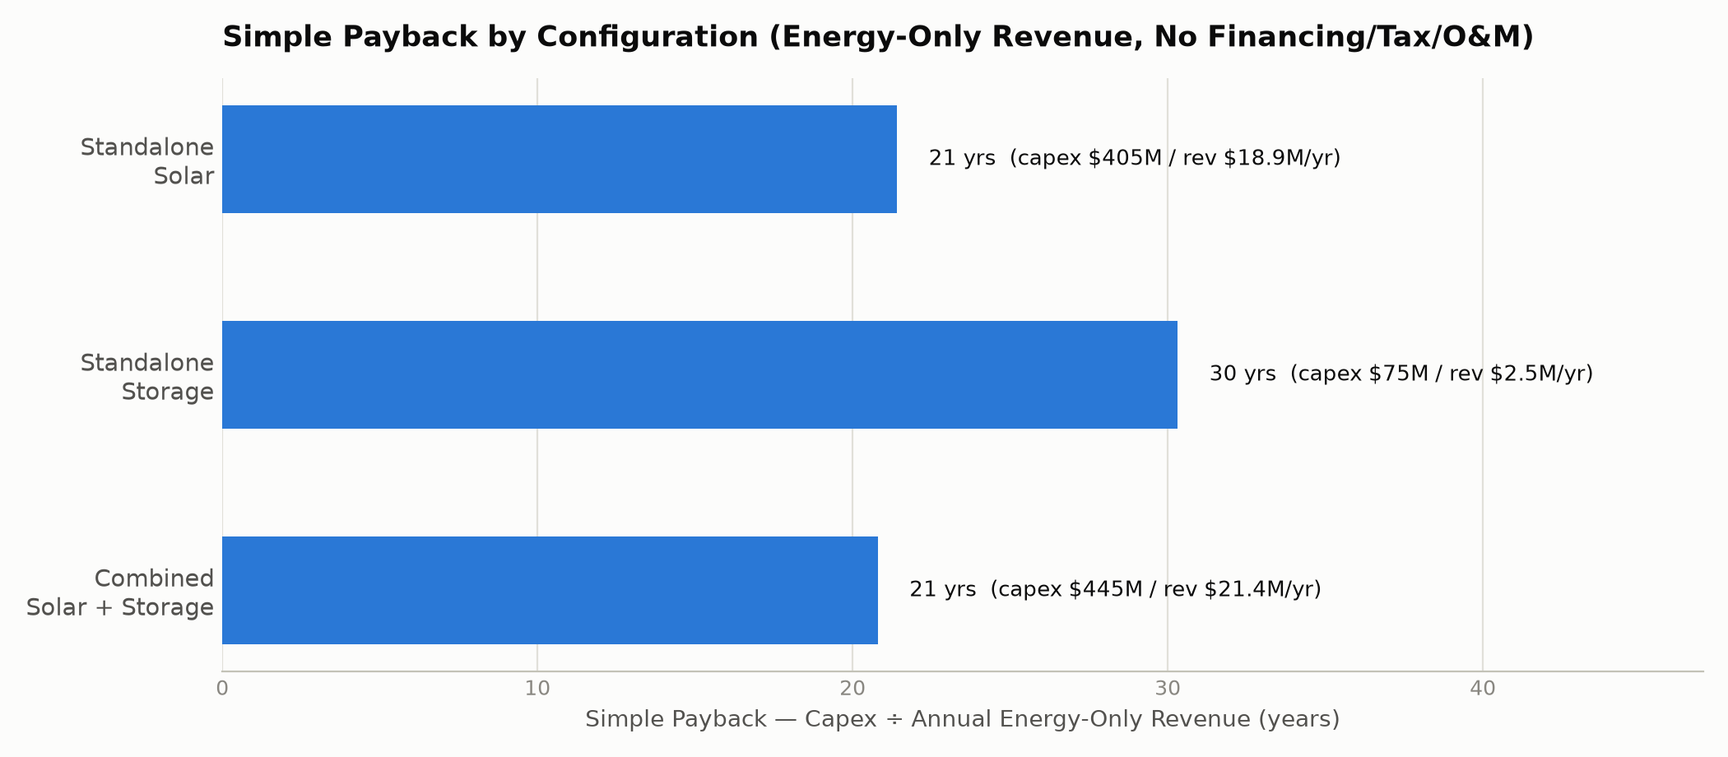
Q3C · RECOMMENDATION
Combined Solar + Storage Is the Recommended Installation
WHY COMBINED
— Matches standalone solar's payback almost exactly — storage is effectively added at no economic cost.
— Combined package pricing ($1.25/W solar, $350/kWh storage) saves ~$35M in capex vs. building both standalone.
— Better hedges the Q3a outlook: storage value should rise as solar capture price erodes.
— Simple payback (capex ÷ 2023 backcast revenue, no financing/tax/O&M): Standalone Solar ~21 yrs, Standalone Storage ~30 yrs, Combined ~21 yrs.
Caveat: standalone storage still looks weak here because only real-time energy arbitrage was modeled. Real storage revenue also includes capacity & ancillary services (Q3b) — revisit before committing capital.
GCV Solar + Storage Valuation | E3 Applicant Exercise
11 / 11

